Slide 1
AI Development Project
Group 1: Paavo, Josefine, and Olle

Slide 2
Goal for the App/Project
Offer an LLM chat interface where you can upload books/manuals and trust the answers are anchored in those documents
Surface relevant snippets, similarity confidence, and reranking so the assistant stays grounded instead of hallucinating
Keep the workflow accessible via Gradio loader + CLI while centralizing embedding/data handling

Slide 3
RAG-application demo
- Interactive loader lets you upload books/docs and choose the target profile (mini/sm/md)
- Loaded content is chunked, embedded, and stored so it can back future conversations
- Query app allows querying LLM, and the model grounds it's answers on relevant context.

Slide 4
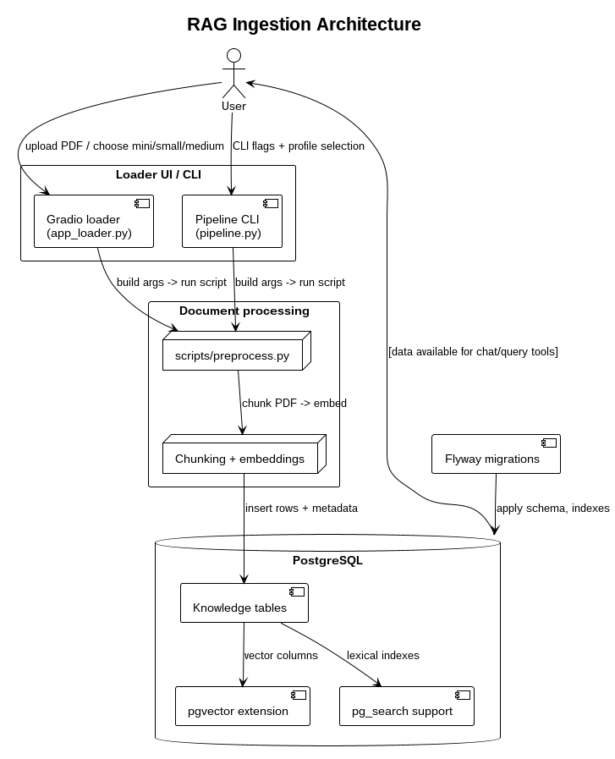

Slide 5
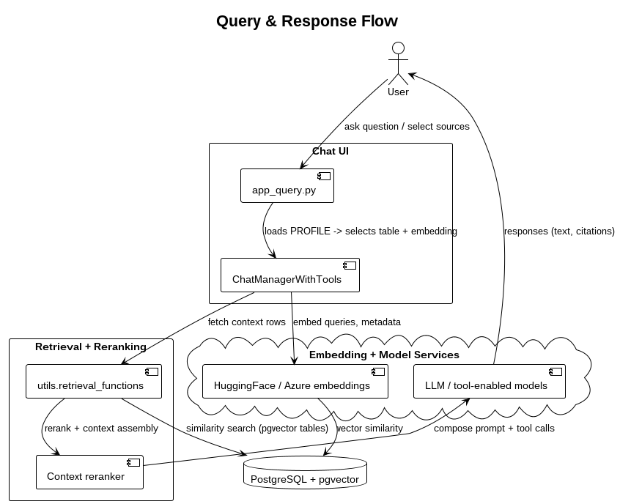

Slide 6
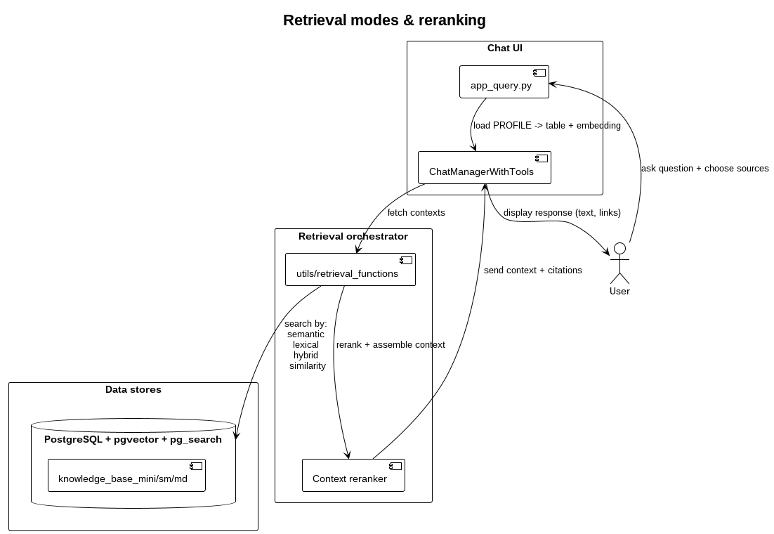

Slide 7
Tech stack overview
- Docker Compose: boots `pgvector_database` (PostgreSQL 18 + pgvector + pg_search) and Flyway migrations
- Embeddings: prefer Hugging Face local models for mini/sm; fallback to OpenAI/Azure OpenAI for larger profiles
- LangChain + Gradio: The gradio chat app supports retriever tools, reranking, and a streaming the final answer
- Utils: `scripts/preprocess.py`, `utils/loader_utils.py`, and `chat_manager.py` share env-driven steps for consistency

Slide 8
Architecture in brief
- Loader apps (`app_loader.py`, `pipeline.py`) run `scripts/preprocess.py` with shared `utils/loader_utils.py`
- Preprocess pipeline chunking via spaCy/semantic chunker + local/Azure embeddings, then writes to `knowledge_base_mini/sm/md`
- Database stores vectors (pgvector) and lexical indexes (pg_search); migrations live under `database-migrations/`

Slide 9
Technical Notes
- Docker Compose boots the `pgvector_database` (PostgreSQL 18 + pgvector + pg_search) + Flyway migrations (`database-migrations` service)
- Env hierarchy: `project.env` → `.env` → `--env-file` overrides; controls PG, embeddings, Azure keys, chunking behavior
- Key libs: `pdfplumber`, spaCy, `sentence-transformers`, `psycopg2`, `pgvector`, `langchain`, `gradio`, `dotenv`
- Run commands: `uv sync`, `docker compose up -d database`, `uv run pipeline.py` / `uv run app_loader.py`, `uv run app_query.py`

