Slide 1

Fusing Effectful Comprehensions
Olli Saarikivi
Margus Veanes Todd Mytkowicz Madan Musuvathi
Aalto University
Helsinki, Finland
olli.saarikivi@iki.fi
Microsoft Research
Redmond, USA
{margus,toddm,madanm}@microsoft.com

Slide 2
Motivation
Disk / Network
9 95 7d 2e 98 80 e4 3e 76 0b 3b
Pipelines of stream comprehensions are common in log/data analysis
Stateless, functional comprehensions
Effectful comprehensions with loop carried state
Sources of overhead
Communication
Unspecialized computation
Objectives
Allow modular code
Fuse pipeline to single representation
Generate efficient code
Deserialize
12/12/12 SPY 50.13} {12/13/12 S
SelectPrice
49.44, 50.13, 48.13, 51.32, 53.53
FindPriceDips
0, 0, 0, 0, 5, 0, 0, 3, 0, 0, 0, 0, 0, 0
Serialize
b1 a9 86 a8 70 7d a3 66 01 05 3a
Disk / Network

Slide 3
The Fusion Engine
C#
Regex
XPath
Frontend
Compile frontend languages to
branching symbolic transducers (BSTs)
Fuse a pipeline of BSTs into a single BST
Use an satisfiability modulo theories (SMT) solver for pruning
Apply reductions
Reachability Based Branch Elimination
Control State Reduction (CAV 2017)
Generate efficient fused code
BSTs
Fusion
RBBE
BST
CodeGen
Fused C#

Slide 4




Taxonomy of Symbolic Transducers
Branching Symbolic Transducer (BST)
Flat transitions are replaced by trees of rules of the following forms:
$Ite(φ,T,F)$: if-then-else rules replace guards
$Base({\left[f_{i}\right]}_{i=1}^{n},q,g)$: base rules yield output and move to a new state
$Undef$, undef rules make rejection explicit
Symbolic Transducer (ST)
Transitions $p\underset{→}{φ⁄{\left[f_{i}\right]}_{i=1}^{n}; g}q$ can use a register for additional state
Classical Transducer
Finite (small) alphabets
Finite set of control states
Concrete transitions $p\underset{→}{a/{\left[b_{i}\right]}_{i=1}^{n}}q$
Symbolic Finite Transducer (SFT)
I/O in a decidable theory instead of an alphabet
Symbolic transitions $p\underset{→}{φ⁄{\left[f_{i}\right]}_{i=1}^{n}}q$

Slide 5





















Advantages of Branching Rules
False case
True case
Base rule
$$\left[x\right];x$$
$$x≥0$$
$$\left[​\right];x+r$$
$$\left[x\right];x$$
$$\left[​\right];x+r$$
BST
$$0$$
$$x≥0$$
$$x<|r|$$
$$\left[​\right];x+r$$
$$x<|r|$$
$$\left[x\right];x$$
$$x≥0$$
$$⊥$$
$$\left[​r\right]$$
$$⊥$$
$$⊥$$
Explicitly complete and deterministic
Which evaluation strategy to choose?
Initial register value
Ite rule
Undef rule
Finalizer
Transition
$$x<0⁄\left[x\right];x$$
$$true⁄\left[​\right];x+r$$
ST
$$0$$
$$x≥0∧x<\left|r\right|⁄\left[x\right];x+r$$
$$true⁄\left[​r\right]$$

Slide 6
Fusing BSTs
C#
Regex
XPath
Frontend
Adjacent pairs of BSTs in a pipeline are fused into a single BST until one remains
The resulting BST
Implements the same transduction
Gets rid of intermediate streams
While larger, exposes reduction opportunities
BSTs
Fusion
RBBE
BST
CodeGen
Fused C#

Slide 7
















The Fusion Operator
$$a$$
$$s$$
$$δ_{A}$$
$$s′$$
$$a$$
Fusion
$$[b_{1},…,b_{n}]$$
$$(s,t)$$
$$δ_{A⨂B}$$
$$(s′,t′)$$
$$t$$
$$δ_{B}$$
$$⋯$$
$$δ_{B}$$
$$t′$$
$$[c_{1},…,c_{m}]$$
$$[c_{1},…,c_{m}]$$

Slide 8
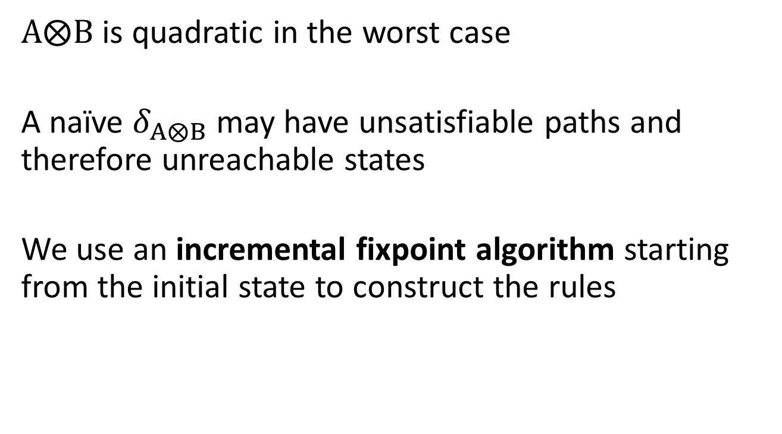
Incremental Fusion
$A⨂B$ is quadratic in the worst case
A naïve $δ_{A⨂B}$ may have unsatisfiable paths and therefore unreachable states
We use an incremental fixpoint algorithm starting from the initial state to construct the rules

Slide 9

















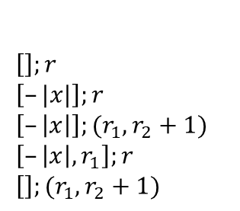
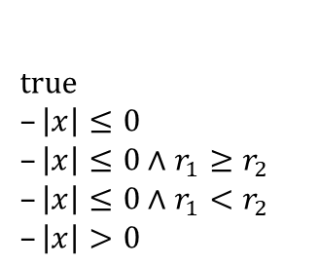







BST Fusion in Practice
$$A$$
$$B$$
$$\left[−\left|x\right|,r\right];r+1$$
$$\left[​\right];r+1$$
$$x>0$$
$$\left[x​\right];r$$
$$1$$
P
2
$$\left[​\right];r+1$$
$$A⨂B$$
$$1$$
1
$$x≥r$$
$$\left[x​\right];r$$
$$\left[−\left|x\right|,r_{1}​\right];(r_{1}+1,r_{2})$$
$$r_{1}≥r_{2}$$
$$\left[−\left|x\right|​\right];(r_{1}+1,r_{2}+1)$$
Path
$true$
$–\left|x\right|≤0$
$–\left|x\right|≤0∧r_{1}≥r_{2}$
$–\left|x\right|≤0∧r_{1}<r_{2}$
$–\left|x\right|>0$
Rule
$\left[​\right];r$
$\left[​–|x|\right];r$
$\left[​–\left|x\right|\right];(r_{1},r_{2}+1)$
$\left[​–\left|x\right|,r_{1}\right];r$
$\left[​\right];(r_{1},r_{2}+1)$
$$\left(1,1\right)$$
$$−\left|x\right|>0$$
$$\left[​\right];(r_{1}+1,r_{2}+2)$$
P1
P2
$$r_{1}≤r_{2}$$
$$\left[r_{1}​\right];(r_{1}+1,r_{2}+1)$$
$$−\left|x\right|≥r_{2}$$
$$r_{1}>0$$
Unsatisfiable branch
$$\left[−\left|x\right|\right];(r_{1}+1,r_{2}+1)$$
$$\left[−\left|x\right|,r_{1}​\right];(r_{1}+1,r_{2})$$

Slide 10
Reductions
C#
Regex
XPath
Frontend
Reductions are applied after every step of fusion to keep BSTs small
Control State Reduction
Olli Saarikivi, Margus Veanes. Minimization of Symbolic Transducers. CAV 2017.
Reachability Based Branch Elimination
Remove branches that are unsatisfiable in the context of reachable register values
BSTs
Fusion
RBBE
BST
CodeGen
Fused C#

Slide 11
Reachability Based Branch Elimination
Breadth-first forward-reachability analysis
Cheap underapproximation to reduce workload
Bounded backward-reachability analysis
Safe overapproximation to prove unreachability
Propagate reachability conditions to preceding states until fixpoint
Weakest Precondition
Weakest Precondition

Slide 12








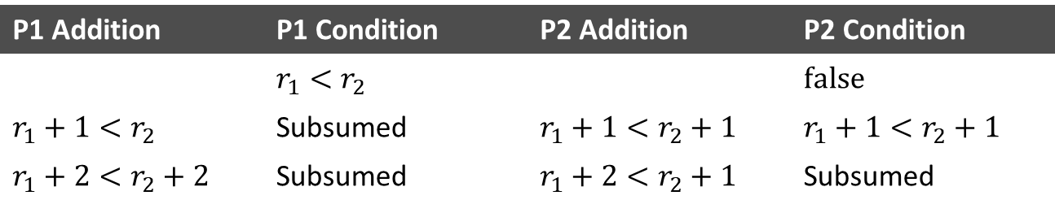
RBBE in Practice
Can this branch be eliminated?
$$\left[−\left|x\right|,r_{1}​\right];(r_{1}+1,r_{2})$$
$$\left[−\left|x\right|​\right];(r_{1}+1,r_{2}+1)$$
$$\left[−\left|x\right|​\right];(r_{1}+1,r_{2}+1)$$
$$r_{1}≥r_{2}$$
$$\left(1,1\right)$$
P1
P2
$$r_{1}>0$$
$$\left[−\left|x\right|​\right];(r_{1}+1,r_{2}+1)$$
$$\left[−\left|x\right|,r_{1}​\right];(r_{1}+1,r_{2})$$
P1 Addition | P1 Condition | P2 Addition | P2 Condition
 | $$r_{1}<r_{2}$$ |  | $$false$$
$$r_{1}+1<r_{2}$$ | Subsumed | $$r_{1}+1<r_{2}+1$$ | $$r_{1}+1<r_{2}+1$$
$$r_{1}+2<r_{2}+2$$ | Subsumed | $$r_{1}+2<r_{2}+1$$ | Subsumed
Yes, because $r=\left(1,1\right)∧(r_{1}<r_{2})$ is unsatisfiable

Slide 13
Frontends
C#
Regex
XPath
Frontend
Comprehensions can be specified as
Imperative C#
Regular expressions
XPath
Pipelines are specified as compositions of comprehensions
Tool generates a function for the user to execute the pipeline
BSTs
Fusion
RBBE
BST
CodeGen
Fused C#

Slide 14
C# Frontend
partial class DecodeDigitPairs
: Transducer<char,char>
{
char prev = 0;
public override IEnumerable<char> Update(char x)
{
if (prev == 0)
{ // no previous digit was recorded
if (’5’ <= x && x <= ’9’) {
prev = x; // store the digit
} else {
yield return x; // output directly
}
}
else
{ // prev != 0 so prev is the previous digit
if (’5’ <= x && x <= ’9’) {
yield return (char)((10 * (prev - 48))
+ (x - 48));
prev = 0;
} else {
yield return x; // output directly
}
}
}
public override IEnumerable<char> Finish()
{
if (prev != 0) yield return prev;
}
}
Code is natural C# using
Integral types, booleans and structs; and their operators.
All control flow constructs except try-catch.
Calls into pure and side effect free functions.
Detailed description in
Olli Saarikivi, Margus Veanes. Translating C# to Branching Symbolic Transducers. LPAR 2017.

Slide 15
Regex Frontend
Extract 4th column from CSV and parse using ParseInt
(([^,\n]*,){3}(?<ParseInt>\d+)(\n|(,[^\n]*\n)))*
Skip 3 columns
Parse digits
Skip to EOL
All lines
Must have no ambiguity between the capture group and the expressions around it.
Compiles to a single BST that parses the matched digits using the named BST ParseInt

Slide 16
XPath Frontend
Extract populations and parse using ParseInt
st:ParseInt(/cities/city/population)
As in the regex frontend, matched characters are sent to ParseInt
The BST uses an integer counter to ignore arbitrarily deep XML
<cities>
<city name=’Roslyn’>
<timezone>PST</timezone>
<population>893</population>
</city>
<city name=’Santa Barbara’>
<population>88410</population>
</city>
</cities>

Slide 17
Evaluation
C#
Regex
XPath
Frontend
Comparison of modular pipelines
LINQ: code from our code generator, communicating with IEnumerable<>
Method Call: “fused” using method calls to pass outputs/inputs
Hand Written: modular implementations using the standard library where possible
Fused: fused code produced by our tool
Comparison against hand-fused HTML encoder from .NET 4.5
BSTs
Fusion
RBBE
BST
CodeGen
Fused C#

Slide 18
Modular Pipelines
CSV
XML

Slide 19
Hand-Fused AntiXSS.HtmlEncode
.NET 4.5 AntiXSS library fuses UTF8 surrogate repair with HTML encoding

Slide 20
Conclusion
Good abstractions
Let programmers easily express their intent
Let the system compile for efficient execution
Our approach allows modular code that performs
as well as hand-fused code
better than unfused and traditionally fused code
Tool is developed on Github in the Automata library:
https://github.com/AutomataDotNet/Automata
https://github.com/OlliSaarikivi/Automata

