Slide 1



Minimization of Symbolic Transducers
Olli Saarikivi
Margus Veanes

Slide 2
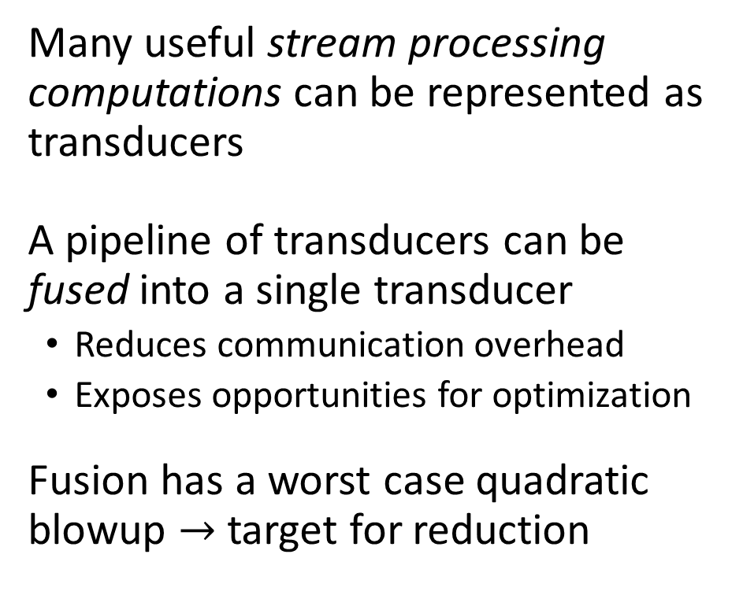
Motivation
Disk / Network
9 95 7d 2e 98 80 e4 3e 76 0b 3b
Many useful stream processing computations can be represented as transducers
A pipeline of transducers can be fused into a single transducer
Reduces communication overhead
Exposes opportunities for optimization
Fusion has a worst case quadratic blowup $→$ target for reduction
Deserialize
12/12/12 SPY 50.13} {12/13/12 S
SelectPrice
49.44, 50.13, 48.13, 51.32, 53.53
FindPriceDips
0, 0, 0, 0, 5, 0, 0, 3, 0, 0, 0, 0, 0, 0
Serialize
b1 a9 86 a8 70 7d a3 66 01 05 3a
Disk / Network

Slide 3
A Fusion Engine
C#
Regex
XPath
Frontend
Symbolic Transducers (STs) as the intermediate representation
Fuse adjacent STs in a pipeline until a single ST remains
Apply reductions during fusion
Control State Reduction
Reachability Based Branch Elimination (PLDI 2017)
STs
Fusion
CSR
ST
RBBE
CodeGen
Fused C#

Slide 4


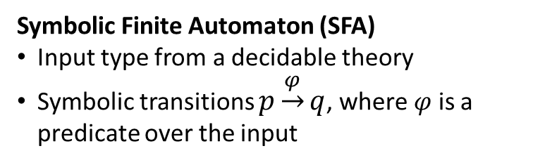

Symbolic Finite Automata
Classical Automaton
Finite (small) alphabet
Concrete transitions $p\underset{→}{a}q$
Symbolic Finite Automaton (SFA)
Input type from a decidable theory
Symbolic transitions $p\underset{→}{φ}q$, where $φ$ is a predicate over the input
EveryOtherEven
$$x\operatorname{mod}{2}=0$$
Guard
A
B
Accepting state
$$⊤$$
Rejecting state

Slide 5





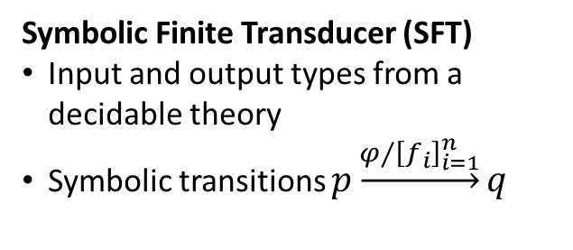




Symbolic (Finite) Transducers
Symbolic Transducer (ST)
Transitions $p\underset{→}{φ⁄{\left[f_{i}\right]}_{i=1}^{n}; g}q$ can use a register for additional state
Classical Transducer
Finite (small) alphabets
Finite set of control states
Concrete transitions $p\underset{→}{a/{\left[b_{i}\right]}_{i=1}^{n}}q$
Symbolic Finite Transducer (SFT)
Input and output types from a decidable theory
Symbolic transitions $p\underset{→}{φ⁄{\left[f_{i}\right]}_{i=1}^{n}}q$
ParseInts
$$¬\operatorname{IsDigit}{(x)}∕[];0$$
$$\operatorname{IsDigit}{(x)}∕[]; \left(10∗r\right)+x−\text{′}0\text{′}$$
$$0$$
$$\operatorname{IsDigit}{(x)}∕[];x−"0"$$
$$⊤∕[r]$$
1
2
$$⊤∕[]$$
$$¬\operatorname{IsDigit}{(x)}∕[r];0$$
Finalizer
Initial register value
Guard
Yields
Register update

Slide 6

Running Example: ☺
Pipeline of two SFTs
Smileyfy changes :) to ☺
Unsmileyfy changes ☺ to :)
Equivalent to just Unsmileyfy
The fused pipeline should reduce to Unsmileyfy
the beach :) See you later! ☺ Remembe
Smileyfy
Smileyfy Unsmileyfy
the beach ☺ See you later! ☺ Remembe
Unsmileyfy
the beach :) See you later! :) Remembe

Slide 7



















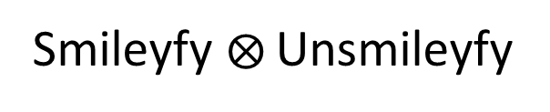
Smileyfy
Unsmileyfy
$$⊤⁄[]$$
$$x=\text{′}\text{:}\text{′}⁄[]$$
$$⊤⁄[\text{′}\text{:}\text{′}]$$
$$⊤⁄[]$$
A
1
2
$$x≠\text{′}\text{:}\text{′}⁄[x]$$
$$x=\text{′}\text{)}\text{′}⁄[\text{′}☺\text{′}]$$
$$x=\text{′}\text{:}\text{′}⁄[x]$$
$$x=\text{′}☺\text{′}⁄[\text{′}\text{:}\text{′},\text{′}\text{)}\text{′}]$$
$$x≠\text{′}\text{:}\text{′}∧x≠\text{′}\text{)}\text{′}⁄[\text{′}\text{:}\text{′},x]$$
$$x≠\text{′}☺\text{′}⁄[x]$$
Smileyfy Unsmileyfy
$$⊤⁄[]$$
$$x=\text{′}\text{:}\text{′}⁄[]$$
$$⊤⁄[\text{′}\text{:}\text{′}]$$
$$x≠\text{′}\text{:}\text{′}∧x≠\text{′}☺\text{′}⁄[x]$$
1A
2A
$$x=\text{′}☺\text{′}⁄[\text{′}\text{:}\text{′},\text{′}\text{)}\text{′}]$$
$$x=\text{′}\text{)}\text{′}⁄[\text{′}\text{:}\text{′},\text{′}\text{)}\text{′}]$$
$$x=\text{′}\text{:}\text{′}⁄[x]$$
$$x≠\text{′}\text{:}\text{′}∧x≠\text{′}\text{)}\text{′}∧x≠\text{′}☺\text{′}⁄[\text{′}\text{:}\text{′},x]$$
$$x=\text{′}☺\text{′}⁄[\text{′}\text{:}\text{′}\text{,}\text{′}\text{:}\text{′},\text{′}\text{)}\text{′}]$$

Slide 8



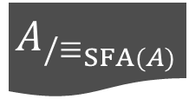
Control State Reduction
$$A$$
Quotient ³
$$A_{/≡_{SFA(A)}}$$
Encoding ¹
¹ Encode into an SFA that accepts valid transductions
² Minimize to produce an equivalence relation
³ Use the equivalence relation to merge states in original ST
$$SFA(A)$$
Minimize ²
$$≡_{SFA(A)}$$

Slide 9

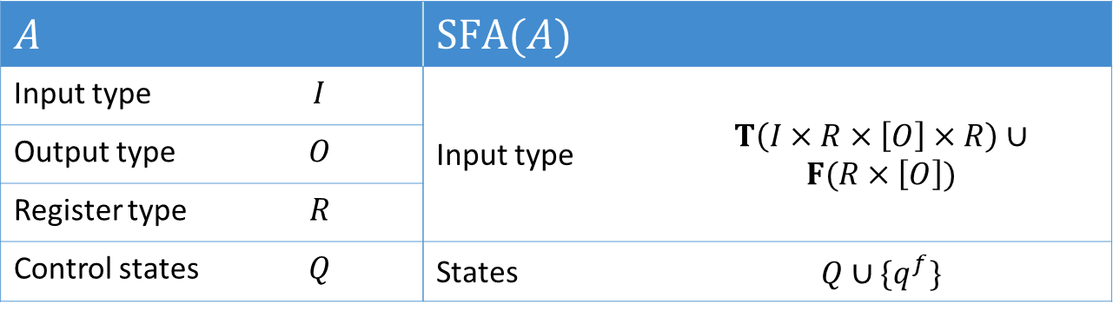
The Encoding
Idea: inputs represent transitions as tuples of input $×$ current register $×$ outputs $×$ new register
$SFA(A)$ accepts valid transductions
$A$ |  | $SFA(A)$
Input type | $$Ι$$ | Input type | $$T\left(Ι×R×\left[Ο\right]×R\right)∪$$ $$F(R×\left[Ο\right])$$
Output type | $$Ο$$
Register type | $$R$$
Control states | $$Q$$ | States | $$Q∪\{q^{f}\}$$

Slide 10




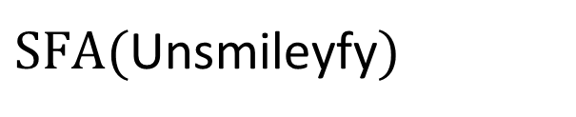




The Encoding in Practice
Transition
$$x≥1⁄[r];x+r$$
Encoding
$$IsT\left(x\right)∧x_{i}≥1∧x_{o}=\left[x_{r}\right]∧x_{r^{′}}=x_{i}+x_{r}$$
Guard
Yields
Update
Unsmileyfy
$SFA($Unsmileyfy$)$
$$q^{f}$$
$$⊤⁄[]$$
$$IsF\left(x\right)∧x_{o}=[]$$
A
$$x=\text{′}☺\text{′}⁄[\text{′}\text{:}\text{′},\text{′}\text{)}\text{′}]$$
$$x≠\text{′}☺\text{′}⁄[x]$$
A
$$IsT\left(x\right)∧x_{i}=\text{′}☺\text{′}∧x_{o}=[\text{′}\text{:}\text{′},\text{′}\text{)}\text{′}]$$
$$IsT\left(x\right)∧x_{i}≠\text{′}☺\text{′}∧x_{o}=[x_{i}]$$

Slide 11
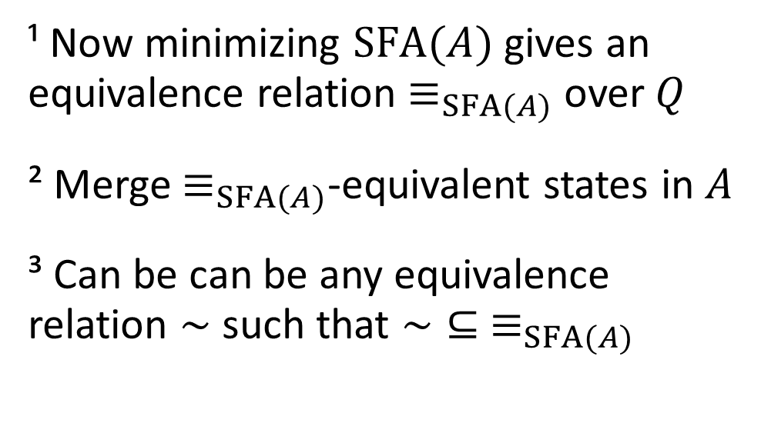
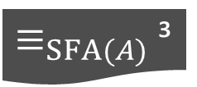
Control State Reduction
$$A$$
Quotient ²
$$A_{/≡_{SFA(A)}}$$
Encoding
¹ Now minimizing $SFA(A)$ gives an equivalence relation $≡_{SFA(A)}$ over $Q$
² Merge $≡_{SFA(A)}$-equivalent states in $A$
³ Can be can be any equivalence relation $\sim$ such that $\sim ⊆ ≡_{SFA(A)}$
$$SFA(A)$$
Minimize ¹
$≡_{SFA(A)}$ ³

Slide 12





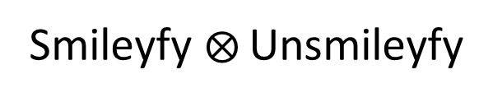




Late Yields Block Reduction
Smileyfy Unsmileyfy
$$⊤⁄[]$$
$$x=\text{′}\text{:}\text{′}⁄[]$$
$$⊤⁄[\text{′}\text{:}\text{′}]$$
$$x≠\text{′}\text{:}\text{′}∧x≠\text{′}☺\text{′}⁄[x]$$
1A
2A
$$x=\text{′}☺\text{′}⁄[\text{′}\text{:}\text{′},\text{′}\text{)}\text{′}]$$
$$x=\text{′}\text{)}\text{′}⁄[\text{′}\text{:}\text{′},\text{′}\text{)}\text{′}]$$
$$x=\text{′}\text{:}\text{′}⁄[x]$$
$$x≠\text{′}\text{:}\text{′}∧x≠\text{′}\text{)}\text{′}∧x≠\text{′}☺\text{′}⁄[\text{′}\text{:}\text{′},x]$$
$$x=\text{′}☺\text{′}⁄[\text{′}\text{:}\text{′}\text{,}\text{′}\text{:}\text{′},\text{′}\text{)}\text{′}]$$
States are not equivalent
All transitions will yield ‘:’ first

Slide 13
Quasi-Determinization
Moves output to be as early as possible
Used in the minimization of classical transducers
Initial work by Christian Choffrut
A more algorithmic approach by Mehryar Mohri
Generalized to Tree Transducers as “Earliest Normal Form”
The classical algorithm
For all states find longest common prefixes of outputs in outgoing transitions
Push the prefixes backwards to incoming transitions
Repeat until nothing can be moved

Slide 14




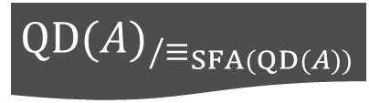
Control State Reduction
$$A$$
Quasi-Determinize ¹
$$QD(A)$$
Quotient ²
$${QD(A)}_{/≡_{SFA(QD(A))}}$$
Encoding ²
¹ ST is Quasi-Determinized as a preprocessing step
² Rest of the algorithm uses the quasi-determinized ST
$$SFA(QD(A))$$
Minimize ²
$$≡_{SFA(QD(A))}$$

Slide 15
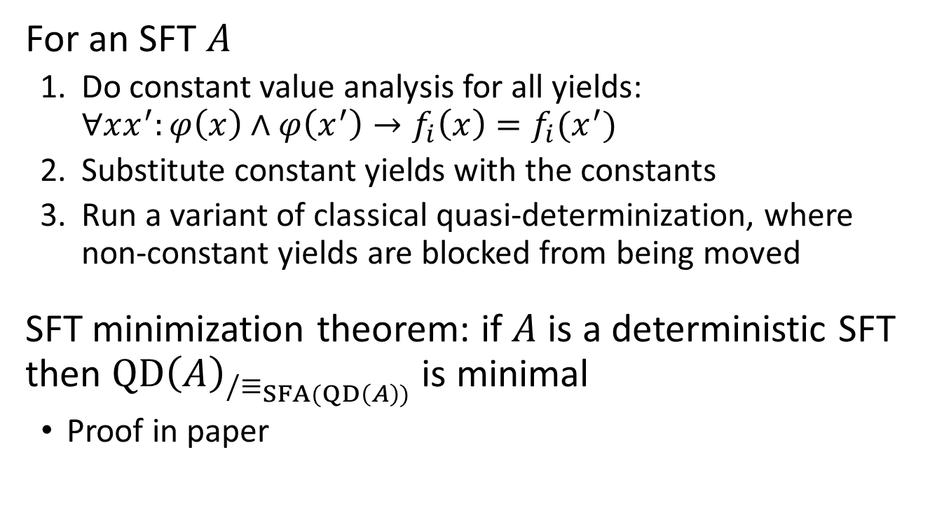
Quasi-Determinization of SFTs
For an SFT $A$
Do constant value analysis for all yields: $∀xx^{′}:φ\left(x\right)∧φ\left(x^{′}\right)→f_{i}\left(x\right)=f_{i}(x^{′})$
Substitute constant yields with the constants
Run a variant of classical quasi-determinization, where non-constant yields are blocked from being moved
SFT minimization theorem: if $A$ is a deterministic SFT then $QD{\left(A\right)}_{/≡_{SFA(QD\left(A\right))}}$ is minimal
Proof in paper

Slide 16








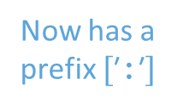

Quasi-Determinization in Practice
Smileyfy Unsmileyfy
$$⊤⁄[]$$
$$x=\text{′}\text{:}\text{′}⁄[\text{′}\text{:}\text{′}]$$
$$⊤⁄[]$$
$$x=\text{′}\text{:}\text{′}⁄[]$$
$$⊤⁄[\text{′}\text{:}\text{′}]$$
1A
2A
Now has a prefix $[\text{′}\text{:}\text{′}]$
$$x≠\text{′}\text{:}\text{′}∧x≠\text{′}☺\text{′}⁄[x]$$
$$x=\text{′}\text{:}\text{′}⁄[\text{′}\text{:}\text{′}]$$
$$x=\text{′}☺\text{′}⁄[\text{′}\text{:}\text{′},\text{′}\text{)}\text{′}]$$
$$x=\text{′}\text{)}\text{′}⁄[\text{′}\text{)}\text{′}]$$
$$x=\text{′}\text{:}\text{′}⁄[\text{′}\text{:}\text{′}]$$
$$x=\text{′}\text{)}\text{′}⁄[\text{′}\text{:}\text{′},\text{′}\text{)}\text{′}]$$
$$x=\text{′}\text{:}\text{′}⁄[x]$$
$$x≠\text{′}\text{:}\text{′}∧x≠\text{′}\text{)}\text{′}∧x≠\text{′}☺\text{′}⁄[x]$$
$$x≠\text{′}\text{:}\text{′}∧x≠\text{′}\text{)}\text{′}∧x≠\text{′}☺\text{′}⁄[\text{′}\text{:}\text{′},x]$$
$$x=\text{′}☺\text{′}⁄[\text{′}\text{:}\text{′},\text{′}\text{)}\text{′}]$$
$$x=\text{′}☺\text{′}⁄[\text{′}\text{:}\text{′}\text{,}\text{′}\text{:}\text{′},\text{′}\text{)}\text{′}]$$
Non-Constant
Constant
Now the states are equivalent

Slide 17
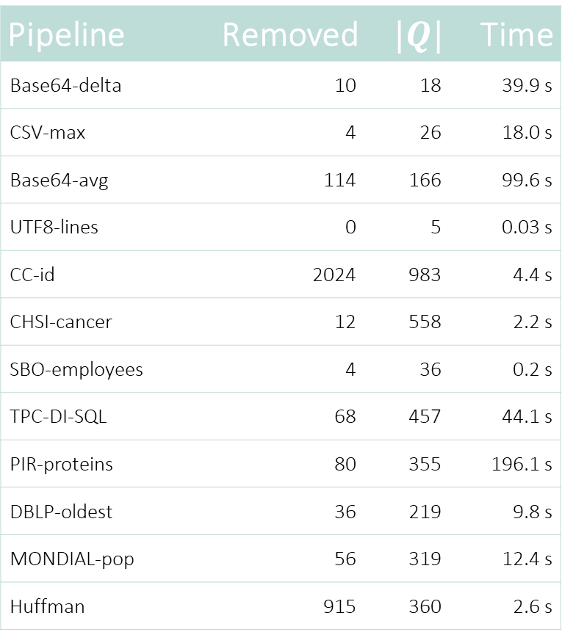
Efficacy of CSR for Fusions of STs
Pipeline | Removed | $$|Q|$$ | Time
Base64-delta | 10 | 18 | 39.9 s
CSV-max | 4 | 26 | 18.0 s
Base64-avg | 114 | 166 | 99.6 s
UTF8-lines | 0 | 5 | 0.03 s
CC-id | 2024 | 983 | 4.4 s
CHSI-cancer | 12 | 558 | 2.2 s
SBO-employees | 4 | 36 | 0.2 s
TPC-DI-SQL | 68 | 457 | 44.1 s
PIR-proteins | 80 | 355 | 196.1 s
DBLP-oldest | 36 | 219 | 9.8 s
MONDIAL-pop | 56 | 319 | 12.4 s
Huffman | 915 | 360 | 2.6 s
CSV parsing with regexes
XML parsing with XPath
English Huffman decode
+ line count

Slide 18
Conclusions
Our Control State Reduction algorithm provides
large reductions for fused pipelines of STs
a minimization approach for deterministic SFTs
Implementations in the Automata library
https://github.com/OlliSaarikivi/Automata
https://github.com/AutomataDotNet/Automata
Also included in the paper
Quasi-Determinization of STs
Strengthening STs with invariants for more reduction
Huffman coding using SFTs

