Slide 1
Week 05
The Back-End
(code generation)
Goal: produce target code for a given platform and optimise it
COMP26020 - week 5

Slide 2
Introduction
Source code
Front-
End
IR
Middle-
End
IR
Back-End
Object code
instruction
selection
register
allocation
instruction
scheduling
Well-understood
Engineering
Where are we?
  The task of the back-end is to take the (partly optimised) intermediate representation and generate target code. Two issues:
    Select target language instructions – a pattern matching problem
    Optimise in line with what the target platform offers
  We are going to focus on:
    instruction selection: map intermediate representation into target code
    register allocation: decide which values will reside in registers.
    instruction scheduling: reorder operations to hide latencies…
  Conventional wisdom says that we lose little by solving these (NP-complete) problems independently but they inter-relate.

Slide 3
Instruction Selection
Characteristics:
  essentially pattern matching: match IR patterns to target code
  can make locally optimal choices; global optimality is NP-complete
  assume enough registers.
Assume a RISC-like target language:
    load r1, @a ; load register r1 with the memory value for a
    load r1, [r2] ; load r1 with the memory value pointed by r2
    mov r1, 3 ; r1=3
    add r1, r2, r3 ; r1=r2+r3 (same for mult, sub, div)
    shr r1, r1, 1 ; r1=r1>>1 (shift right; r1=r1/2)
    store r1 ; store r1 in memory
    nop ; no operation
    br L ; branch to label L
COMP26020 - week 5

Slide 4
Code generation for arithmetic expressions
Adopt a simple treewalk scheme; emit code in postorder:
expr(node)
{ int result, t1, t2;
switch(type(node))
{ case *,/,+,-:
t1=expr(left child(node));
t2=expr(right child(node));
result=NextRegister();
emit(op(node),result,t1,t2);
break;
case IDENTIFIER:
t1=base(node); t2=offset(node);
result=NextRegister();
emit(…) /* load IDENTIFIER */
break;
case NUM:
result=NextRegister();
emit(load result, val(node));
break;
}
return result;
}
Example: x+y:
load r1, @x
load r2, @y
add r3,r1,r2
(load r1,@x would
involve a load from
address base+offset)
COMP26020 - week 5

Slide 5
Issues with arithmetic expressions
What about values already in registers?
  Modify the IDENTIFIER case.
Why the left subtree first and not the right?
  (cf. 2*y+x; x-2*y; x+(5+y)*7): evaluate the most demanding (in registers) subtree first (Sethi-Ullman labelling scheme).
2nd pass to minimise register usage/improve performance.
The compiler can take advantage of commutativity and associativity to improve code for integers.
Problem: generate code that multiplies an integer with an unknown using only shifts and adds! E.g.:
  325*x = 256*x+64*x+4*x+x or (4*x+x)*(64+1) (from an old compiler)
  When is it better not to use integer multiplication?
COMP26020 - week 5

Slide 6
Array references
Agree on a memory storage scheme for array elements:
  Row-major order: layout as a sequence of consecutive rows: A[1,1], A[1,2], A[1,3], A[2,1], A[2,2], A[2,3]
  Column-major order: layout as a sequence of consecutive columns: A[1,1], A[2,1], A[1,2], A[2,2], A[1,3], A[2,3] (FORTRAN’s approach)
We can easily derive formulas to compute an array element starting from the first element of the array(base). E.g. for an array defined as size [n][m], element [i][j] is given by:
  row-major: base+(i*(m+1)+j)*w
  column-major: base+(j*(n+1)+i)*w
  where w=sizeof(single_array_element)
COMP26020 - week 5

Slide 7
Control-Flow statements
If expr then stmt1 else stmt2
  1. Evaluate the expr to true or false
  2. If true, fall through to then; branch around else
  3. If false, branch to else; fall through to next statement.
  (if not(expr) br L1; stmt1; br L2; L1: stmt2; L2: …)
While loop; for loop; or do loop:
  1. Evaluate expr
  2. If false, branch beyond end of loop; if true, fall through
  3. At end, re-evaluate expr
  4. If true, branch to top of loop body; if false, fall through
  (if not(expr) br L2; L1: loop-body; if (expr) br L1; L2: …)
Complex Boolean expressions can also be evaluated using treewalk but not only. E.g.:
  Short-circuit evaluation: the C expression (x!=0 && y/x>1) relies on short-circuit evaluation for safety.
COMP26020 - week 5

Slide 8

Procedures / Functions / Methods
Procedures are key to building complex software but they are a high-level abstraction not supported by low-level hardware. An interesting trade-off!
The compiler needs to generate code that emulates the behaviour of procedures. For every call:
  Pre-call will add instructions to allocate memory for procedure specifics, which is de-allocated in post-return. Prologue will initialize variables and so on…
This is costly: in Java, an optimisation called method inlining is trying to embed the code for methods in the code where they are called from.
Procedure P
Procedure Q
Prologue
Prologue
Pre-call
Post-return
Epilogue
Epilogue

Slide 9
Register Allocation
Source code
Front-
End
IR
Middle-
End
IR
Back-End
Object code
instruction
selection
register
allocation
instruction
scheduling
Well-understood
Engineering
Register Allocation:
    The initial code makes use of an unbounded number of registers (virtual registers) but the machine has only a limited number of registers (physical registers), say k.
    The task:
      Produce correct k register code.
      Minimise number of loads and stores (spill code) and their space.
      The allocator must be efficient (e.g., no backtracking)
    Assume a RISC-like (three-address) type of code.
COMP26020 - week 5

Slide 10
Background
Basic Block: a maximal length segment of straight-line (i.e., branch-free) code. (Importance: strongest facts are provable for branch-free code; problems are simpler; strongest techniques.)
Local Register Allocation: within a single basic block (BB)
Global Register Allocation: across an entire procedure (many BBs).
Allocation: choose what to keep in registers.
Assignment: choose specific registers for values.
Modern processors may have multiple register classes:
  General-purpose, floating-point, branch target, …
  Problem: interactions between classes - Assume separate allocation for each class.
Complexity: Only simplified cases of local allocation and assignment can be solved in linear time. All the rest (including global allocation – even for 1 register – and most sub-problems) are NP-complete. We need good heuristics!
Real compilers face real problems!

Slide 11
Liveness and Live Ranges
Problem: What is the number of registers needed in a basic block?
  Naïve: all occurrences of a variable to the same register.
  Realistic: Compute a set of live ranges and use their name space.
A value of a variable is live between its definition and its uses:
  Find definitions (x←…) and uses (…←…x…)
  From definition to last use is the “live range”
  Can represent live range as an interval [i,j] in basic block.
Over all instructions in the basic block, let:
  MAXLIVE be the maximum number of values live at an instruction
  k, the number of physical registers available.
    If MAXLIVE ≤ k, allocation is trivial.
    If MAXLIVE > k, some values must be saved to memory (‘spilling’).
COMP26020 - week 5

Slide 12
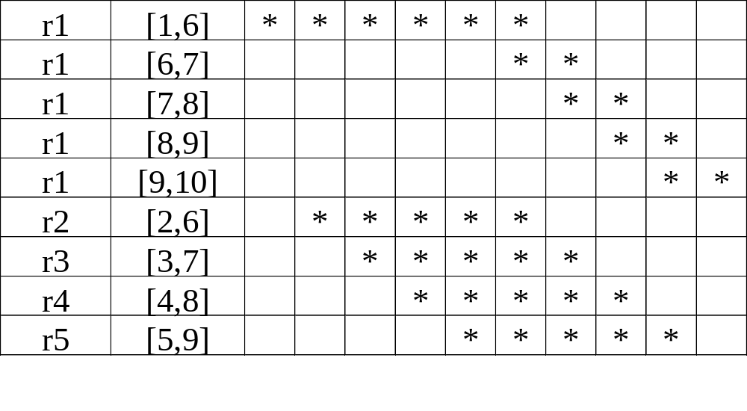
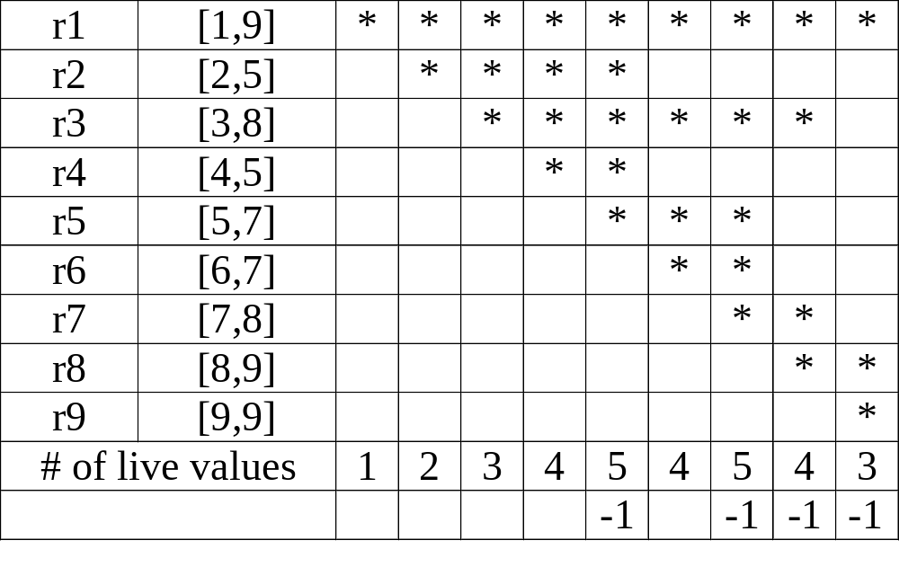
Example / Exercise
1. load r1,@a
2. load r2,2
3. load r3,@b
4. load r4,@c
5. load r5,@d
6. mult r1,r1,r2
7. mult r1,r1,r3
8. mult r1,r1,r4
9. mult r1,r1,r5
10.store r1
1. load r1,@a
2. load r2,@y
3. mult r3,r1,r2
4. load r4,@x
5. sub r5,r4,r2
6. load r6,@z
7. mult r7,r5,r6
8. sub r8,r7,r3
9. add r9,r8,r1
If a live range starts at an instruction where another live range terminates many instruction sets (but not all) permit the use of the same register for both live ranges.
COMP26020 - week 5

Slide 13
Basic (Local) Register Allocation
Top-down register allocation
  Reserve registers for the most frequently used values. All other values are loaded from / stored to memory when needed.
  Problem: a value heavily used in one part of the code but rarely used in the next part of the code will still occupy a register.
Bottom-up register allocation (Best’s algorithm)
  Keep a pool of registers; assign one register when a value is initialised (start of the live range); return register to the pool at the end of the live range.
  If at some point we need to assign a register but there is no register in the pool, select the register that is used farthest in the future, store its value and return it (a process known as ‘spilling’)
  Due to Sheldon Best (1955) – often reinvented. Many have argued for its optimality…
COMP26020 - week 5

Slide 14
Register Allocation via graph colouring
The idea:
  live ranges that do not interfere can share the same register.
The algorithm:
1. Construct live ranges
2. Build interference graph
3. (try to) construct a k-colouring of the graph:
    If unsuccessful (i.e., we need more than k colours), choose values to spill (on the basis of some cost estimates) and repeat from start (choosing what to spill is a critical issue).
4. Map colours onto physical registers
COMP26020 - week 5

Slide 15
Graph Colouring - Background
The problem:
  A graph is said to be k-colourable iff the nodes can be labelled with integers 1…k so that no edge connects nodes with the same label.
Examples:
3-colourable
2-colourable
A colouring that uses k colours is termed a k-colouring and
k is the graph’s chromatic number.
(Famous problem: the map-colouring problem)
COMP26020 - week 5

Slide 16
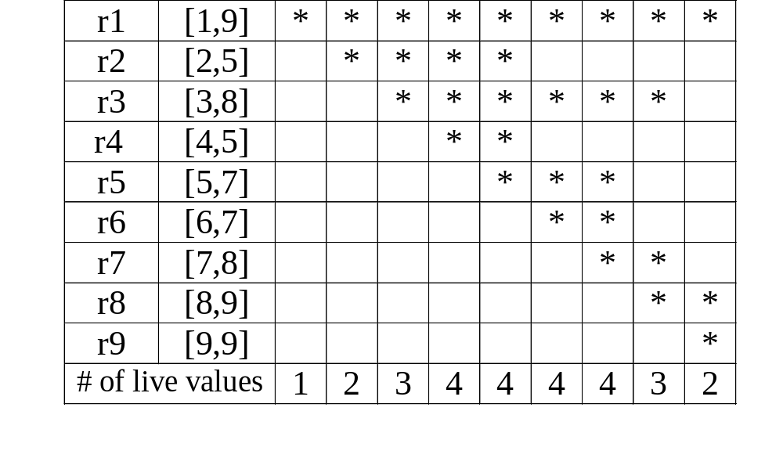
Build the interference graph
What is an interference?
  Two values interfere if there exists an operation where both are simultaneously live; if they interfere they cannot occupy the same register.
The interference graph:
  Nodes: represent values (or live ranges).
  Edges: represent individual interferences.
Example (2nd example from slide 12):
r1
r2
r3
r4
r5
r6
r7
r8
r9

Slide 17
Construct a k-colouring
Top-down colouring:
  Rank the live ranges (that is, the nodes):
    Possible ways of ranking: number of neighbours, spill cost, etc
  Follow the ranking to assign colours:
    (for each node, pick the first colour that is not used by the node’s neighbours)
  If the compiler cannot find a k-colouring, it needs to spill some value (store after definition, load before each use), something that splits the live range.
(Observation: every node with a number of neighbours less than k will always receive a colour!)
COMP26020 - week 5

Slide 18
The big picture
  Register allocation through graph colouring is popular. (for anyone interested, this is the original paper: “Register Allocation via Coloring”. Computer Languages 6(1), Jan. 1981)
  A variant known as bottom-up colouring is particularly common
To discover global live ranges, use the Control Flow Graph. Then:
  At some point p in a procedure, a value v is live if:
    it has been defined along a path from the procedure entry’s to p, and
    a path exists from p to a use of v, along which v is not redefined.
  In practice, the compiler finds all values that are live on entry to each basic block, as well as those that need to be live on exit from each basic block.
If the compiler needs to spill, which live range to choose? The answer is try to estimate the cost of spilling. Some components:
  Cost of computing the address of the value related to this live range
  Execution frequencies: best to avoid values inside loops that are executed multiple times
In practice the size of the interference graph may be quite large
COMP26020 - week 5

Slide 19
Instruction Scheduling
Source code
Front-
End
IR
Middle-
End
IR
Back-End
Object code
instruction
selection
register
allocation
instruction
scheduling
Well-understood
Engineering
Instruction Scheduling
  Instruction Latency: length time elapsed from the time the instruction was issued until the time the results can be used. For an add this may be 1 cycle, for mult, load it may be more…
  The problem:
      Given a code fragment for some target machine and latencies for each individual instruction, reorder operations to minimise execution time.
      Recall: modern processors may have multiple functional units.
  The task:
      Produce correct code that minimizes execution time

Slide 20
Background
The compiler knows that many instructions have delay latencies when executed. The details are processor-related but the result may appear with delay (instruction latency):
    For example: a load is scheduled, its result appears <delay> cycles later.
    However, the execution continues unless the result is referenced.
    Premature reference of the result will cause hardware to stall.
Modern machines can issue several operations per cycle.
Execution time is order-dependent (has been since the 60s)
Overview of a solution:
  Move loads back at least <delay> slots from where they are needed, but this increases register pressure (i.e., more registers may be needed).
  Ideally, we want to minimise both hardware stalls and added register pressure.

Slide 21
Motivating Example
Two variants to compute (a+b)+c:
(9 cycles – 2 registers): (6 cycles – 3 registers):
1. load r1, @a 1. load r1, @a
2. load r2, @b 2. load r2, @b
5. add r1,r1,r2 3. load r3, @c
6. load r2, @c 5. add r1,r1,r2
9. add r1,r1,r2 6. add r1,r1,r3
assume that the latency of a load is 3 cycles; all other instructions have a latency of 1 cycle
NB: costs due to the memory hierarchy are not part of the picture
Hardware will
stall until result
is available!
COMP26020 - week 5

Slide 22
Instruction Scheduling for a basic block The big picture
1. Build a precedence (data dependence) graph.
2. Compute a priority function for the nodes of the graph.
3. Use list scheduling to construct a schedule, one cycle at a time:
  Use a queue of operations that are ready
  At each cycle:
    Choose a ready operation and schedule it
    Update the ready queue.
A greedy heuristic; open to variations.
(greedy heuristic: An algorithmic technique in which an optimisation problem is solved by finding locally optimal solutions)
COMP26020 - week 5

Slide 23
Build a precedence graph
1. load r1, @x
2. load r2, [r1+4]
3. and r3, r3, 0x00FF
4. mult r6, r6, 100
5. store r6
6. div r5, r5, 100
7. add r4, r2, r5
8. mult r5, r2, r4
9. store r4
1
3
4
2
6
5
7
8
9
COMP26020 - week 5

Slide 24
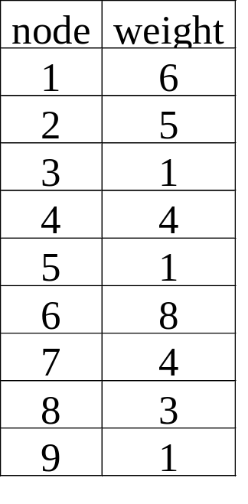
Compute a priority function
Assign to each node a weight equal to the longest delay latency (total) to reach a leaf in the graph from this node (include latency of current node).
weight_{i}=latency_{i}+max(weight_{all successor nodes})
(Assume: div 4 cycles, and
mult 3 cycles; 1 cycle for the rest):
1
3
4
2
6
5
7
8
9
COMP26020 - week 5

Slide 25
(Local) List scheduling
Cycle=1; Ready=set of available operations; Active={}
While (Ready ∪ Active != {})
if (Ready!={}) then
remove an op from Ready (based on the weight)
schedule(op)=cycle
Active=Active ∪ op
cycle=cycle+1
for each op in Active
if (schedule(op)+delay(op)<=cycle) then
remove op from Active
for each immediate successor s of op
if (all operand of s are available) then
Ready=Ready ∪ s
COMP26020 - week 5

Slide 26
Find the schedule
cycle | Instructions ready | Schedule | Instructions active
1 | 6, 1, 4, 3 | 6 (div r5,r5,100) | 6
2 | 1, 4, 3 | 1 (load r1,@x) | 6, 1
3 | 2, 4, 3 | 2 (load r2, [r1+4]) | 6, 2
4 | 4, 3 | 4 (mult r6,r6,100) | 6, 4
5 | 7, 3 | 7 (add r4,r2,r5) | 4, 7
6 | 8, 3, 9 | 8 (mult r5,r2,r4) | 4, 8
7 | 3, 9, 5 | 3 (and r3,r3,0x00ff) | 8, 3
8 | 9, 5 | 9 (store r4) | 8, 9
9 | 5 | 5 (store r6) | 5
COMP26020 - week 5

Slide 27
More on list scheduling
Two distinct classes of list scheduling:
  Forward list scheduling: start with all available operations; work forward in time (the algorithm presented here)
  Backward list scheduling: start with leaves; work backward in time
  Folk wisdom is to try both and keep the best result.
Variations on computing priority function:
  Maximum path length containing node (decreases register usage).
  Prioritise critical path.
  Number of immediate successors or total number of descendants.
  Increment weight if node contains a last use (shortens live ranges)
With a small modification the algorithm can deal with cases where multiple operations can be scheduled at the same time
COMP26020 - week 5

Slide 28
Further Issues
The back-end is essentially a sequence of optimising transformations that aim to generate optimised target code.
Register allocation interferes with instruction scheduling:
  The former before the latter restricts the choices for scheduling.
  If the latter before the former and register allocation has to spill registers, the whole (carefully done) schedule changes!
  The same can be said about instruction selection too.
Most of the active compiler research revolves around areas of optimisation in relation to middle/back-end. Trying to optimise in relation to new target platforms is always a big challenge.
Additional Reading: Cooper, Chapters 11-13 (quite detailed coverage); Aho2, Chapter 8, pages 540-560.
COMP26020 - week 5

Slide 29
Finally…
Source
Lexical
Analysis
I.C.
Optimisation
tokens
IR
Syntax
Analysis
Code
Generation
Abstract Syntax Tree (AST)
symbolic instructions
Semantic
Analysis
Target code
Optimisation
Annotated AST
optimised symbolic instructions
Intermediate
code generat.
Target code
Generation
Target
front-end
back-end
Compilation is an exciting topic: we tried to go through the basics but we have barely scratched the surface. For anyone interested in the topic, you can access the ‘Engineering a Compiler’ textbook, through your UoM account and find out more: https://www.sciencedirect.com/book/9780120884780/engineering-a-compiler

