Slide 1

The Influence of Class Structure on Program Comprehension: An Empirical Study
Ahmed Alardawi
Ph.D. student

Slide 2
Research Outlines
Research Aim, Questions, and Objectives
Program Comprehension, Theories, Strategies, and Models
Research Plan
Research Methodology
Car and Line-Edit Studies
Model Evaluation
Methodological and Pedagogical Issues
Research Contributions
Further works

Slide 3
Research Aim
assess the ease of comprehension of OO programs for different problem characteristics that can possess different possible solution decompositions
Research questions
Are the OO programs easier to comprehend than non OO programs? How to go about empirically investigate OO program comprehension?
What are the existing models of program comprehension? What are the main types of knowledge appropriate to investigate OO program comprehension?
How do different elements, such as, class concept, problem characteristics, and solution decompositions influence the OO program comprehension?
the objectives are:
to provide a rich view of the difference in the ease of comprehension between OO programs and non OO programs
to evaluate current models of OO program comprehension
to propose a new empirically grounded based model of OO program comprehension

Slide 4
Program Comprehension Theories
top-down model Brooks (1983) - Soloway and Ehrlich (1989)
high-level abstraction to low-level abstraction
hypothesis-driven process
based on beacons
applied when code is familiar
required good level of experience, not appropriate for novices
bottom-up model Shneiderman and Mayer (1979) - Pennington (1987a)
low-level abstraction to high-level abstraction
based on chunking code
applied when code is unfamiliar
does not required good level of experience, appropriate for novices
Integrated model Van mayrhauser and vans (1995) - Storey (2006)
combined 4 sum-models:
top-down, program model, situation model, and knowledge based
necessary for large size programs
any of the first 3 sub-models can be activated, each of whichhas its preferred knowledge type
each model has its own characteristics
which of these models are fit to OO programs?

Slide 5
Program Comprehension Strategies
Systematic strategy
read code in detail
required static and dynamic knowledge
successful in modification task
As-needed strategy
focus on certain code
required only static knowledge
successful in maintenance task

Slide 6
Program Comprehension Models
Pennington model of program comprehension
text relations | knowledge structures | mental representation | model
elementary operations | text structure knowledge | dynamic and functional views | program model
control flow | text structure knowledge | dynamic view | program model
function | plan knowledge | functional view | situation model
data flow | plan knowledge | dynamic and functional view | situation model
state | plan Knowledge | dynamic and functional view | program/situation model
Limitations
does not account for representation of OO concepts
classes and their relationships i.e., composition and inheritance
delocalised plan i.e., client-server relationship
macrostructure i.e., elementary function

Slide 7
Program Comprehension Models
Burkhardt model of OO program comprehension
text relations | knowledge structures | mental representation | model
Program model
control flow | text structure knowledge | dynamic view | program model
elementary operations | text structure knowledge | dynamic and functional views | program model
elementary functions | text structure knowledge | dynamic and functional views | program model
situation model
Static Aspects of Situation Model
problem classes | problem knowledge and plan knowledge | object view | situation model
relations between problem classes | problem knowledge and plan knowledge | object view | situation model
computing or reified classes | generic programming knowledge and plan knowledge | object view | situation model
main goals | problem knowledge and plan knowledge | functional view | situation model
dynamic aspects of situation model
client–server | plan knowledge (complex delocalised plans) | dynamic and functional views | situation model
data flow | plan knowledge | dynamic and functional views | situation model

Slide 8
Research Plan
Pennington and Burkhardt models were taken as a basis of the investigation
the comprehension was assessed at both at the knowledge categories level rand the overall program level
did not distinguish between two sub-models (program and situation models), it was important to assess the ease of comprehension of each of the following types of knowledge categories:
Elementary Operations
Control Flow
Data Flow
Program Goals
State
Problem Classes
there was a shift from memory-based task to search-based task to allow subjects search through the program text rather than memory recall
this approach was more fruitful in enhancing and led to proposing a new empirically grounded based model of OO program comprehension
Presenting the first paper at PPIG 2010- Dundee

Slide 9
Research methodology 1
Détienne 2006 claimed that since these claim is cognitive in nature, it is important to assess it empirically
comparative empirical evaluation approach in the form of controlled empirical experiment is the most appropriate approach to perform the evaluation
replicate and build on the existent empirical studies
relate the research findings to a wide rang of related studies
Notes:
According to De Vans (2013):
if the aim of the research is to test some element of an existing theory, a positivist paradigm using quantitative methods and deductive reasoning is appropriate.
If the aim of the research is to construct theory, a phenomenological paradigm using qualitative methods and inductive reasoning is appropriate
if the aim of the research is to both test and construct theory, the pragmatic paradigm using both quantitative and qualitative methods and inductive and deductive reasoning is appropriate.

Slide 10
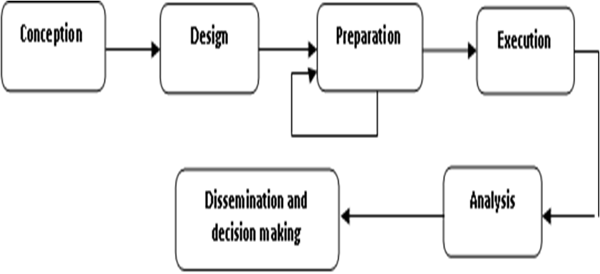
Research methodology 2
experimental research framework
conception:
objective are defined
research questions are clearly stated
design
hypotheses are formulated
experimental components (treatments, subjects, variables, and procedure) are defined
preparation
pilot study is run
execution
treatments are applied to subjects according to the prescribed procedure
analysis
an appropriate statistical techniques are employed
dissemination and decision making
conclusions are documented and experiment can be replicated

Slide 11
Research methodology 3
Specific of the Investigation
experimental methodology was tailored to meet the needs of the investigation
Choice of Subjects
between-subjects-design, each group was then exposed to different experimental treatment.
A stratified random sampling approach
Choice of Materials
two problems set each of which has different characteristics (tangibility and richness)
general characteristics do not require any specialised domain knowledge
Choice of Metrics
effort: the time spends to accomplish the comprehension task
performance: the correct responses of the given comprehension questions
ranking: the level at which subjects rank their comprehension
Notes:
Decomposition is the way of characterising each solution of the problem into Item to be processed
The Item id the perception obtained from consideration of input data and processing requirements to subsequent decompositions of the problem
The various alternative Items based solutions are mapped onto characteristic process for each problem
Each process is considered as a perception that dominants the elaboration of the solution
For Car only one possible Item “car status” can be considered as perception dominates the elaboration of primitive solution
For Line-Edit, 3 possible alternative solutions “Char”, “Word”, and “Line” can be considered as perceptions dominate the elaboration of different solutions
Char was considered as primitive perception and Word was considered as abstract perception

Slide 12
Car Study
subjects
3sets of experiment
353 undergraduate students
37% males and 62% females
average age 20 years
materials
background questionnaire
program version of the Car problem (Non-Object based and Object based)
comprehension questions, ranking question
procedure
verbally informed
response to background questionnaire,starting time reordered for all subjects
Response to comprehension questions
Ending time recorded for each subjects individually
response to ranking question
metrics
independent variables (program version and knowledge categories )
dependent variables: (effort, performance, and ranking)
hypotheses
H₀₁: There is no significant difference in terms of ease of comprehension between Non-Object based program and Object based program by (i) effort, (ii) performance, and (iii) ranking.
H₀₂: There is no significant difference in terms of ease of comprehension in knowledge categories between Non-Object based program and Object based program.
H₀₃: There is no significant difference in terms of ease of comprehension in knowledge categories by (i) All group (ii) Non-Object group, and (iii Object group.
Presenting the Second paper at PPIG 2011-Sheffield
Presenting the Third Paper at PPIG 2011-York
Notes:
normality test - descriptive analysis - Mann-Whitney - Kruskal-Willis
performance and ranking were better indicators of comprehension, whilst effort ias an inappropriate indicator of comprehension
the Object based program easier to comprehend than the Non-Object based program
the ease of comprehension of Object based program attributed to the problem classes knowledge category.
state knowledge category has a positive dominant effect in comprehension for the all sets of groups (All group, Non-Object group, and Object group)
problem classes knowledge category has a positive dominant effect in comprehension only for the Object group. However, it has a negative strong effect for the Non-Object group.

Slide 13
Line-Edit Study
subjects:
56 postgraduate software engineering students
89% males and 11% females
average age 23 years
materials:
background questionnaire
program version of the Lin e-Edit problem (Non-Object based and Object based)
comprehension question
ranking question
procedure, metrics, hypotheses:
same as in the Car study

Slide 14
Summary of the Studies Findings
 | Car study |  | Line-Edit study
Performance | Object based group outperformed the Non-Object based group |  | Object based group outperformed the Non-Object based group
Knowledge categories that contributed to the difference between program version | Problem Classes |  | Control Flow State Problem Classes
Performance in each knowledge category | positive dominant | negative dominant | positive dominant | negative dominant
All group | State | none | none | none
Non-Object group | State | Problem Classes | none | Problem Classes
Object group | State and Problem Classes | none | none | none
Notes:
e
Problem Classes knowledge category contributes to the difference in comprehension between groups in both Car and Line-Edit studies.
Control Flow and State knowledge categories contribute to this difference only in the Line-Edit study
in the Car study, Problem Classes has a positive effect on the Object based program and a negative effect on the Non-Object based. However, State knowledge category has a positive effect in both program versions
in the Line-Edit study, Problem Classes has a negative effect only on the Non-Object based program

Slide 15
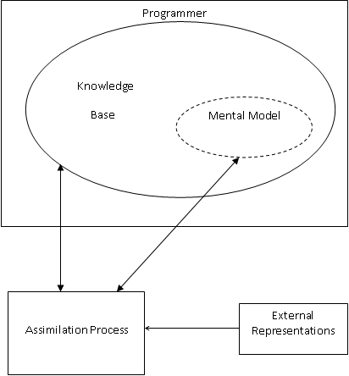
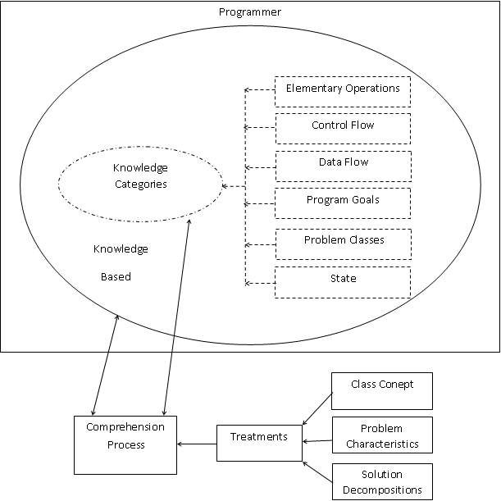
Model Evaluation 1
Elements of software comprehension models (source: O'Brien, 2003)
The tailored operational view of the model used in this investigation

Slide 16
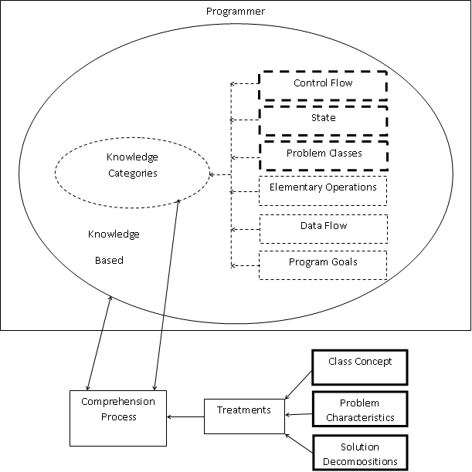
Model Evaluation 2
control flow, problem classes and state knowledge categories are the basis of the proposed model as they were found contributory (primary knowledge)
elementary operations, data flow, and program goals knowledge categories were not contributory (secondary knowledge)
the elements of class concept, problem characteristics, and solution decomposition found empirically to be influential
The empirically grounded based proposed model of OO program comprehension

Slide 17
Model Evaluation 3
Limitations and Extension of the Proposed Model
contributory knowledge would be considered simplistic to describe "critical aspects" of OO program comprehension:
reconsider control flow as "the way in which objects interact with each other", dynamic aspects of problem classes
reconsider state as "state of objects", object is holding state and changing through its behaviour
including these critical aspects as knowledge category is difficult in the current research (knowledge spanned only on OO programs), further comparison should be done between OO programs

Slide 18
Methodological Issues
the lack of criterion for comparability between program versions:
issue of equivalence (OO systematically longer than non OO)
problem classes questions in non OO programs are questionable
the use of additional cues
variables names and comments gave additional source for information
non-meaningful variables names and fewer textual comments approaches considered beyond subjects ability
Pedagogical Issues
what types of knowledge programmers found difficult to comprehension contribute to the theory of OO program comprehension and help educators to teach OO programming
carful attention to data flow and program goals knowledge
understanding of critical aspects of control flow, state, and problem classes
different program examples facilitate comprehension of different types of knowledge
"knowledge-based" program example categorisation is an educational tool to improve OO program comprehension skills

Slide 19
Research Contributions
devising a tailored experimental methodology based on prior studies to meet the needs of the investigation
designing and conducting two main sets of empirical studies (Car and Line-Edit) to assess the ease of comprehension of OO programs
evaluating the existence model and proposing a new empirically grounded based model of OO program comprehension
introducing knowledge-based example programs as an educational tool to improve OO program comprehension skills for programming students
establishing a foundation for further work in the filed of empirical work in OO program comprehension

Slide 20
Further Works
investigate the ease of comprehension of different program examples each of which is assumed to emphasise a certain type(s) of knowledge. this would help in expanding the knowledge-based categorisation
investigate the ease of comprehension of the critical aspects of the primary types of knowledge within the OO programs. This van be done by using problem that possesses different solution decompositions both of which implemented in the form of Object based programs

Slide 21
Thank You

