Slide 1
Targeted protein degradation beyond conventional limits
Company overview · 2026
OYSTER THERAPEUTICS · CONFIDENTIAL

Slide 2
Contents
01
The idea
02
The problem
03
Our solution: the SELFTAC® platform
04
Pipeline
05
Team
Notes:
Contents layout: number, item and dotted rule are composed on the slide (copy a row to add one). The current item is white with a gold number.

Slide 3
The function of a full degrader. The distribution of a small molecule.
THE IDEA
SELFTAC® platform

Slide 4
The problem
02
Why first-generation protein degraders are limited.

Slide 5
Each type of degrader brings its own trade-off
First-generation degraders
Bifunctional degraders
Molecular glues
MODULAR
BULKY
DRUG-LIKE
SERENDIPITOUS
Modular components, but their large size limits oral bioavailability and penetration into tissues like the brain.
Smaller, with more favourable drug-like properties, but without the same rational, modular design approach.

Slide 6
Our solution: the SELFTAC® platform
03
Degraders that travel as small molecules and self-assemble where they are needed.

Slide 7
Separate, assemble, degrade
HOW IT WORKS
Separate
Assemble
Degrade
Degraders start as two small molecular halves that can cross the blood-brain barrier.
Inside the cell the halves clasp back together at a reversible linker.
Once assembled it works like a full degrader, and the cell clears the target protein.

Slide 8
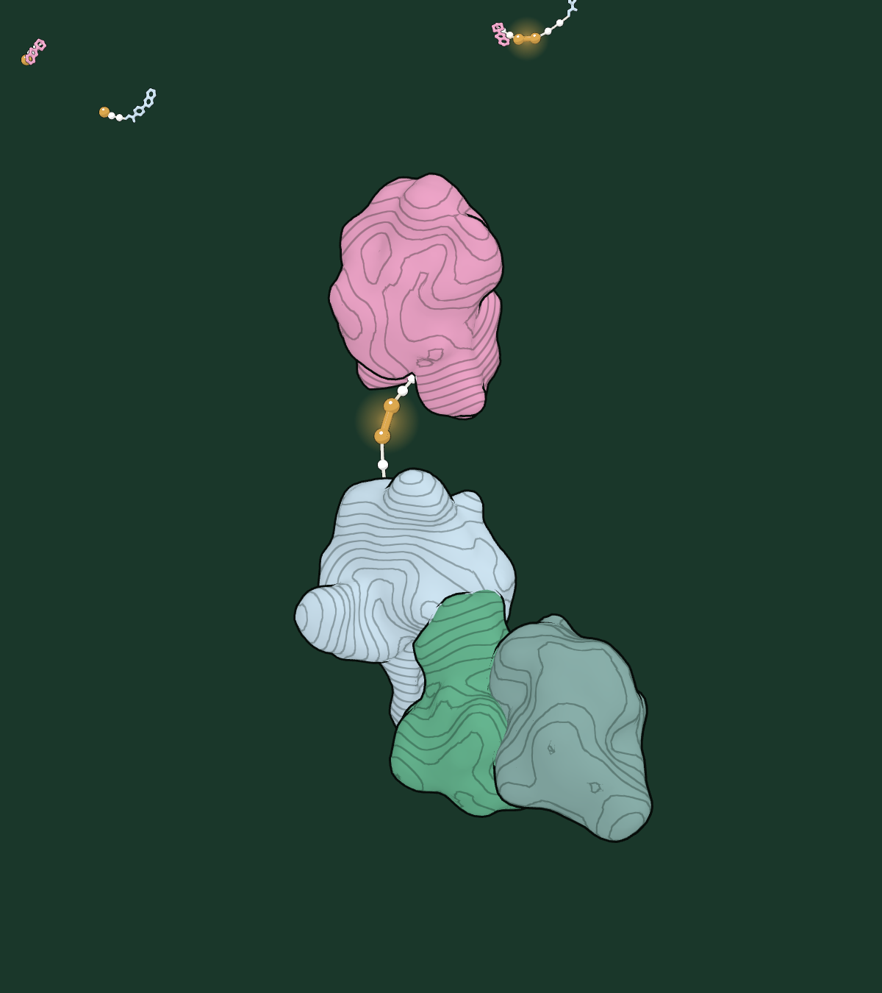
Rebuilt inside the cell
THE TERNARY COMPLEX
One molecule holds the target to the ligase
One end holds the target protein, the other an E3 ligase.
The cell tags the target with ubiquitin and the proteasome breaks it down.
The degrader is not used up: it lets go and finds the next one.
Notes:
Two Column layout: the picture sits in a rounded frame on a glass panel.

Slide 9
Protein degradation, unlocked
01
High oral bioavailability
Make oral degraders the expectation, not the exception.
02
Routine CNS penetration
Open the brain to protein degrader therapeutics.
Four things the platform changes
03
Faster discovery
Turn iterative chemistry into modular design with reusable components.
04
New technology
Integrate emerging E3 ligases as they arrive.

Slide 10
Discovery programmes
Pipeline
THERAPEUTIC AREA | TARGETS | DISCOVERY | LEAD OPTIMISATION | PRECLINICAL | CLINICAL
Oncology | Undisclosed | ● | ○ | ○ | ○
Central nervous system | Undisclosed | ● | ○ | ○ | ○
● stage reached ○ to come
Notes:
Title Only (dark) layout: a glass panel with a native table on it; gold marks the stage reached.

Slide 11
Numbers that carry the story
Illustrative figures
$60M.
2.
1.
Series A2 raised to take SELFTAC® to the clinic
small halves that cross the blood-brain barrier
degrader, reused target after target
Notes:
Title Only layout with stat cards; the gold full stop on big figures is the house touch.

Slide 12
Charts take the palette
Illustrative data
Use the theme
Kelp for the data, gold for the one thing to look at, sage for comparators.
Notes:
Illustrative values only. Charts sit on a white card on the Sea Foam ground.

Slide 13
Next steps
Title and Content layout
Confirm library activity with a clear mechanism of action
Expand the library and build structure-activity relationships
Show oral brain exposure above the free DC₅₀

Slide 14
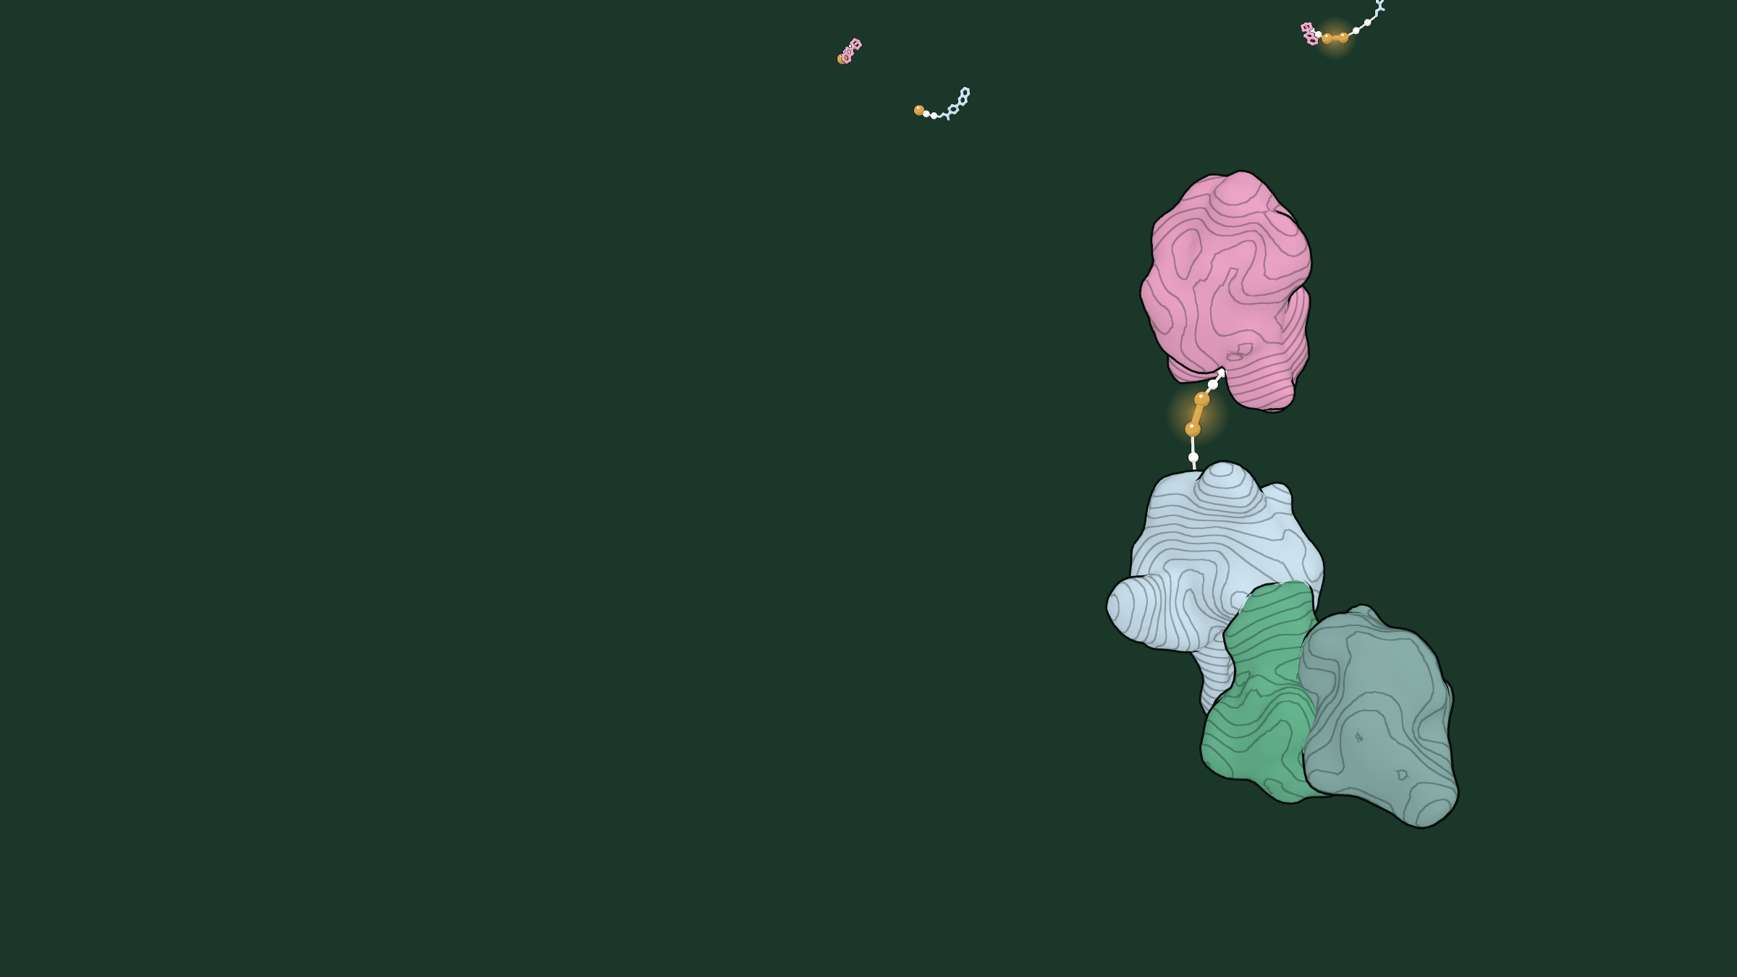
SELFTAC® · TERNARY COMPLEX
One molecule holds the target to the ligase.

Slide 15
Targeted protein degradation beyond conventional limits.
info@oystertx.com · London, United Kingdom · oyster-tx.com

