Slide 1
Targeted protein degradation beyond conventional limits
Company overview · 2026
OYSTER THERAPEUTICS · CONFIDENTIAL
Notes:
Title layout. The background is the SELFTAC ternary complex from the journey animation on the Abyss Green ground.

Slide 2
Contents:
01
The idea
02
The problem
03
Our solution: the SELFTAC® platform
04
Pipeline
05
Team
Notes:
Contents layout: number, item and dotted rule are composed on the slide (copy a row to add one). Set the current item in white.

Slide 3
The function of a full degrader. The distribution of a small molecule.
THE IDEA
SELFTAC® platform

Slide 4
The problem
02
Why first-generation protein degraders are limited.

Slide 5
Each type of degrader brings its own trade-off
First-generation degraders
Bifunctional degraders
Molecular glues
MODULAR
BULKY
DRUG-LIKE
SERENDIPITOUS
Modular components, but their large size limits oral bioavailability and penetration into tissues like the brain.
Smaller, with more favourable drug-like properties, but without the same rational, modular design approach.
Notes:
Title Only layout with two comparison cards on Sea Foam, composed on the slide.

Slide 6
Our solution: the SELFTAC® platform
03
Degraders that travel as small molecules and self-assemble where they are needed.

Slide 7
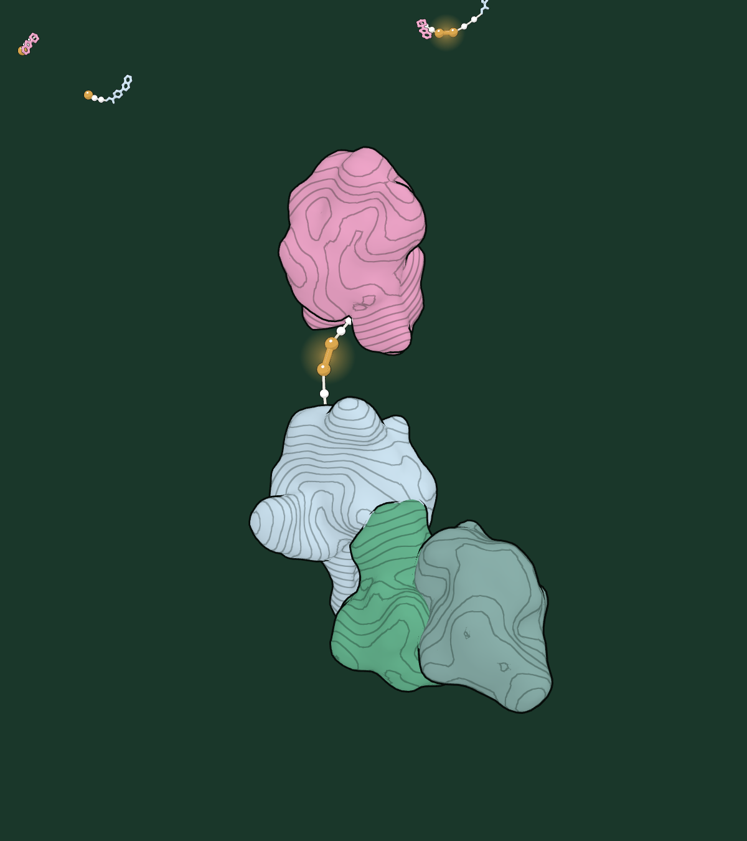
Rebuilt inside the cell
The ternary complex
One end holds the target protein, the other an E3 ligase.
The cell tags the target with ubiquitin and the proteasome breaks it down.
The degrader is not used up: it lets go and finds the next one.
Notes:
Two Column layout: a full-height picture on the right, on an Abyss Green panel.

Slide 8
Protein degradation, unlocked
01
High oral bioavailability
Make oral degraders the expectation, not the exception.
02
Routine CNS penetration
Open the brain to protein degrader therapeutics.
Four things the platform changes
03
Faster discovery
Turn iterative chemistry into modular design with reusable components.
04
New technology
Integrate emerging E3 ligases as they arrive.
Notes:
Divided layout, after the brand guide's own pages: the heading in a narrow column, a dashed rule, the content to its right.

Slide 9
Discovery programmes
Pipeline
THERAPEUTIC AREA | TARGETS | DISCOVERY | LEAD OPTIMISATION | PRECLINICAL | CLINICAL
Oncology | Undisclosed | ● | ○ | ○ | ○
Central nervous system | Undisclosed | ● | ○ | ○ | ○
● stage reached ○ to come
Notes:
Title Only (dark) layout with a native table; gold marks the stage reached.

Slide 10
Charts take the palette
Illustrative data
Use the theme
Kelp for the data, gold for the one thing to look at, sage for comparators. Text is Arial, labels Consolas.
Notes:
Illustrative values only.

Slide 11
Next steps
Title and Content layout
Confirm library activity with a clear mechanism of action
Expand the library and build structure-activity relationships
Show oral brain exposure above the free DC₅₀

Slide 12
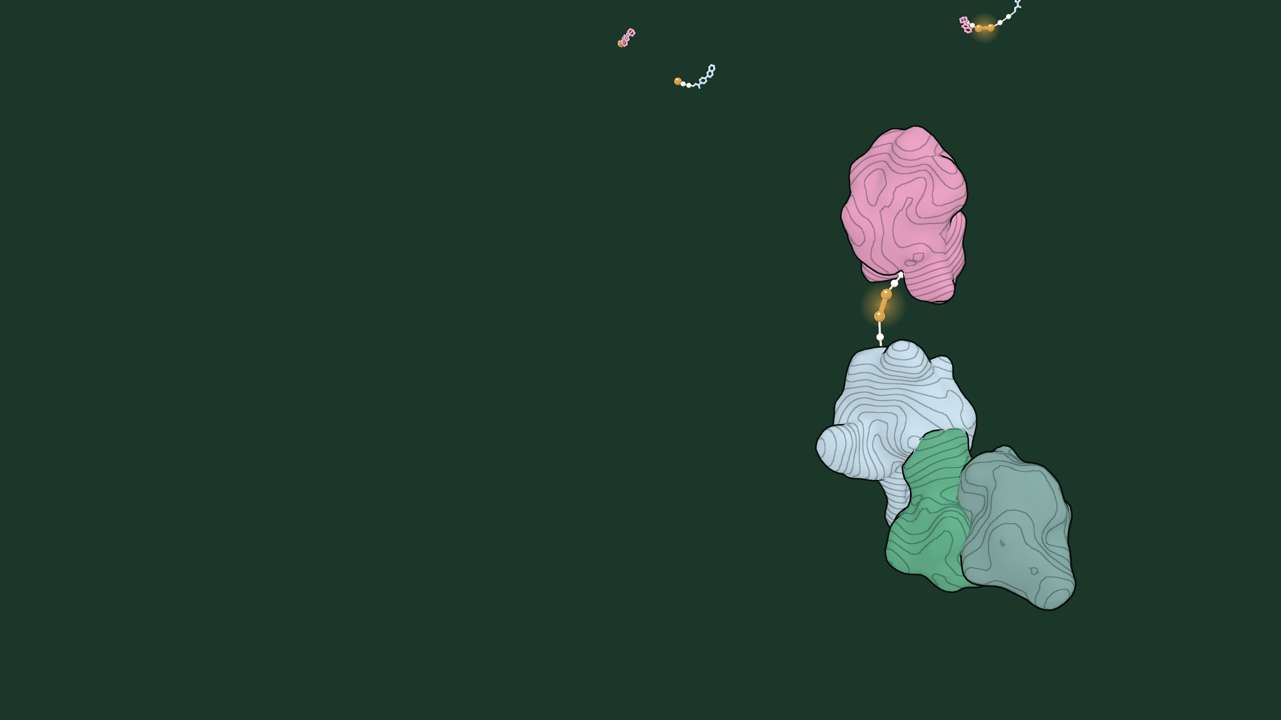
SELFTAC® · TERNARY COMPLEX
One molecule holds the target to the ligase.

Slide 13
Targeted protein degradation beyond conventional limits.
info@oystertx.com · London, United Kingdom · oyster-tx.com

