Slide 1
Targeted protein degradation
beyond conventional limits
We develop smaller protein degrader therapeutics to reach new biological targets and bigger populations. First stop: neurodegenerative disease.
COMPANY OVERVIEW · 2026
Notes:
Title layout. The second line of the title is set in the theme accent (mint) by hand, as on the website.

Slide 2
The function of a full degrader. The distribution of a small molecule.
THE IDEA
SELFTAC® platform

Slide 3
The problem
01
Why first-generation protein degraders are limited.

Slide 4
Each type of degrader brings its own trade-off
FIRST-GENERATION DEGRADERS
Bifunctional degraders
Molecular glues
MODULAR
BULKY
DRUG-LIKE
SERENDIPITOUS
Modular components, but their large size limits oral bioavailability and penetration into tissues like the brain.
Smaller, with more favourable drug-like properties, but without the same rational, modular design approach.
Notes:
Title Only (light) layout with two comparison cards composed on the slide.

Slide 5
Our solution: the SELFTAC® platform
02
Degraders that travel as small molecules and self-assemble where they are needed.

Slide 6


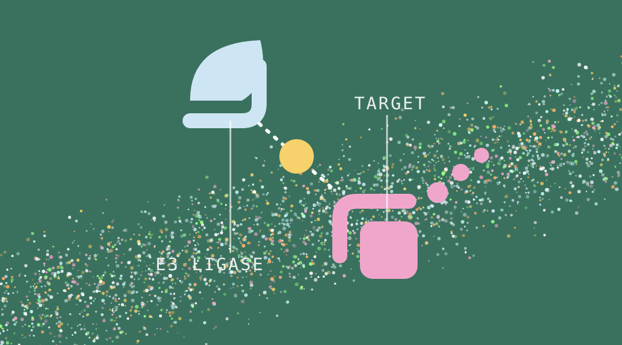
Separate, assemble, degrade
HOW IT WORKS
Separate
Assemble
Degrade
Degraders start as two small molecular components that can cross the blood-brain barrier.
The two small molecules cross the gut wall, cell membranes and the blood-brain barrier.
Once assembled, it behaves like a standard PROTAC and the cell clears the target protein.

Slide 7
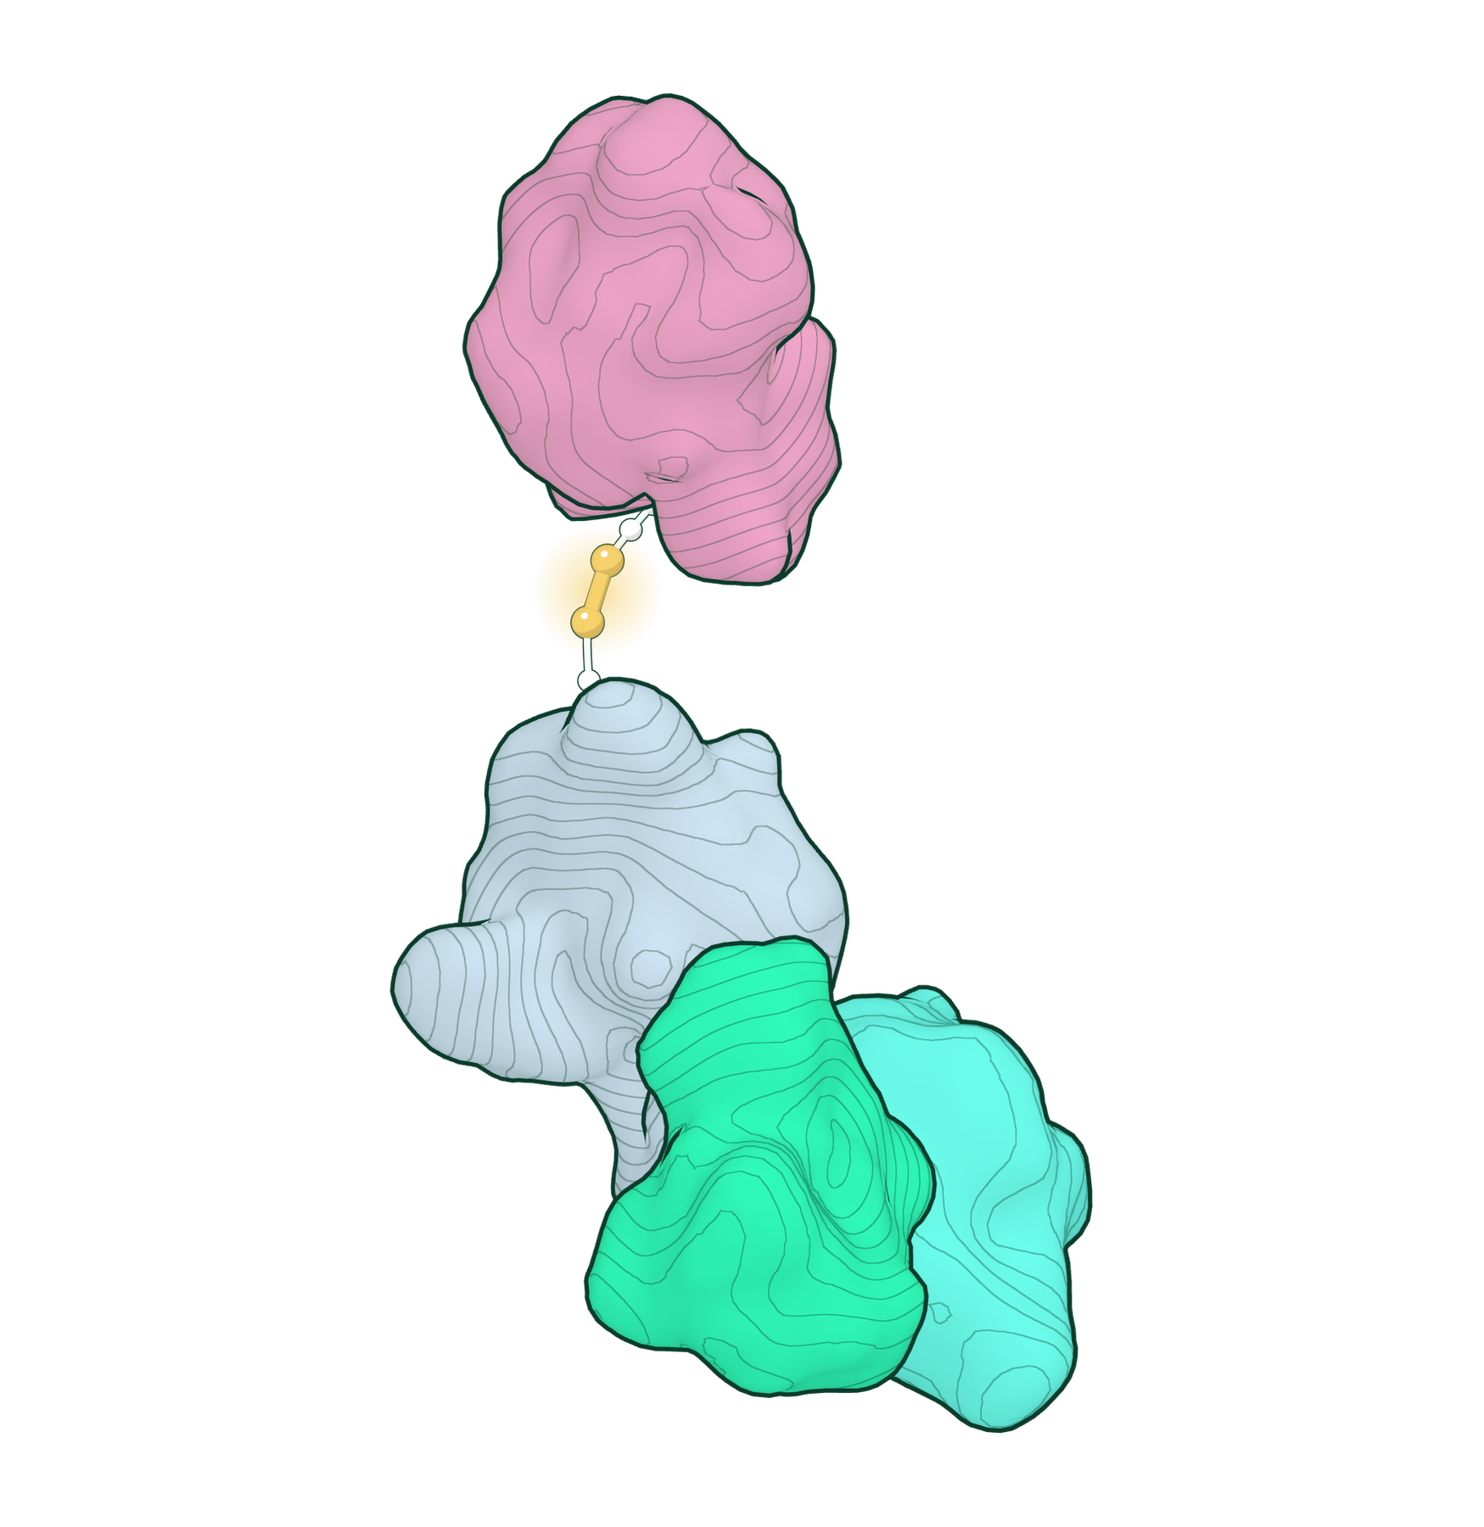
Rebuilt inside the cell
THE TERNARY COMPLEX
One end holds the target protein, the other an E3 ligase.
The cell tags the target with ubiquitin and the proteasome breaks it down.
The degrader is not used up: it lets go and finds the next one.
Notes:
Two Column layout. The picture placeholder sits on a sage panel; a transparent picture (as here) shows the panel behind it.

Slide 8
Protein degradation, unlocked
KEY FEATURES
High oral bioavailability
Routine CNS penetration
Faster discovery
New technology
Make oral degraders the expectation, not the exception.
Open the brain to protein degrader therapeutics.
Turn iterative chemistry into modular design with reusable components.
Integrate emerging E3 ligases as they arrive.

Slide 9
Discovery programmes
PIPELINE
THERAPEUTIC AREA | TARGETS | DISCOVERY | LEAD OPTIMISATION | PRECLINICAL | CLINICAL
Oncology | Undisclosed | ● | ○ | ○ | ○
Central nervous system | Undisclosed | ● | ○ | ○ | ○
● stage reached ○ to come
Notes:
Title Only (dark) layout with a native table; pearls mark the stage reached, gold for the current stage.

Slide 10
Team
03
Medicinal chemists and company builders with a record of turning science into medicines.

Slide 11
The people behind the platform
LEADERSHIP
RJ
Robert Johnson
HF
Harry Finch, PhD
CHIEF EXECUTIVE OFFICER
FOUNDER & CHIEF SCIENTIFIC OFFICER
Previously CEO of Adrestia Therapeutics, acquired by Insmed in 2023.
Medicinal chemist whose research founded the SELFTAC® platform.
Notes:
Replace the monograms with photos cropped to a circle (Picture Format > Crop to Shape > Oval) if you have them.

Slide 12

SELFTAC® · TERNARY COMPLEX
One molecule holds the target to the ligase.
Notes:
Image layout: a full-bleed picture with a caption panel over its lower left.

Slide 13
Targeted protein degradation beyond conventional limits.
info@oystertx.com · London, United Kingdom · oyster-tx.com

