Slide 1






ORAL DOSING
01 ORAL DOSING
Taken by mouth, as a pill.
SELFTAC® degraders are designed to be small enough to be swallowed, not injected.
ORAL
GUT
BARRIER
COMPLEX
DEGRADED
Notes:
Keyframe 1 of 25 (journey progress 0). Taken by mouth, as a pill. SELFTAC® degraders are designed to be small enough to be swallowed, not injected.

Slide 2
ORAL DOSING
01 ORAL DOSING
Taken by mouth, as a pill.
SELFTAC® degraders are designed to be small enough to be swallowed, not injected.
ORAL
GUT
BARRIER
COMPLEX
DEGRADED
Notes:
Keyframe 2 of 25 (journey progress 0.05). Taken by mouth, as a pill. SELFTAC® degraders are designed to be small enough to be swallowed, not injected.

Slide 3

ORAL DOSING
01 ORAL DOSING
Taken by mouth, as a pill.
SELFTAC® degraders are designed to be small enough to be swallowed, not injected.
ORAL
GUT
BARRIER
COMPLEX
DEGRADED
Notes:
Keyframe 3 of 25 (journey progress 0.09). Taken by mouth, as a pill. SELFTAC® degraders are designed to be small enough to be swallowed, not injected.

Slide 4
ORAL DOSING
01 ORAL DOSING
Taken by mouth, as a pill.
SELFTAC® degraders are designed to be small enough to be swallowed, not injected.
ORAL
GUT
BARRIER
COMPLEX
DEGRADED
Notes:
Keyframe 4 of 25 (journey progress 0.115). Taken by mouth, as a pill. SELFTAC® degraders are designed to be small enough to be swallowed, not injected.

Slide 5
01 ORAL DOSING
Taken by mouth, as a pill.
SELFTAC® degraders are designed to be small enough to be swallowed, not injected.
ORAL
GUT
BARRIER
COMPLEX
DEGRADED
Notes:
Keyframe 5 of 25 (journey progress 0.135). Taken by mouth, as a pill. SELFTAC® degraders are designed to be small enough to be swallowed, not injected.

Slide 6

01 ORAL DOSING
Taken by mouth, as a pill.
SELFTAC® degraders are designed to be small enough to be swallowed, not injected.
ORAL
GUT
BARRIER
COMPLEX
DEGRADED
Notes:
Keyframe 6 of 25 (journey progress 0.152). Taken by mouth, as a pill. SELFTAC® degraders are designed to be small enough to be swallowed, not injected.

Slide 7
ORAL
GUT
BARRIER
COMPLEX
DEGRADED
Notes:
Keyframe 7 of 25 (journey progress 0.163).

Slide 8
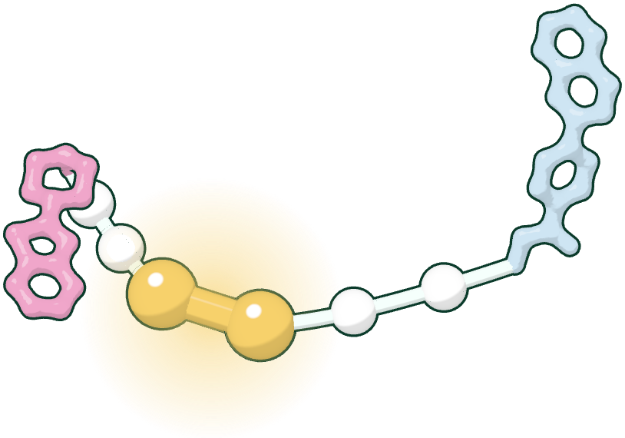
IN THE GUT
02 IN THE GUT
The dimer comes apart into two monomers.
In the gut, each SELFTAC® dimer dissociates at its reversible linker into two small monomers, which are absorbed.
ORAL
GUT
BARRIER
COMPLEX
DEGRADED
Notes:
Keyframe 8 of 25 (journey progress 0.215). The dimer comes apart into two monomers. In the gut, each SELFTAC® dimer dissociates at its reversible linker into two small monomers, which are absorbed.

Slide 9
IN THE GUT
02 IN THE GUT
The dimer comes apart into two monomers.
In the gut, each SELFTAC® dimer dissociates at its reversible linker into two small monomers, which are absorbed.
DIMER
ORAL
GUT
BARRIER
COMPLEX
DEGRADED
Notes:
Keyframe 9 of 25 (journey progress 0.255). The dimer comes apart into two monomers. In the gut, each SELFTAC® dimer dissociates at its reversible linker into two small monomers, which are absorbed.

Slide 10

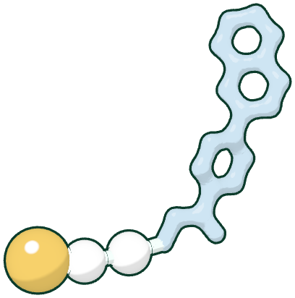

IN THE GUT
02 IN THE GUT
The dimer comes apart into two monomers.
+
In the gut, each SELFTAC® dimer dissociates at its reversible linker into two small monomers, which are absorbed.
ORAL
GUT
BARRIER
COMPLEX
DEGRADED
Notes:
Keyframe 10 of 25 (journey progress 0.296). The dimer comes apart into two monomers. In the gut, each SELFTAC® dimer dissociates at its reversible linker into two small monomers, which are absorbed.

Slide 11
IN THE GUT
02 IN THE GUT
The dimer comes apart into two monomers.
+
In the gut, each SELFTAC® dimer dissociates at its reversible linker into two small monomers, which are absorbed.
MONOMERS
ORAL
GUT
BARRIER
COMPLEX
DEGRADED
Notes:
Keyframe 11 of 25 (journey progress 0.315). The dimer comes apart into two monomers. In the gut, each SELFTAC® dimer dissociates at its reversible linker into two small monomers, which are absorbed.

Slide 12


02 IN THE GUT
The dimer comes apart into two monomers.
+
In the gut, each SELFTAC® dimer dissociates at its reversible linker into two small monomers, which are absorbed.
MONOMERS
ORAL
GUT
BARRIER
COMPLEX
DEGRADED
Notes:
Keyframe 12 of 25 (journey progress 0.36). The dimer comes apart into two monomers. In the gut, each SELFTAC® dimer dissociates at its reversible linker into two small monomers, which are absorbed.

Slide 13
+
MONOMERS
ORAL
GUT
BARRIER
COMPLEX
DEGRADED
Notes:
Keyframe 13 of 25 (journey progress 0.42).

Slide 14

03 THE BARRIER
Small enough to cross into the cell.
+
As monomers, each half crosses the cell membrane, and the blood-brain barrier into the brain.
CELL MEMBRANE · BLOOD-BRAIN BARRIER
ORAL
GUT
BARRIER
COMPLEX
DEGRADED
Notes:
Keyframe 14 of 25 (journey progress 0.5). Small enough to cross into the cell. As monomers, each half crosses the cell membrane, and the blood-brain barrier into the brain.

Slide 15

TARGET CELL
03 THE BARRIER
Small enough to cross into the cell.
+
As monomers, each half crosses the cell membrane, and the blood-brain barrier into the brain.
CELL MEMBRANE · BLOOD-BRAIN BARRIER
ORAL
GUT
BARRIER
COMPLEX
DEGRADED
Notes:
Keyframe 15 of 25 (journey progress 0.56). Small enough to cross into the cell. As monomers, each half crosses the cell membrane, and the blood-brain barrier into the brain.

Slide 16
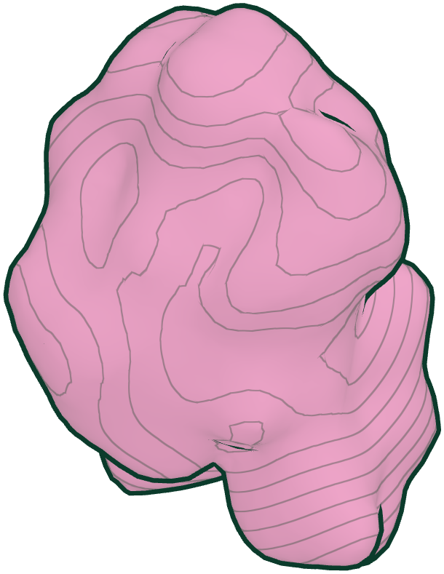
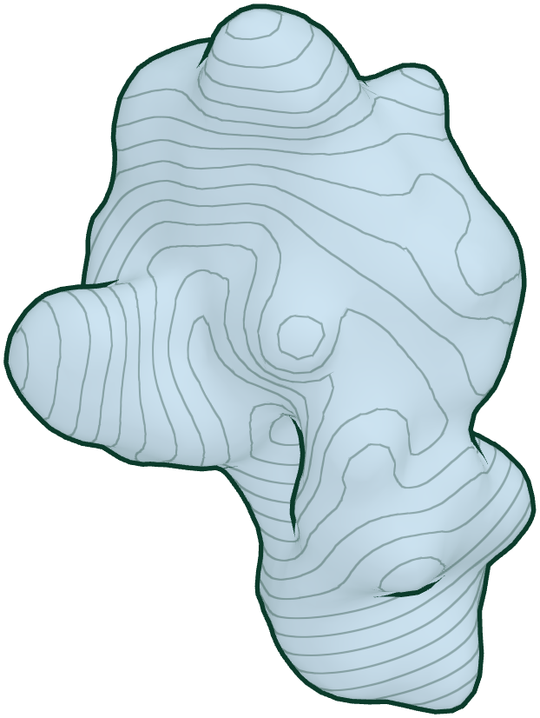
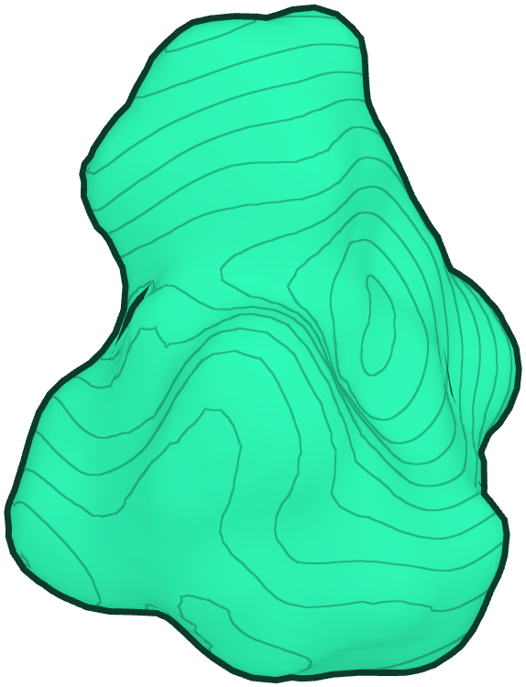
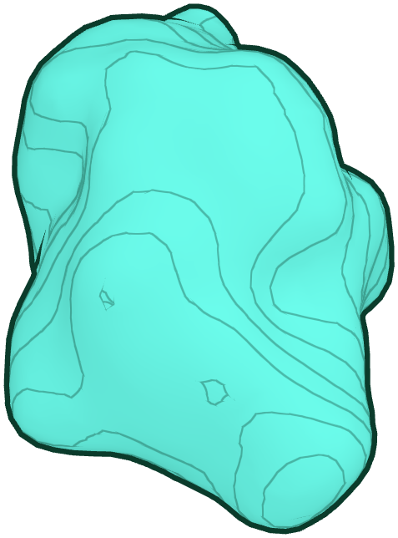
04 TERNARY COMPLEX
Inside the cell, the halves clasp back together.
+
One end holds the target protein, the other an E3 ligase: a ternary complex.
ORAL
GUT
BARRIER
COMPLEX
DEGRADED
Notes:
Keyframe 16 of 25 (journey progress 0.62). Inside the cell, the halves clasp back together. One end holds the target protein, the other an E3 ligase: a ternary complex.

Slide 17
TARGET PROTEIN
04 TERNARY COMPLEX
Inside the cell, the halves clasp back together.
One end holds the target protein, the other an E3 ligase: a ternary complex.
E3 LIGASE
ORAL
GUT
BARRIER
COMPLEX
DEGRADED
Notes:
Keyframe 17 of 25 (journey progress 0.655). Inside the cell, the halves clasp back together. One end holds the target protein, the other an E3 ligase: a ternary complex.

Slide 18
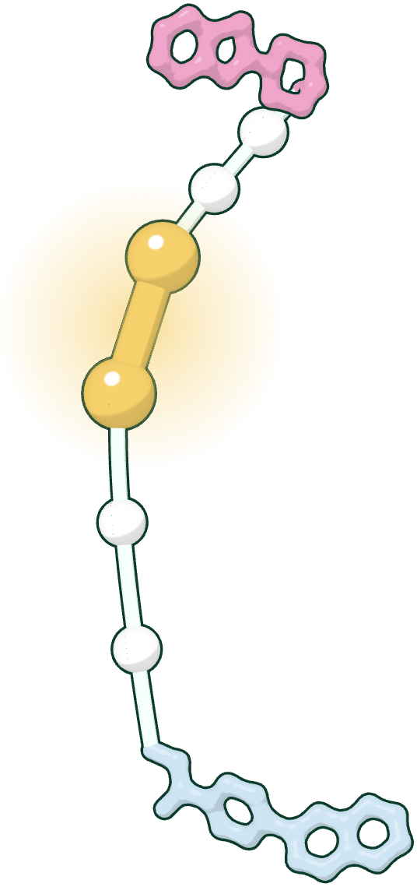
TARGET PROTEIN
04 TERNARY COMPLEX
Inside the cell, the halves clasp back together.
One end holds the target protein, the other an E3 ligase: a ternary complex.
E3 LIGASE
ORAL
GUT
BARRIER
COMPLEX
DEGRADED
Notes:
Keyframe 18 of 25 (journey progress 0.68). Inside the cell, the halves clasp back together. One end holds the target protein, the other an E3 ligase: a ternary complex.

Slide 19
TARGET PROTEIN
04 TERNARY COMPLEX
Inside the cell, the halves clasp back together.
One end holds the target protein, the other an E3 ligase: a ternary complex.
E3 LIGASE
TERNARY COMPLEX
ORAL
GUT
BARRIER
COMPLEX
DEGRADED
Notes:
Keyframe 19 of 25 (journey progress 0.74). Inside the cell, the halves clasp back together. One end holds the target protein, the other an E3 ligase: a ternary complex.

Slide 20
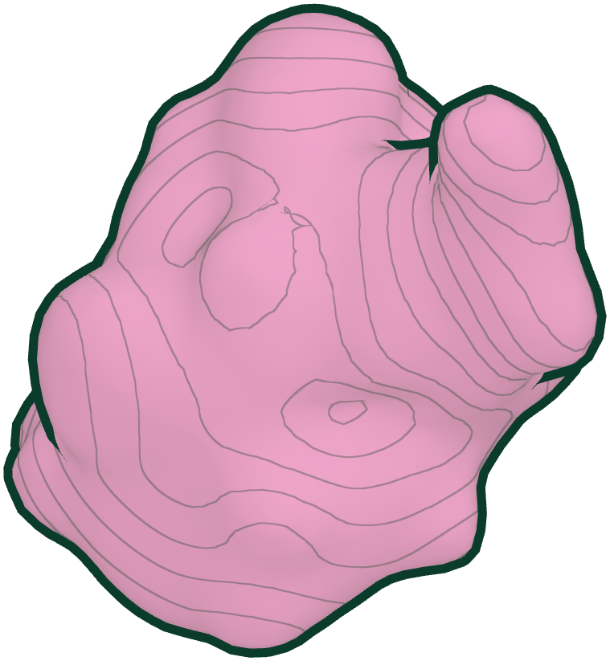
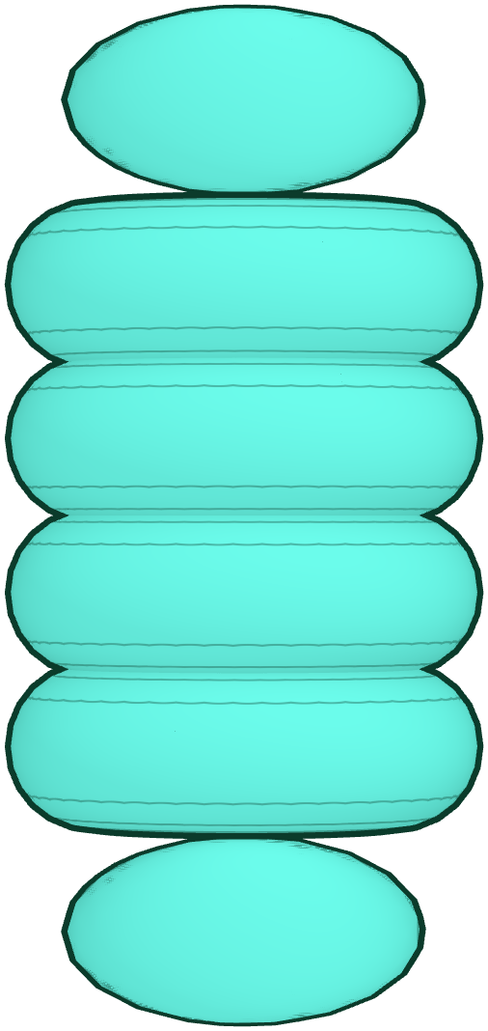
TARGET PROTEIN
05 DEGRADATION
Tagged, then broken down.
Ubiquitin marks the target and the proteasome destroys it. The degrader is free to find the next one.
E3 LIGASE
TERNARY COMPLEX
ORAL
GUT
BARRIER
COMPLEX
DEGRADED
Notes:
Keyframe 20 of 25 (journey progress 0.815). Tagged, then broken down. Ubiquitin marks the target and the proteasome destroys it. The degrader is free to find the next one.

Slide 21
PROTEASOME
05 DEGRADATION
Tagged, then broken down.
Ubiquitin marks the target and the proteasome destroys it. The degrader is free to find the next one.
ORAL
GUT
BARRIER
COMPLEX
DEGRADED
Notes:
Keyframe 21 of 25 (journey progress 0.86). Tagged, then broken down. Ubiquitin marks the target and the proteasome destroys it. The degrader is free to find the next one.

Slide 22
PROTEASOME
05 DEGRADATION
Tagged, then broken down.
Ubiquitin marks the target and the proteasome destroys it. The degrader is free to find the next one.
ORAL
GUT
BARRIER
COMPLEX
DEGRADED
Notes:
Keyframe 22 of 25 (journey progress 0.895). Tagged, then broken down. Ubiquitin marks the target and the proteasome destroys it. The degrader is free to find the next one.

Slide 23



PROTEASOME
05 DEGRADATION
Tagged, then broken down.
Ubiquitin marks the target and the proteasome destroys it. The degrader is free to find the next one.
DEGRADATION
ORAL
GUT
BARRIER
COMPLEX
DEGRADED
Notes:
Keyframe 23 of 25 (journey progress 0.93). Tagged, then broken down. Ubiquitin marks the target and the proteasome destroys it. The degrader is free to find the next one.

Slide 24
05 DEGRADATION
PROTEASOME
Tagged, then broken down.
Ubiquitin marks the target and the proteasome destroys it. The degrader is free to find the next one.
DEGRADATION
ORAL
GUT
BARRIER
COMPLEX
DEGRADED
Notes:
Keyframe 24 of 25 (journey progress 0.965). Tagged, then broken down. Ubiquitin marks the target and the proteasome destroys it. The degrader is free to find the next one.

Slide 25

Targeted protein degradation beyond conventional limits.
Watch again
BRD4, VHL and Elongin B and C from PDB 5T35 (Gadd et al., Nat. Chem. Biol. 2017), ubiquitin from PDB 1UBQ. The degrader is generic and stands in for a SELFTAC® compound; the proteasome is a stand-in, and the person, gut and membrane are illustrations.
Notes:
Keyframe 25 of 25 (journey progress 0.997).

