Slide 1




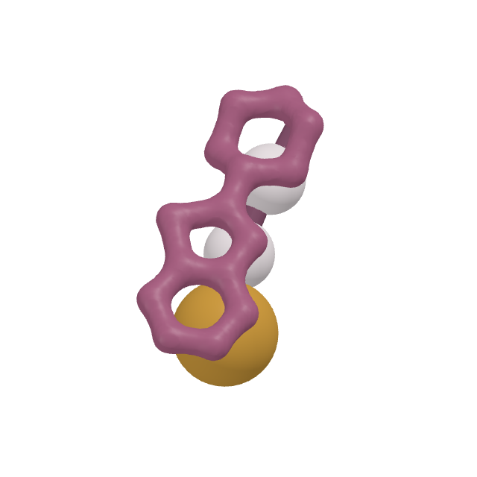
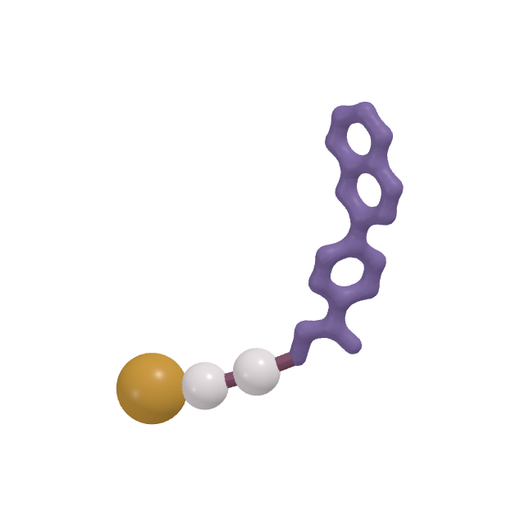
SELFTAC®, in motion
Notes:
SELFTAC: protein degraders, made small enough to reach the brain. Click to start the story; each click morphs to the next beat.

Slide 2
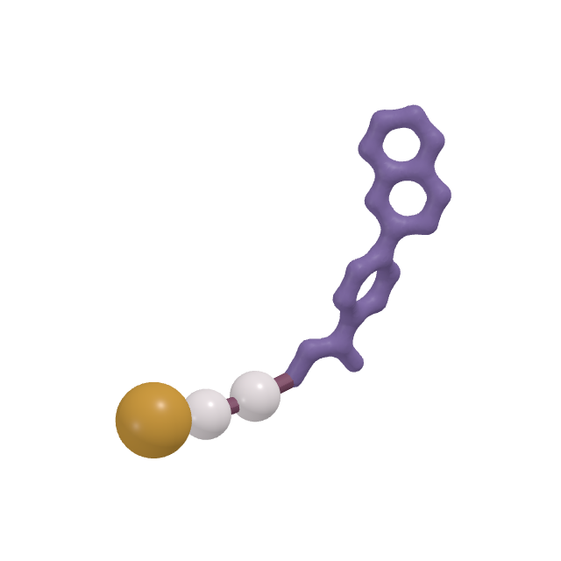

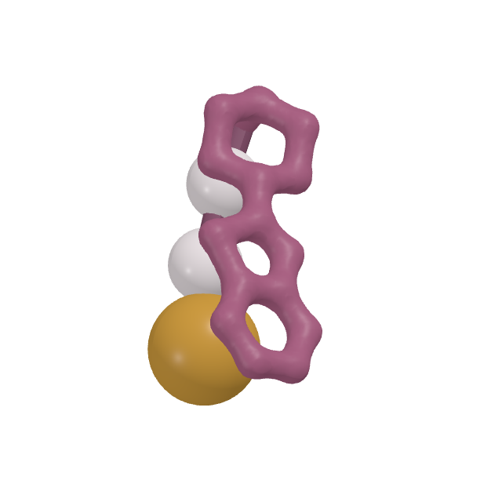
01 · THE SIZE PROBLEM
Protein degraders, made small enough to reach the brain
Degraders remove disease-causing proteins instead of blocking them. Most are too large to be taken by mouth or to enter the brain.
DEGRADER
SPLIT
BARRIER
REBUILT
CLEARED
AGAIN
Notes:
A degrader has two ends: one holds the disease protein, the other recruits the cell’s disposal machinery. Joined by a linker, they are usually too big for oral dosing or the brain. The gold clasp in the middle is the SELFTAC difference.

Slide 3
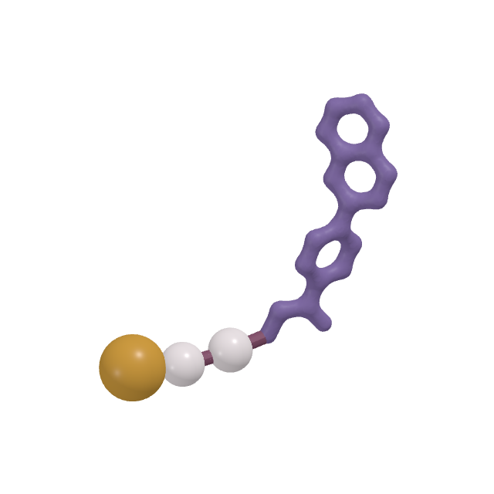
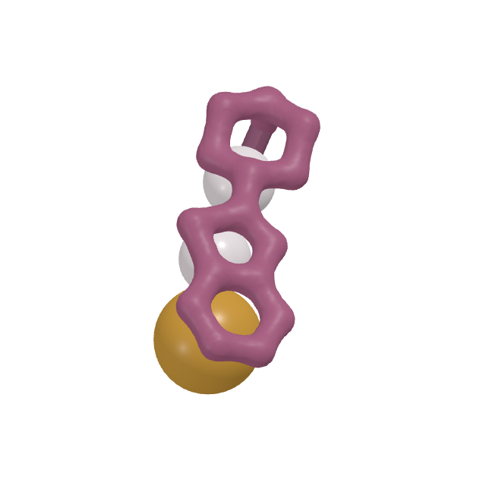
02 · SPLIT
One degrader, two small halves
A reversible linker lets a SELFTAC® molecule travel as two small molecules.
DEGRADER
SPLIT
BARRIER
REBUILT
CLEARED
AGAIN
Notes:
SELFTAC opens at the clasp, a reversible bond, so the drug travels as two small halves.

Slide 4

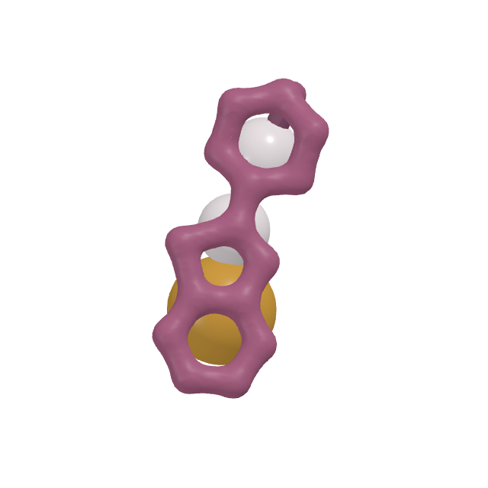
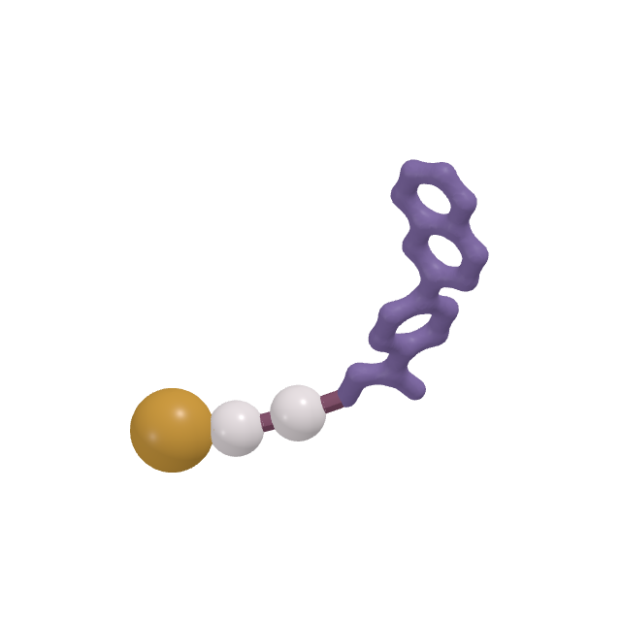
03 · THE BARRIER
Through the cells, not between them
Tight junctions seal the brain’s capillaries. Each half is small enough to pass through the endothelial cells themselves.
DEGRADER
SPLIT
BARRIER
REBUILT
CLEARED
AGAIN
Notes:
The blood-brain barrier is sealed by tight junctions, so a drug must pass through the cells themselves. Small molecules can.

Slide 5



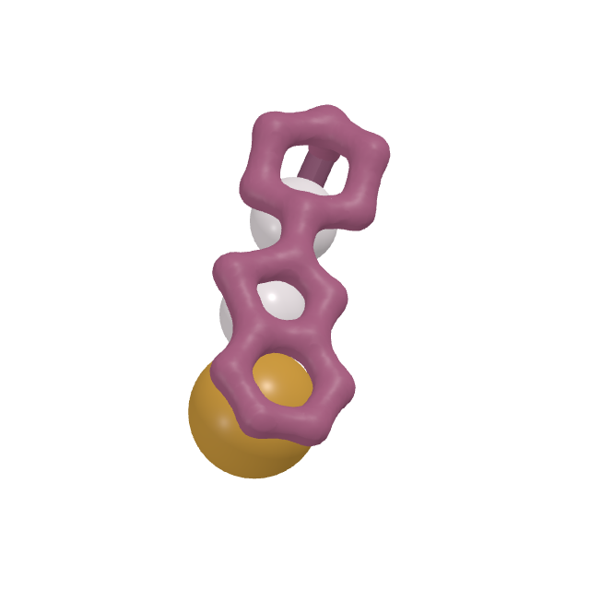
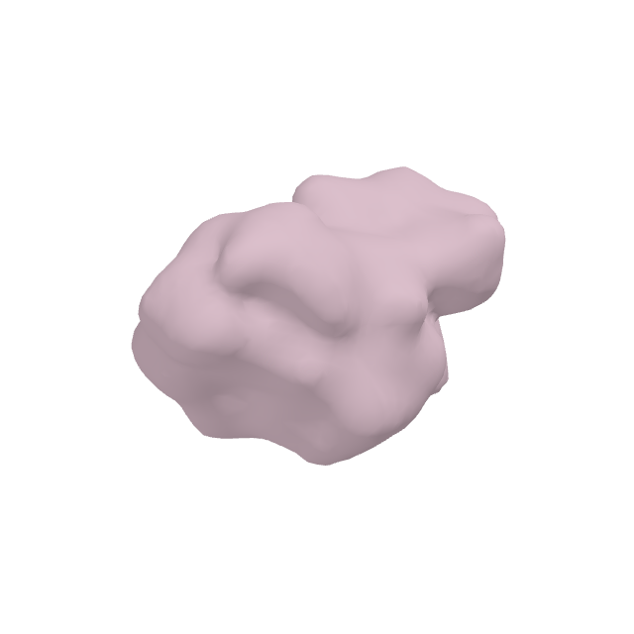
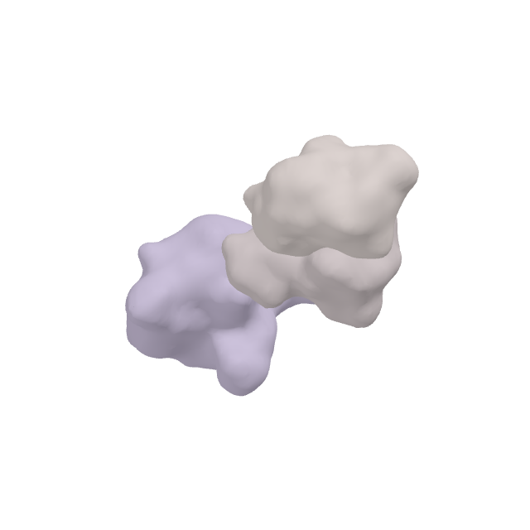
04 · REBUILT
Inside the neuron, the halves click back together
One end holds the target protein, the other an E3 ligase. The clasp closes between them.
DEGRADER
SPLIT
BARRIER
REBUILT
CLEARED
AGAIN
Notes:
Inside the neuron the two halves find each other and the clasp closes, rebuilding the full degrader: one end on the target (BRD4 here), the other on the E3 ligase (VHL).

Slide 6
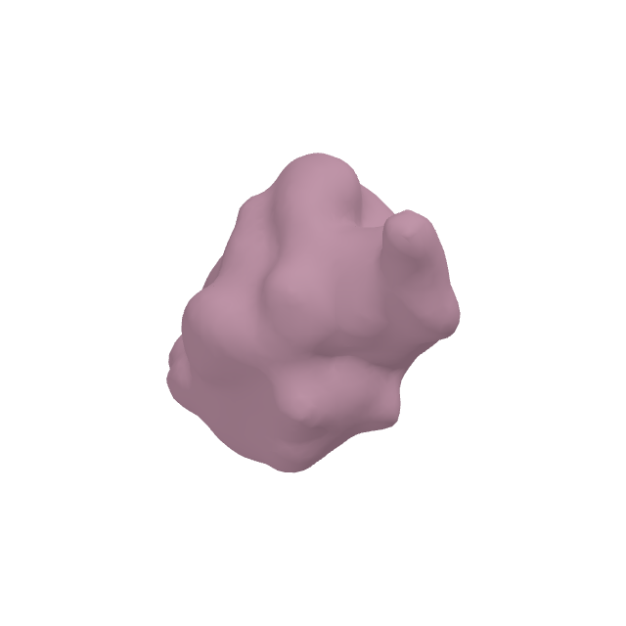


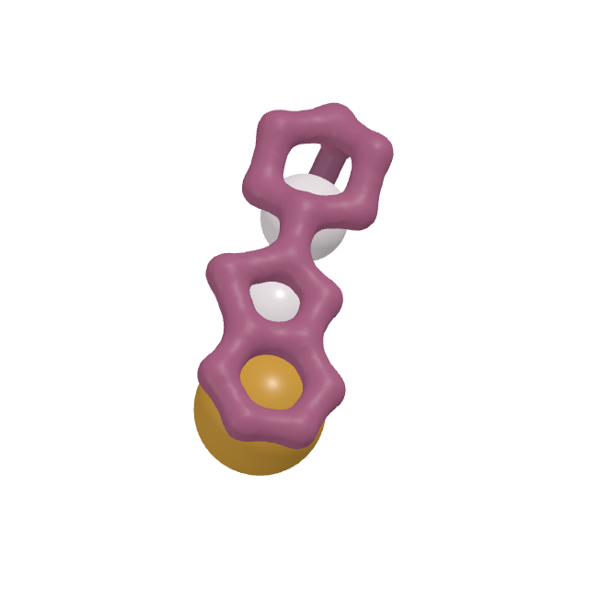
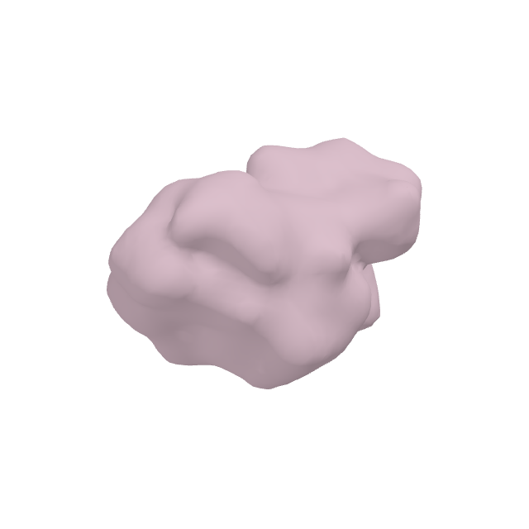
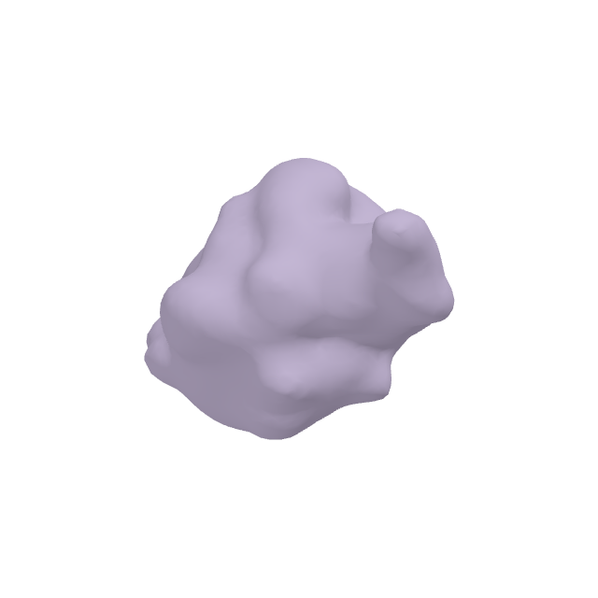
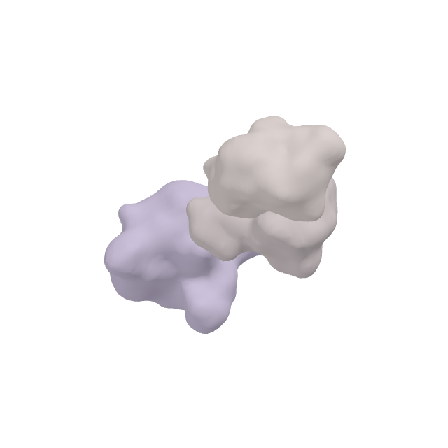
05 · CLEARED
Tagged, then destroyed
An E2 enzyme docks on the ligase and hands ubiquitin, one unit at a time, onto the target.
DEGRADER
SPLIT
BARRIER
REBUILT
CLEARED
AGAIN
Notes:
The ligase brings in an E2 enzyme, which hands ubiquitin onto the face of the target turned towards it, one unit at a time.

Slide 7
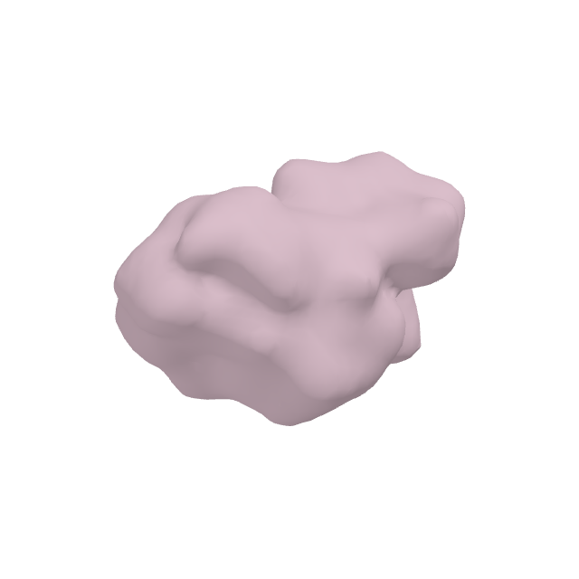

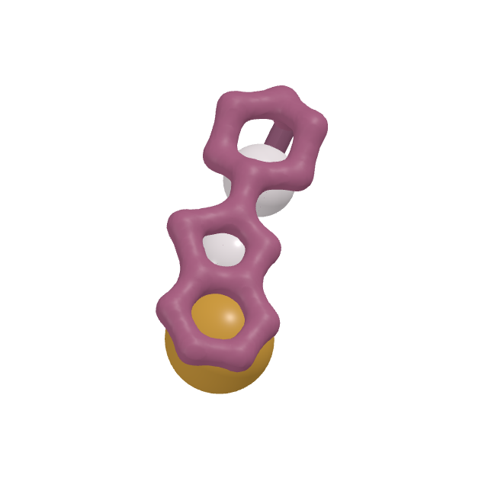
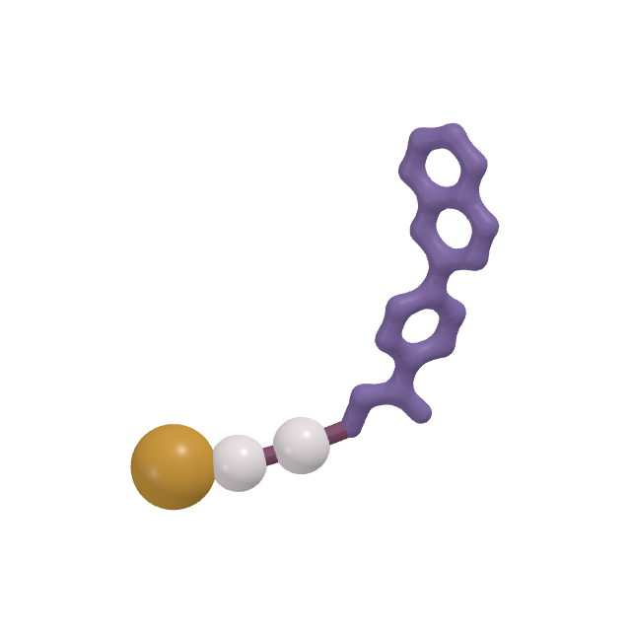
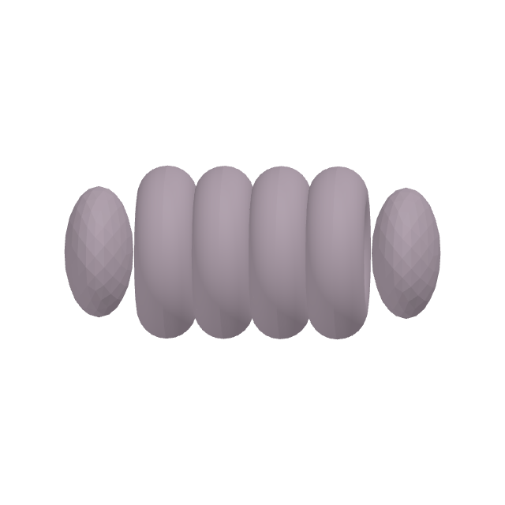
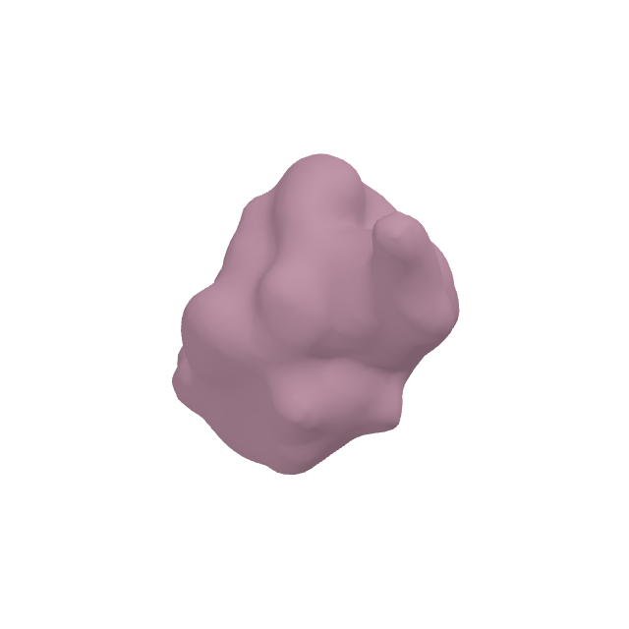

05 · CLEARED
The proteasome breaks the target down
It reads the ubiquitin chain, draws the target in and recycles it.
DEGRADER
SPLIT
BARRIER
REBUILT
CLEARED
AGAIN
Notes:
The proteasome reads the ubiquitin chain and breaks the target down.

Slide 8



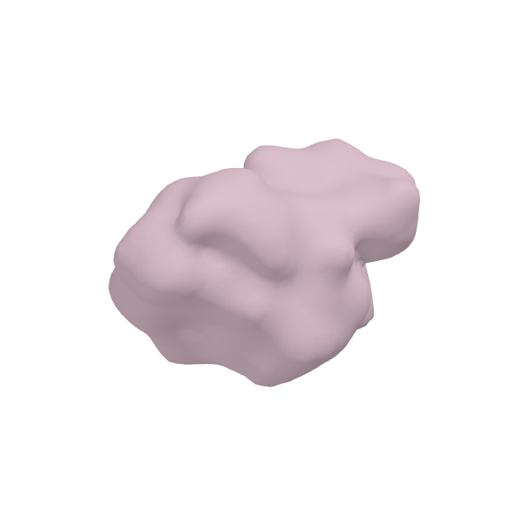

06 · AGAIN
Then it does it again
The degrader is not used up. It lets go and catches the next one, so one molecule can clear many.
DEGRADER
SPLIT
BARRIER
REBUILT
CLEARED
AGAIN
Notes:
The degrader is not used up. It lets go and catches the next target: one molecule clears many.

Slide 9
Oral, brain-penetrant protein degraders
Notes:
Oyster Therapeutics: oral, brain-penetrant protein degraders.

