Slide 1
Task 1

Slide 2
Synthetic Data Generation
Mythical plants
Name (Str)
Height
Min (Int)
Max (Int)
Colours (Array)
Shape (Str)
Flowering (Bool)
Climate (Str)
Plants are defined in plants.json
Must adhere to the schema in plantSchema.json
Allows for any number of new plants to be defined
Additional features could be added to the schema
Easily expandable and modular
Code reads in schema and plant list and generates a user defined number of plants for each type.
Command line arguments allow for the user to specify how many examples for the train test and validation sets, how many decimal places are wanted in the generated heights, and if they want the data to be pre-processed ready for machine learning.

Slide 3
Models
Model | Hidden Size | Activation | Criterion | Optimiser
1 | 100 | Sigmoid | Cross Entropy Loss | SGD
2 | 10 | Sigmoid | Cross Entropy Loss | SGD
3 | 100 | ReLU | Cross Entropy Loss | SGD
4 | 10 | ReLU | Cross Entropy Loss | SGD
Generic Neural Network class in Pytorch
Allows for full customisation of :
Layer Size
Activation Function
Criterion Function
Optimiser
Name for model to be saved under
Outputs trained model for later use
Experiment:
How Hidden Size and Activation affects accuracy

Slide 4

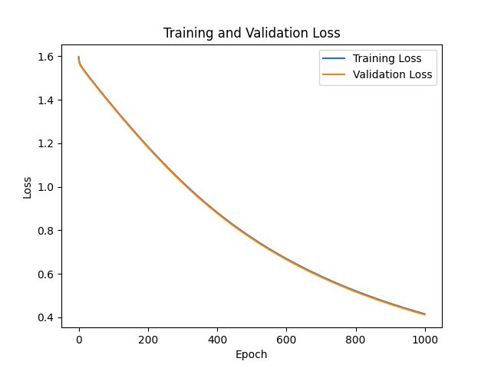
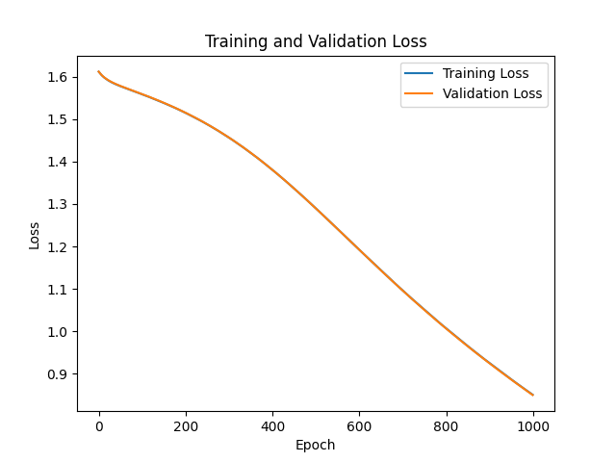
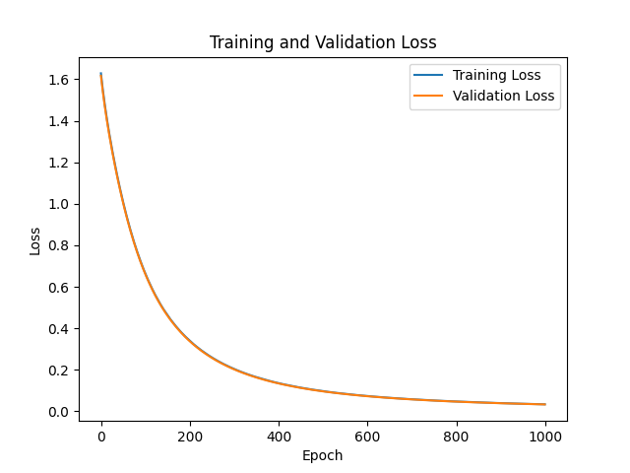
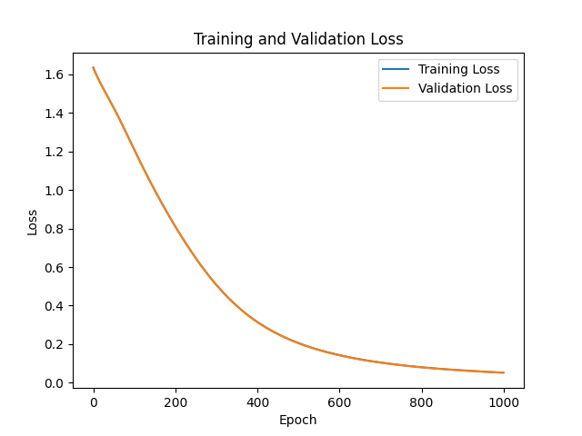
Training
1
2
1
Hidden : 100
Activation : Sigmoid
100% on test set
2
Hidden : 10
Activation : Sigmoid
89.25% on test set
3
Hidden : 100
Activation : ReLU
100% on test set
4
Hidden : 10
Activation : ReLU
100% on test set
3
4

Slide 5
Conclusion
Sigmoid based models fell short
One having 89.25% accuracy on the test set
Having 100 Hidden Layers is better
Models converged faster with the same learning rate
Datasets too easy to predict
Train and Validation Loss was too similar
100% on test set from 3 of the models
Given customisability of generator, numbers could be tweaked to make the flowers harder to separate

