Slide 1
Task 3

Slide 2
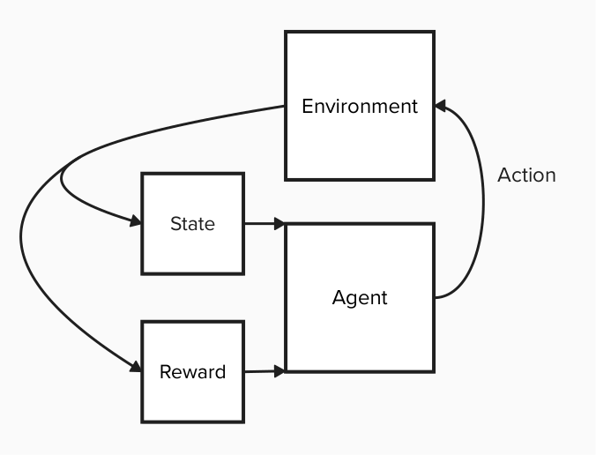
DQN
Supervised Learning Algorithm
Agent tries to get the highest cumulative reward
Takes actions based on Q-values
Expected cumulative reward (looks into future)
Q-values are calculated by the neural network acting as a function approximator
Q-values calculated for each state-action pair
Uses Epsilon greedy exploration
Likelihood decays with time
Neural network is updated based on the rewards from the agent
Randomly sampled from a replay memory
To update the policy network
Notes:
Model based on thesis code and the pytorch wiki

Slide 3
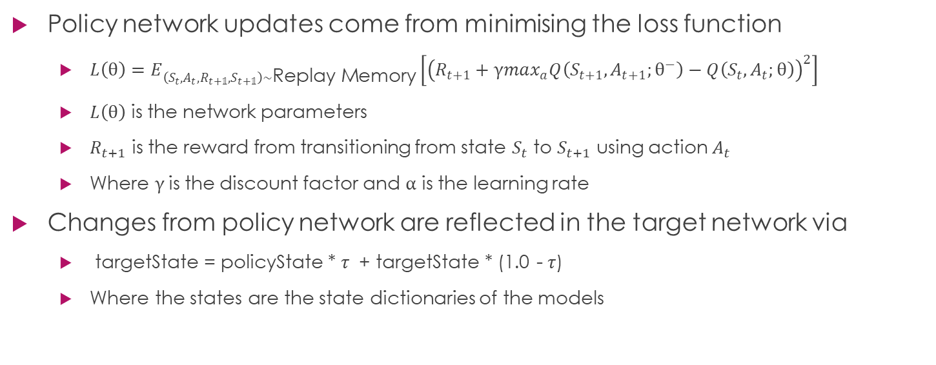
Network Updates
Policy network updates come from minimising the loss function
$L\left(θ\right)=E_{\left(S_{t},A_{t},R_{t+𝟙},S_{t+𝟙}\right)∼\text{Replay} \text{Memory}}\left[{\left(R_{t+1}+γmax_{a}Q\left(S_{t+1},A_{t+1};θ^{−}\right)−Q\left(S_{t},A_{t};θ\right)\right)}^{2}\right]$
$L\left(θ\right)$ is the network parameters
$R_{t+1}$ is the reward from transitioning from state $S_{t}$ to $S_{t+1}$ using action $A_{t}$
Where $γ$is the discount factor and $α$ is the learning rate
Changes from policy network are reflected in the target network via
targetState = policyState * $τ$ + targetState * (1.0 - $τ$)
Where the states are the state dictionaries of the models

Slide 4
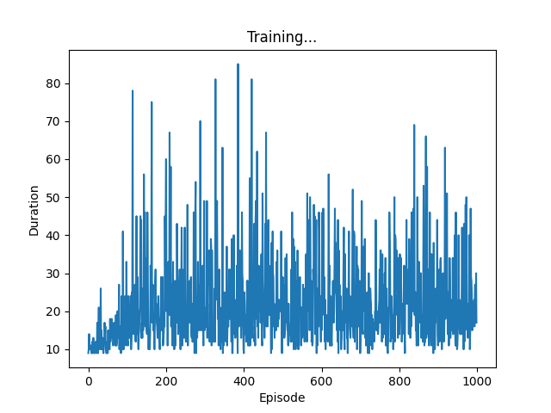
Training
Run with parameters
Batch Size : 128
Replay Memory Size : 1000
Episodes : 1000
Gamma : 0.99
Learning Rate : 0.0001
Epsilon Start : 0.9
Epsilon End : 0.01
Epsilon Decay : 1000
Hidden Layer Size : 64
Notes:
By changing
env = gym.make('CartPole-v1’) to env = gym.make('CartPole-v1', render_mode="human")
the model can be watched while training

Slide 5
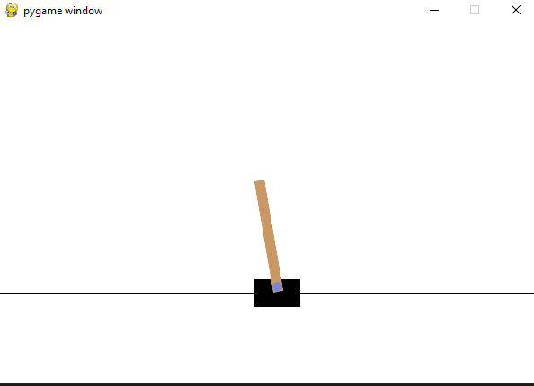
Outputs
Model “cartPole.pth” is saved to be reloaded
This is the model after all the training not the best run
Best run could be saved by only saving when a model reaches best performance or by using checkpoints
Using savedModelDemo.py the model can be displayed
Prints the best score out that the model achieved in its run
85 from the training conducted with previous parameters

Slide 6
Conclusion
Highest duration is rather low
Indicates further parameter tuning is needed
Would suggest changing:
Replay memory
Learning rate
Epsilon decay
Hidden layers

