Slide 1
Fine-Grained Emotion Classification
Using TF-IDF, BiLSTM, and RoBERTa on the GoEmotions Dataset
Oliver Wakeford Ahzam Afaq Hamza Tarazi
Hands-on NLP Course Project
February 13, 2026
Fine-Grained Emotion Classification

Slide 2
Why Fine-Grained Emotions?
Beyond Positive vs. Negative
Traditional Sentiment Analysis
Binary
Positive Negative
Mood Mood
Example: ”I can’t believe you did that”
Context A: Anger (betrayal)
Context B: Admiration (impressive feat) Context C: Amusement (funny mistake)
Fine-Grained Analysis
27 Emotions + Neutral
Admiration, Amusement, Anger, Confusion, Gratitude, Grief...
Applications: Empathetic Chatbots · Mental Health Monitoring · Customer Feedback
Fine-Grained Emotion Classification

Slide 3
The GoEmotions Dataset
Demszky et al. (2020)
Source: 54,263 Reddit comments
Taxonomy: 27 emotions + Neutral (28 classes)
Annotation:
Min. 3 raters per example
94% agreement on at least one label
Multi-label Task: 16.4% of samples have 2+ labels
Example: "Wow, I had no idea you built that all by yourself! It looks incredible."
Labels: Surprise + Admiration
Fine-Grained Emotion Classification

Slide 4
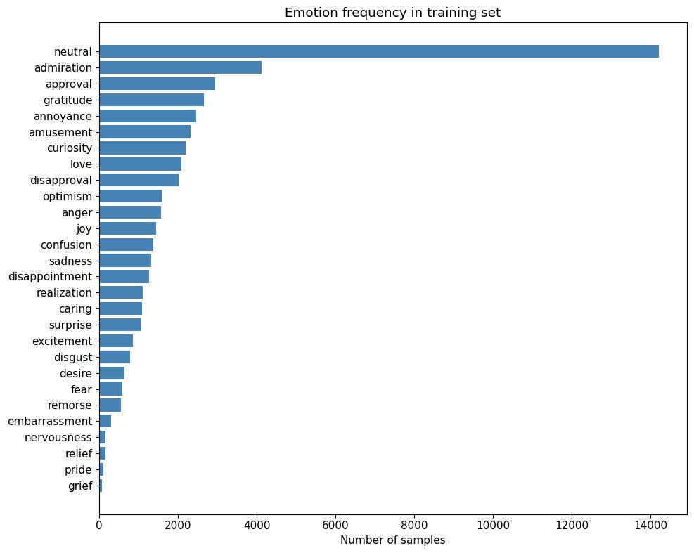
Dataset Challenge: Extreme Class Imbalance
The Gap
Neutral: ∼18,000 training samples
Grief: ∼100 training samples
Ratio: 180× gap between largest and smallest class
Evaluation Strategy:
We use Macro F1 Score.
Treats all 28 emotions equally regardless of frequency.
Published Baselines:
Logistic Regression:0.38
BERT-base: 0.46
Fine-Grained Emotion Classification

Slide 5
Model Progression Overview
Three Models, One Question: What Does Each Architecture Add?
Model 1
TF-IDF + LogReg
(Bag of Words)
Model 2 BiLSTM + GloVe (Sequence)
Model 3
RoBERTa
(Context)
F1: 0.375 F1: 0.371 F1: 0.530
Progression: From statistical word counting → static embeddings → dynamic contextual embeddings.
Unexpected Result: Complexity did not guarantee performance in the middle step.
Fine-Grained Emotion Classification

Slide 6
Model 1: TF-IDF + Logistic Regression
Macro F1: 0.375 (published baseline: 0.38)
Key details:
TF-IDF: 10,000 features, unigrams + bigrams
OneVsRest Logistic Regression with balanced class weights
Training time: ~2 minutes
Key Takeaway: Surprisingly strong, hard to beat with word frequency alone
Strengths & Weaknesses
Strong Signals:
Gratitude (0.87) → ”Thanks” Amusement (0.78) → ”lol”
Weak Signals:
Relief (0.04) → No unique vocab
Fine-Grained Emotion Classification

Slide 7
Model 2: BiLSTM + GloVe Embeddings
Macro F1: 0.371 (vs Published: 0.41)
The Domain Mismatch
The Pipeline:
GloVe Coverage: Only 58.9%
41% of our vocabulary had no pre-trained vector.
Why? GloVe is trained on Wikipedia/News.
Reddit is full of slang, typos, and
internet-speak not found in formal corpora.
1
GloVe 300d Embeddings
BiLSTM (128 hidden units)
Dropout Layer
Linear Output (28 classes)
2
3
4
Fine-Grained Emotion Classification

Slide 8
Model 3: RoBERTa Fine-Tuned
Macro F1: 0.530 (vs Published BERT: 0.46) +7%
Why RoBERTa?
Trained on 160GB text (vs BERT’s 16GB).
Includes web data closer to Reddit language.
Dynamic masking. no next-sentence-prediction.
Key Techniques
Sqrt-dampened class weights: Handles the 1:180 imbalance without overfitting rare classes.
Threshold Optimization: Tuned per-class thresholds (0.1–0.6) on validation set instead of fixed 0.5.
1
2
Biggest Gains: Context-dependent emotions (Confusion: 0.21 → 0.41).
Fine-Grained Emotion Classification

Slide 9
Results at a Glance
Model | Macro F1 | Published Baseline | ∆
Majority Class | 0.018 | — | —
TF-IDF + LogReg | 0.375 | 0.38 | -0.005
BiLSTM + GloVe | 0.371 | 0.41 | -0.039
RoBERTa | 0.530 | 0.46 (BERT) | +0.070
Note: BiLSTM ≈ TF-IDF due to domain mismatch in embeddings. RoBERTa’s contextual understanding drives the real performance jump.
Fine-Grained Emotion Classification

Slide 10
Which Emotions Are Easiest and Hardest?
Based on RoBERTa F1 Scores
Easiest (Distinctive Lexicon)
Hardest (Subtle/Contextual)
Gratitude: 0.91 (”thanks”)
Amusement: 0.82 (”lol”, ”haha”)
Love: 0.81 (”love”, ”¡3”)
Admiration: 0.71
Realization: 0.27 (”oh I see”)
Disappointment: 0.33
Nervousness: 0.36
Relief: 0.38
Correlation between Training Size and F1 is only r = 0.34.
Difficulty is about ambiguity, not just data quantity.
Fine-Grained Emotion Classification

Slide 11
The Neutral Absorption Problem
Major Error Pattern:
When the model has low confidence, it defaults to
Neutral (the dominant class).
Other Confusions
Semantic Overlap Anger ↔ Annoyance Apprroval ↔ Admiration Confusion ↔ Curiosity
Specific Absorptions (Validation Set): Annoyance → Neutral: 93 cases Approval → Neutral: 86 cases Realization → Neutral: 63 cases
Fine-Grained Emotion Classification

Slide 12
Key Takeaways
1
Simple Baselines are Hard to Beat
TF-IDF is competitive for emotions with clear vocabulary. Never skip the baseline.
2
Embeddings Need Domain Alignment
Formal Wikipedia embeddings (GloVe) failed on informal Reddit text. Data match > Model complexity.
3
Contextual Models Unlock Subtle Emotions
RoBERTa’s gain wasn’t general—it came specifically from context-heavy classes (Confusion, Approval) that Bag-of-Words cannot capture.
Fine-Grained Emotion Classification

Slide 13
Thank You!
Any Questions?
Summary of F1 Scores:
TF-IDF (0.375) → BiLSTM (0.371) → RoBERTa (0.530)
Code available in our Jupyter notebook on Google Colab
Oliver Wakeford · Ahzam Afaq · Hamza Tarazi
Fine-Grained Emotion Classification

