Slide 1
GlobalMart Sales Analysis 2012-2016
V1.1

Slide 2
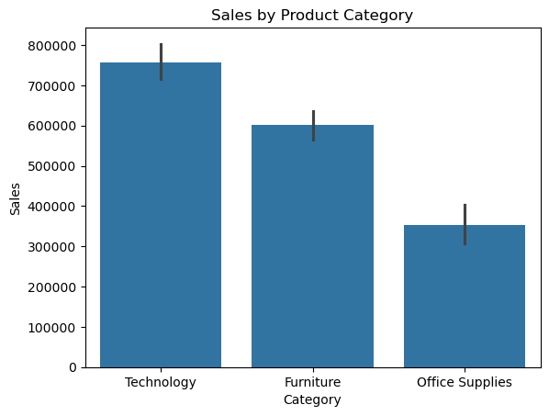
Most Profitable Categories
Technology, Furniture and Office Supplies.
Technology is the best-selling category for this company. Furniture is a close second. Technology sales are approximately double Office Supplies.
Recommendations:
Technology and Furniture sales indicate these are good areas for additional investment or marketing efforts.
Further investigation of Office Supplies to consider either strategies to boost sales or whether to redirect focus to other categories.

Slide 3
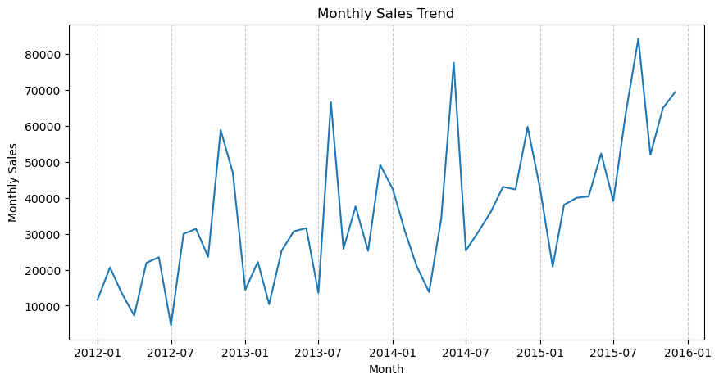
Sales Trends
Global sales show an upward trend between 2012 and 2016: monthly sales increasing over time.
There is a drop in sales in the first season of each year.
Peaks could be due to events or promotions, or seasonal variation.
Recommendations:
Reduce inventory in late December to save on cost during the slump in the first quarter
Assign the most marketing budget to the June-September season where people are most likely to spend
Further investigation may reveal insights into the variable month of the seasonal peak. Compare these peaks to internal marketing efforts and global events
The upward trend is a sign of healthy growth. It’s likely a good time to look into a loyalty program to retain these customers long-term
Significant peaks in sales occurred in the mid to late summer each year:
Nov 2012
Aug 2013
Jun 2014
Sep 2015

Slide 4
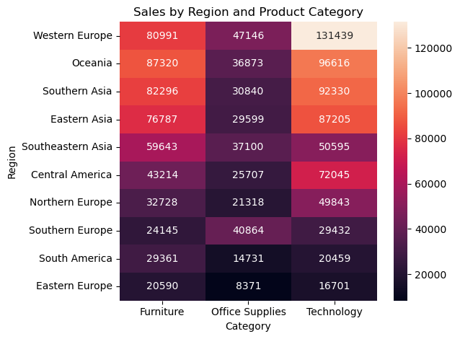
Sales and Profits by Region
Regions with highest sales are Western Europe, Oceana, and Southern and Eastern Asia.
Region sales vary by product category: e.g.
Southern Europe is a particularly high purchaser of office supplies relative to other products,
Central America shows a preference for Technology.
Oceana dominates sales of furniture supplies.
Recommendations:
Targeted marketing efforts specific to the unique customer product preferences in each region.

Slide 5
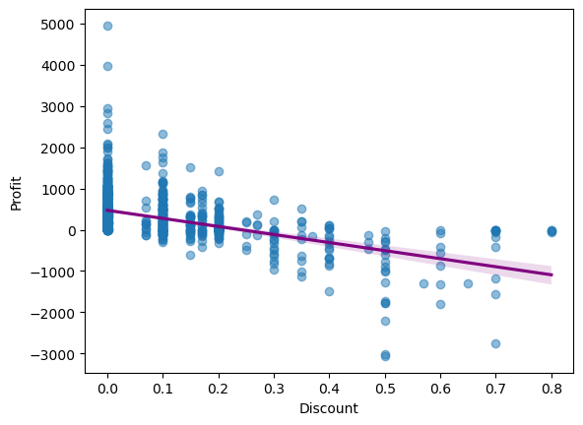
Discount vs Profit
Global data shows a total profit of 288920, and a total discount of 93, suggesting discounts are a very minor factor when considering influencers on profit.
There is a moderate negative correlation between Discount and Profit suggesting that greater discounts are somewhat associated with reduced profits.
Recommendations
Discounts are rarely applied currently so are not meaningfully impacting profits.
In considering future marketing approaches, existing data suggests discounts ineffective in increasing profits.
Further analysis may investigate the effect of discounts on other main goals such as sales quantity and company reputation.

Slide 6
Recommendations
Product and Regional Strategy
Invest in high-performing categories (Technology and Furniture)
Seasonal Efficiencies
Lean operations during the first quarter
Discounts
Avoid broad discounts to maintain profit margin
Launch a loyalty program to secure current growth into future value
Localized Marketing strategy
Review Office Supplies: consider boosting sales or reallocating resources
Concentrate marketing budget on the June-September period
Investigate what contributes to the shifting summer peak

Slide 7
Summary: GlobalMart (2012–2016)
Sales Trends and Seasonality
Between 2012-2016, GlobalMart maintained a healthy upward trajectory. Monthly sales show predictable peaks and troughs each year: a recurring slump in the first quarter and significant sales spikes occurring annually between June and September. The exact month of the annual peak has varied from June to November, and further investigation is recommended to explore what factors influence this.
Category and Regional Insights
Technology products dominate total sales, with sales approximately double those of Office Supplies. Furniture is a close second. The data highlights distinct regional preferences: Oceania dominates the Furniture market, Central America shows a bias toward Technology, and Southern Europe favours Office Supplies. This suggests a one-size-fits-all global marketing strategy may be less effective than a localized, category-specific approach.
Discounts
Discounts are currently used minimally within this Store. There is a moderate negative correlation between discounts and profit, suggesting that increasing discounts would not translate to higher profitability for the Superstore. This implies the brand holds enough value to maintain margins without relying on aggressive price-cutting strategies.
Strategic Recommendations
To capitalize on these findings, the organization should consider the following:
Operational Efficiency: Minimise inventory during the first quarter to reduce costs during this slump, and reallocate the most marketing budget to the June–September window when sales are much higher.
Targeted Growth: Prioritize investment in Technology and Furniture, while deploying region-specific campaigns (e.g., Office Supplies in Southern Europe) to align with proven local demand.
Customer Retention: Transition away from traditional discounting in favor of a global Loyalty Program. This will leverage the current upward sales trend to lock in long-term customer retention and future revenue without eroding profit margins.
In conclusion, by aligning inventory with seasonal cycles and tailoring product focuses to regional strengths, the Global Superstore is well-positioned to convert its current upward trend into sustainable, high-margin global dominance.
This report provides a comprehensive evaluation of GlobalMart’s sales performance, regional dynamics, and profitability drivers over a four-year period. It shows a business in a strong growth phase, characterized by a consistent upward trend in sales, alongside specific seasonal and regional variations which can be opportunities for further growth.

