Slide 1
Prerequisite software install
RStudio
R libraries (install.packages)
httr
jsonlite
tidyverse
plumber
gapminder
png

Slide 2
APIs & Plumber
Dr Olly Butters
Public Health, Policy and Systems

Slide 3
Session overview
What is an API, where are they used? (~25 mins)
Exercise - Two R examples of using existing external APIs. (~15 mins)
Introduction to plumber. (~15 mins)
Exercise - Write some plumber code. (~30 mins)
Final comments. (~5 mins)

Slide 4
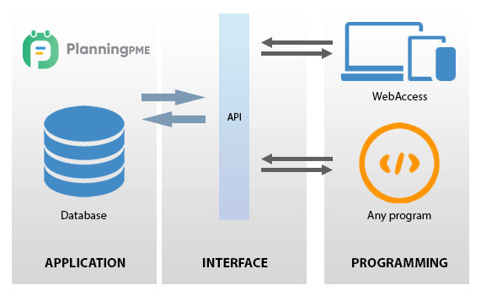
What is an API?
Application Programming Interface.
https://www.planningpme.com/planningpme-api.htm

Slide 5
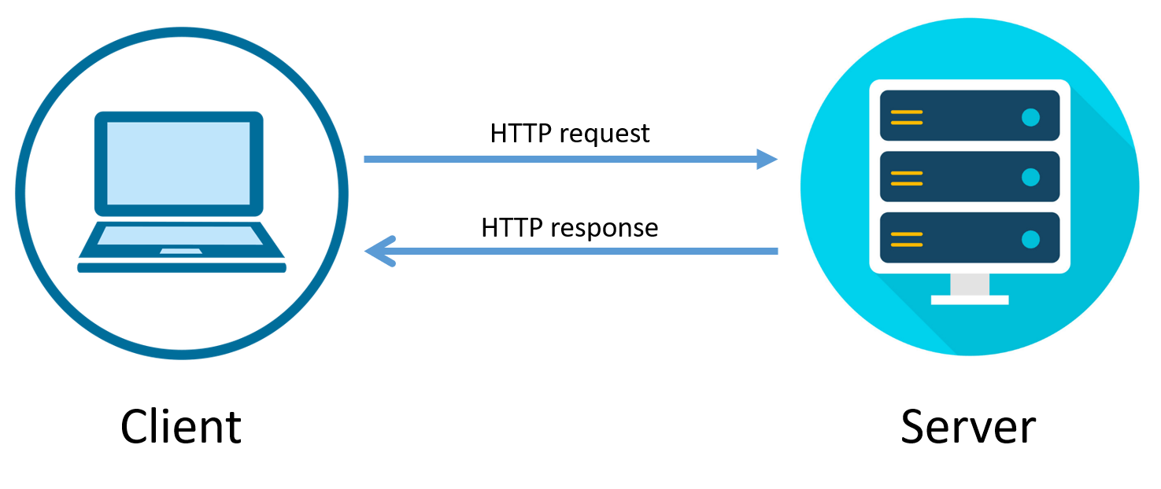
What is an API?
https://bytesofgigabytes.com/networking/how-http-request-and-response-works/

Slide 6
Why bother?
Easier than connecting to underlying applications.
Common language.
Static interface.

Slide 7










Google maps API
Google maps API

Slide 8
Example APIs
Manage services
Amazon Web Services
Microsoft Azure
Get data
Google maps
Wikidata
Fitbit
British library
Data.parliament.uk
Add data
Twitter
Facebook
Instagram
Real world interaction
Google Nest
Dishwasher
Burglar alarm
Book appointments
GP systems
Restaurants

Slide 9
Health data APIs
Bioportal -> Look up ontologies etc.
Gov health stats
NHS Digital -> Loads of APIs to find/get/add data/
Air quality.
UK government API catalogue
Urban Observatory
https://data.police.uk/docs/

Slide 10
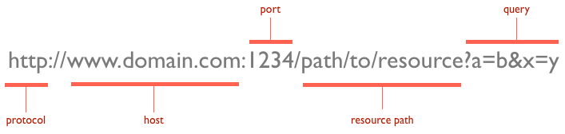
Anatomy of a query URL (the request)
Mongolariun, CC BY-SA 4.0 <https://creativecommons.org/licenses/by-sa/4.0>, via Wikimedia Commons

Slide 11
Response
Typically get a header and content in the response
Response codes in header
200 – OK
404 – Not found
500 – Internal server error
Content is usually JSON or XML

Slide 12
Exercises: connect to some APIs
Exercise 1: Using an API - how many people are in space right now?
Exercise 2: Using an API - what is the UK Covid-19 case rate?

Slide 13
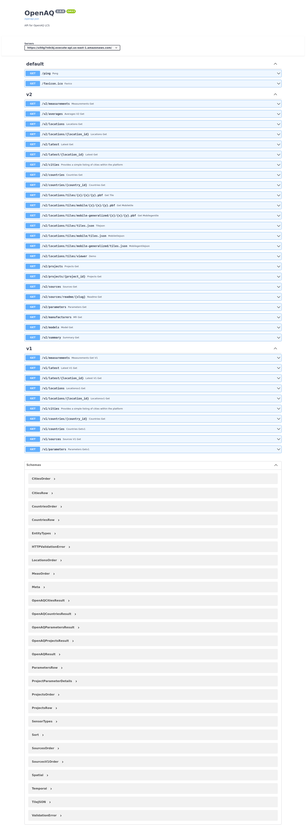
Swagger
Web tool to help explore and use compliant APIs

Slide 14
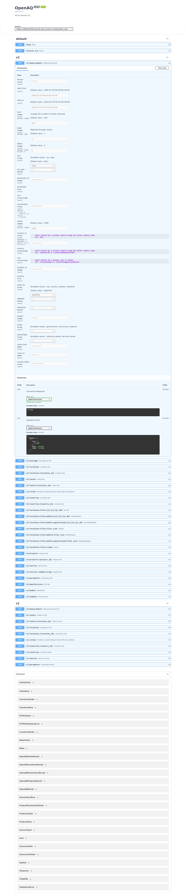
Swagger

Slide 15
Decorators
Decorators let you modify function behaviour without modifying the function code!
#. I am a decorator my_function <- function() { #do awesome stuff }
Common in other languages.

Slide 16
Plumber function
#* Return the square of a number
#* @param a The number to square
#* @get /square
function(a) {
as.numeric(a) * as.numeric(a)
}

Slide 17




Plumber – access to functions
Terminal or curl
Swagger
Plumber function
Plumber API

Slide 18
Exercises: write some plumber code
Exercise 3: Run example plumber functions (/hello, /square, /plot)
Exercise 4: Write a plumber function to use gapminder data to show population of the UK in 1982
Exercise 5: Write a plumber function to allow a user to find out the population of any country during any year in gapminder.
Exercise 6: Write a plumber function to plot the population change of a user defined country.

Slide 19
Additional points
GET/POST
Bounds checks
Security is vital on public APIs
Good list of public APIs - https://github.com/public-apis/public-apis
https://docs.openaq.org/#/v2/measurements_get_v2_measurements_get

