Slide 1
APIs & Plumber R library
Dr Olly Butters
Public Health, Policy and Systems
olly.butters@liverpool.ac.uk

Slide 2
Learning objectives
Understand what an API is.
Use existing APIs.
Develop our own APIs.

Slide 3
Session overview
What is an API, where are they used? (~25 mins)
Exercise - Two R examples of using existing external APIs. (~15 mins)
Introduction to plumber. (~15 mins)
Exercise - Write some plumber code. (~30 mins)
Final comments. (~5 mins)

Slide 4
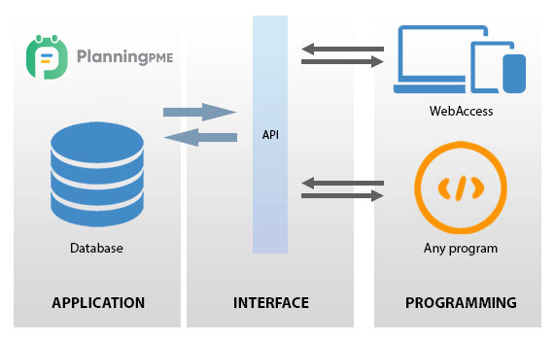
What is an API?
Application Programming Interface.
https://www.planningpme.com/planningpme-api.htm

Slide 5


Steps towards an API
function get_diabetes_count() {
SELECT COUNT(*)
FROM database
WHERE Disease=Diabetes;
}
Name | ID | Disease
John | 2345 | Diabetes
Jane | 7853 | Asthma
Judy | 1337 | Diabetes
Joe | 8867 | COPD

Slide 6
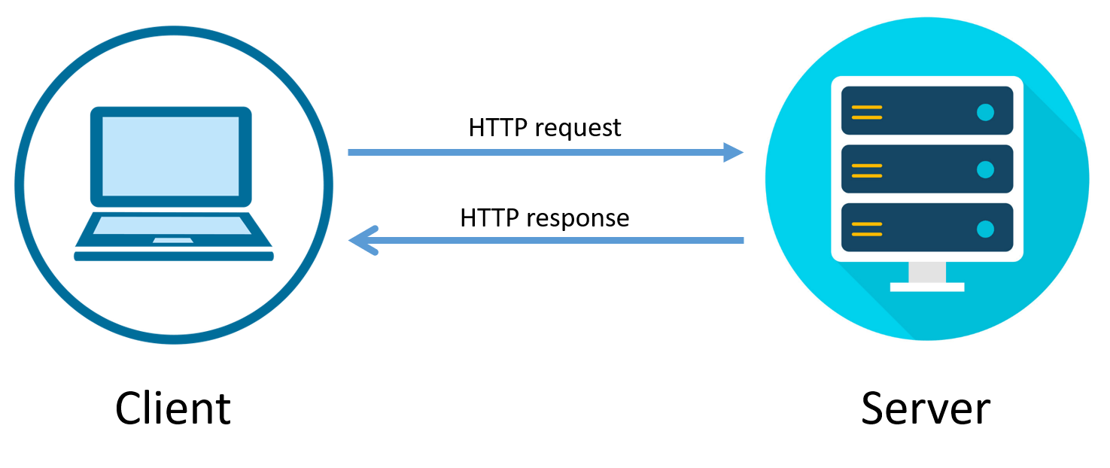
API messaging
https://bytesofgigabytes.com/networking/how-http-request-and-response-works/

Slide 7
Why bother?
Easier than connecting to underlying applications.
Can make subset of data/application available.
Common language.
Static interface.

Slide 8










Google maps API
Google maps API

Slide 9
Example APIs
Manage services
Amazon Web Services
Microsoft Azure
Get data
Google maps
Wikidata
Fitbit
British library
Data.parliament.uk
Add data
Twitter
Facebook
Instagram
Real world interaction
Google Nest
Dishwasher
Burglar alarm
Book appointments
GP systems
Restaurants

Slide 10
Health data APIs
Bioportal -> Look up ontologies etc.
Government health stats -> Going to use these today
NHS Digital -> Loads of APIs to find/get/add data
Air quality.
UK government API catalogue
Urban Observatory
https://data.police.uk/docs/
Care Quality Commission -> locations of care homes

Slide 11
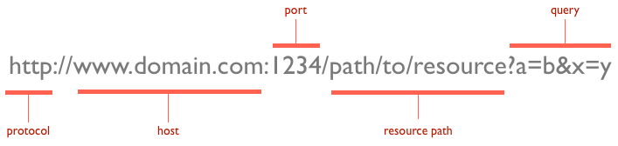
Anatomy of an API URL (the request)
Mongolariun, CC BY-SA 4.0 <https://creativecommons.org/licenses/by-sa/4.0>, via Wikimedia Commons

Slide 12
Anatomy of an API URL (the request)
Pavement
Liver building
Flat number 3
Kitchen/cupboard/get_mug
colour=red
Road
Liver building
Garage number 2
Park/car
Mongolariun, CC BY-SA 4.0 <https://creativecommons.org/licenses/by-sa/4.0>, via Wikimedia Commons

Slide 13
Query vs Path based API
Query based:
someapi.com:1234/flu_cases?location=england&type=hospitalisation
Path based:
someapi.com:1234/location/england/type/hospitalisation/flu_cases

Slide 14
Response
Typically get a header and content in the response
Response codes in header
200 – OK
404 – Not found
500 – Internal server error
Content is usually JSON or XML

Slide 15
Google maps elevation API call example
Request: https://maps.googleapis.com/maps/api/elevation/json?locations=39.7391536%2C-104.9847034
{ "results": [ { "elevation": 1608.637939453125, "location": { "lat": 39.7391536, "lng": -104.9847034 }, "resolution": 4.771975994110107, }, ], "status": "OK", }
Response:

Slide 16
Exercises 1: Find out a useless fact
https://github.com/OllyButters/HDS-plumber/archive/refs/heads/main.zip
Open README.md
Open exercise_1_api_useless_facts.R
Run the R file one line at a time (Ctrl-Enter) and read the comments as you go.

Slide 17
Exercise 2: Write an R script to find out what the influenza hospitalisation rate in England is and plot it
Start a new R file called exercise_2_api_influenza_rate.R
Copy the relevant parts from the first exercise.
The query URL (the request) is: https://api.ukhsa-dashboard.data.gov.uk/themes/infectious_disease/sub_themes/respiratory/topics/Influenza/geography_types/Nation/geographies/England/metrics/influenza_healthcare_hospitalAdmissionRateByWeek?age=all&page=2&page_size=365
Can copy URL from the README.md file.
Get the data from the API and plot it.
If you get really stuck you can look at exercise_2_influenza_answer.R

Slide 18
Exercise 1 & 2 summary
Used two APIs to get data from remote services.
Now we are going to build our own APIs and connect to them in a similar way.

Slide 19
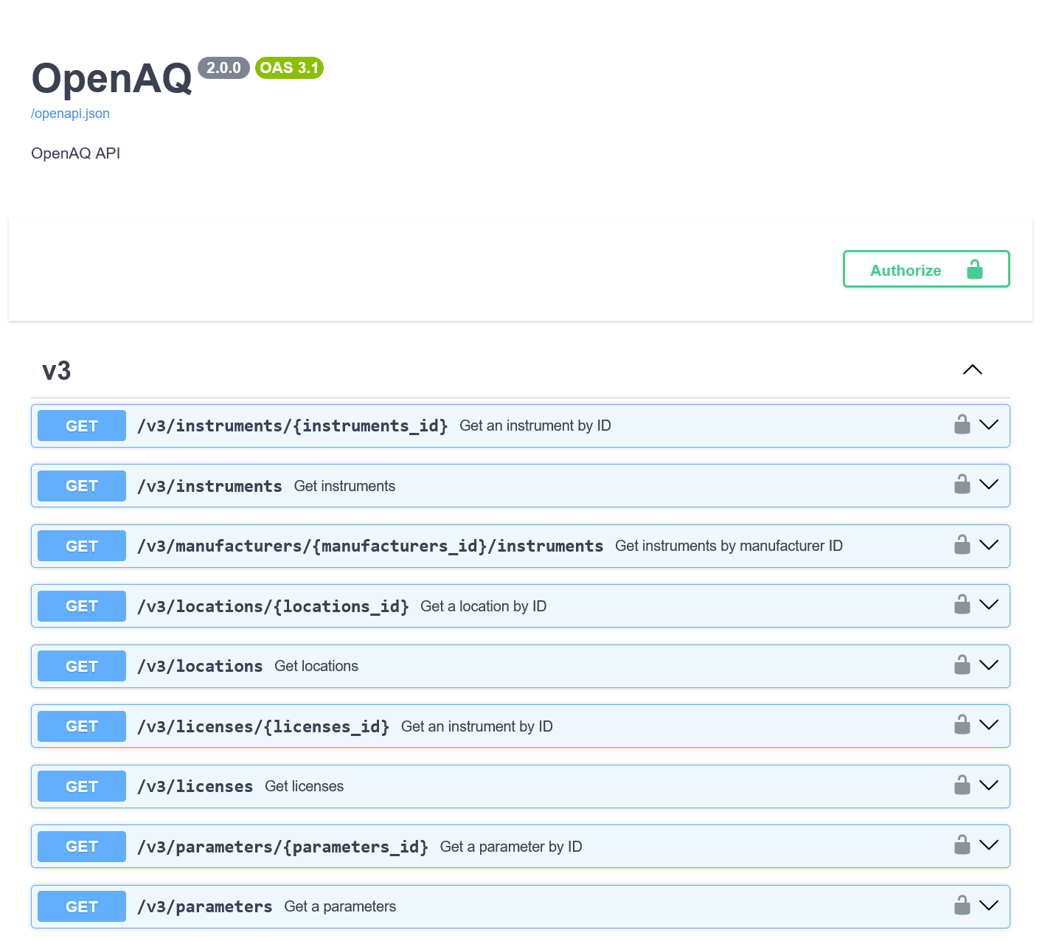
Swagger
Web tool to help explore and use compliant APIs
https://api.openaq.org/docs

Slide 20
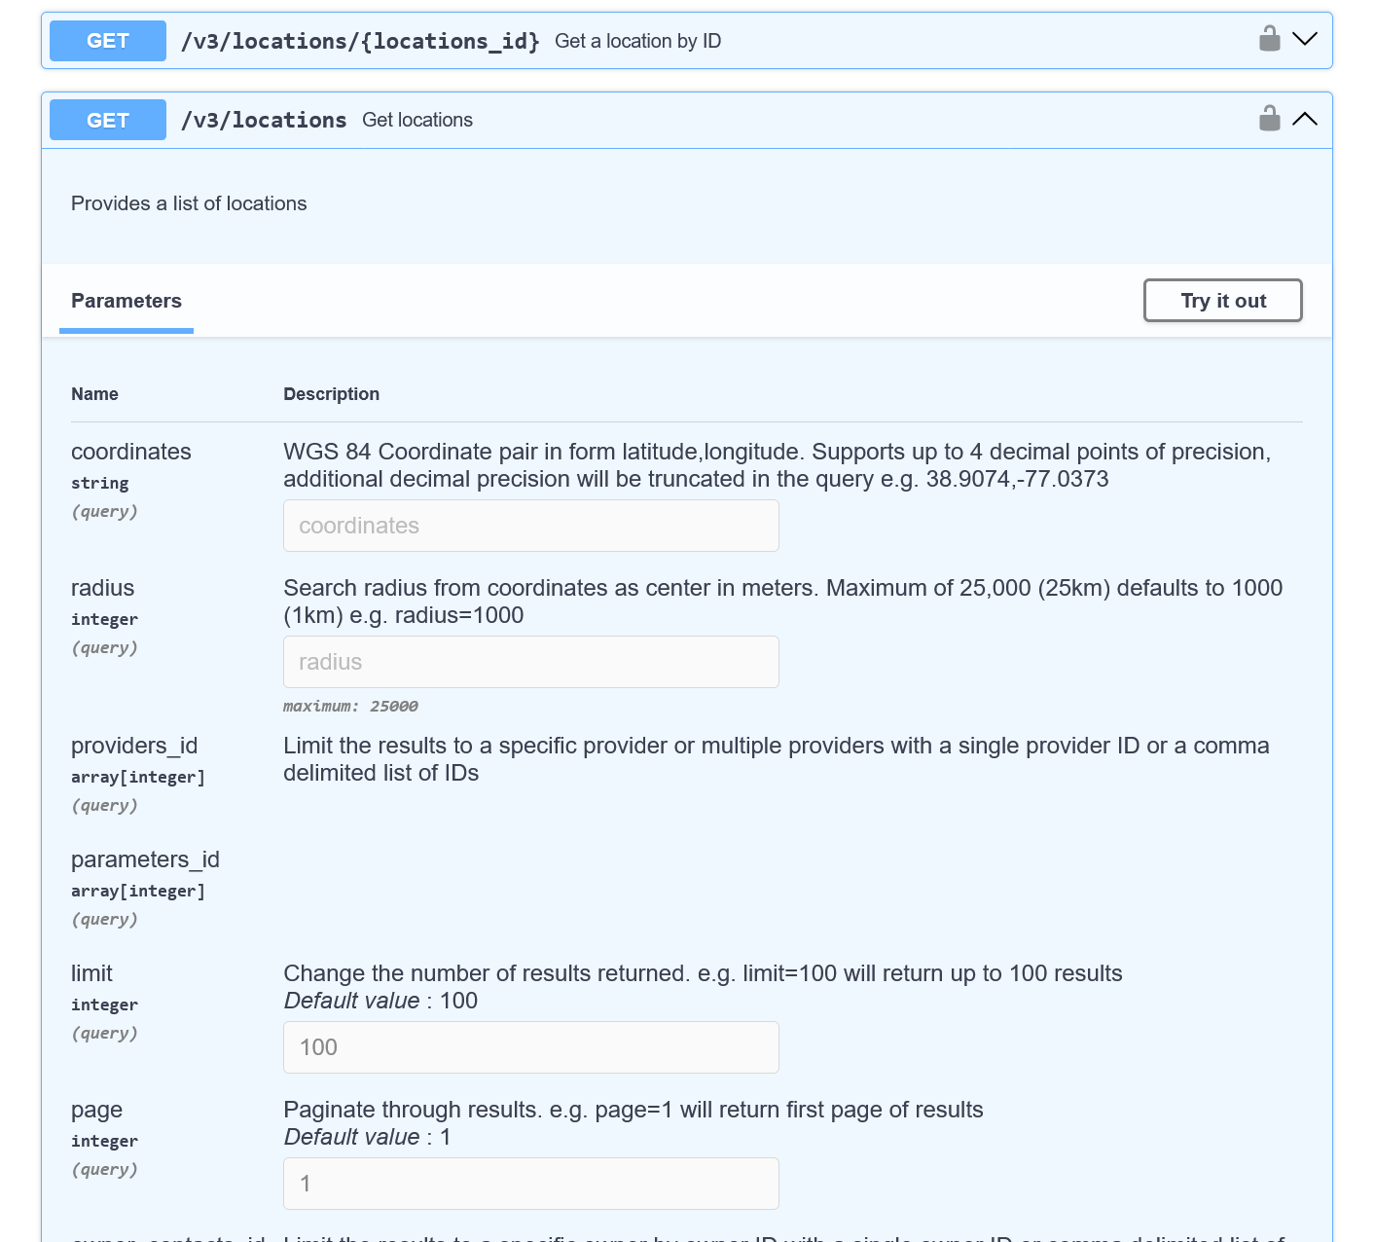
Swagger
User interface for adding query parameters

Slide 21
Decorators
Decorators let you modify function behaviour without modifying the function code!
Start with a # so ignored most of the time.
Common in other languages.
#* I am a decorator my_function <- function() { #do awesome stuff }

Slide 22
Plumber function
#* Return the square of a number
#* @param a The number to square
#* @get /square
function(a) {
as.numeric(a) * as.numeric(a)
}

Slide 23




Plumber – access to functions
R/plumber function
Swagger
Run in Plumber
http://127.0.0.1:1234
Server
Clients

Slide 24
Exercise 3: Run some plumber code
Open exercise_3_plumber_example_server.R
Click on the "Run API" button on the top right of the code.
This will open a web browser with swagger running in it
Run example plumber functions (/hello, /square, /plot)
Open request URLs directly in a web browser
Open a second RStudio instance (Session > New Session), open exercise_3_plumber_example_client.R, run examples.
More info in the README.md document

Slide 25
Plumber – access to functions
R/plumber function
Swagger
Run in Plumber
http://127.0.0.1:1234
Server
Clients

Slide 26
Exercises: write some plumber code
Exercise 4: Write a plumber function to use gapminder data to show population of the UK in 1982. (Gapminder is a dataset of populations of various countries from 1952 - 2007).
Exercise 5: Write a plumber function to allow a user to find out the population of any country during any year in gapminder.
Exercise 6: Write a plumber function to plot the population change of a user defined country.

Slide 27
Additional points
GET/POST
GET -> Usually GETting data, POST -> usually submitting data.
Bounds checks -> What if I ask for gapminder data for this year?
Security is vital on public APIs
Good list of public APIs - https://github.com/public-apis/public-apis
APIs can change or be retired!

