Slide 1
Contract Testing: why and how?
An introduction to Spring Cloud Contract testing
By
Olly Crook

Slide 2

About me
I am a software developer from the UK, who has been working in the Netherlands for over 25 years on numerous projects, and within Rabobank, focusing on Java for more than 15 years
I can be contacted at: Oliver.Crook@rabobank.nl

Slide 3
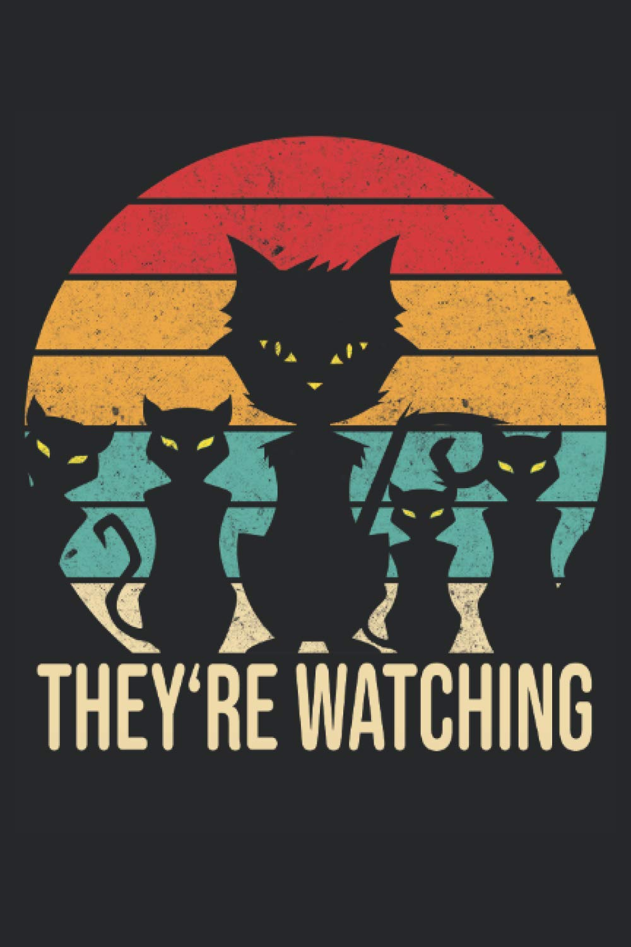
Paperwork!
Questions – add them to the chat and I will try to answer
The session is being recorded

Slide 4
What will I talk about?
I will describe what I mean by contract testing
I will not dive deeply into concepts – I prefer to show by example
I will demonstrate the concepts with real code that you can download
I will not be talking about Pact or Pactflow

Slide 5
The code for this demo is in GitHub
The micro-services (and this presentation) can be downloaded from GitHub https://github.com/OllyCrook/contract-test-demo
This repo also contains README files, and this presentation
The idea is that you can download this code and play with it

Slide 6

What is the problem?
Micro-service A
getStuff
Micro-service C
Uses
{name, price, description}
getStuff
Returns
(name, price, description}
Micro-service B
getStuff
Uses
{name, price}
- does not use description

Slide 7

Remove “description” from getStuff interface
Micro-service A
getStuff
Micro-service C
Uses
{name, price, description}
getStuff
Returns
(name, price}
- description is removed
Micro-service B
Description is no longer in the reply
Consumer A no longer works
Consumer B is OK
getStuff
Uses
{name, price}
- does not use description

Slide 8
How can contract testing help?
Contract testing will test the interface between the micro-services (but we will also use it for more)
Contract testing should detect the problem shown in the previous slide before deployment
In fact, the contracts tests will run automatically when building the code
We do not need any external stub applications, databases, etc

Slide 9
Our goal with contract tests
Reduce amount of manual testing between micro-services
Manual testing
Manual testing
Contract tests
Junit tests
Junit tests

Slide 10
A bit of jargon - Consumer-driven testing
Our contracts will be consumer-driven contracts
The consumer establishes which agreements must be complied with
The producer (=provider) is responsible for satisfying the requirements set by the consumer
See: https://dzone.com/articles/contract-testing-strategy-producer-driven-or-consu

Slide 11
For example
Consumer A
getStuff
Provider C
Uses
{name, price, description}
getStuff
Returns
(name, price, description}
Consumer B
getStuff
Uses
{name, price}
- does not use description

Slide 12
Even more jargon
My code demo code will use:
Spring Cloud Contract Verifier
Spring Cloud Contract Stubrunner
I will cover these later

Slide 13
And yet more jargon!
API (Application Programming Interface) This defines the interface for a micro-service, including the request/response layouts
Micro-service In my examples, this is a small Java application, built using Spring Boot
WireMock WireMock is a server for stubbing and mocking web services. It runs locally when running tests A unit test sends requests to it, and the WireMock server sends replies
WireMock mappings file This contains a request and response file It is used by the WireMock server to find a response which matches the request message

Slide 14



Overview of our 2 micro-services in GitHub
Consumer micro-service
Other apps
Provider micro-service
/consumer/products/{category}
getProductDetails
getProductList
Returns: {code, name, price, description}
I want ice-cream
NOW!
getProducts
/provider/products/{category}
getProducts
Uses: List of {code, name, price}
Returns: List of {code, name, price}
MongoDB
(NonSql database)

Slide 15
We want to test the getProducts API
Consumer micro-service
Other apps
Provider micro-service
/consumer/products/{category}
getProductDetails
getProductList
Returns: {code, name, price, description}
I want ice-cream
NOW!
getProducts
/provider/products/{category}
getProducts
Uses: List of {code, name, price}
Returns: List of {code, name, price}
MongoDB
(NonSql database)

Slide 16
Firstly, setup the contracts for the provider
Consumer micro-service
Other apps
Provider micro-service
/consumer/products/{category}
getProductDetails
getProductList
Returns: {code, name, price, description}
I want ice-cream
NOW!
getProducts
/provider/products/{category}
getProducts
Uses: List of {code, name, price}
Returns: List of {code, name, price}
MongoDB
(NonSql database)

Slide 17
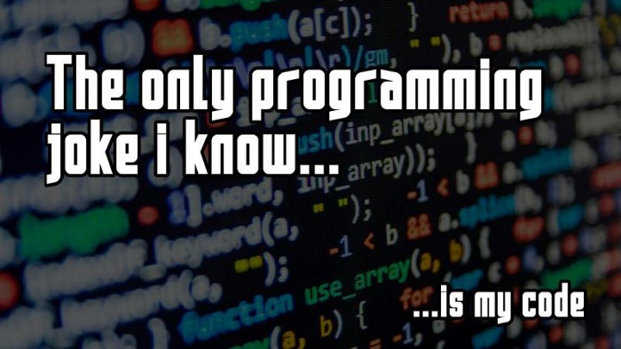
To the code!

Slide 18
Summary of the producer contracts
I showed these contract definitions (amongst others)
- provider/src/test/resources/contracts/providerContract - getProducts_ICEMONGO.groovy (plus several other groovy contract files)
And this base class
provider/src/test/java/nl/crook/olly/contract/demo/provider/contract/base/ - ProviderContractBase.java

Slide 19
Remember the stubs.jar file in the Provider?
stubs.jar is generated every time we do a build. It is key to everything
It can be stored in Nexus, local Maven repo, Azure, Git, etc
We will use it later in the Consumer tests
A typical stubs.jar structure is something like this
Stubs.jar
provider contracts test1.groovy test2.java test3.kt mappings test1.json test2.json test3.json
These WireMock mappings files contain the contracts for the provider service. Other services (the consumers) can use these to test their interfaces

Slide 20
Reminder: How did I build the stubs jar file?
mvn clean install - generates and runs Junit tests to verify the consistency of the tests - if the Junit tests are successful, then it builds the stubs jar file - the generated Junit tests can also be run manually to investigate issues
mvn clean install –DskipTests - builds the stubs jar file directly - does not generate the contract Junit tests - skips the verifications - you could end up with a stubs.jar that contains invalid info

Slide 21
Base class. What was that again?
Contract verifier base classes are key to running the verification
Base classes are NOT used to generate the stubs jar file
Base classes are used to build and run Junit verification tests for the contracts
The base classes in our examples use RestAssuredMockMvc to run the application (see links at end of presentation for more details)
You can use the base classes to setup in-memory databases, mock beans, utility methods (for use by Groovy etc) and much much more
If the generated Junit tests fail, the stubs.jar will not be built
The key to all this voodoo magic is Spring Cloud Contract Verifier

Slide 22
Spring Cloud Contract Verifier?
" Spring Cloud Contract Verifier enables Consumer Driven Contract (CDC) development of JVM-based applications. It moves TDD to the level of software architecture."
This description has a nice buzzword in it - TDD: Test Driven Development
I think of it as a way of verifying that your generated stubs.jar contains valid WireMock mappings files

Slide 23
Now test the Consumer API
Consumer micro-service
Api Junit test
stubs.jar Generated when building the provider
The consumer will download this jar from the local repo, Nexus, Azure, Git, etc
getProducts
/provider/products/{category}
Uses: List of {code, name, price}

Slide 24

To the consumer code!

Slide 25
Summary of the Consumer API test
We used the following Junit test in the Consumer
-consumer/src/test/java/nl/crook/olly/contract/demo/consumer/contract/apitest - ProviderApiContractTest.java
This uses the following StubRunner annotation to download and run the stubs jar file from the specified repository
@AutoConfigureStubRunner(ids = {"nl.crook.olly.contract.demo.provider:provider:+:stubs:8091"}, stubsMode = StubRunnerProperties.StubsMode.LOCAL, repositoryRoot = https://maven.to-do/nexus/content/repositories/release )
Where
StubsMode.LOCAL specifies that we will retrieve the stubs.jar file from the local Maven repo. We could also change it to REMOTE, to download from Nexus, etc
The URLs for the endpoints are configured in application-contract-tests.yml

Slide 26
Can we define dynamic responses?
Can we build it? Yes we can!
See the following which I set up in the provider, where we can see some of the stuff we can do
- provider/src/test/resources/contracts/providerContract - getProducts_ICEMONGO2_body_in_script_example.groovy - getProducts_ICEMONGO3_bodymatchers_custom_command_example.groovy - getProducts_ICEMONGO4_copy_from_request_to_response_example.groovy - getProducts_ICEMONGO5_dynamic response_example.groovy - getProducts_ICEMONGO6_consumer_producer_example.groovy - getProducts_ICEMONGOXXX_random_request_url.groovy
For more examples of what can be done, see https://cloud.spring.io/spring-cloud-contract/2.0.x/multi/multi__contract_dsl.html

Slide 27

Once more unto the code!

Slide 28
Consumer example: Integration tests (and TDD)
Consumer micro-service
getProducts
/provider/products/{category}
Provider mappings
files
Consumer contract
integration tests
getProductList
getPromotionDetails
/marketing/promotion/{category}
Marketing mappings
files
The WireMock mappings are set up manually (or by a test generator) to simulate the endpoints that Consumer service talks to

Slide 29

Hi Yo Silver! To the integration tests we go!

Slide 30
Summary: Consumer code for integration tests
The contract definitions are in an consumerIntegration directory, to help separate them from the contract tests
- consumer/src/test/resources/contracts/consumerIntegration - getProduct_tc_happy_flow.groovy - getProduct_tc_error_with_marketing_service.groovy - getProduct_tc_error_with_provider_service.groovy
The contract verifier base class for this example is hardcoded in the pom as
- consumer/src/test/java/nl/crook/olly/contract/demo/consumer/contract/base - ContractBase.java
Note
Each groovy test contains a "test-case". This makes it easier to determine which WireMock mappings and response files are used for the tests
We use utility classes in this package to support the use of test-cases - consumer/src/test/java/nl/crook/olly/contract/demo/consumer/contract/base/utils

Slide 31
Integration tests can reduce manual testing
Manual testing
Manual testing
Integration
tests
Manual testing
Contract tests
Contract tests
Junit tests
Junit tests
Junit tests

Slide 32
What will the contract tests not detect?
If the provider changes the functionality, by adding extra fields to the response, the tests will probably pass, but the interface will no longer work as expected
For example, if CurrencyCode is added to the response for getProducts, then the tests may still pass. But now we do not know if the price is in Euros, US dollars, Leu, etc
This could have a BIG impact, especially when we go live!
There are many more examples that you can probably think of
Some solutions
We need to make sure that functional changes to interfaces are clearly communicated
Or make a new contract test and disable/remove the obsolete one. This will cause consumer contract tests to fail, which can be detected and fixed before we go live
Or…?

Slide 33
New subject: Re-use the contract test data to build stubs
We can re-use all the WireMock mappings files (in the stubs.jar files) to build stub applications
I will show how to create the following two stubs
contract-stub Contains only the test data (WireMock mappings files) that are used for API tests
endpoint-stub Contains ALL the test data (WireMock mappings files) from ALL of the generated jars

Slide 34
contract-stub – for API testing by non-Java apps
Cloud environment
App 1 (COBOL)
contract-stub
App 2 (Fortran)
App 3 (.Net)
The contract-stub contains all the mappings from the stubs.jar files
Useful if an external app is unable to use the stubs.jar files
External apps can then test their interfaces against this stub

Slide 35
endpoint-stub – for use in the cloud
Cloud environment
endpoint-stub:
Contains all the WireMock mappings files and response files for the endpoints In other words, it contains the integration test mappings from consumer-service
Does NOT contain any of the mappings from the provider-stubs.jar files
Useful for performance test, security tests, stress tests etc
Consumer service
Testers
(performance tests, etc)
endpoint-stub
Simulates Provider and Marketing
services

Slide 36
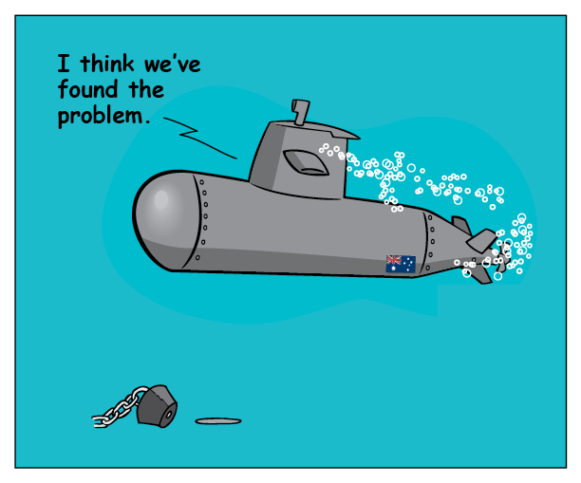
Let's generate some stubs!

Slide 37
Summary: stubs code
The stubs are in the following directories
stubs/contract-stub
pom.xml Downloads the contract mappings from provider-stubs.jar and consumer-stubs.jar
stubs/endpoint-stub
pom.xml Downloads the mappings files from provider-endpoint-mappings.jar and consumer-endpoint-mappings.jar
Note: consumer and provider are responsible for generating the above jar files
pom.xml Contain plugins to generate consumer-endpoint-mappings.jar and provider-endpoint-mappings.jar (needed for the endpoint-stub)

Slide 38
Tips and tricks
Keep it simple!
Use good naming conventions!!
The stubs.jar is the key to everything
Verification!!
Clearly define what you want to test
Keep a good balance between existing Junit tests and the contract-generated Junit tests.
Run Consumer and Provider pipelines regularly in Jenkins, Azure, etc to regularly to detect issues.
Make the tests traceable. Especially useful when if you ever need to analyse the log from a pipeline
Don’t trust the OpenApi definitions 100%. They may not tell the complete story

Slide 39
Useful links
GitHub location containing the code for this demo (including the README file) https://github.com/OllyCrook/contract-test-demo
Spring Cloud Contract documentation https://cloud.spring.io/spring-cloud-contract/reference/html/index.html
Difference between consumer and producer driven tests https://dzone.com/articles/contract-testing-strategy-producer-driven-or-consu
Some examples using with Java, YAML, Groovy, Kotlin https://cloud.spring.io/spring-cloud-contract/reference/html/project-features.html
Dynamic fields in the reponse body. See section 93.5 and 93.11.3 in https://cloud.spring.io/spring-cloud-static/Greenwich.RELEASE/multi/multi_contract-dsl.html
How Contract Tests Improve the Quality of Your Distributed Systems https://www.infoq.com/articles/contract-testing-spring-cloud-contract/
RestAssuredMockMvc https://www.baeldung.com/spring-mock-mvc-rest-assured

Slide 40
More links
Pact and Pactflow
Pact – an open-source alternative to Spring Boot Contract. This can be used with a variety of technologies (Java, Angular, .Net, etc) https://docs.pact.io/
Pactflow – a commercial alternative to Spring Boot Contract. This can be used with a variety of technologies (Java, Angular, .Net, etc) https://pactflow.io/
Spring cloud messaging
Spring Cloud Stream messaging examples, but that is possible. See, for example https://cloud.spring.io/spring-cloud-contract/2.1.x/multi/multi__spring_cloud_contract_verifier_messaging.html
Stub runner for messaging https://cloud.spring.io/spring-cloud-contract/2.0.x/multi/multi_stub-runner-for-messaging.html

Slide 41
This is the end
Reminder, this presentation and the code can be found here:
https://github.com/OllyCrook/contract-test-demo
Please play around with it. Feedback welcome!
Any questions?

