Slide 1
Logbook (Olog)
Eric Berryman and Kunal Shroff

Slide 2
Overview
Last Quarter Deliverables
What’s new
Summary

Slide 3
Deliverables
Released CSS general logbook interface
Released CSS Log Entry
Agreed on CSS Log Viewer mock up
Released Python API

Slide 4
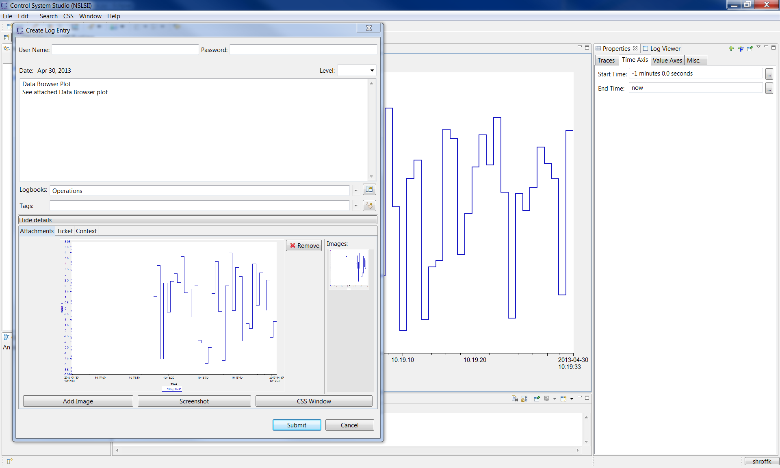
CSS Logbook Interface (Databrowser)

Slide 5
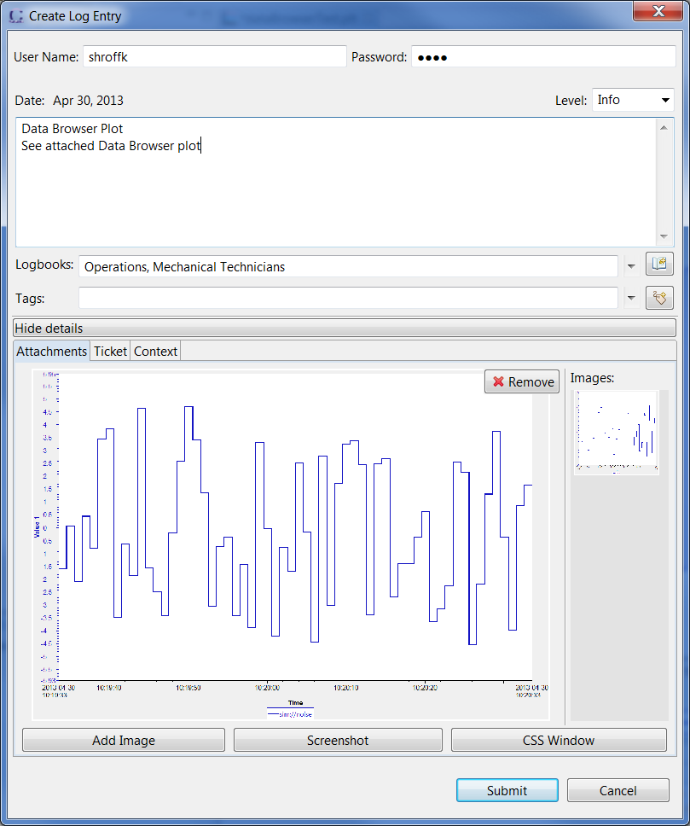
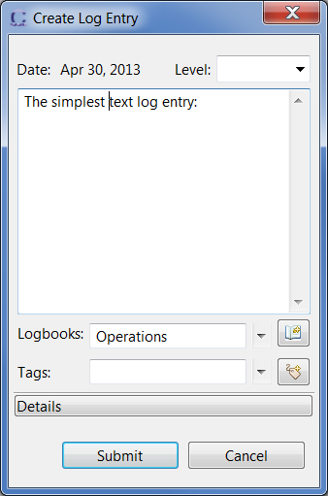
CSS Logbook Entry

Slide 6
Current Logbook Web Application
Technologies
Web application
Built with CakePHP
Using REST datasource
Web service
Built on Glassfish
Apache Jackrabbit embedded for attachments
Log data in mySQL
Lucene in Jackrabbit allows searching of attachments
Application
Apache
CakePHP
Logbook REST
Datasource
Logbook Web Service
Glassfish
REST
Apache Jackrabbit Content Repository
Lucene
mySQL

Slide 7
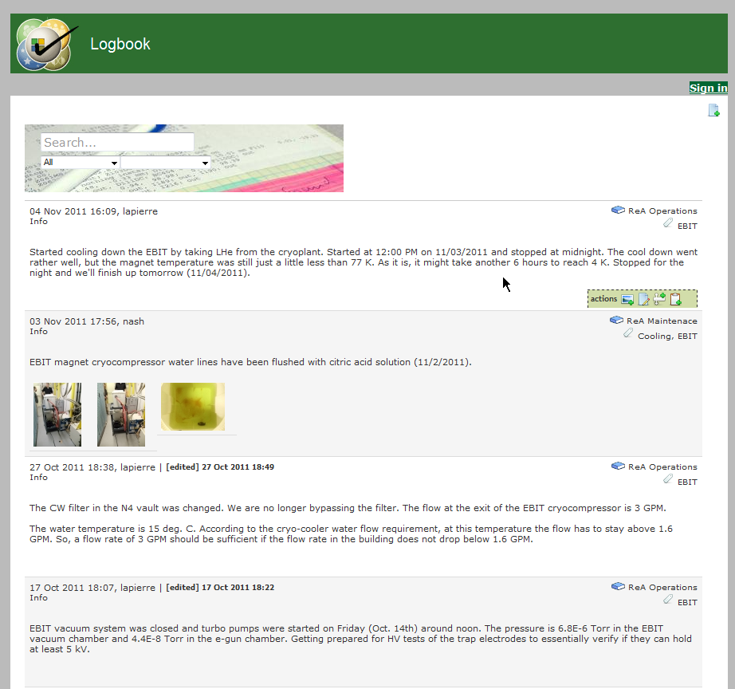
Current Logbook Web Application

Slide 8
Next Logbook Web Application
Technologies
Server-side
Client-side
Twitter Bootstrap (HTML5)
jQuery getJSON() (Javascript)
Application
Apache
Browser
Bootstrap
jQuery
getJSON
Logbook Web Service
Glassfish
REST
Apache Jackrabbit Content Repository
Lucene
mySQL

Slide 9
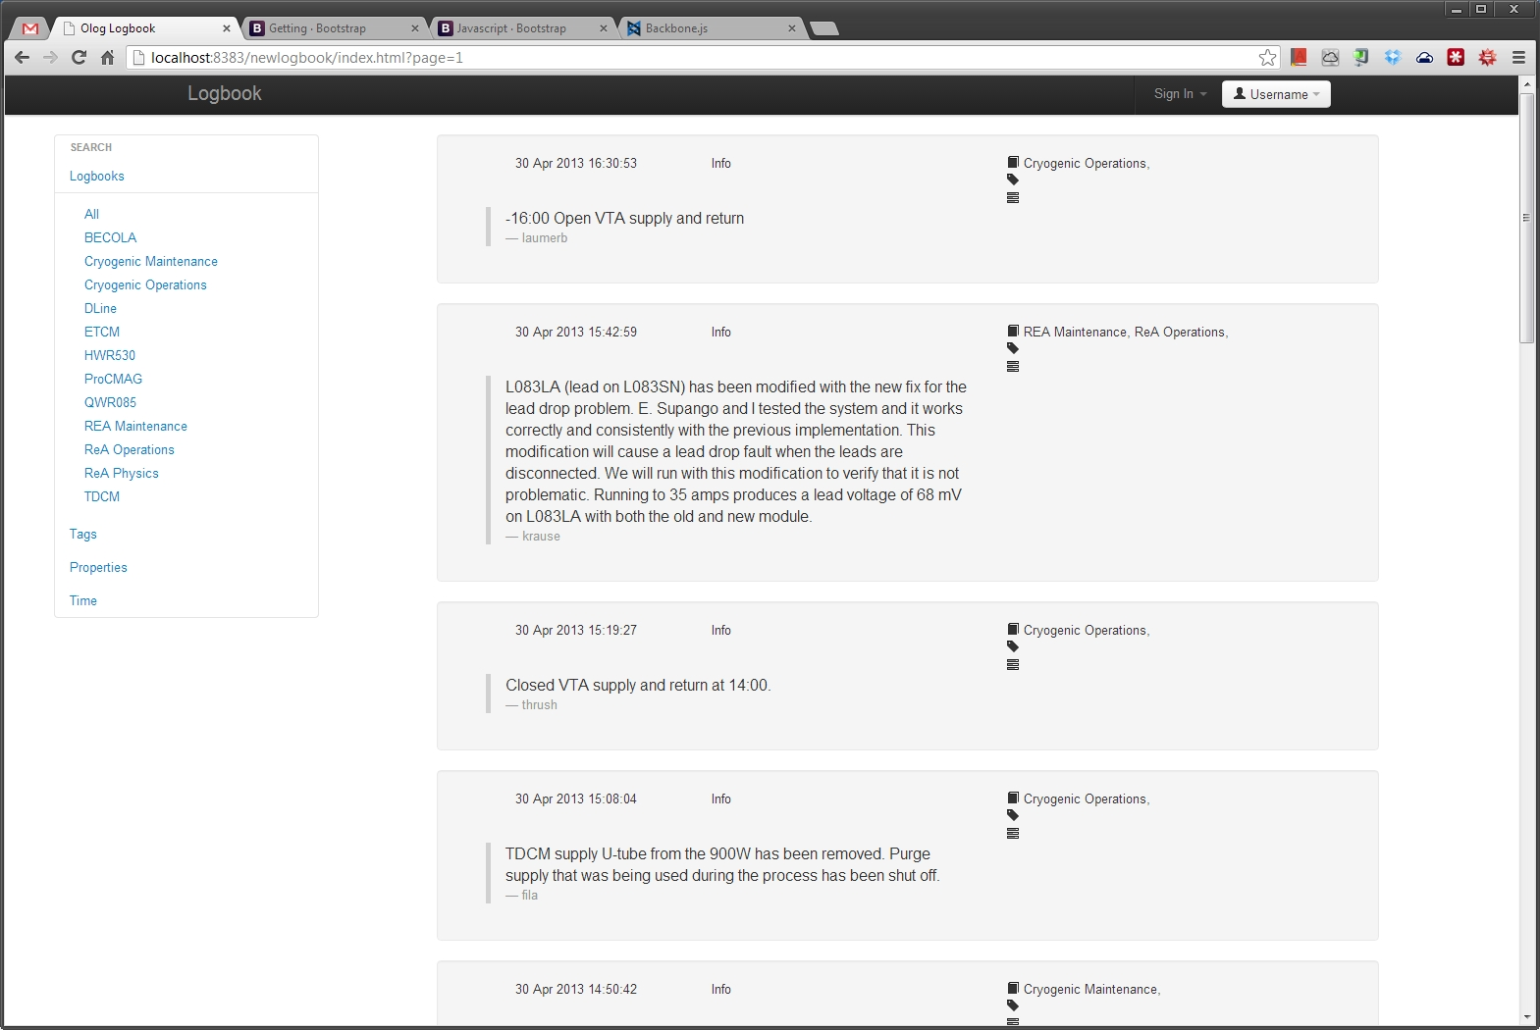
New Logbook* Web Application
*very alpha

Slide 10
Future Work
Release new CSS logbook viewer
Bootstrap web client

Slide 11
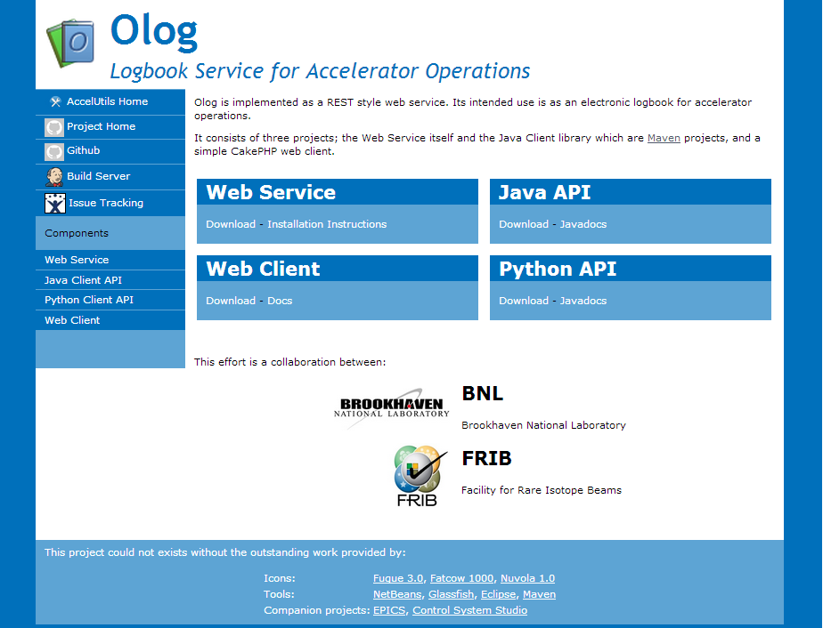
Where to find us
http://olog.github.com contact: berryman@frib.msu.edu

Slide 12
Elog Details: REST API [1]
http GET:
http://irmis3.nscl.msu.edu/Olog/resources/logs?ticket.id=7624
Response:
<?xml version="1.0" encoding="UTF-8" standalone="yes"?><logs>
<log createdDate="2013-01-30T09:08:33-05:00" modifiedDate="2013-01-30T09:08:33 05:00“ owner="berryman" source="127.0.0.1" version="1" id="3670" level="Info" state="Active">
<description>Data Browser Plot See attached Data Browser plot</description>
<logbooks>
<logbook owner="r3logbkg" name="ReA Operations" state="Active">
<id>12</id>
</logbook>
</logbooks>
<tags/>
<properties>
<property groupingNum="0" id="3" name="Context">
<attributes>
<entry>
<key>FileDescription</key>
<value>test</value>
</entry>
<entry>
<key>FileName</key>
<value>test.plt</value>
</entry>
</attributes>
</property>
<property groupingNum="0" id="2" name="Ticket">
<attributes>
<entry>
<key>id</key>
<value>7624</value>
</entry>
<entry>
<key>url</key>
<value> https://intra.nscl.msu.edu/troublereports/detailReport.php?id=7624 </value>
</entry>
</attributes>
</property>
</properties>

Slide 13
Elog Details: REST API [2]
New:
<?xml version="1.0" encoding="UTF-8" standalone="yes"?><logs>
<log createdDate="2013-01-30T09:08:33-05:00" modifiedDate="2013-01-30T09:08:33 05:00“ owner="berryman" source="127.0.0.1" version="1" id="3670" level="Info" state="Active">
<description>Data Browser Plot See attached Data Browser plot</description>
<logbooks>
<logbook owner="r3logbkg" name="ReA Operations" state="Active">
<id>12</id>
</logbook>
</logbooks>
<tags/>
<attachments>
<attachment>
<contentType>image/png</contentType>
<fileName>plot.png</fileName>
<fileSize>12455</fileSize>
</attachment>
<attachment>
<contentType>application/octet-stream</contentType>
<fileName>test.plt</fileName>
<fileSize>4458</fileSize>
</attachment>
</attachments>
</log>

