Slide 1
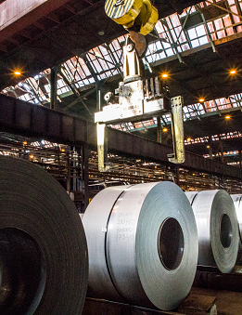
Predicting energy consumption of a smart small-scale steel industry in South Korea using regression analysis.

Slide 2

Objectives of the study
Methodology
Discussion & Conclusion

Slide 3

1. OBJECTIVES OF THE STUDY

Slide 4
Objectives of study
i. To create a multiple linear regression model of energy consumption with factors that influence its variability.
ii. To determine which factors significantly contribute to the increase in energy consumption.
iii. To predict future energy consumption using the model created.

Slide 5
Dataset used for model building.
Daewoo Steel Co. Ltd. in Gwangyang, South Korea.
Contains 10 variables and 35040 observations.
The dependent variable is Usage_kWh.
The independent variables are detailed below.
Lagging_Current_Reactive.Power_kVarh
Leading_Current_Reactive_Power_kVarh
tCO2(CO2)
Lagging_Current_Power_Factor
Leading_Current_Power_Factor
NSM

Slide 6

2. METHODOLOGY

Slide 7
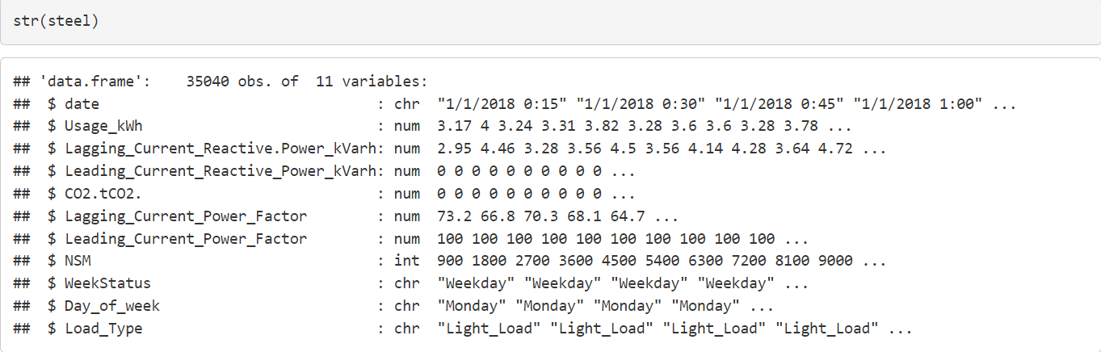
2.1 EXPLORATORY DATA ANALYSIS
a. Examined the structure of the data set.
b. Detected missing values in the data set

Slide 8
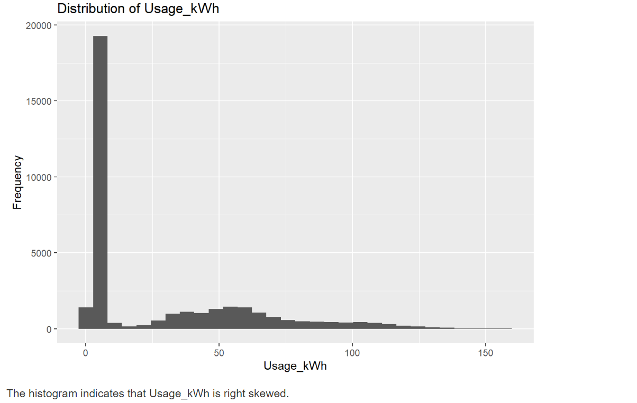
c) Examined the distribution of the response variable

Slide 9
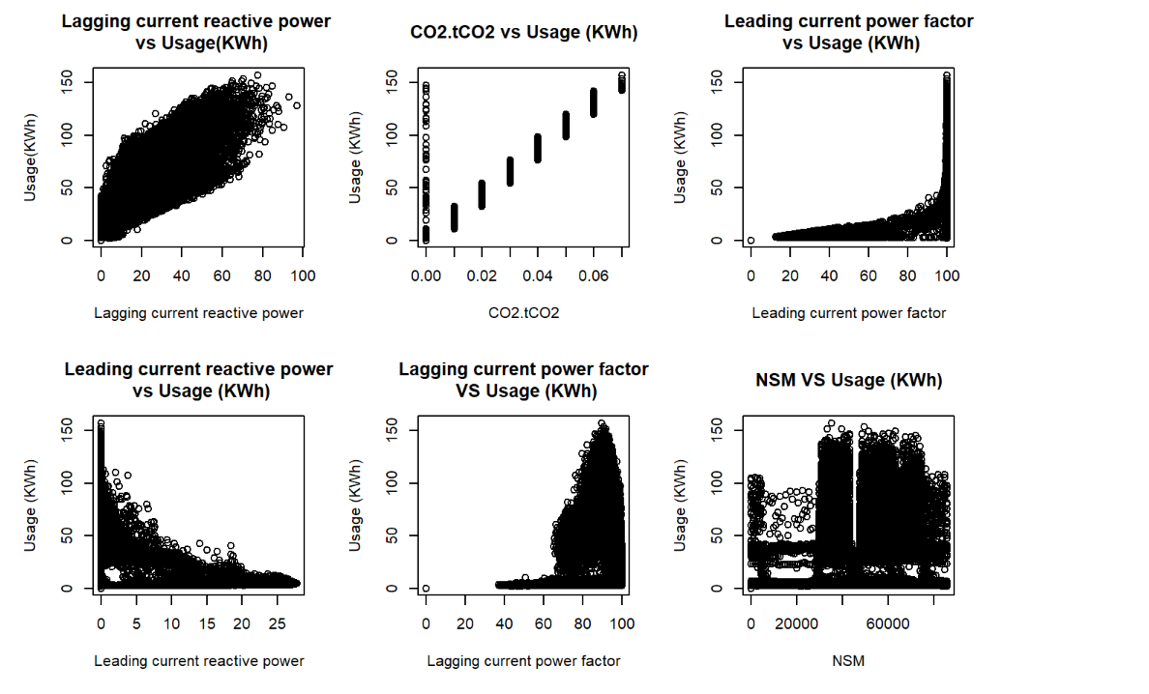
d) Examined the relationship between the response variable and all regessors

Slide 10
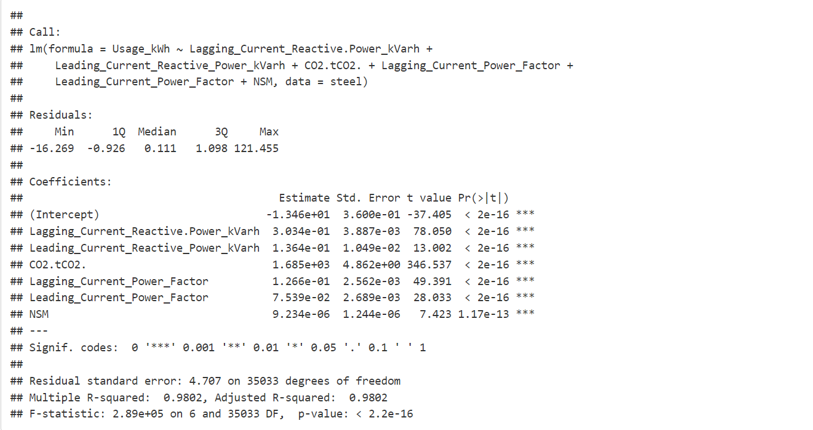
2.2 Model building
Base line model considers all the chosen regressors.

Slide 11
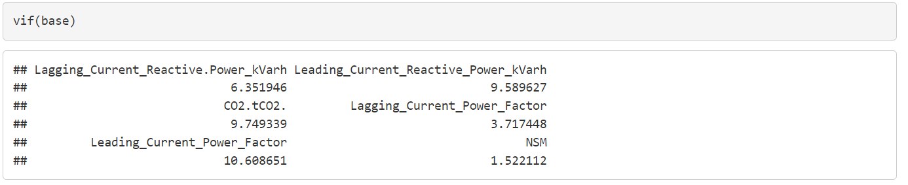
Checked multicollinearity for baseline model.

Slide 12
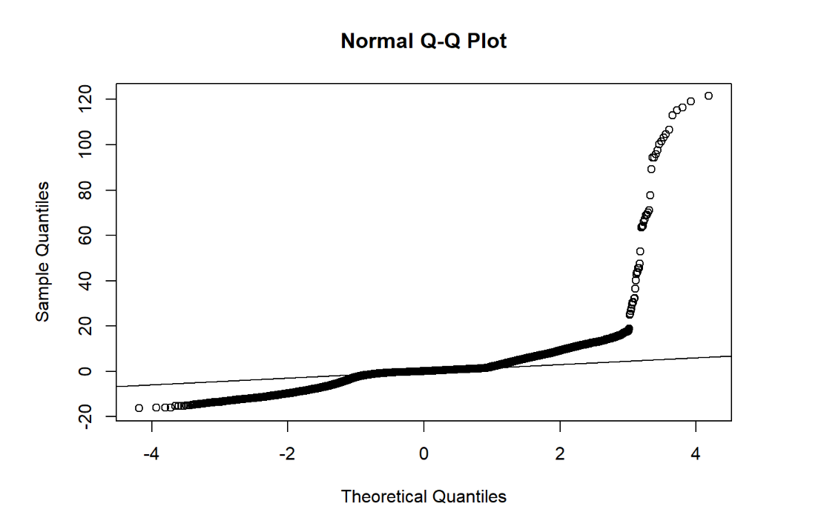
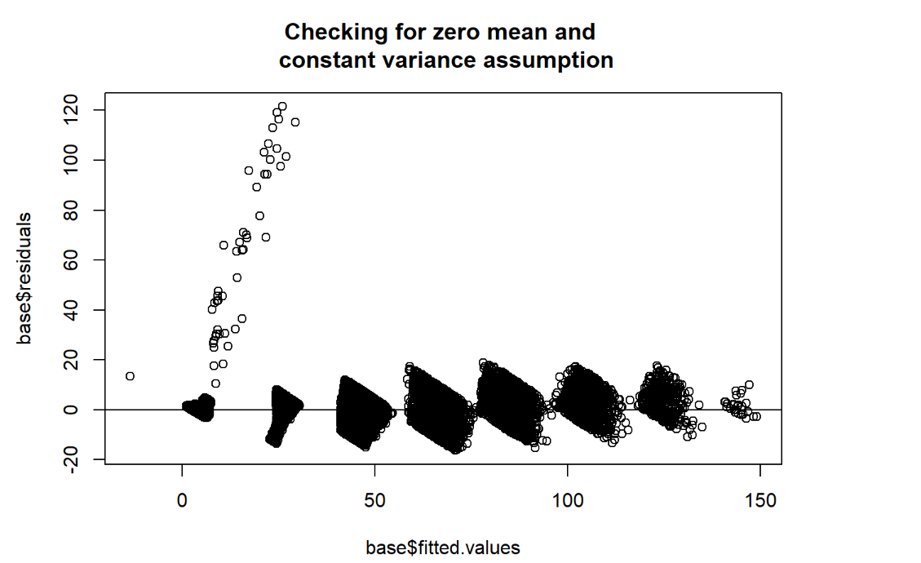
Residual analysis of the baseline mdoel

Slide 13
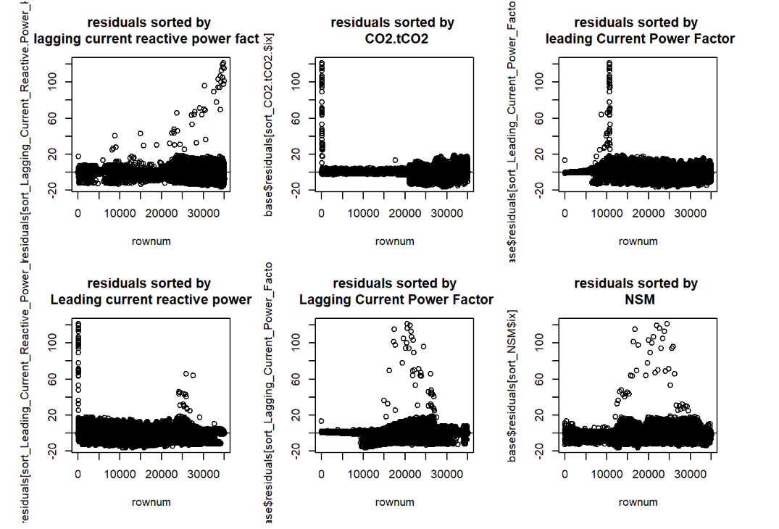
Independence of error terms for baseline model

Slide 14
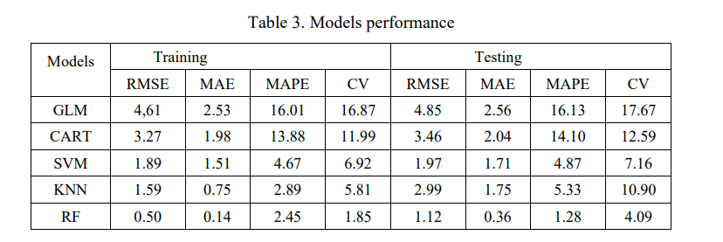
Transformation.
We tried the transforming the response variable and the regressors.
There was no appropriate transformation for achieving linearity relationship.
Table 1: “the GLM model produce highest values of RMSE, MAE, MAPE and CV values in the test set. This shows the data is not linearly related to any of the independent variables” (Sathishkumar et.al., 2020)

Slide 15
Addressing multicollinearity
Computed the VIF
Performed correlation analysis
Examined the partial F-statistic for each regressor variable.
Also deleted any insignificant regressors after addressing multicollinearity.

Slide 16
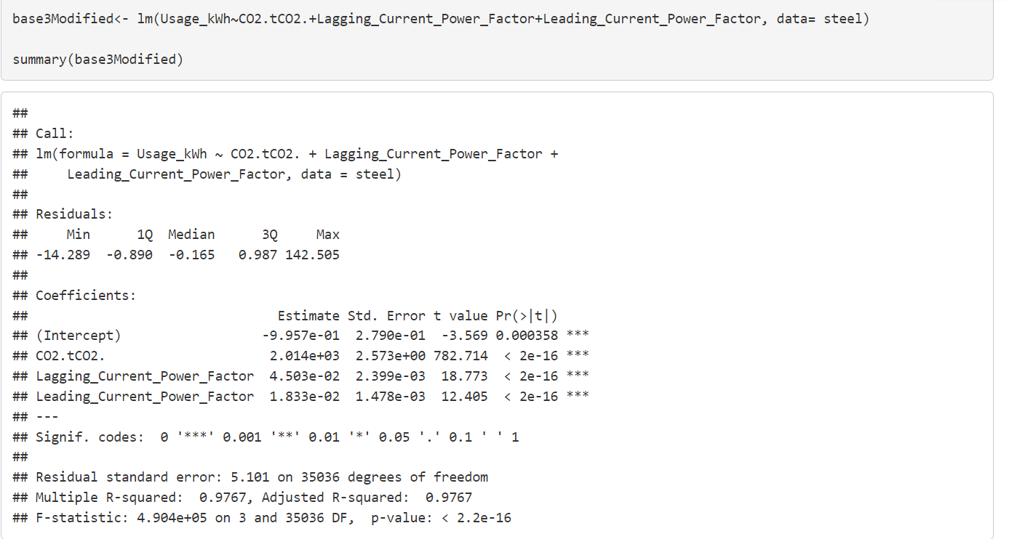
New model

Slide 17
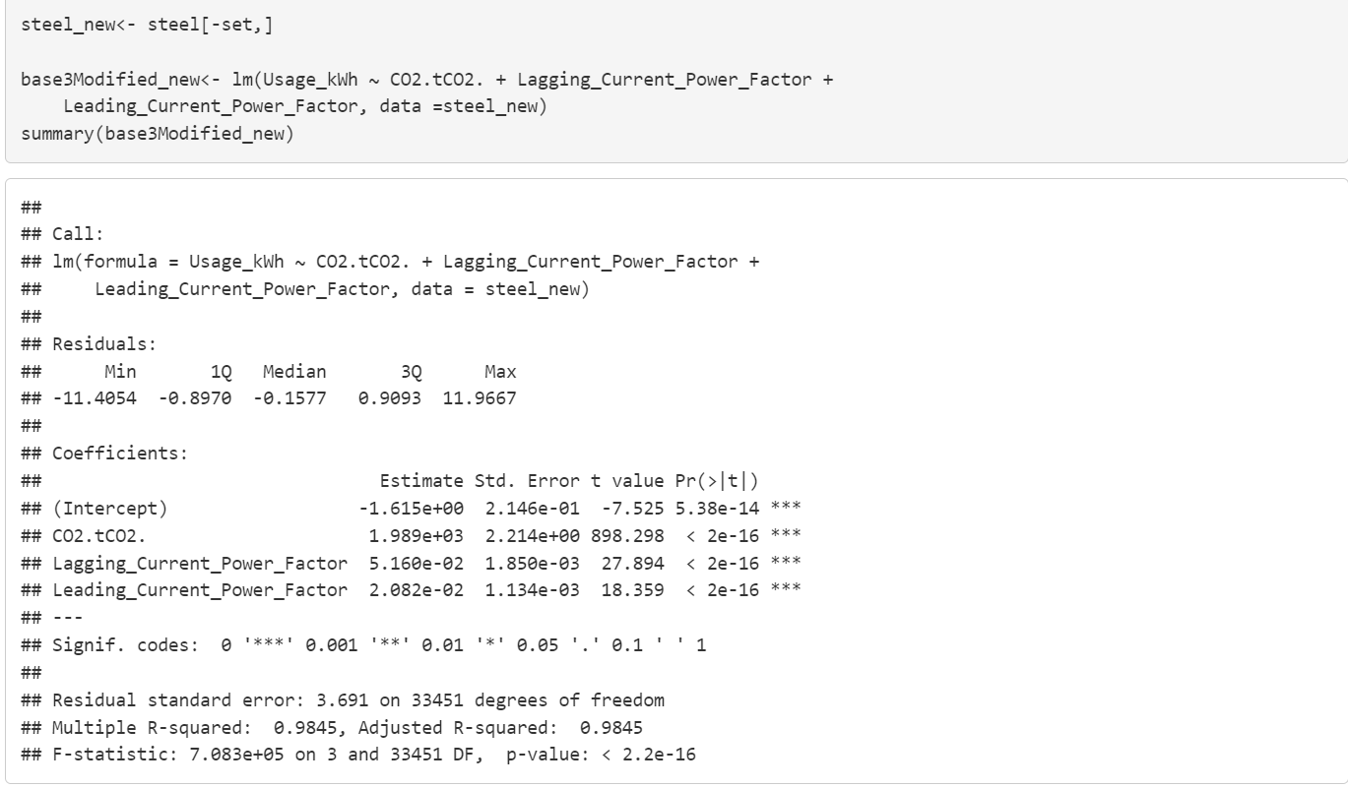
Identifying influential points, outliers, leverage points.
We fitted new model (Modified) on a data set excluding the outliers, leverage and influential points.

Slide 18
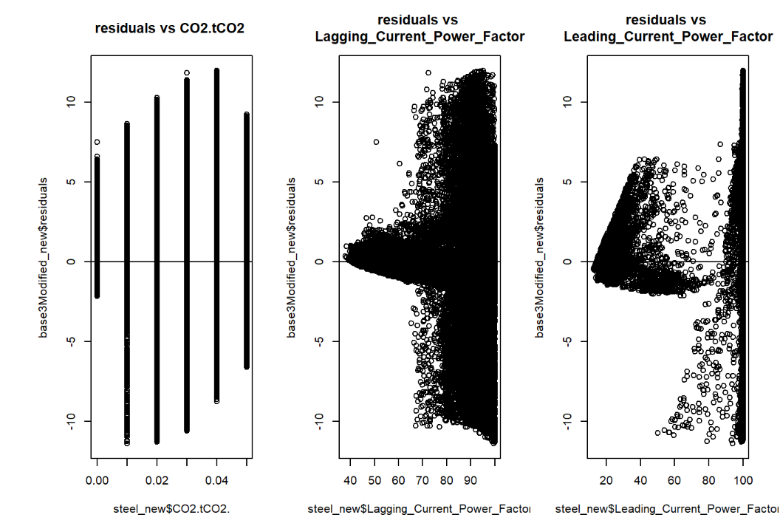
Checking Linear model assumptions for the modified model

Slide 19
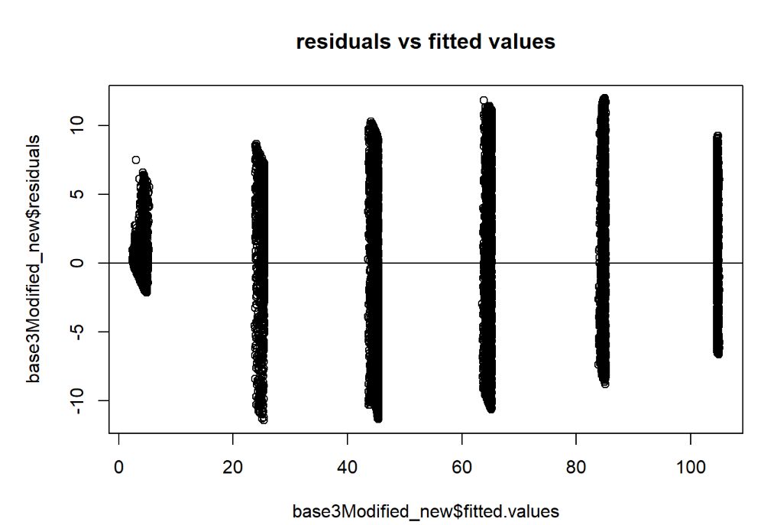
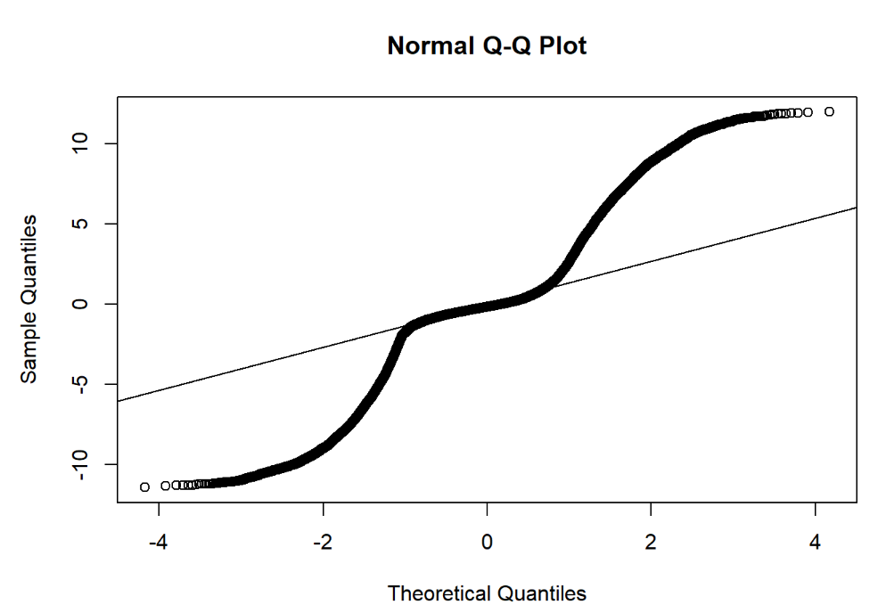

Slide 20
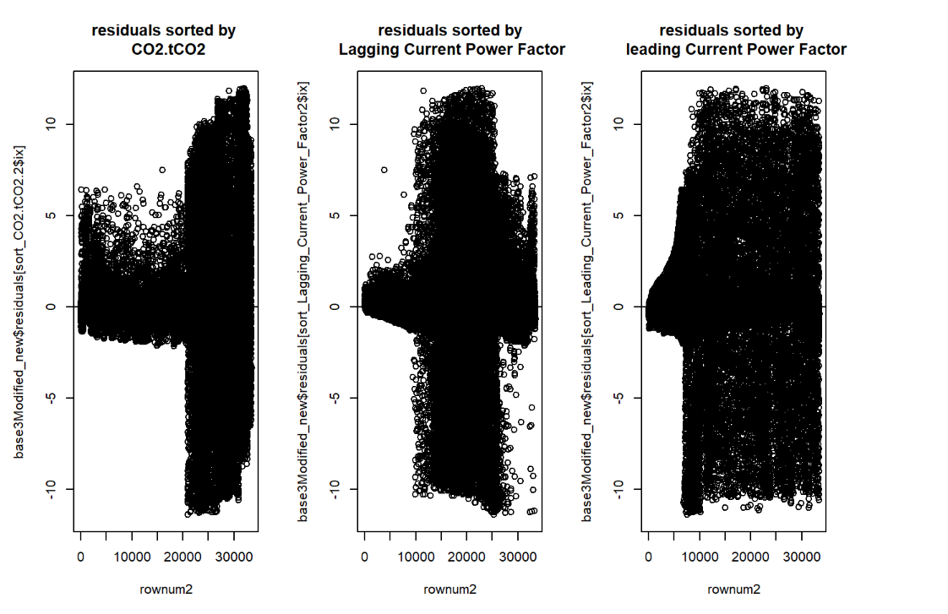

Slide 21

3. DISCUSSION AND CONCLUSION

Slide 22
3.1 DISCUSSION
The response variable is not linearly related with the independent variables.
The modified model is better than the new model.
Challenge: There was a need of a subject expert in energy consumption to guide on the behavior of factors that influence energy consumption.
Limitation of study: The analysis is conducted for just one industry.
Model | Adjusted R squared | MSE
New model | 0.9767 | 26.02020
Modified model | 0.9845 | 13.62348

Slide 23
3.2 CONCLUSION.
We shall report both models however we prefer the modified model to the new model.
New model equation;
Predicted Usage (KWh) = -9.957x 10⁻¹ + 2.014 x10³ x CO2.tCO2 + 4.503x10⁻² x Lagging_Current_Power_Factor + 1.833x10⁻² x Leading_Current_Power_Factor
Modified model equation;
Predicted Usage (KWh) = -1.615 +1.989x10³ x CO2.tCO2 + 5.160x10⁻²x Lagging_Current_Power_Factor + 2.082 x10⁻² x Leading_Current_Power_Factor
We recommend future researchers to use robust machine learning algorithms that can deal with non-linear relationships. Algorithms Like;
Random Forests,
Classification Regression Trees
Support Vector Machine.
etc

Slide 24


Slide 25


