Slide 1
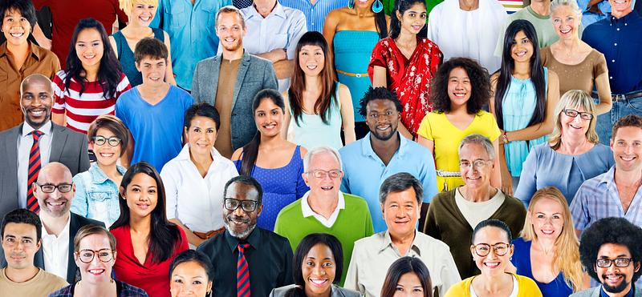

EXPLORING THE CONNECTION BETWEEEN MONEY ,CULTURE AND MARRIAGE
Presented by : OLOYEDE FESTUS OYEBISI
Student number:2345336

Slide 2


WHAT DRIVES MARITAL CHOICES?
OBJECTIVE : “Investigating if Income and ethnicity has an influence on marital status”
QUESTIONS: “How does income vary by marital status? Are there ethnic disparities in marriage trends ?”
Karney, Benjamin R. 2021. “Socioeconomic Status and Intimate Relationships.” Annual Review of Psychology 72 (1): 391-414. https://doi.org/10.1146/annurev-psych-051920-013658.

Slide 3
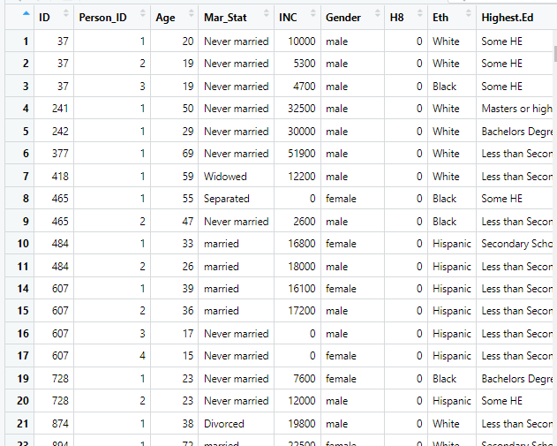
THE DATA STORY: “DATA INSIGHTS FROM 27,410 PEOPLE”
2021 ENGLISH HOUSEHOLD CENSUS DATA SET CONTAINING DATAS FROM 27,410 PEOPLE.
“VARIABLES INCLUDE Mar_Stat, INC , Eth, and Gender”
“Cleaned data by removing null values and renaming variables for clarity”

Slide 4
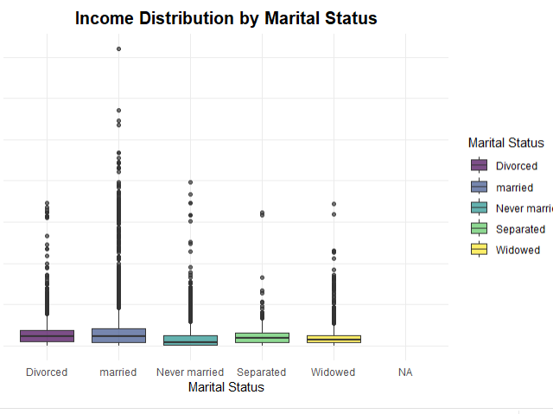
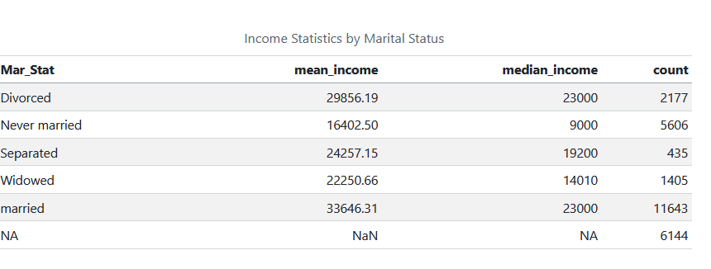
HOW DOES INCOME VARY BY MARITAL STATUS ?
MARRIED INDIVIDUALS SHOW A HIGHER MEDIAN INCOME
NEVER MARRIED INDIVIDUALS GENERALLY HAVE LOWER INCOME
HIGHER MEAN AND MEDIAN INCOME FOR MARRIED INDIVIDUALS
According to Brown and Smith (2021), marriage provides financial gains and benefits for couples as they usually take on shared responsibilities with double income dynamics within the home. This plot and analysis share similar sentiments.
Brown, M. and Smith, J. (2021) 'Marriage, Income, and Economic Stability: An Analysis', Social Economics Journal, 28(2), pp. 78-91.

Slide 5
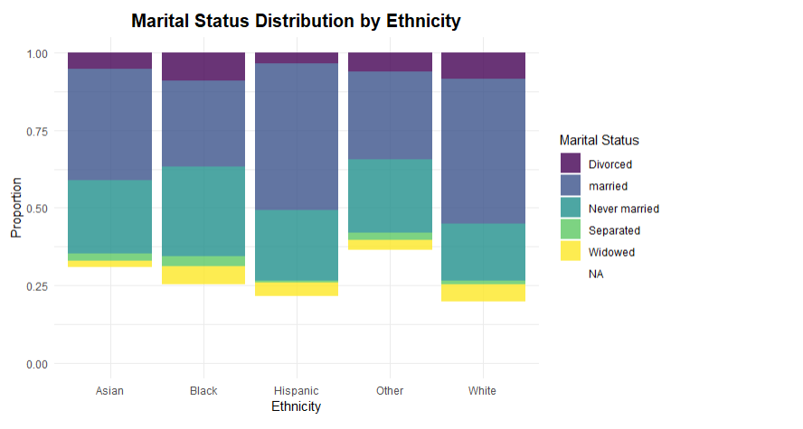
CULTURAL PATTERNS IN MARRIAGE CHOICES
MARITAL STATUS VARIES AMONG DIFFERENT ETHNIC GROUPS
IT IS CERTAIN THAT SOME ETHNIC GROUPS HAVE HIGHER PERCENTAGE OF MARRIED INDIVIDUALS , WHILE SOME ETHNICITIES SHOW A LARGER “NEVER MARRIED ” POPULATION
THE BLACKS HAVE THE HIGHEST NEVER MARRIED PERCENTAGE
THE HISPANICS HAVE THE HIGHEST MARRIED PERCENTAGE

Slide 6
DATA CRITICISM AND CONCLUSION
DATA CRITICISM
Missing income data
inaccurate binary gender classifications ,no geographical location ,work experience. This would have provided more understanding of income disparities.
The dataset is quantitative but lacks qualitative insights that could provide context behind income disparities, occupational segregation that affects earning among minority group
CONCLUSION
Higher income very much associated with marriage across all ethnic groups
Cultural and social factors influence marital trends by ethnicity
Higher Income for married individuals across all ethnic groups.
Income distribution highlights cultural differences and economic differences.

Slide 7

REFERENCES
Karney, Benjamin R. 2021. “Socioeconomic Status and Intimate Relationships.” Annual Review of Psychology 72 (1): 391-414. https://doi.org/10.1146/annurev-psych-051920-013658.
Wickham, Hadley. 2014. “Tidy Data.” Journal of Statistical Software 59 (10). https://doi.org/10.18637/jss.v059.i10.
Wickham, Hadley, Mara Averick, Jennifer Bryan, Winston Chang, Lucy D’Agostino McGowan, Romain François, Garrett Grolemund, et al. 2019. “Welcome to the Tidyverse” 4: 1686. https://doi.org/10.21105/ioss.01686._
2021 English Household Census Data_
Office for National Statistics (2021)_
R Core Team (2023). R: A Language and Environment for Statistical Computing
Brown, M. and Smith, J. (2021) 'Marriage, Income, and Economic Stability: An Analysis', Social Economics Journal, 28(2), pp. 78-91.

