Slide 1
BECAUSE
Because
The analyst agent that shows its work. Ask why something happened and audit every claim.
TRACK
TEAM
Explain Why
OlsOls Agents
Notes:
GenAI Works Open Agent Hackathon 2026. Live demo: https://because-agent.vercel.app. Code: https://github.com/OlsOls4/because

Slide 2
02/15
Why questions get fluent answers that nobody can check.
LLMs explain fluently but unverifiably. Dashboards show what changed, never why. Doing it properly takes hours of pulling and lining up sources.
Notes:
The problem: answering 'why did X change?' properly means pulling several sources, aligning periods, testing competing explanations and writing down what does not fit.

Slide 3
03/15
Who it is for
Analysts
Journalists
Students and investors
Explain a margin or revenue move from filings in seconds, with the bridge in points of revenue.
Check a claimed cause of inflation or unemployment against official series before publishing.
Learn to reason from evidence: see the hypotheses that failed, not just the answer.
Notes:
Target users: anyone who has to defend a 'because' to a sceptical reader.

Slide 4
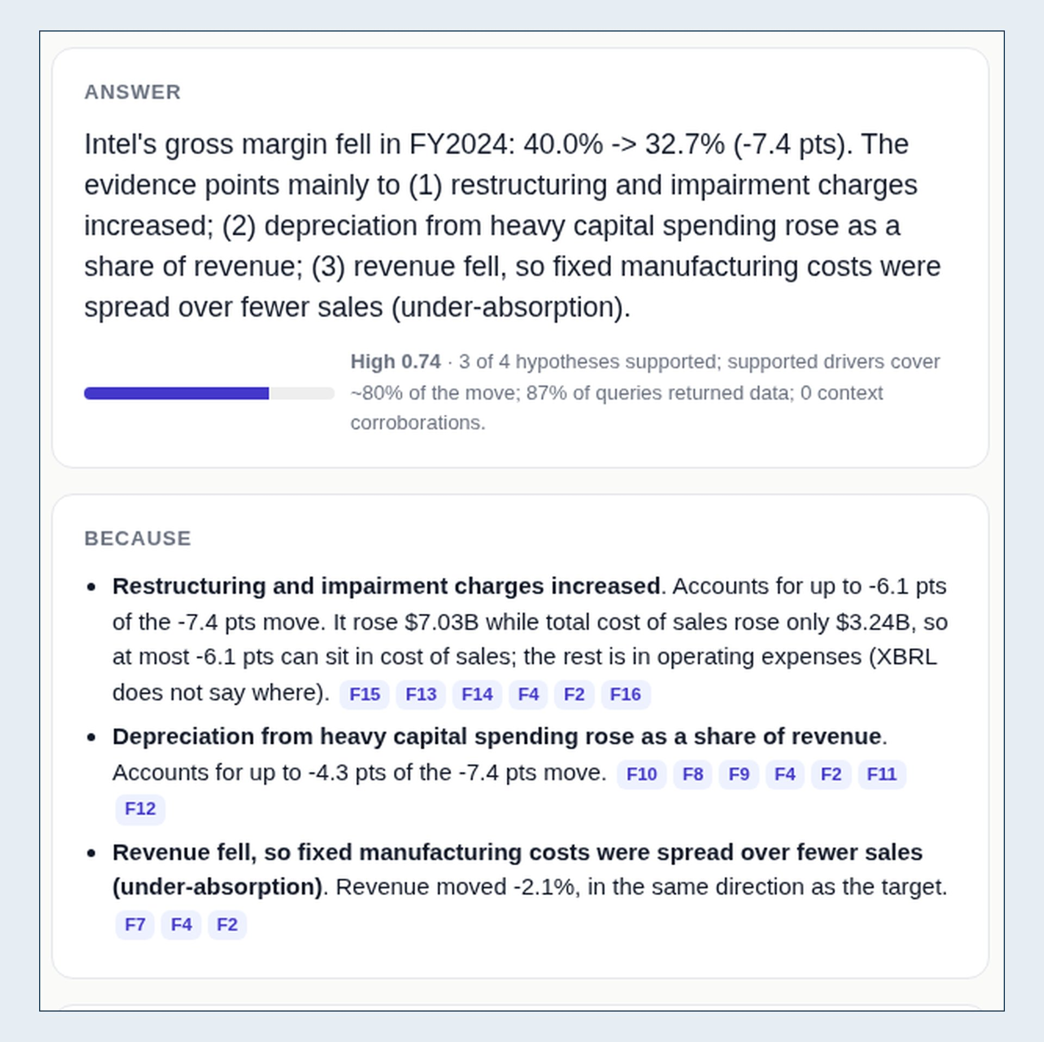
04/15
Ask why then audit
Intel's 2024 gross margin from SEC filings. Every claim cites findings; every finding cites a query and a source row.
Notes:
Screenshot of https://because-agent.vercel.app, Intel 2024 gross margin: 40.0% -> 32.7%, drivers restructuring/impairment, depreciation, lower revenue. Confidence High 0.74.

Slide 5
05/15
One investigation
SCOUT
RECALL
QUERY AND TEST
ANSWER AND REMEMBER
Classifies the question, runs the guard and issues an HMAC-signed contract for the allowed tools.
H-MEM returns what the agent already believes and which query it came from.
Zetaris SQL pulls target and drivers. Each hypothesis gets a numeric rule and a verdict.
Cited claims, counter-evidence and confidence; every finding is written back with provenance.
Notes:
The LLM is optional. Answers are computed from data first; an LLM may only rewrite findings and is rejected unless every sentence cites a finding and every number appears in the evidence.

Slide 6
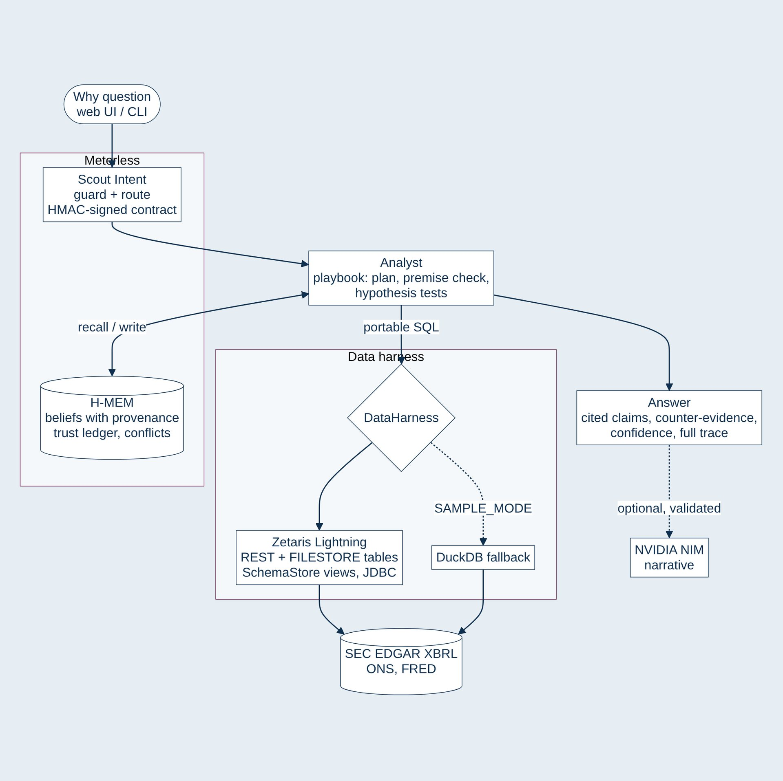
06/15
Architecture
Meterless decides and remembers. Zetaris federates the data. The same portable SQL runs on a DuckDB fallback.
Notes:
Scout -> Analyst -> DataHarness (ZetarisBackend over JDBC / UI proxy, DuckDB in SAMPLE_MODE) -> SEC EDGAR XBRL, ONS, FRED. H-MEM recall and write. Optional NVIDIA NIM narrative, validated.

Slide 7
07/15
01
Sponsor technology
Zetaris federates. Meterless decides and remembers.

Slide 8
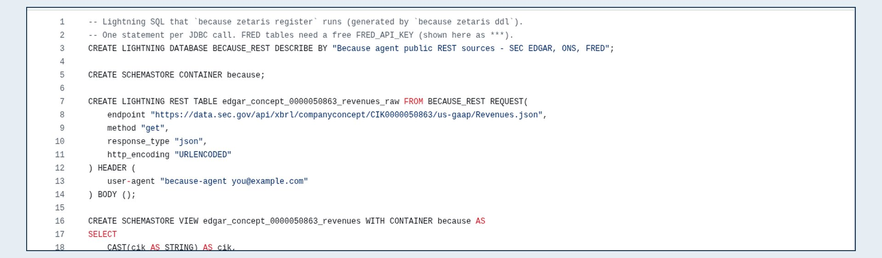
08/15
Three public source families federated by Lightning, queried with one portable SQL dialect.
Tables
SEC, ONS as REST tables; FRED as FILESTORE CSV
Zetaris is the data harness
Channels
JDBC, UI SQL proxy or REST
CI
Real Lightning bundle on GitHub Actions
Notes:
Unique: FRED without an API key federated as FILESTORE CSV; REST tables CACHE TABLE'd after registration; companies registered lazily on first question; views reused never dropped. Workflow: .github/workflows/zetaris-e2e.yml.

Slide 9
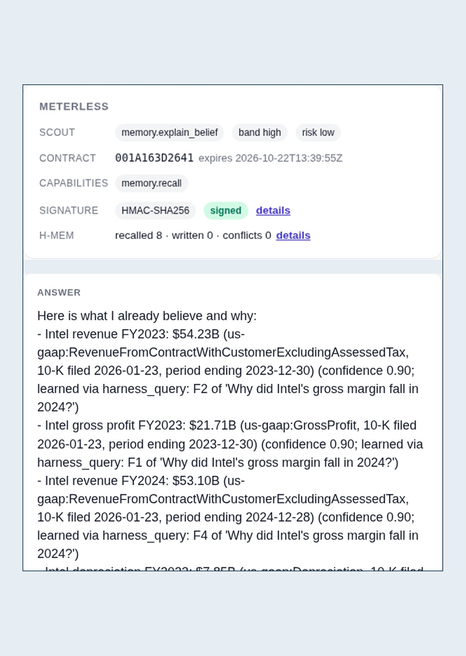
09/15
H-MEM
Every finding is a memory with SQL, rows and source URL. Conflict scan flags restated numbers.
Meterless remembers why
SCOUT INTENT
Intent registry, five-layer guard, HMAC-SHA256 contracts with TTL and scope checks.
H-MEM stores beliefs with the query that produced them. Scout gates every tool call.
ASK IT WHY
Memory recall answers what it believes and audits the trail behind each belief.
Notes:
Unique: memory provenance makes 'why do you believe this?' answerable across sessions. Prompt injection is refused by Scout before any tool runs (examples/outputs/guard-blocked.json).

Slide 10
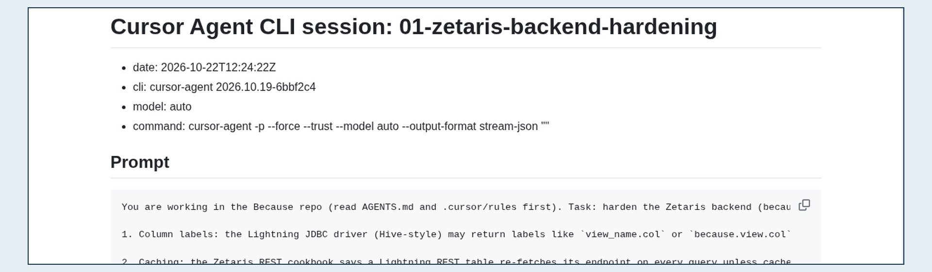
10/15
Three headless Cursor Agent CLI sessions did real work, logged in the repo.
Rules
AGENTS.md and .cursor/rules
Built in Cursor
Sessions
Zetaris hardening, FRED FILESTORE, UI polish
NVIDIA
NIM is the first-choice narrative LLM
Notes:
Sessions: Zetaris backend hardening; FRED as FILESTORE + 'because zetaris sql'; web UI polish. docs/cursor-sessions/. NVIDIA NIM is the first-choice LLM provider for the validated narrative (meta/llama-3.3-70b-instruct).

Slide 11
11/15
02
Proof and next
Conformance, tests and the road ahead.

Slide 12
12/15
Results
13/13
1.00
58
0.70-0.94
H-MEM conformance
Scout eval top-1
Offline tests
Confidence on 4 saved runs
Notes:
Sources: conformance/meterless/hmem-scorecard.txt, conformance/meterless/scout-eval-report.md, pytest -q (58 passed), examples/outputs/. The v1 Scout corpus is a smoke set, treat as conformance not a benchmark.

Slide 13
13/15
Stack
LAYER
TECHNOLOGY
Routing
Meterless Scout Intent
Memory
Meterless H-MEM
Data harness
Zetaris Lightning, DuckDB fallback
Data
SEC EDGAR, ONS, FRED, Wikipedia
Narrative
NVIDIA NIM, Groq or Gemini
App
Python, FastAPI, Vercel
Notes:
Dependencies: duckdb, httpx, fastapi, uvicorn, python-dotenv; optional JayDeBeApi + JPype1 for Zetaris JDBC.

Slide 14
14/15
Next
Semantic layer
Markovian
Richer data
Dreaming
Zetaris USL model joining EDGAR facts and macro series
Bounded state for long, multi-company investigations
CPI weights, XBRL segments, Eurostat
Cross-question insights proposed for approval
Notes:
From README Next steps.

Slide 15
15/15
Read the trace
because-agent.vercel.app · github.com/OlsOls4/because
DEMO
CODE
because-agent.vercel.app
github.com/OlsOls4/because
Notes:
MIT licence. Built during the build window from 22 Oct 2026; pre-existing components declared in README and docs/SPONSORS.md.

