Slide 1
Edge Detection

Slide 2
Edge Detection
What are edges in an image?
Edge Detection
Edge Detection Methods
Edge Operators
Matlab Program
Performance

Slide 3


What are edges in an image?
Edges are those places in an image that correspond to object boundaries.
Edges are pixels where image brightness changes abruptly.
Brightness vs. Spatial Coordinates

Slide 4
More About Edges
An edge is a property attached to an individual pixel and is calculated from the image function behavior in a neighborhood of the pixel.
It is a vector variable (magnitude of the gradient, direction of an edge) .

Slide 5
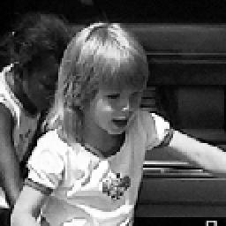
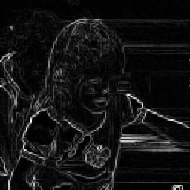
Image To Edge Map

Slide 6
Edge Detection
Edge information in an image is found by looking at the relationship a pixel has with its neighborhoods.
If a pixel’s gray-level value is similar to those around it, there is probably not an edge at that point.
If a pixel’s has neighbors with widely varying gray levels, it may present an edge point.

Slide 7
Edge Detection Methods
Many are implemented with convolution mask and based on discrete approximations to differential operators.
Differential operations measure the rate of change in the image brightness function.
Some operators return orientation information. Other only return information about the existence of an edge at each point.

Slide 8
Roberts Operator
Mark edge point only
No information about edge orientation
Work best with binary images
Primary disadvantage:
  High sensitivity to noise
  Few pixels are used to approximate the gradient

Slide 9
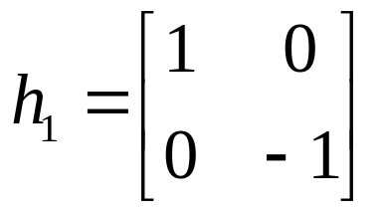
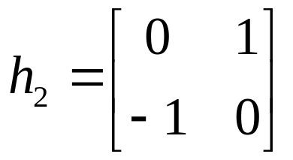
Roberts Operator (Cont.)
First form of Roberts Operator
Second form of Roberts Operator

Slide 10
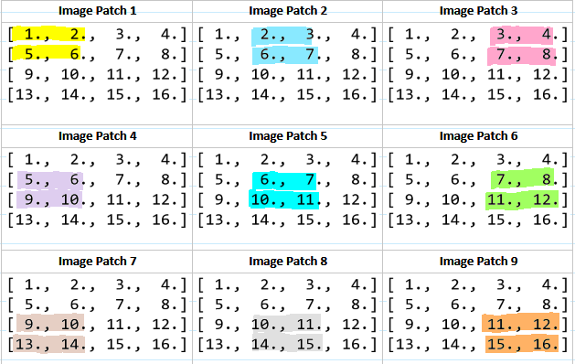
Convolution

Slide 11
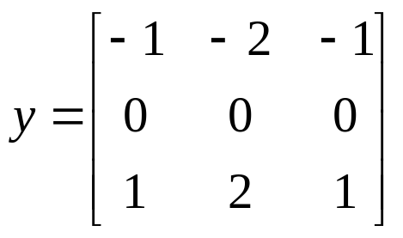
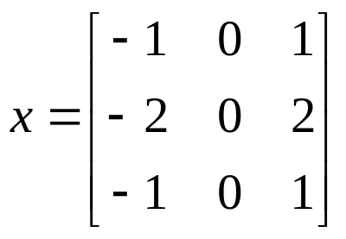
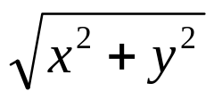
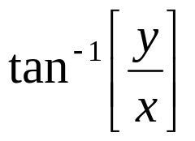
Sobel Operator
Looks for edges in both horizontal and vertical directions, then combine the information into a single metric.
The masks are as follows:
Edge Magnitude = Edge Direction =

Slide 12
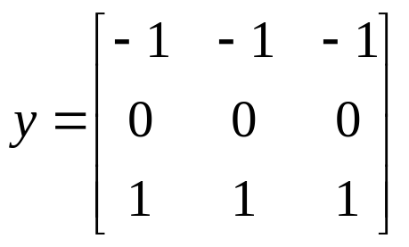
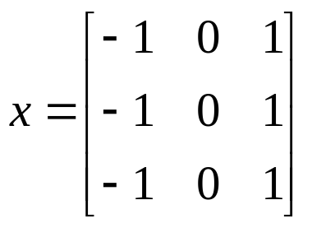
Prewitt Operator
Similar to the Sobel, with different mask coefficients:
Edge Magnitude = Edge Direction =

Slide 13
Kirsch Compass Masks
Taking a single mask and rotating it to 8 major compass orientations: N, NW, W, SW, S, SE, E, and NE.
The edge magnitude = The maximum value found by the convolution of each mask with the image.
The edge direction is defined by the mask that produces the maximum magnitude.

Slide 14
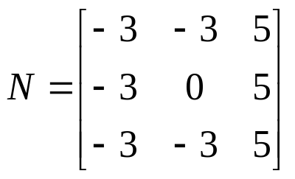
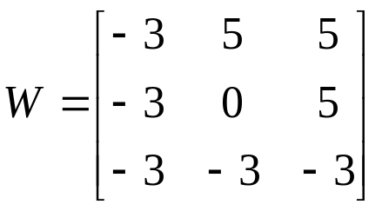
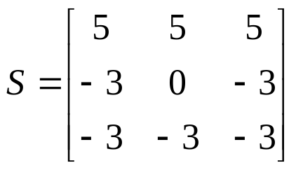
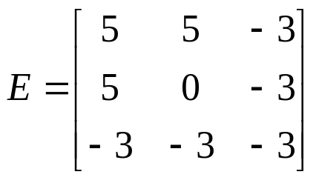
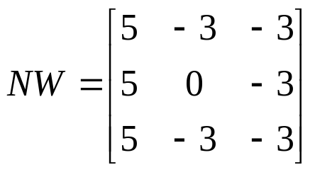
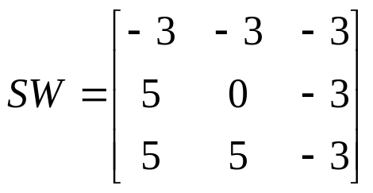
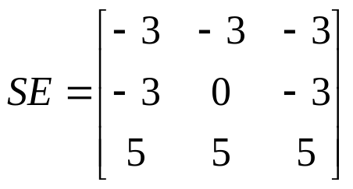
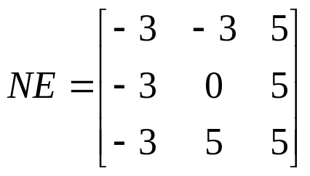
Kirsch Compass Masks (Cont.)
The Kirsch masks are defined as follows:
EX: If NE produces the maximum value, then the edge direction is Northeast

Slide 15
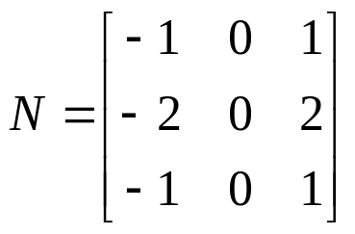
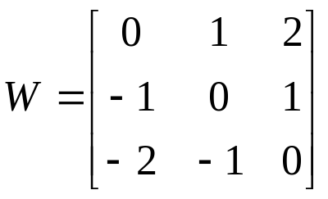
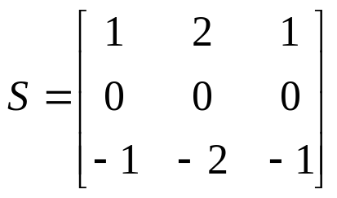
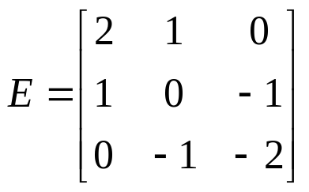
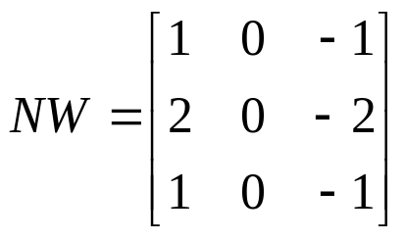
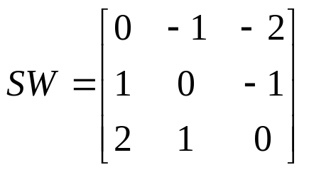
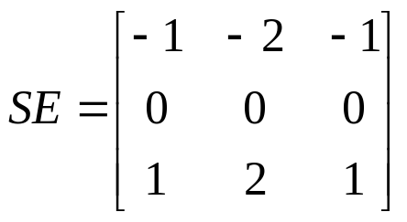
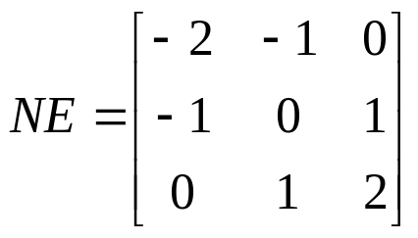
Robinson Compass Masks
Similar to the Kirsch masks, with mask coefficients of 0, 1, and 2:

Slide 16
Laplacian Operators
Edge magnitude is approximated in digital images by a convolution sum.
The sign of the result (+ or -) from two adjacent pixels provide edge orientation and tells us which side of edge brighter

Slide 17
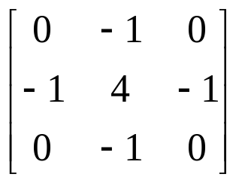
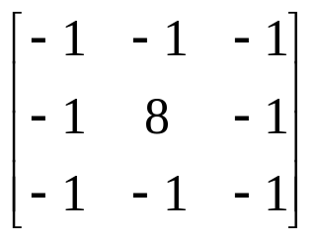
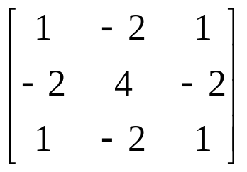
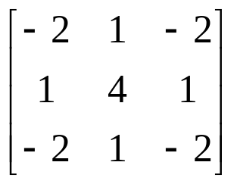
Laplacian Operators (Cont.)
Masks for 4 and 8 neighborhoods
Mask with stressed significance of the central pixel or its neighborhood

Slide 18
Edge Map In Matlab Program
Implement all methods in this presentation
Set up edge detection mask(s)
Use convolution method (filter2 function)
Calculate edge magnitude
Show the result of edge map
No calculation of edge direction

Slide 19
Performance
Sobel and Prewitt methods are very effectively providing good edge maps.
Kirsch and Robinson methods require more time for calculation and their results are not better than the ones produced by Sobel and Prewitt methods.
Roberts and Laplacian methods are not very good as expected.

Slide 20
A Quick Note
Matlab’s image processing toolbox provides edge function to find edges in an image.
Edge function supports six different edge-finding methods: Sobel, Prewitt, Roberts, Laplacian of Gaussian, Zero-cross, and Canny.
Edge is a powerful edge-detection method

