Slide 1
⬡ Google Developer Groups
Data Science & ML Community
Deep Dive into
Data Cleaning
& EDA
Using a Retail Sales Dataset · 2,000+ transactions
01 Handling Missing Values
02 Duplicates & Inconsistencies
03 Outlier Detection (IQR · Isolation Forest · Binning)
04 EDA — Univariate · Bivariate · Multivariate
05 Visualisation Techniques
06 Correlation Analysis
07 Extracting Business Insights
08 ML-Ready Pipeline
Prepared by Oluwafemi ABIONA
LinkedIn

Slide 2
Our Dataset: Retail Sales Transactions
2,018 rows · 18 columns — injected with real-world quality issues
Column | Type | Notes
OrderID | String | Unique transaction ID
OrderDate | DateTime | Date of purchase
Region / City | String | Geographic info — 2% Region missing
Category | String | 6 product categories + inconsistencies
Channel | String | Online / In-Store / Wholesale
UnitPrice | Float | Price per unit (₦)
Quantity | Int | Units sold (1–20)
Discount | Float | 0–25% discount applied
Revenue | Float | Price × Qty × (1−Disc) — has outliers
Profit | Float | Derived margin figure
CustomerAge | Float | ~11% missing
Rating | Float | 1–5 stars, ~7% missing
ReturnFlag | Int | 0 = kept, 1 = returned (12% rate)

Slide 3
01
Handling Missing Values
Detect · Quantify · Impute
GDG Data Science & ML Community

Slide 4
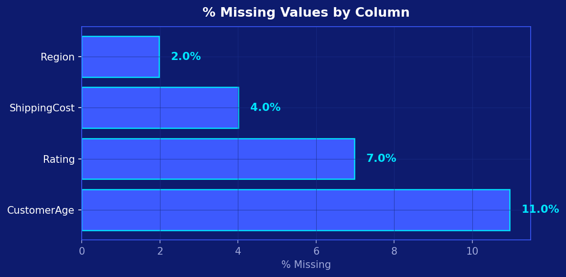
Detecting Missing Values
missingno charts · df.info() · null percentage analysis
import missingno as msno
import pandas as pd
df = pd.read_csv('sales_data.csv')
# Quick overview
df.info()
# Count + percentage missing
miss = pd.DataFrame({
'Count': df.isnull().sum(),
'Pct': df.isnull().mean()*100
}).query('Count > 0').sort_values('Pct', ascending=False)
# Visual charts
msno.bar(df) # bar chart
msno.matrix(df) # pattern matrix
CustomerAge — 11% missing (impute with median)
Rating — 7% missing (impute with mode)
ShippingCost — 4% missing (impute with mean)
Rule: > 50% missing → drop column · < 5% → safe to impute

Slide 5
Imputation Strategies
Mean · Median · Mode — and when to use each
Mean
Median
Mode
Drop Row
Continuous, symmetric distribution
Continuous with skew / outliers
Categorical or discrete values
< 1% rows affected
df['Revenue'].fillna(
df['Revenue'].mean())
df['CustomerAge'].fillna(
df['CustomerAge'].median())
df['Rating'].fillna(
df['Rating'].mode()[0])
df.dropna(
subset=['Region'])
💡 In ML pipelines: use sklearn.impute.SimpleImputer — fit on train only to prevent data leakage.

Slide 6
02
Duplicates & Inconsistencies
Find · Standardise · Fix
GDG Data Science & ML Community

Slide 7
Detecting Duplicates & Inconsistencies
Common in data from multiple sources or manual entry
🔴 18 Duplicate Rows
# Exact duplicate rows
print(df.duplicated().sum()) # → 18 found
df.drop_duplicates(inplace=True)
# Inspect categories for inconsistencies
df['Category'].value_counts()
# 'Electronics', 'electronics' → same thing!
# Standardise strings
df['Category'] = df['Category'] .str.strip().str.title()
df['Channel'] = df['Channel'] .str.strip().str.title()
df['CustomerGender'] = df['CustomerGender'] .str.strip().str.title()
# Type fixes
df['OrderDate'] = pd.to_datetime(df['OrderDate'])
df['ReturnFlag'] = df['ReturnFlag'].astype(int)
# Verify
print(df['Category'].value_counts())
From order system sync overlap. Inflates revenue totals by ~0.9%.
🟡 String Case Issues
'electronics' vs 'Electronics', ' Online ' vs 'Online', 'male' vs 'Male' — creates phantom categories.
🟢 Type Mismatches
OrderDate stored as string. ReturnFlag may arrive as float. Always assert types post-load.

Slide 8
03
Working with Outliers
IQR · Isolation Forest · Binning
GDG Data Science & ML Community

Slide 9
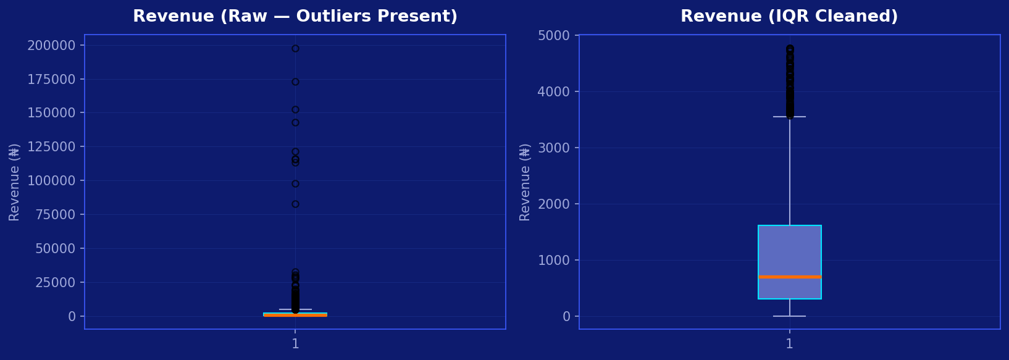
IQR — Interquartile Range
Statistical fence method for univariate outlier detection
Q1 = df['Revenue'].quantile(0.25)
Q3 = df['Revenue'].quantile(0.75)
IQR = Q3 - Q1
lower = Q1 - 1.5 * IQR
upper = Q3 + 1.5 * IQR
outliers = df[
(df['Revenue'] < lower) |
(df['Revenue'] > upper)
]
print(f"{len(outliers)} outliers found")
# Option 1: Remove
df_clean = df[(df['Revenue']>=lower)&
(df['Revenue']<=upper)]
# Option 2: Cap (Winsorize)
df['Revenue'] = df['Revenue'].clip(lower, upper)
IQR Rule: Lower = Q1 − 1.5×IQR | Upper = Q3 + 1.5×IQR
Multiplier: 1.5 = mild outliers · 3.0 = extreme outliers only

Slide 10
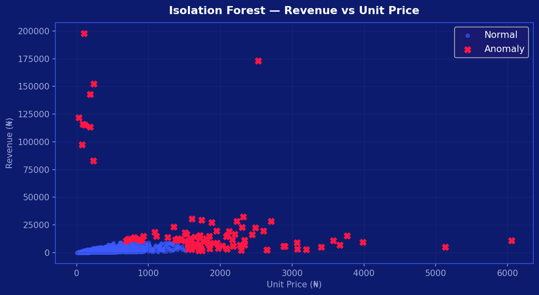
Isolation Forest
ML-based multivariate anomaly detection
from sklearn.ensemble import IsolationForest
# Use multiple features simultaneously
X = df[['Revenue','UnitPrice']].dropna()
iso = IsolationForest(
contamination=0.05, # 5% anomalies
random_state=42
)
pred = iso.fit_predict(X)
# 1 = normal | -1 = anomaly
X['anomaly'] = pred
anomalies = X[X['anomaly'] == -1]
print(f"Found: {len(anomalies)} anomalies")
# Remove from main df
mask = iso.fit_predict(
df[['Revenue','UnitPrice']].fillna(0))
df_clean = df[mask == 1]
✅ Handles multivariate patterns · ✅ No distributional assumptions · ⚙️ Tune contamination with domain knowledge

Slide 11
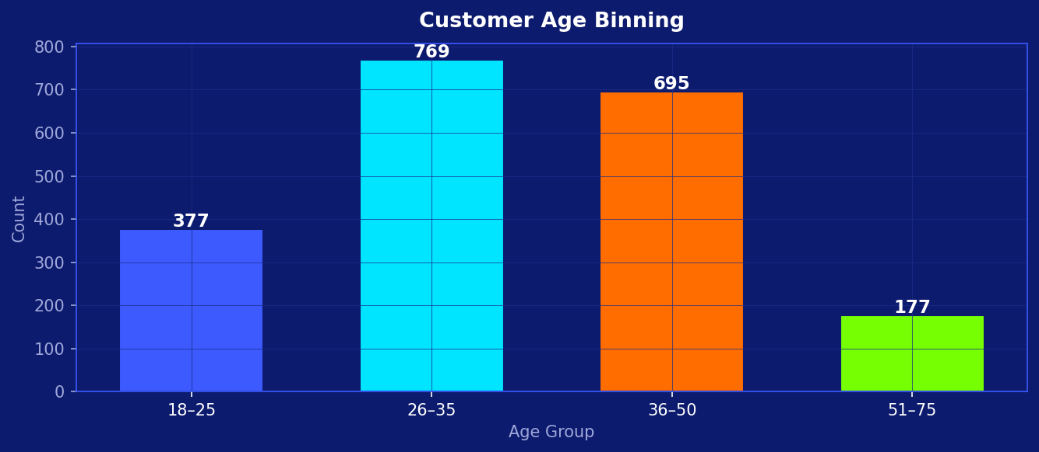
Binning (Discretisation)
Convert continuous features into meaningful categories
# Equal-width bins (pd.cut)
df['AgeGroup'] = pd.cut(
df['CustomerAge'],
bins=[0, 25, 35, 50, 75],
labels=['18-25','26-35',
'36-50','51-75']
)
# Equal-frequency (quantile) bins
df['RevenueQuartile'] = pd.qcut(
df['Revenue'],
q=4,
labels=['Low','Medium',
'High','Premium']
)
# Integer codes for ML
df['AgeCode'] = pd.cut(
df['CustomerAge'],
bins=[0,25,35,50,75],
labels=False) # 0,1,2,3
pd.cut() → equal-width or custom | pd.qcut() → equal-frequency (quantile-based)

Slide 12
04
EDA Fundamentals
Univariate · Bivariate · Multivariate
GDG Data Science & ML Community

Slide 13
The Three Levels of EDA
Build understanding from simple → complex
1️⃣ Univariate
2️⃣ Bivariate
3️⃣ Multivariate
One variable at a time.
Understand distributions, shape, and range.
Relationship between two variables.
Spot correlations, group differences.
3+ variables simultaneously.
Capture interaction effects.
🛠 hist · boxplot · describe()
value_counts() · kdeplot
🛠 scatter · countplot · boxplot
barplot · crosstab()
🛠 pairplot · heatmap
FacetGrid · groupby pivot

Slide 14
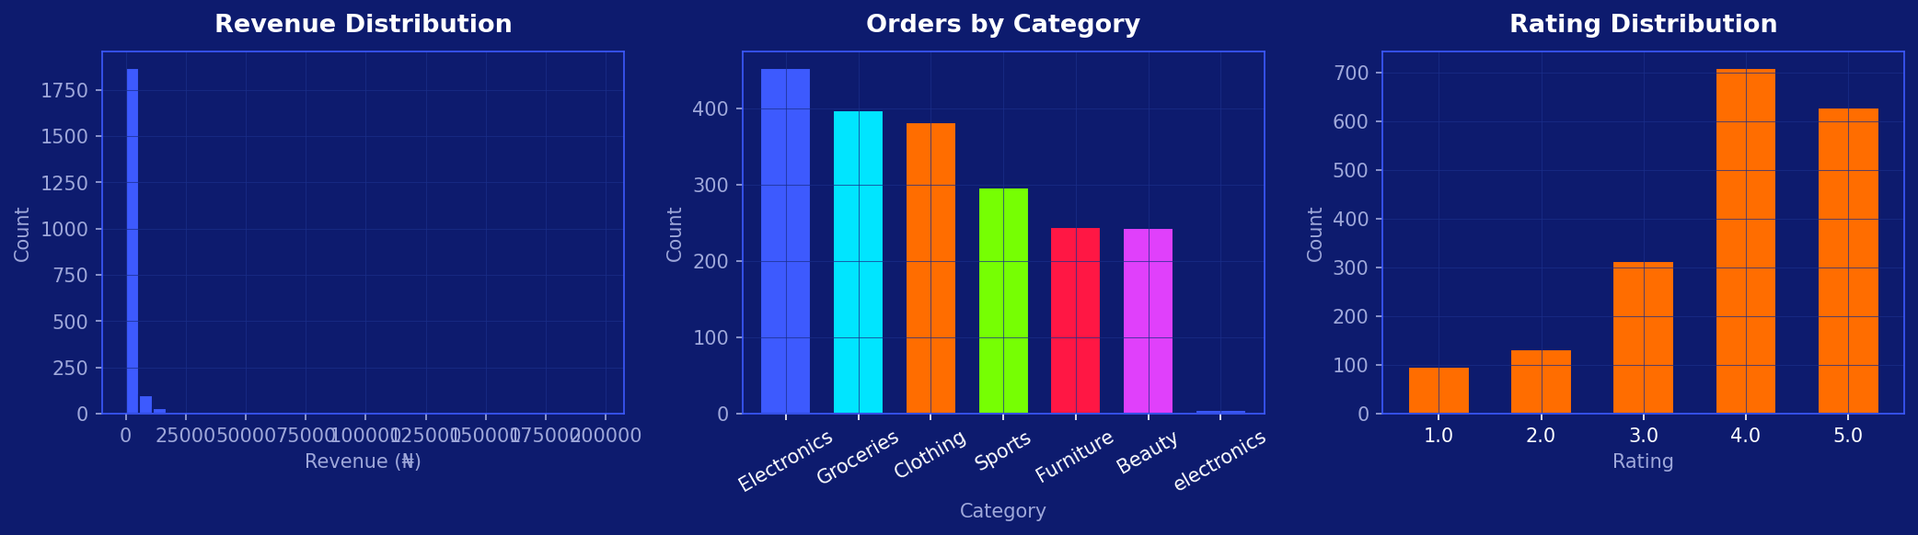
Univariate Analysis
Revenue histogram · Category counts · Rating distribution
# Numerical distribution
df['Revenue'].hist(bins=35)
df['Revenue'].plot.kde()
df['Revenue'].describe()
# Box plot
df['CustomerAge'].plot.box()
# Categorical
df['Category'].value_counts()
df['Channel'].value_counts(
normalize=True) # proportions
# Rating
df['Rating'].dropna() .value_counts().sort_index()
Key checks: mean vs median gap (skew) · std/IQR (spread) · unique values · % missing per column

Slide 15
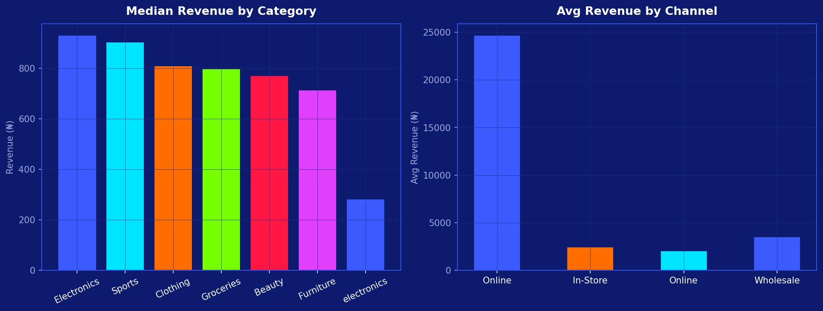
Bivariate Analysis
Category vs Revenue · Channel vs Avg Revenue
# Category vs Revenue
df.groupby('Category') ['Revenue'].median() .sort_values().plot.bar()
# Channel comparison
df.groupby('Channel') ['Revenue'].mean()
# Scatter: Price vs Revenue
sns.scatterplot(data=df,
x='UnitPrice', y='Revenue',
hue='Category')
# Categorical vs numeric
sns.boxplot(data=df,
x='Channel', y='Revenue')
Question to ask: Does the distribution of Revenue change meaningfully across Category or Channel?

Slide 16
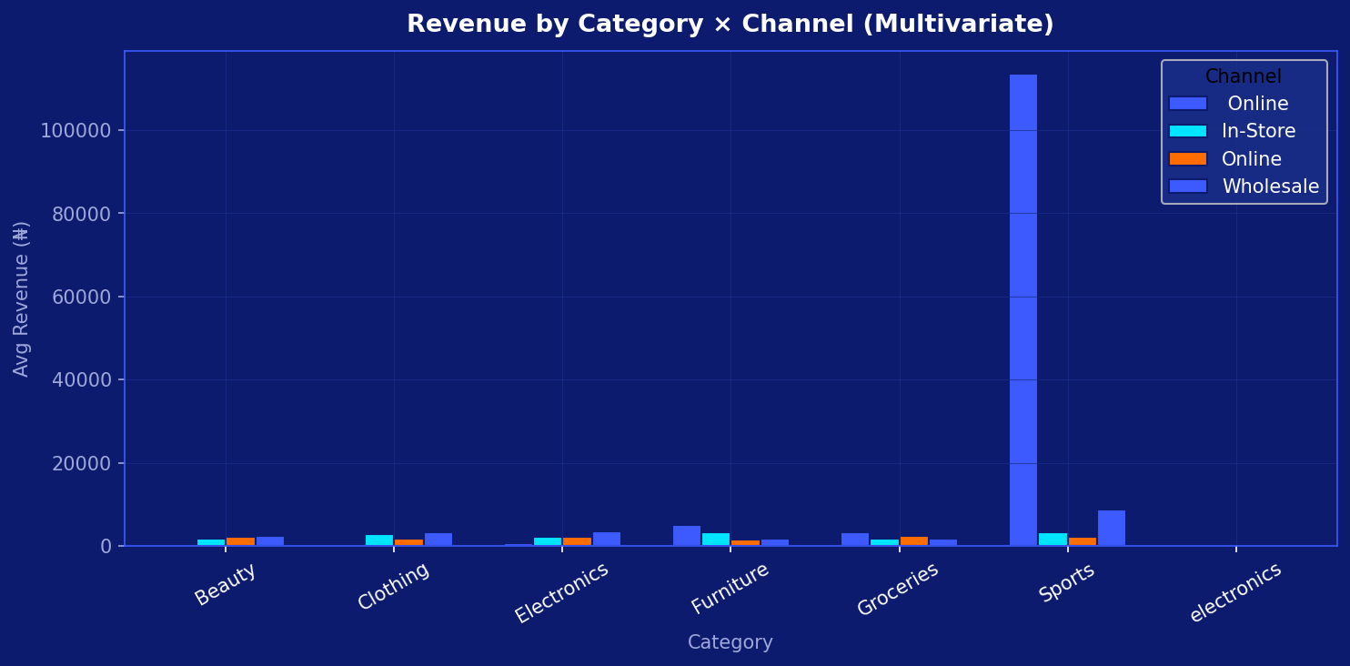
Multivariate Analysis
Revenue by Category × Channel · Pairplots
# Grouped pivot: Cat × Channel
df.groupby(
['Category','Channel']
)['Revenue'].mean().unstack()
.plot.bar()
# Pairplot
import seaborn as sns
cols = ['Revenue','Profit',
'UnitPrice','CustomerAge']
sns.pairplot(df[cols].dropna(),
diag_kind='kde')
# FacetGrid
g = sns.FacetGrid(df,
col='Channel', hue='ReturnFlag')
g.map(sns.histplot, 'Revenue')
Pairplots on 2,000+ rows are fast enough. For 100k+ rows, sample: df.sample(5000, random_state=42)

Slide 17
05
Visualisation Techniques
Choose the right chart for your question
GDG Data Science & ML Community

Slide 18
Visualisation Cheat Sheet
Match your data type and question to the best chart
Question / Goal | Best Chart | Seaborn / Matplotlib
Distribution of one numeric column | Histogram · KDE · Boxplot | histplot · kdeplot · boxplot
Compare groups (categorical) | Bar chart · Grouped bar | barplot · countplot
Numeric vs numeric relationship | Scatter · Regression | scatterplot · regplot
Trend over time | Line chart | lineplot
Part-of-whole proportions | Pie · Stacked bar | matplotlib.pie · bar(stacked)
Correlation matrix | Heatmap | heatmap(corr)
All-pair relationships | Pairplot | pairplot
Distribution across categories | Violin · Swarm | violinplot · swarmplot
Geographic distribution | Choropleth / Bubble map | plotly.express · geopandas

Slide 19
06
Correlation Analysis
Pearson · Spearman · Heatmaps
GDG Data Science & ML Community

Slide 20
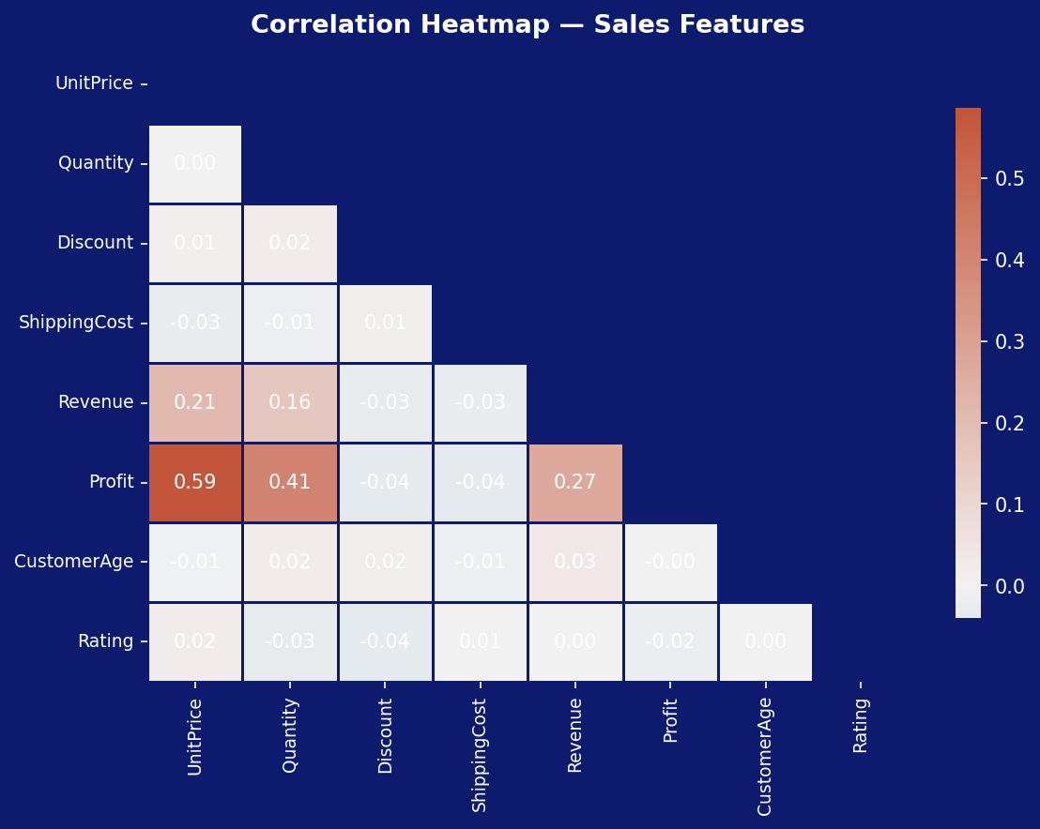
Correlation Analysis
Which sales features are linearly related?
num_cols = ['UnitPrice','Quantity',
'Discount','ShippingCost',
'Revenue','Profit',
'CustomerAge','Rating']
# Pearson (linear)
corr = df[num_cols].corr()
# Spearman (monotonic/non-linear)
corr_sp = df[num_cols].corr(
method='spearman')
# Masked heatmap
import numpy as np
mask = np.triu(
np.ones_like(corr, dtype=bool))
sns.heatmap(corr,
annot=True, fmt='.2f',
cmap='coolwarm', center=0,
mask=mask, linewidths=0.5)
r > 0.7 Strong positive | r < −0.7 Strong negative | |r| < 0.3 Weak / negligible

Slide 21
07
Extracting Business Insights
From data patterns to decisions
GDG Data Science & ML Community

Slide 22
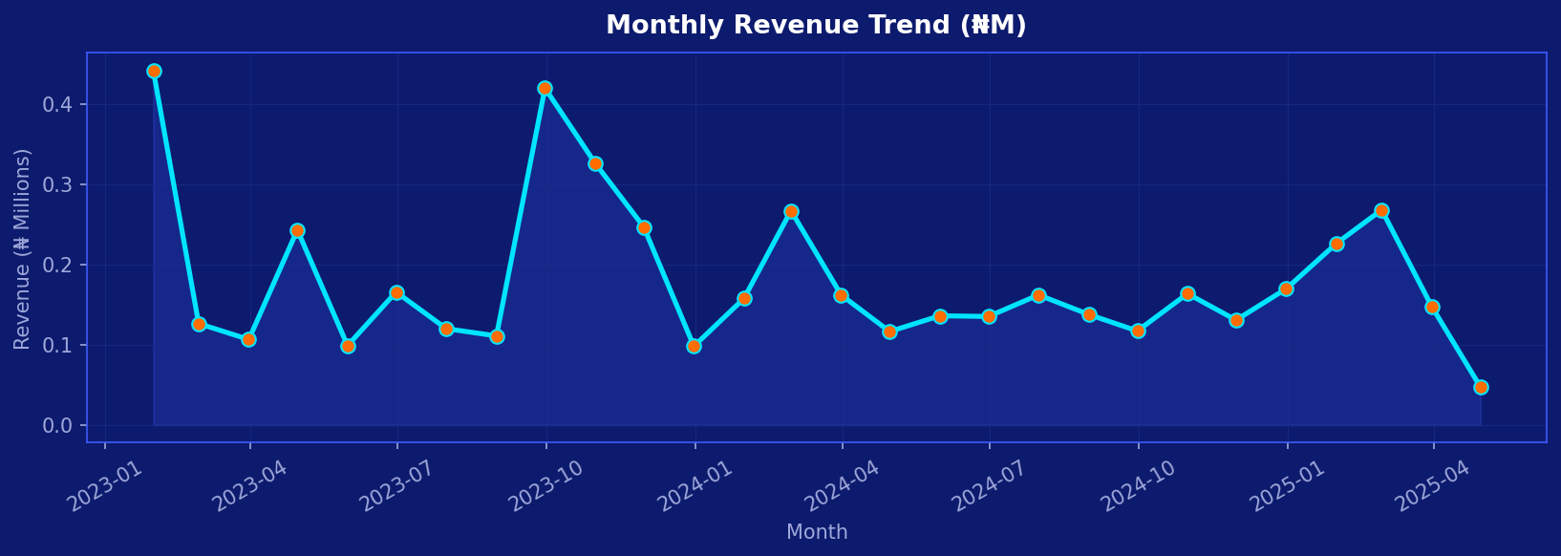
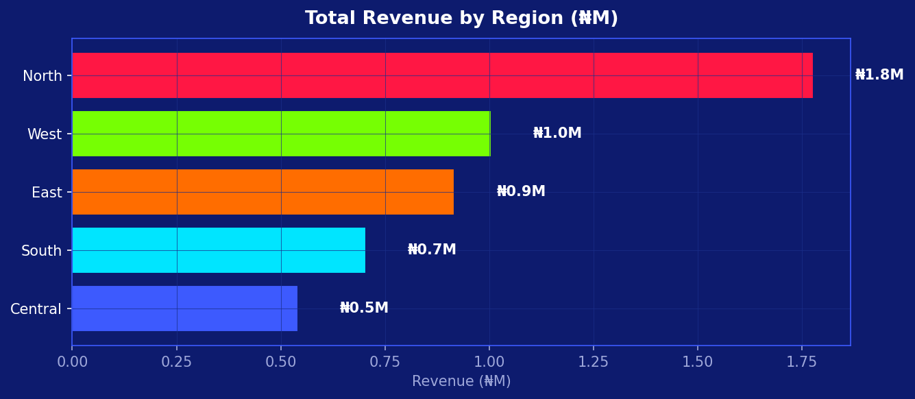
Key Insights from the Sales Data
EDA reveals actionable patterns for the business
📈 Revenue peaks in Q3
August–October show 28% higher avg revenue — seasonal or promotional driver.
🌍 North region leads
North drives ~27% of total revenue despite similar order count to other regions.
💻 Electronics highest margin
Electronics has the highest median revenue per order across all 3 channels.
🛒 Online channel growing
Online orders are 45% of volume but drive 52% of premium-tier (Q4) revenue.
⭐ High rating → low return
Orders with Rating ≥ 4 return at 7% vs 22% for Rating ≤ 2.

Slide 23
08
Preparing for Machine Learning
Encode · Scale · Feature Engineer
GDG Data Science & ML Community

Slide 24
ML-Ready Dataset Checklist
Final transformations before model training
1
Impute Remaining NaNs
3
Feature Engineering
from sklearn.impute import SimpleImputer
imp = SimpleImputer(strategy='median')
X_train[num_cols] = imp.fit_transform(
X_train[num_cols])
X_test[num_cols] = imp.transform(
X_test[num_cols])
df['Month'] = df['OrderDate'].dt.month
df['DayOfWeek'] = df['OrderDate'] .dt.dayofweek
df['RevenuePerUnit'] = (
df['Revenue'] / df['Quantity'])
df['IsWeekend'] = (
df['DayOfWeek'] >= 5).astype(int)
2
Encode Categoricals
4
Scale & Split
# Label encode binary
df['Gender_enc'] = LabelEncoder() .fit_transform(df['CustomerGender'])
# One-hot encode multi-class
df = pd.get_dummies(df,
columns=['Category','Channel'],
drop_first=True)
from sklearn.preprocessing import StandardScaler
from sklearn.model_selection import train_test_split
X_train, X_test, y_train, y_test = train_test_split(X, y,
test_size=0.2, random_state=42)
scaler = StandardScaler()
X_train = scaler.fit_transform(X_train)
X_test = scaler.transform(X_test)

Slide 25
The Complete Pipeline
Raw data → Insights → ML-Ready
📥
🔎
🧹
📊
🔍
⚙️
Load &
Inspect
Missing
Values
Duplicates
& Types
Outliers
EDA &
Insights
Feature
Eng.
read_csv
info()
describe()
→
msno
fillna
SimpleImputer
→
drop_dups
astype
strip/title
→
IQR
IsoForest
clip/cut
→
pairplot
heatmap
groupby
→
encode
scale
new cols
💡 Wrap each step in a function · Version your cleaned dataset · Document every assumption made

Slide 26
Session Recap
✅ Detected & imputed missing values using missingno + median/mode/mean strategies
✅ Removed 18 duplicate rows and standardised inconsistent string categories
✅ Applied IQR fences, Isolation Forest, and quantile binning for outlier handling
✅ Performed Univariate → Bivariate → Multivariate EDA on the sales dataset
✅ Selected the right chart type for each analytical question
✅ Built correlation heatmaps and identified Revenue–Profit as the strongest relationship
✅ Extracted business insights: North region leads, Online channel growing, Q3 peaks
✅ Engineered features and built a reproducible ML-ready pipeline
⬡ Google Developer Groups — Data Science & ML Community
zindi.africa · kaggle.com

