Slide 1
Discount Compliance assessment
By: Olumide Afolami
For: Rogers Telecommunications

Slide 2
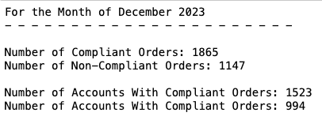
Data Profiling: Data Characteristics & Limitations
The dataset for this analysis comprises of 3,012 unique orders from 2,223 accounts
Number of Compliant Orders: 1,865
Number of Non-Compliant Orders: 1,147
Number of Accounts With Compliant Orders: 1,523
Number of Accounts With Compliant Orders: 994
Overall Discount Compliance Rate: 61.9%

Slide 3
Data Insights: Compliance by Province
For the month of December 2023, we can observe the following variances in provincial Orders:
New Brunswick has the highest discount compliance rate at 74.4% across 250 orders, generated from 241 unique customer accounts.
Expectedly, we received the most orders from Ontario, totaling 2,718 unique orders across 2,055 customer accounts, with a compliance rate of 61.3%
We received the fewest orders from Newfoundland and Labrador, with 44 total orders across 44 customer accounts, and a discount compliance rate low of 27.3%
SERVICE_PROVINCE | TOTAL ACCOUNTS | TOTAL UNIQUE ORDERS | COMPLIANCE RATE
NEW BRUNSWICK | 241 | 250 | 74%
ONTARIO | 2055 | 2718 | 61%
NEWFOUNDLAND AND LABRADOR | 44 | 44 | 27%

Slide 4
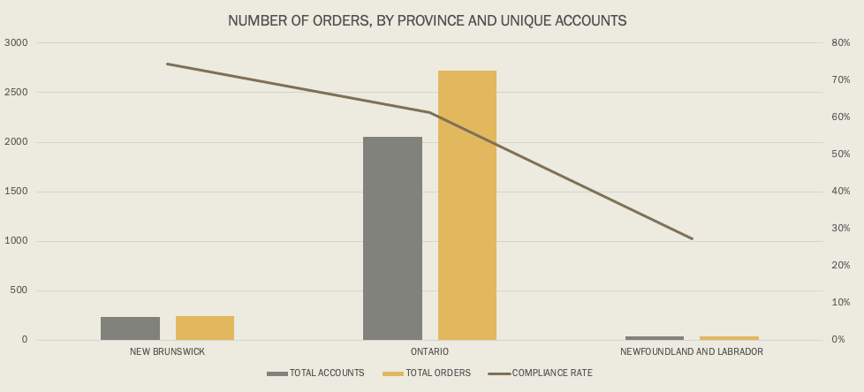
Order Summary By Province

Slide 5
Data Insights: Compliance by Discount Code Usage
The data suggests that certain codes, such as ZAK and EKK are offered across different provinces, while codes FQK, PQS, and LDK were only offered in Ontario.
Discount code FQK saw relatively high usage, given the higher discount rate, but also reported the highest cases of non-compliance, indicating potential misuse or misapplication
Discount code ZAK and PQS had 0% compliance rates across 259 orders in Ontario, hinting at misuse or misapplication. ZAK also posted low compliance (24%) in Newfoundland, although this is in keeping with the 27% compliance observed across the province
DISCOUNT_CODE | SERVICE_PROVINCE | COMPLIANT | AVG_DISCOUNT_OFFERED | UNIQUE_ORDERS | COMPLIANCE_RATE
ZAK | NEW BRUNSWICK | Y | 5.00% | 99 | 86%
EKK | NEW BRUNSWICK | Y | 5.00% | 127 | 69%
FQK | ONTARIO | Y | 9.99% | 2313 | 62%
LDK | ONTARIO | Y | 10.00% | 405 | 59%
EKK | NEWFOUNDLAND AND LABRADOR | Y | 5.00% | 26 | 27%
ZAK | NEWFOUNDLAND AND LABRADOR | Y | 5.00% | 5 | 24%
ZAK | ONTARIO | N | 10.00% | 232 | 0%
PQS | ONTARIO | N | 10.00% | 27 | 0%

Slide 6
Data Insights: Order Types and Source Systems
For the month of December 2023, the most processed Order Types were ‘PR’s (presumably Purchase Requests), with a 95.9% (2,891) share of all unique orders
86% (2,510 Orders) of these came through the Digital Channels
Overall, there are fewer orders through the "CRM" system, which indicates a need for better integration or promotion of this channel

Slide 7
Recommendations: Revenue Leakage Points
Enhance Discount Management Controls: Tighter controls and validations for discount code usage can ensure they are applied correctly across eligible transactions. This can be done by cross-referencing discount codes with order types and customer eligibility criteria. This eliminates cases in the data where different discount rates are applied to Orders made within the same time period
This also reduces or eliminates discrepancies with discount_start_dates and discount_end_dates for the same discount codes.
Improve Data Accuracy and Integrity: Regular audits of data inputs, especially around discount application and order processing helps to ensure data integrity. This can help identify discrepancies early and prevent revenue leakage.
Optimize Order Processing Systems: Integrating the "Digital" and "CRM" systems more closely to streamline order processing and improve data consistency. This could also involve automating data entry processes to reduce human error

Slide 8
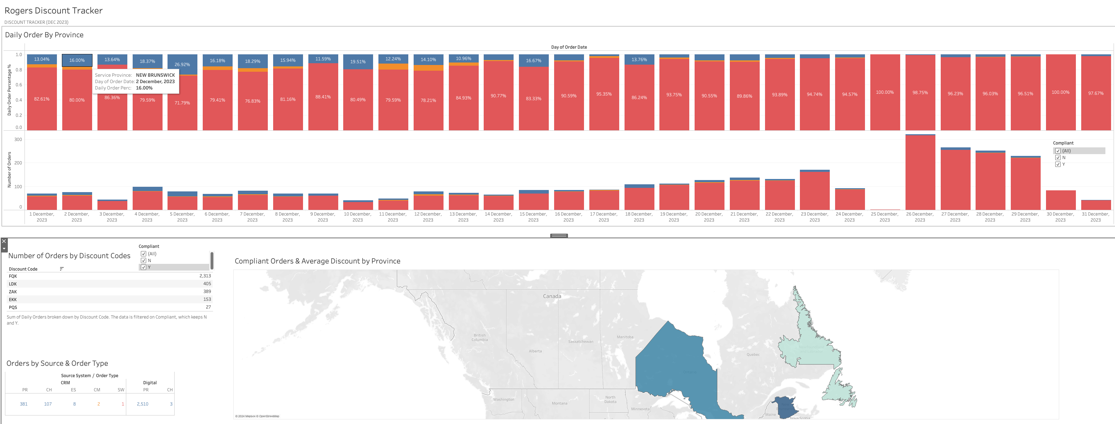
Recommendations: Revenue Leakage Points (2)
Develop Targeted Revenue Assurance Dashboards: A comprehensive dashboard using tools like Tableau or Power BI can help track key metrics such as compliance rates, discount code usage, and order processing efficiency. This will provide real-time insights and facilitate quick corrective actions. (see attached sample Tableau dashboard)

