Slide 1
Retail Sales Analytics
(Global Mart Dataset)
By:
Olumide Olaoye
(Data Analyst)
October 2021

Slide 2
Table of Contents
Introduction
Project Brief
Objective
Sales Forecast Profile
Distribution of Geographical Markets and Customer Segments
Distribution of Market-Segments
Comparison of Markets with Sales Vs Profit
Retail Global Mart Sales Forecast
6 Months Sales Forecast for Global Mart
3. Conclusion

Slide 3
1. Introduction

Slide 4
Project Brief
Forecast the Sales of Product Categories across the various Market Segments for the next six months.
Provide analytics that will aid proper estimation and effective planning of inventory and business processes.

Slide 5
Objective
Build a Sales Forecast Profile by visualizing the following:
Distribution of Geographical Markets and Customer Segments
Distribution of Market-Segments
Comparison of Markets with Sales Vs Profit
Sales Trends for Global Mart
Six Months Sales Forecast for Global Mart

Slide 6
2. Sales Forecast Profile

Slide 7
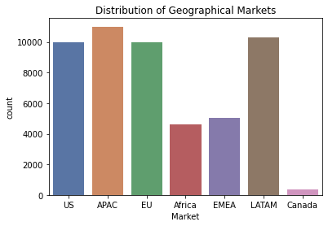
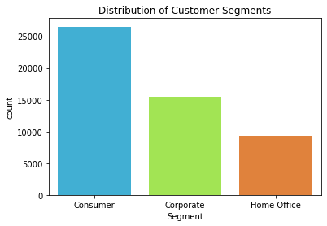
2.1 Distribution of Geographical Markets and Customer Segments
A count of the geographical market occurrences of all customer orders show that majority of the orders originated from the Asia Pacific (APAC) region. Conversely, the Canada market region accounted for the least amount of orders.
As it concerns Product Categories, Consumer products were the products that were ordered the most, while Home Office products accounted for the least number of orders.

Slide 8
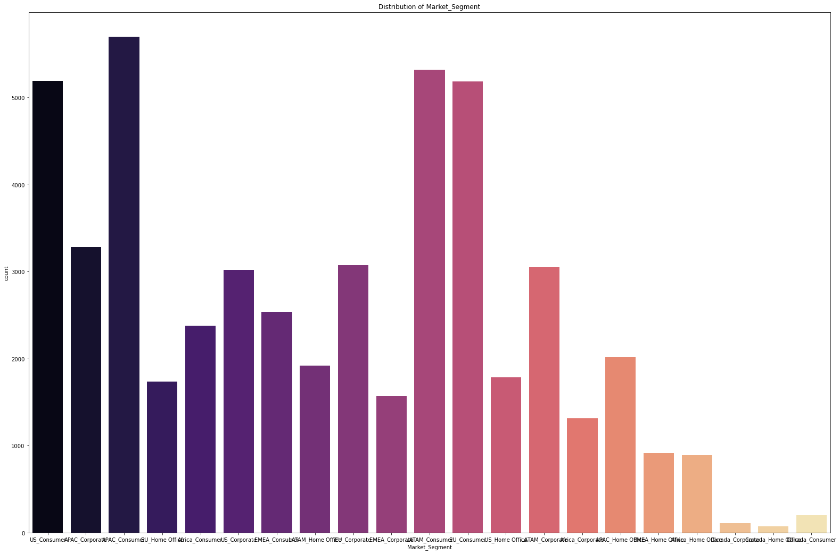
2.2 Distribution of Market-Segments
When we consider the distribution of Global Mart orders in terms of Market segments, it was observed that the APAC_Consumer market segment has the highest amount of orders while the Canada_Home Office market segment accounted for the lowest amount of orders.

Slide 9
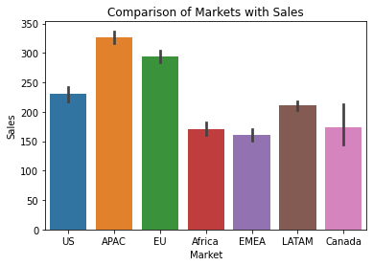
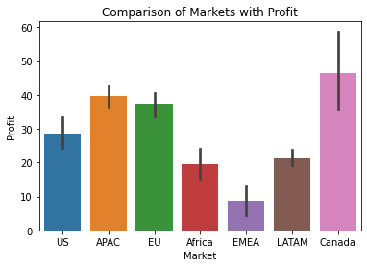
2.3 Comparison of Markets with Sales Vs Profit
When the various Global Mart Markets are compared in terms of value of Sales transactions, the APAC Market emerge as the Market with the highest total Sales figure.
However, the Canada Market produced the highest profits amongst the markets despite emerging 5th in terms of Sales value.
This insight reveals that high sales value does not necessarily amount to high profits. Other factors might bring about this discrepancy.

Slide 10
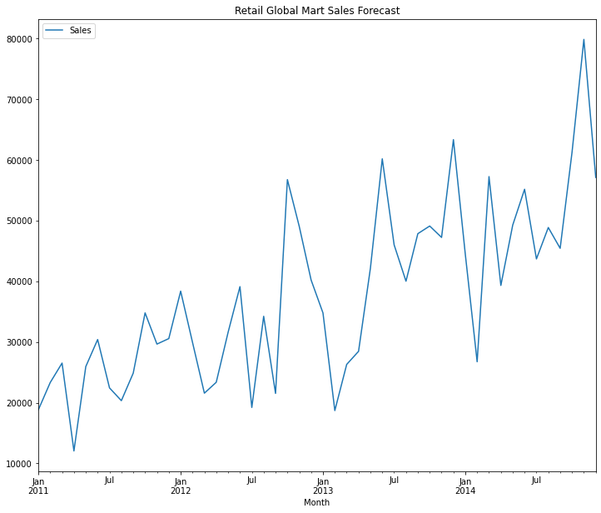
2.4 Retail Global Mart Sales Forecast
The sales for Global Mart depicts a general upward trends.
There's a general upward trends in sales of Global Mart products across the categories over the period of the years from Jan 2011 towards the end of 2014.
There are some seasonal upward and downward movements occurring within the period, as indicated in the graph, which means some other factors might lead to low sales at a particular period of times but the sales always picked up and improves on the previous times afterwards.

Slide 11
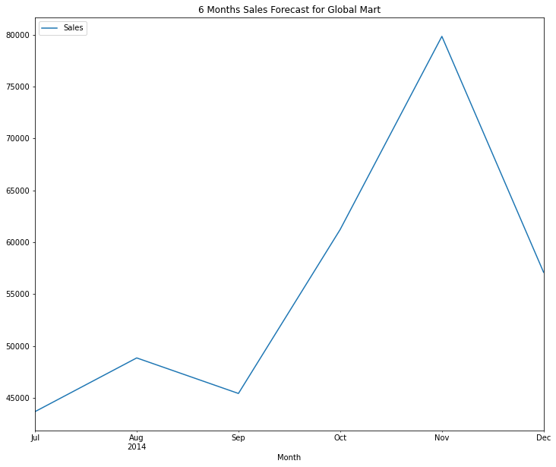
2.5 6 Months Sales Forecast for Global Mart
The general trend pattern for Global Mart product sales shows an upward trend.
There seems to be an upward trend for a period of 6 months forecast and some seasonal components as well within that period.

Slide 12
3. Conclusion

Slide 13
Conclusion
The 6 months Sales Forecast for all the product categories of Global Mart store shows that the volumes of sales in the second half of the year 2014 (July – December) will be more than the sales recorded in the first half (January – June), irrespective of some seasonal occurrences within the period. It is advised that inventory should be increased around this time. To ensure better turn round time, business processes should be fine tuned for increased profitability across the Markets

Slide 14
Thank you

