Slide 1
Social Sector Fire Analytics
(2020 Markets Fire Logs Dataset)
By
Olumide Olaoye
(Data Analyst)
October 2021

Slide 2
Table of Contents
Introduction
Project Briefing
Objective
Market Fire Incidents Analysis Profile
Market Types with Fire Incidents
Fire Incidents by Month
Fire Incidents by State
Methods of putting out the Fires
Distribution of Reported Causes of Fires
Markets with Recurring Fire Incidents
3. Recommendations & Conclusion

Slide 3
1. Introduction

Slide 4
Project Brief
To track the logs of fire incidents that occurred in Nigeria in the year 2020 with their Dates, Market Name, LGA and other features about the fire.

Slide 5
Objective
Build a Nigerian Market Fire incidents Profile by visualizing the following:
Market Types with Fire Incidents
Fire Incidents by Month
Fire Incidents by State
Methods of putting out the Fires
Distribution of Reported Causes of Fires
Markets with Recurring Fire Incidents

Slide 6
2. Market Fire Incidents Analysis Profile

Slide 7
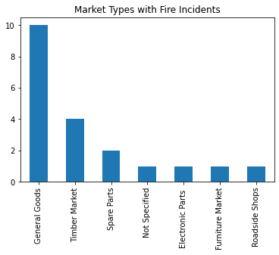
2.1 Market Types with Fire Incidents
The most common type of markets where fire occurred from the dataset was General Goods.
The least types of markets where fire occurred were Roadside Shops, Furniture Market and Electronic Parts
More facilities are to be put more in General Goods markets to reduce the occurrence of fire incidents

Slide 8
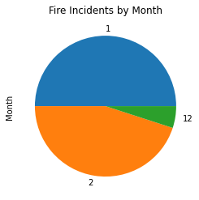
2.2 Fire Incidents by Month
Fire incidents occurred more in the month of January, followed by February and occurred least in the month of December.
More measures should be put in place in the months when fire incidents are more occurrent, to ensure that these incidents are reduced drastically

Slide 9
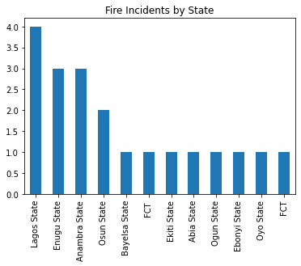
2.3 Fire Incidents by State
As expected, the state with the highest numbers of fire incidents was Lagos State. This might be due to the metropolitan nature and the population of the city.
The states with the lowest numbers of fire incidents in the year 2020 were Ekiti, Abia, Bayelsa, Oyo, FCT, Ogun, and Ebonyi states.
More focus should be placed on metropolitan cities like Lagos, Port Harcourt and Kano, to guard against fire incidents due to much economic activities in these states.

Slide 10
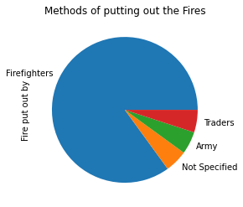
2.4 Methods of putting out the Fires
The commonest ways by which fires were put out was by mostly the Firefighters.
The methods of using Traders and Army to put out the fires were not common.
The other few times fire was put out were not specified in the dataset.

Slide 11
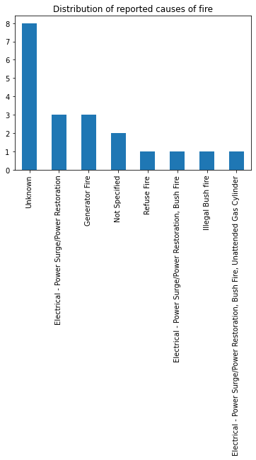
2.5 Distribution of Reported Causes of Fires
The reported causes of fire in these markets in 2020 were mostly unknown from the dataset. This might be that the cases were not reported.
Refuse Fire, Illegal Bush Fire, and Electrical-Power Surge were the least causes of fire incidents.
The government of Nigeria at the various levels (Federal, States and LG) need to place much emphasis on the importance of data in Social Sector services to unearth the causes of most environmental disasters in the country

Slide 12
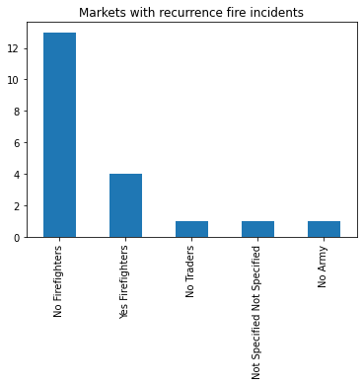
2.6 Markets with Recurring Fire Incidents
There were more recurring fire incidents at the markets where there were no firefighters.
We had some cases of recurring fire incidents at the markets where there were firefighters also.
Markets where there were no army and traders had the least recurrence of fire incidents.
Other markets where there were small recurrence of fire incidents were not specified in the dataset.
There are many factors that could be responsible for the recurrence of fires.

Slide 13
3. Recommendations & Conclusion

Slide 14
Recommendations
More focus should be placed on metropolitan cities like Lagos, Port Harcourt and Kano, to guard against fire incidents due to much economic activities in these states.
The government of Nigeria at the various levels (Federal, States and LG) need to place much emphasis on the importance of data in Social Sector services to unearth the causes of most environmental disasters in the country.
Awareness about causes of fire incidents should be created on traditional media platforms and social media to sensitize people about its possible causes, effects on economic activities and the importance of reporting such cases to the relevant authorities for proper documentation and response.
From the analyses and insights gotten from this dataset, it is evident that fire incidents are more prevalent at the markets where there are no facility or provision for fire fighters or fire extinguishers. It is therefore paramount for the government to put in place facilities like fire fighters and fire extinguishers at these modern markets, especially the ones at the metropolitan areas.

Slide 15
Conclusion
The dataset contains logs of fire incidents that occurred in some Nigerian markets in the year 2020.
The dataset was cleaned and prepared for analysis by using Python library Pandas
The visuals were prepared with the Python library Matplotlib.
The main takeaway from this findings is that Nigeria government needs to put more premium on data, in order to make informed decisions based on good governance and social amenities

Slide 16
Thank you

