Slide 1
Guest Data Analysis
Guest Data Unit (Assimilation Department)

Slide 2
Guest analysis by service time
Are you a? | 1st Service | 2nd Service | 3rd Service | 4th Service | 5th Service
First Timer | 10.000 | 38.000 | 45.000 | 15.000 | 13.000
Second Timer | 1.000 | 2.000 | 2.000 | 1.000 | 0.000

Slide 3
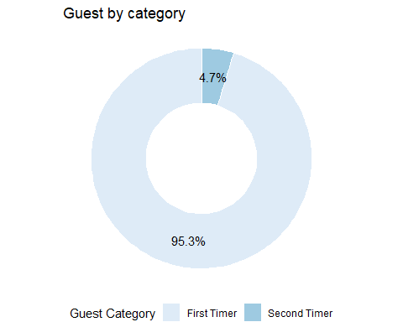
Guest analysis by guest category

Slide 4
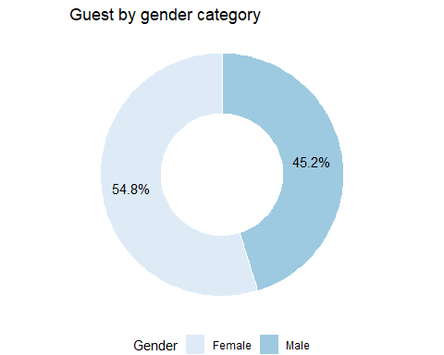
Guest analysis by gender

Slide 5
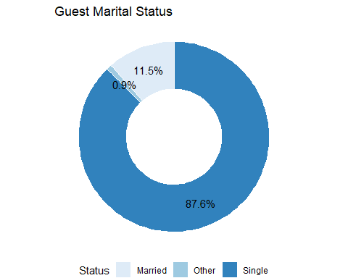
Guest by marital status

Slide 6
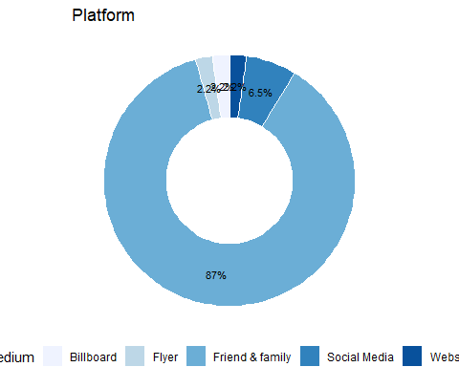
How did our guest hear about us?

Slide 7
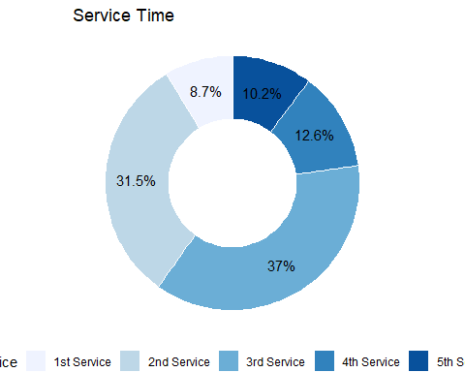
Guest by service attendance

Slide 8
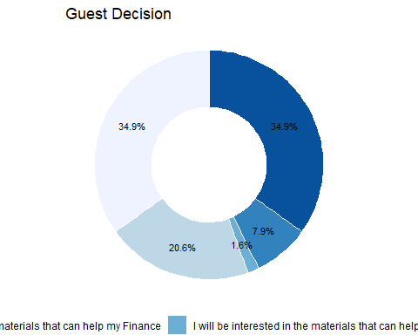
Decisions made by guest

Slide 9
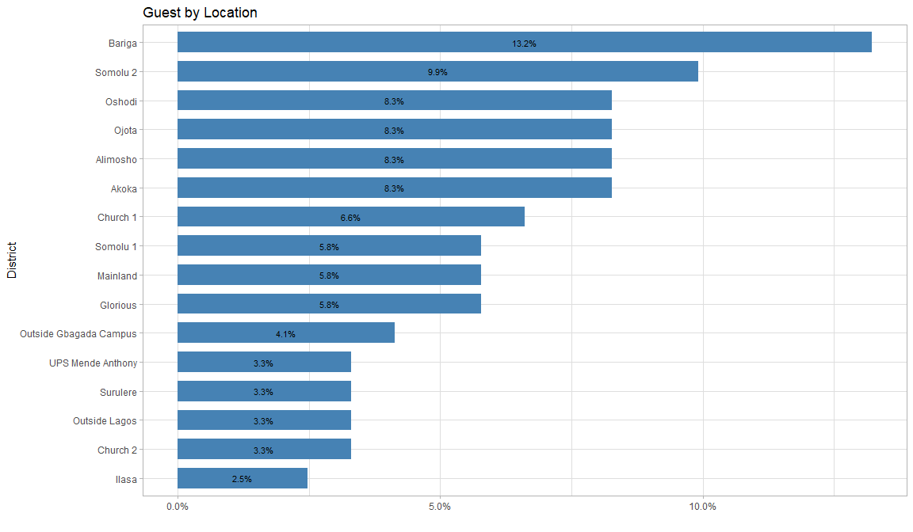
Guest by Location

Slide 10
Appreciation

Slide 11
Feedback
For feedback, kindly reach the Head of Guest Data Unit via (a.dayoajimuda@gmail.com)

