Slide 1
Analyzing historical trends to generate insights to convert casual riders to annual members.
Presented by: Oluwadamilare Caleb Fabiyi
Last updated: May 21, 2022

Slide 2
Table of Contents.
Project objective.
Data Source.
Insights from data.
Conclusions.
Recommendations.

Slide 3
Project objective

Slide 4
Why undergo this analysis?
Analyzing our company’s historical bike trip data to identify trends to discover how annual Members and Casual riders use Cyclistic’s bikes differently.
Use insights from data to discover why casual riders would prefer to buy Cyclistic annual memberships and design a new marketing strategy to convert casual users to annual members.
Recommend how Cyclistic can use digital media to influence casual riders to become members.

Slide 5
Data Integrity and Credibility.
This data is of high integrity and credibility as it was gotten from our company’s online data storage and it was inspected and thoroughly cleaned before analysis.

Slide 6
Data insights

Slide 7
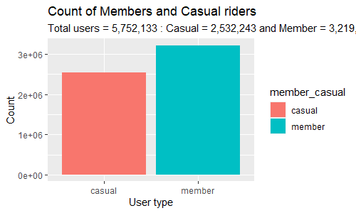
Riders Count
There were 5,752,133 total rides from May 2021 to April 2022.
There were more Member users rides (2,532,243) than Casual users rides (3,219,890).

Slide 8
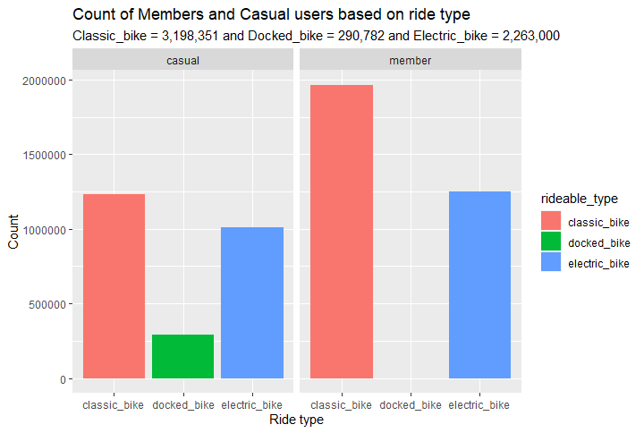
Ride type analysis
Both member and casual users prefer Classic bikes and electric bikes to docked bikes.
Member are not riding using docked bikes.

Slide 9
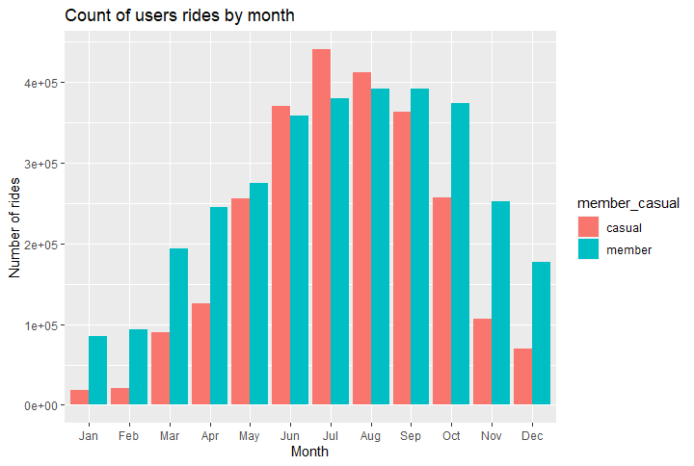
Comparative ride counts by month.
Casual users are not patronizing bikeshare early in the year (January to April) and late in the year (November and December)
There is also a generally low patronage in the beginning and end of the year.
There is a surge in rides by Casual users that surpasses those of member users from June to August, this might be due to awareness by marketing efforts.

Slide 10
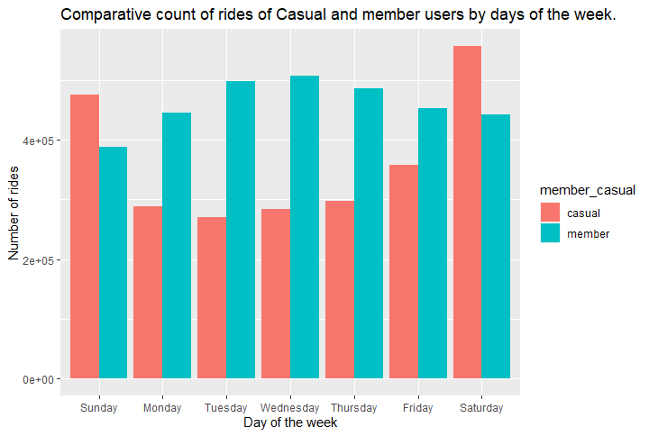
Weekdays analysis
There are more Casual users than Member users during weekends.
There is a relatively high usage by member users during working days (Monday to Fridays)

Slide 11
Conclusions
A lot Casual riders prefer weekend rides.
There is a very low marketing effort at the beginning and end of the year.
Users prefer Electric and classic bikes to docked bikes.

Slide 12
Recommendations
The company should prepare a discounted membership package that will be exclusive for weekends usage.
The company should intensify marketing and promotion efforts at the beginning and end of the year, we should also promote the new weekend membership packages during weekends.
The company should purchase more electric bikes and classic bikes and use them in digital media for promotion of their new membership package.

Slide 13
Thank you !!!

