Slide 1

Basic Computer Skills for Digital Forensics
A-I Vocational Training Institute of Cybersecurity
Prepared by:
Aminu Idris
(CCNA, CompTIA Security+, CEH, OSCP, CISSP, CISM)

Slide 2
Windows Command Line Tutorial

Slide 3
Overview
Windows File System
Create folders and files
File Copy & Deletion
Networks
Search for information
Create a batch file

Slide 4
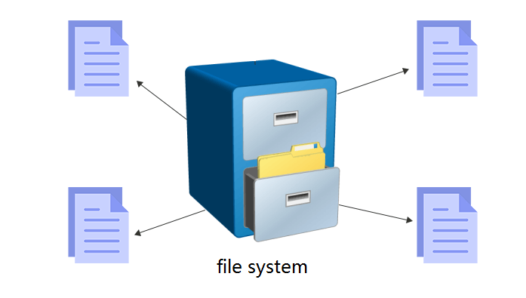
Windows File System

Slide 5
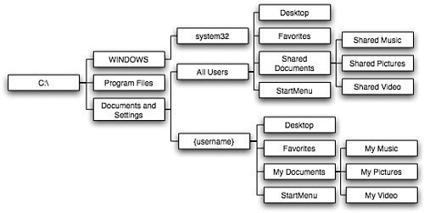
Windows System file structure (Tree-like)

Slide 6
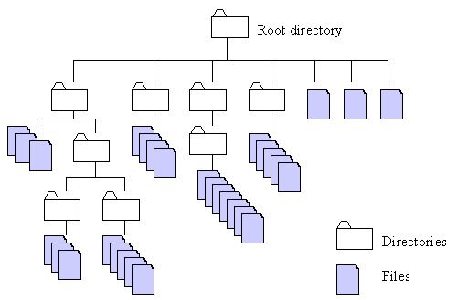



Absolute and relative paths
Absolute path
a path is built starting from the system root
Relative path
a path is built starting from the current location,
as it is relative to the present position
current
location
how to access the file

Slide 7
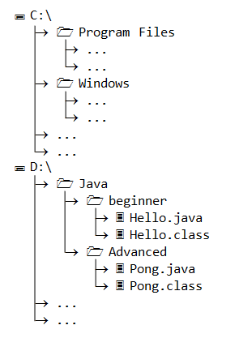
Example of paths
Write an absolute path to Hello.java
D:\Java\beginner\Hello.java
Under Beginner folder, write path to Pong.java
absolute path
D:\Java\Advanced\Pong.java
relative path
..\Advance\Pong.java

Slide 8
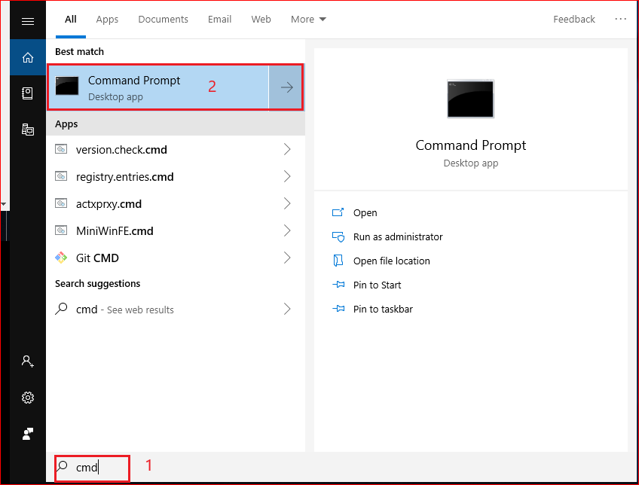
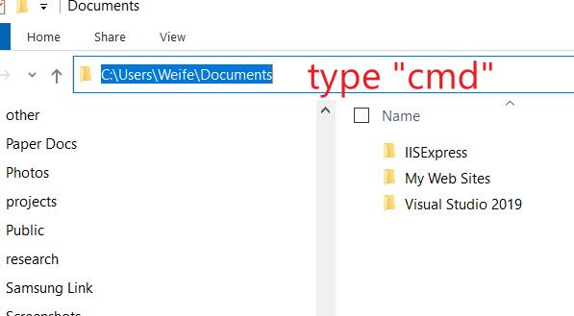
How to Open Command Prompt?
Method 1
Method 2

Slide 9
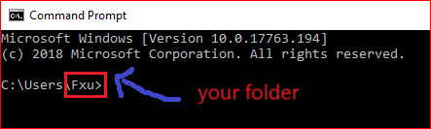

Absolute path example
Root directory
A volume or drive letter
C:
\Users
\Fxu

Slide 10

Change path using relative path
C:
C:
Change to an upper directory
\Users
\Users
\Fxu
Now you are here
You are here

Slide 11

C:
C:
Change to an upper directory/root
\Users

Slide 12


How does Windows find/run your applications?
Assume you want to open Notepad.
Search for the noteapp.exe in the current folder
if the notepad.exe in the current folder, execute it
otherwise search all paths defined by Windows

Slide 13
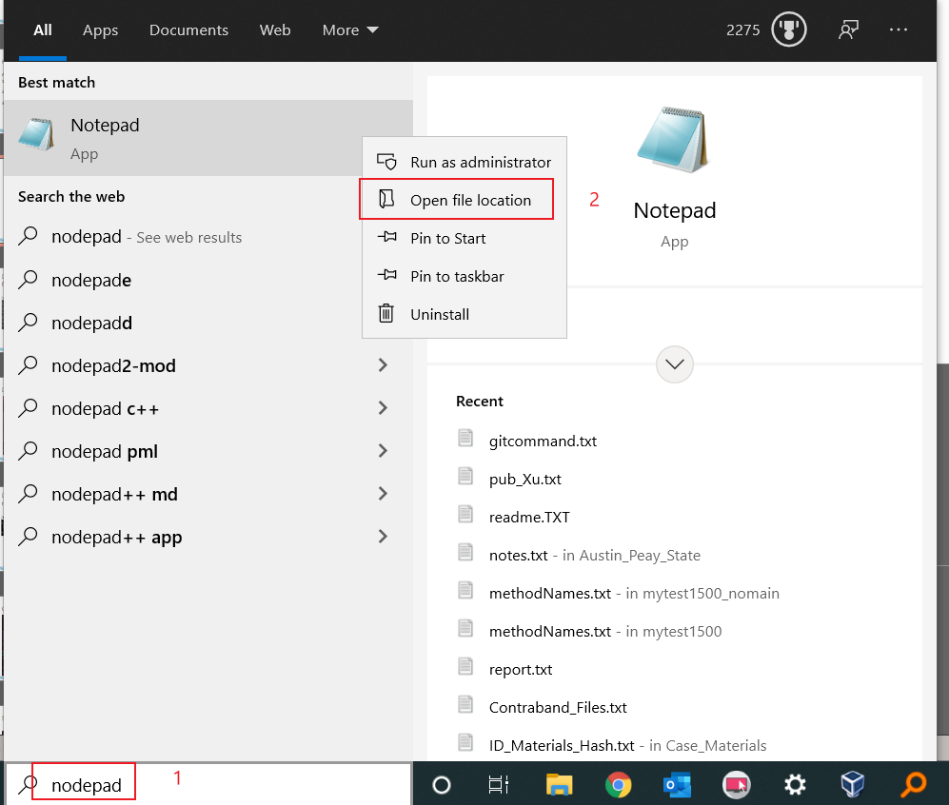

Slide 14
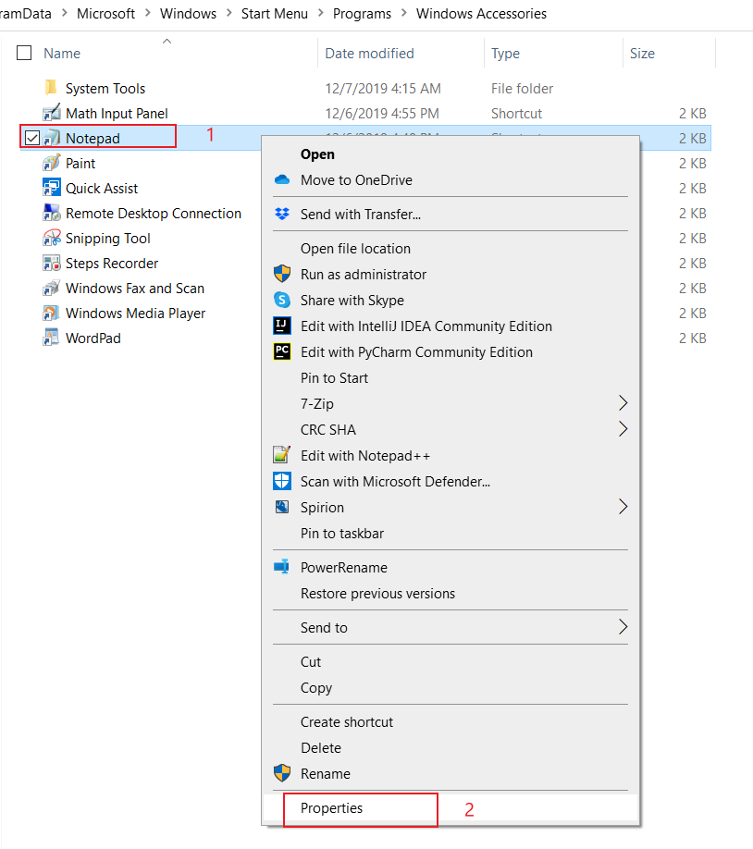
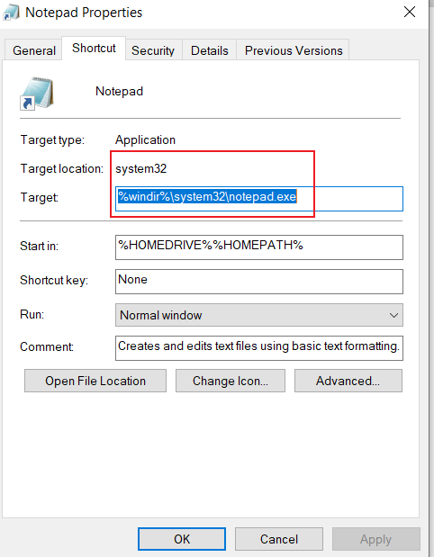
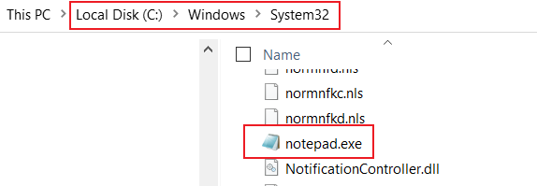

Slide 15
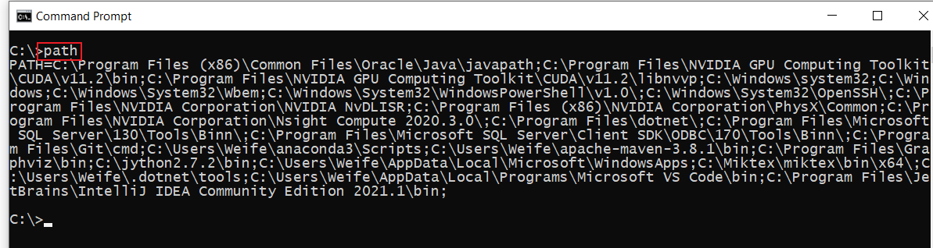
Displays or sets a search path for executable files

Slide 16
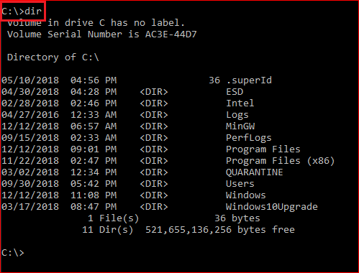
Display root

Slide 17
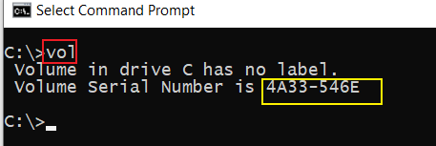
Displays a disk volume label and serial number

Slide 18
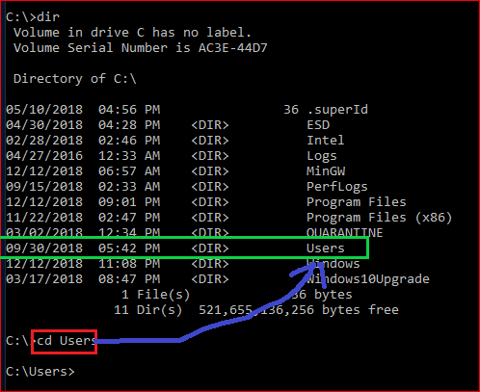
Change to \users directory
cls
Clears the screen

Slide 19
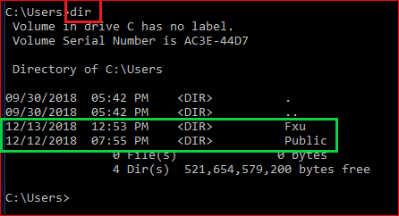
Show all files under the \Users

Slide 20
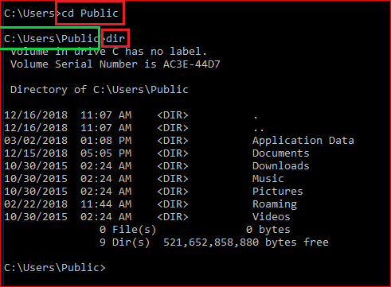
Change directory to \Public and display the content of the folder

Slide 21
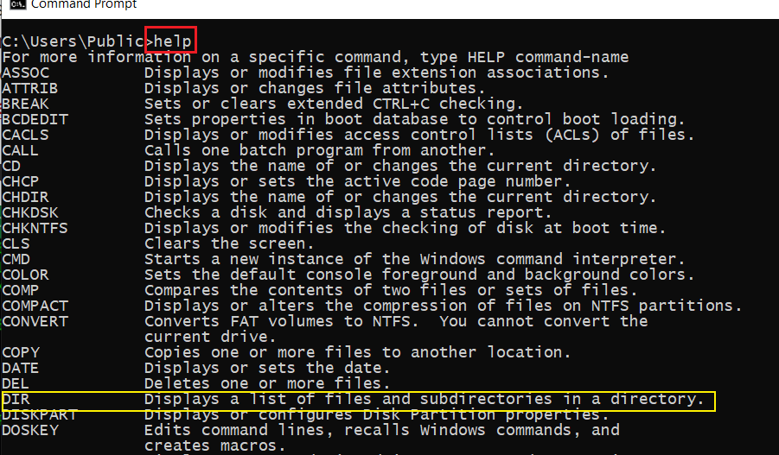
Help command

Slide 22
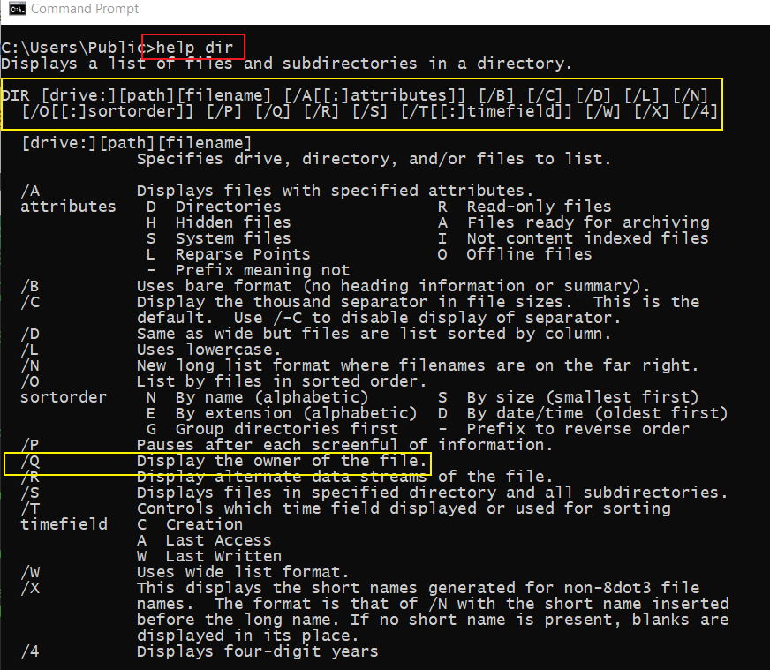
Get help when use dir

Slide 23
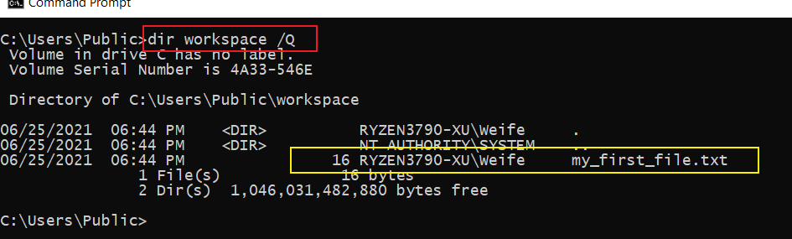
Find the owner of the file

Slide 24
Create folders and files

Slide 25
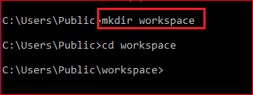
C:
C:
\Users
\Users
Create a folder
\Public
\Public
\workspace

Slide 26
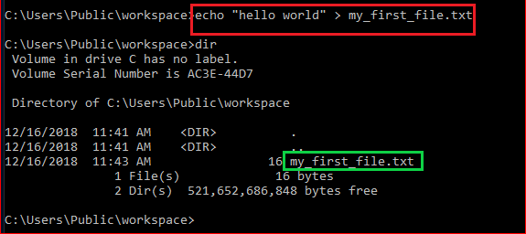
Create a new text file
C:
\Users
\Public
\workspace
hello world
my_first_file.txt

Slide 27
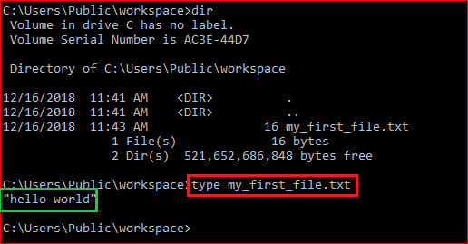
Show the content of the file: type

Slide 28
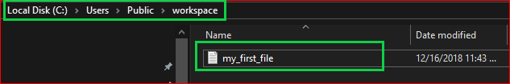

Show the content of the file

Slide 29
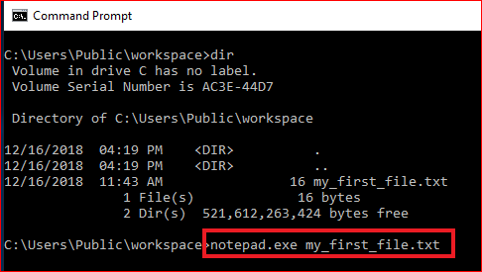
Show the content of the file: exe command

Slide 30
File Copy & Deletion

Slide 31
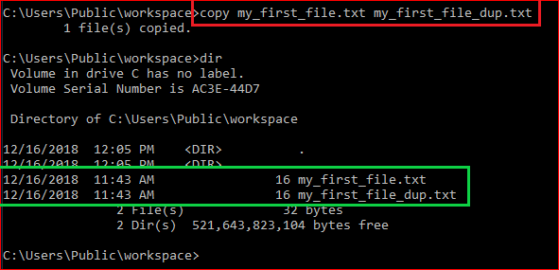
Duplicate files

Slide 32
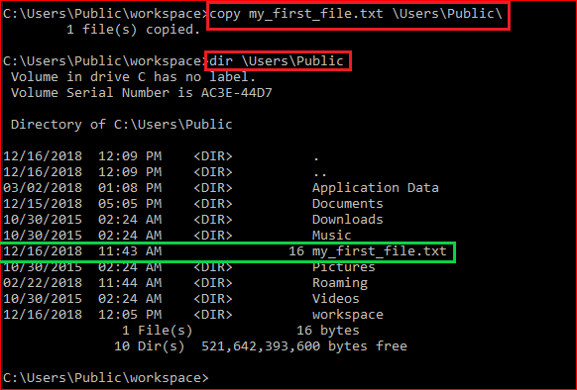
Copy a file to a different location

Slide 33
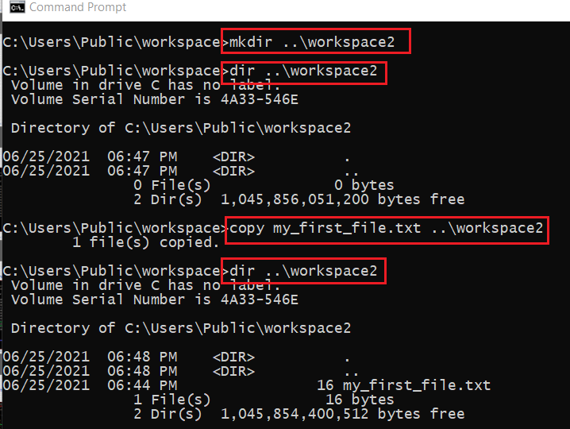

Copy a file to a new folder \workspace2 without using cd command
C:
create a folder
copy a file
.. parent folder
\Users
create a folder
copy a file
\Public
you are here
\workspace
\workspace2

Slide 34
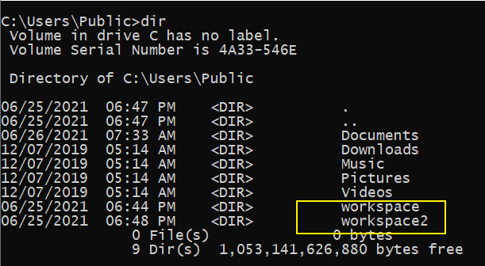
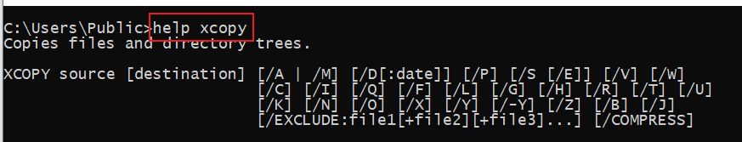
copy the whole folder to /workspace3
C:
\Users
\Public
you are here
\workspace
\workspace2
\workspace3
?

Slide 35
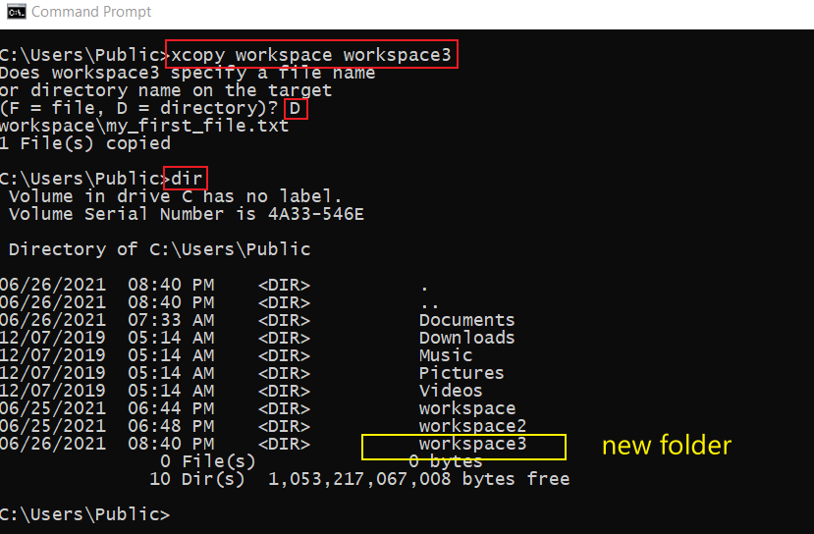

Slide 36
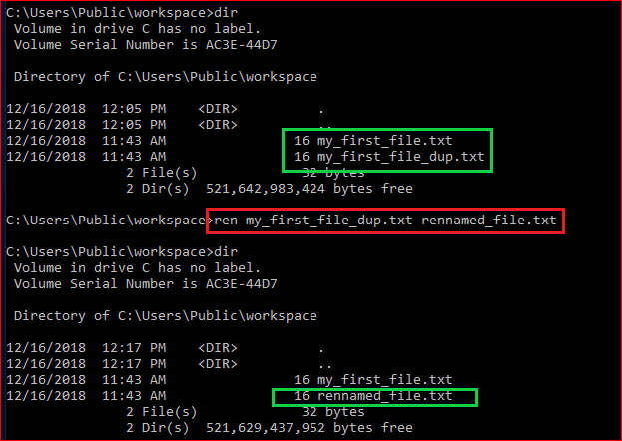
Rename a file

Slide 37
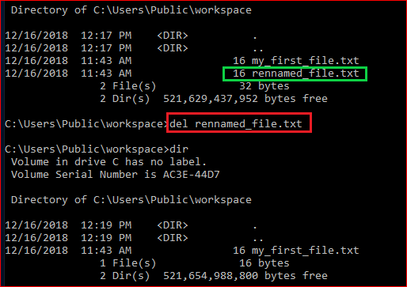
Delete a file

Slide 38
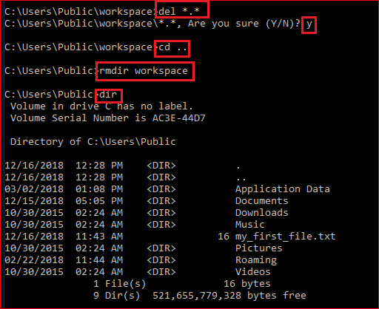
Delete a folder (rmdir/rd)

Slide 39
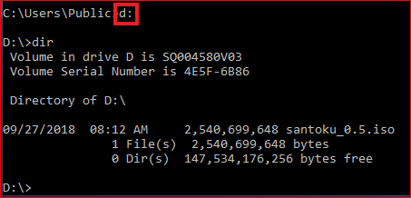
Change to a different drive

Slide 40
Networking

Slide 41
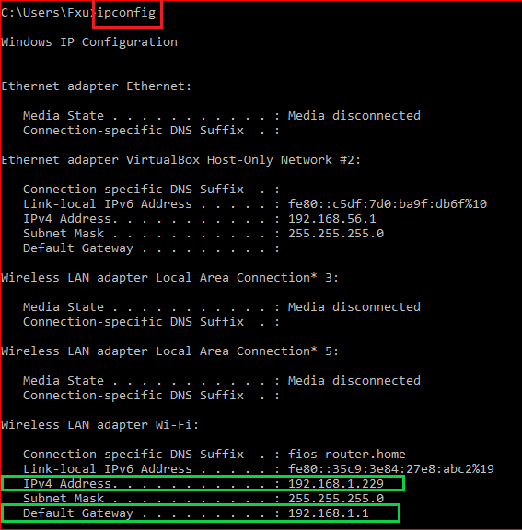
IP and default gateway

Slide 42
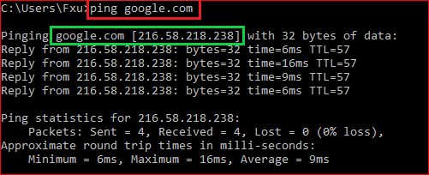
Test network connection

Slide 43
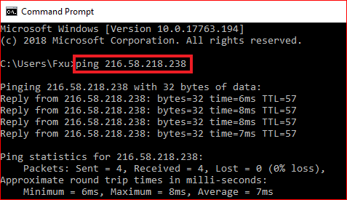
Test network connection

Slide 44
Search for information

Slide 45
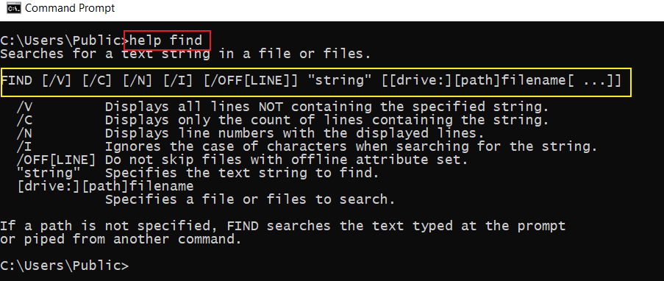
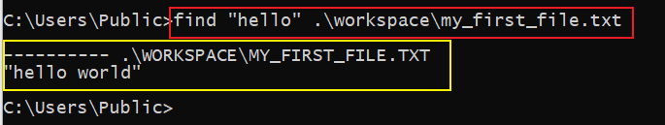
How to search for a string in a file?

Slide 46
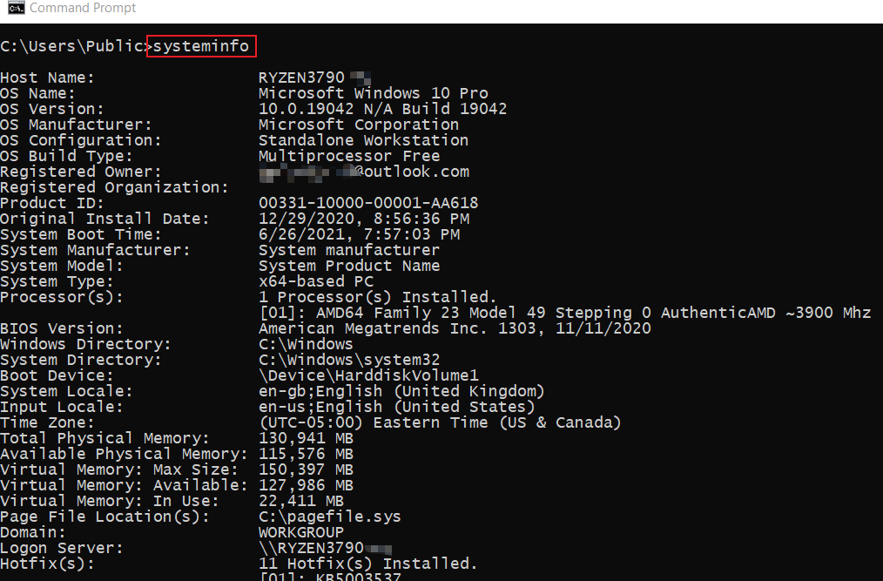
How to find system information?

Slide 47
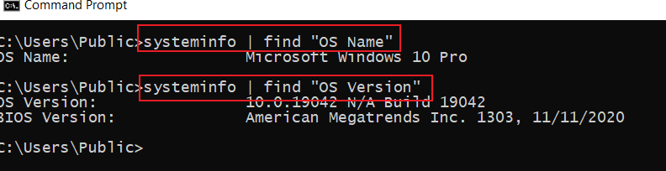
How to find specific system information using pipeline |

Slide 48
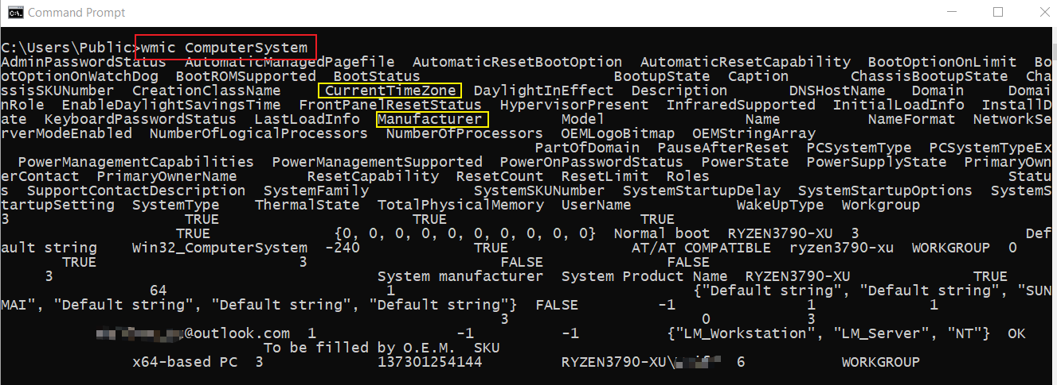
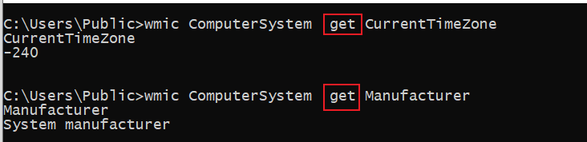
How to find system information using wmic?
Windows Management Interface Command
find property using get

Slide 49
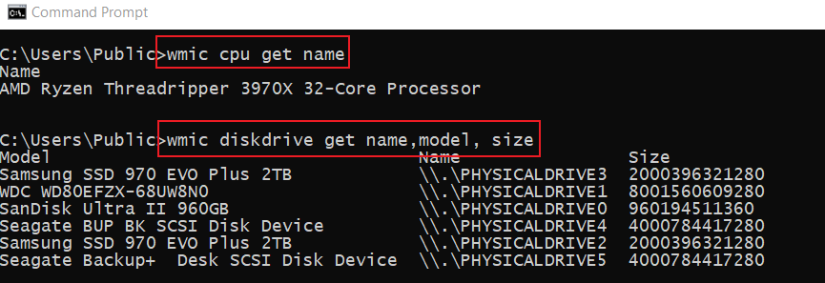
Find CPU/disk information

Slide 50
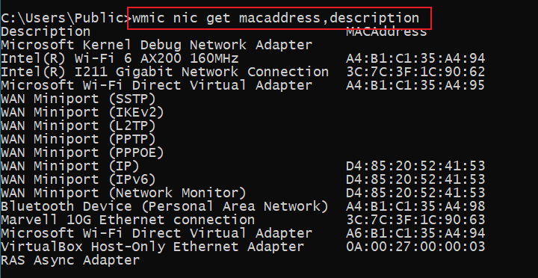
How to Find the MAC Address of Your Computer ?
Notes:
wmic nic get macaddress,description

Slide 51
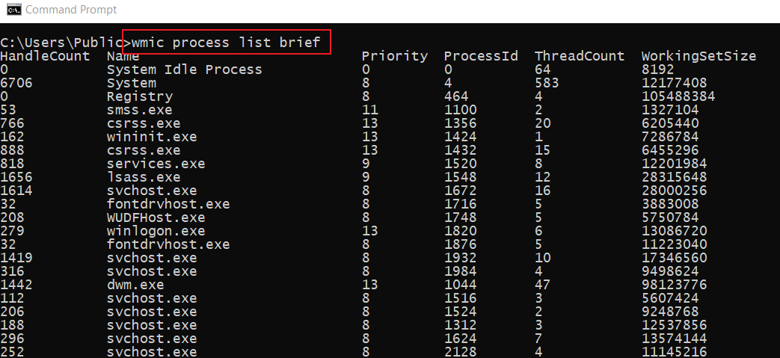
List Processes
Notes:
wmic process list brief

Slide 52
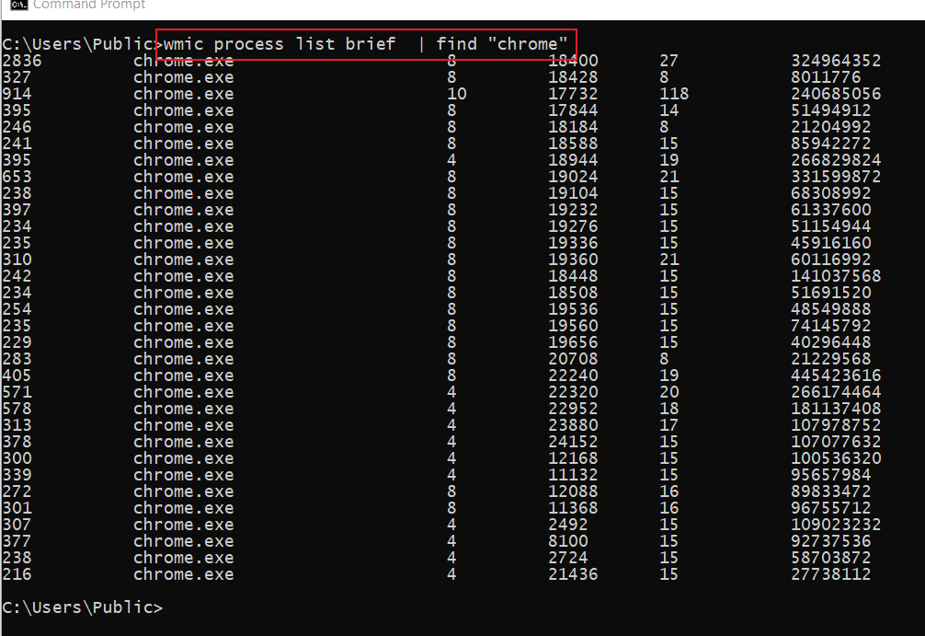
List all Chrome Browser process

Slide 53
Create a batch file

Slide 54
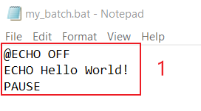
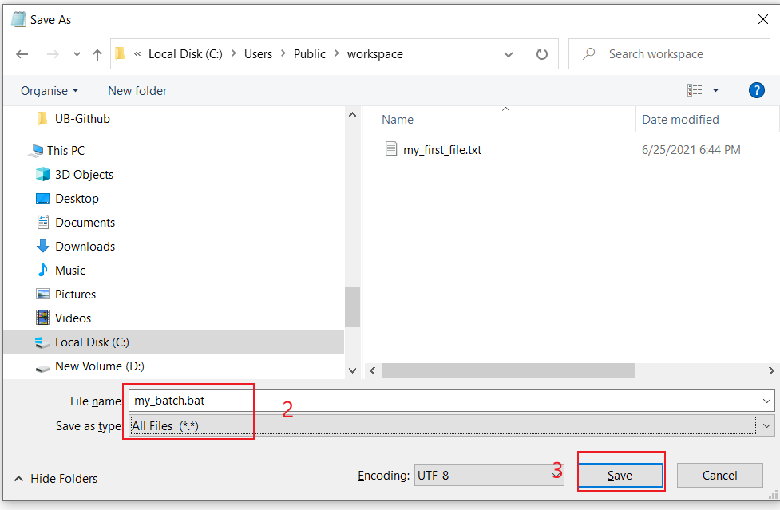
Create a “Hello world” batch
Notes:
@ECHO OFF
ECHO Hello World!
PAUSE

Slide 55

Execute “Hello World” batch

Slide 56


Batch for showing system information
Notes:
@ECHO OFF
:: This batch file details Windows 10, hardware, and networking configuration.
TITLE System Info
ECHO Please wait... Checking system information.
:: Section 1: Windows 10 information
ECHO ==========================
ECHO WINDOWS INFO
ECHO ============================
systeminfo | find "OS Name"
systeminfo | find "OS Version"
systeminfo | find "System Type"
:: Section 2: Hardware information.
ECHO ============================
ECHO HARDWARE INFO
ECHO ============================
systeminfo | find "Total Physical Memory"
wmic cpu get name
wmic diskdrive get name,model,size
:: Section 3: Networking information.
ECHO ============================
ECHO NETWORK INFO
ECHO ============================
ipconfig | findstr IPv4
START https://support.microsoft.com/en-us/windows/windows-10-system-requirements-6d4e9a79-66bf-7950-467c-795cf0386715
PAUSE

Slide 57


Execute the batch sys_info.bat
Where you are?
Show sys information

Slide 58
Assignment
Make the file sys_info.bat callable at any folder
create a new folder, e.g., workspace4
copy the .bat to the new folder
modify the path variable to add the new folder
make sure the .bat can be executed

