Slide 1

DFI101 Basic Computer Skills for Digital Forensics
A-I Vocational Training Institute of Cybersecurity
Prepared by:
Aminu Idris
(CCNA, CompTIA Security+, CEH, OSCP, CISSP, CISM)

Slide 2
Number Systems

Slide 3
Overview
Number systems and conversion
Date, date format, date conversion
American Standard Code for Information Interchange (ASCII code)
Data stored in memory

Slide 4
Number systems

Slide 5
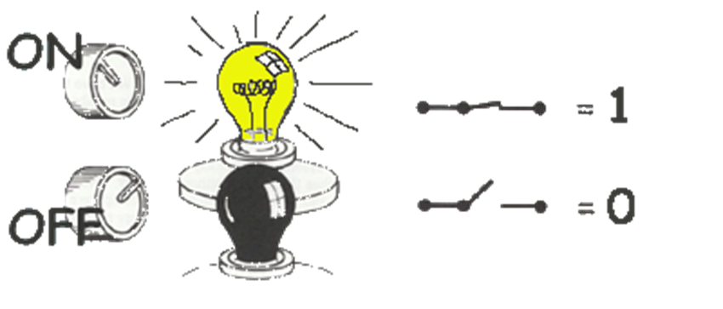

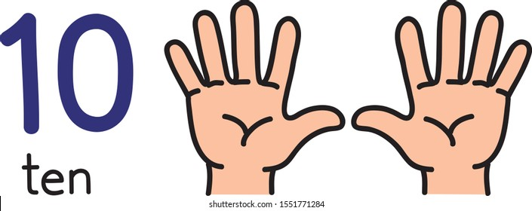
System | Base | Symbols | Used by humans? | Used by CPU? | Used by Forensic Professionals?
Decimal | 10 | 0, 1, … 9 | Yes | No | Yes
Binary | 2 | 0, 1 | No | Yes | Yes
Hexa- decimal | 16 | 0, 1, … 9, A, B, … F | No | No | Yes

Slide 6
Conversion among number systems
Decimal
Binary
Hexadecimal

Slide 7

Conversion table
Decimal | Binary | Hexa- decimal
0 | 0 | 0
1 | 1 | 1
2 | 10 | 2
3 | 11 | 3
4 | 100 | 4
5 | 101 | 5
6 | 110 | 6
7 | 111 | 7
Decimal | Binary | Hexa- decimal
8 | 1000 | 8
9 | 1001 | 9
10 | 1010 | A
11 | 1011 | B
12 | 1100 | C
13 | 1101 | D
14 | 1110 | E
15 | 1111 | F

Slide 8
Binary Addition
A | B | A + B
0 | 0 | 0
0 | 1 | 1
1 | 0 | 1
1 | 1 | 10
1
1
10101 21 + 11001 + 25 101110 46
carry bit

Slide 9
Decimal to Decimal
placeholder
Weight
126₁₀ => 6 x 10⁰ = 6 2 x 10¹ = 20 1 x 10² = 100 126
Decimal
Base

Slide 10

Binary to Decimal
placeholder
Weight
Multiply each bit by 2^{n}, where n is the “weight” of the bit
The weight is the position of the bit, starting from 0 on the right
Add the results
101010₂ => 0 x 2⁰ = 0 1 x 2¹ = 2 0 x 2² = 0 1 x 2³ = 8 0 x 2⁴ = 0 1 x 2⁵ = 32
42₁₀
Base
$(()): Shell Arithmetic
2# base 2

Slide 11
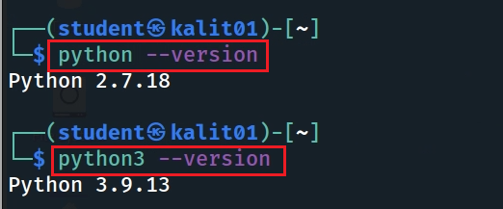
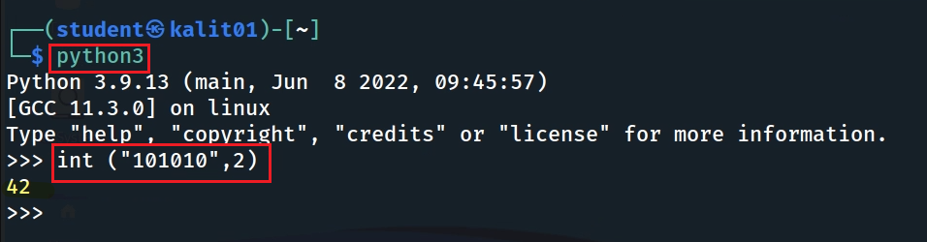
Binary to Decimal (Python code)
Check Python version
I use Python version 3.9
# hex to int
int ("800", 16)
Notes:
python:
int("0101", 2)

Slide 12

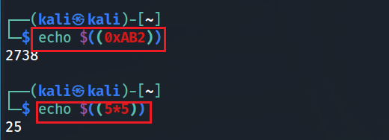
Hexadecimal to Decimal
Multiply each bit by 16^{n}, where n is the “weight” of the bit
The weight is the position of the bit, starting from 0 on the right
Add the results
AB2₁₆ => (?)₁₀
2 x 16⁰ = 2 x 1 = 2 B x 16¹ = 11 x 16 = 176 A x 16² = 10 x 256 = 2560
2738₁₀
python code: int("ab2", 16)
$(()): Shell Arithmetic
Notes:
https://www.gnu.org/software/bash/manual/html_node/Shell-Arithmetic.html
python code: int("ab2", 16)

Slide 13


Decimal to Binary
126₁₀ = (?)₂
2 126 63 0
Divide by 2, keep track of the remainder
First remainder is bit 0 (LSB, least-significant bit)
Second remainder is bit 1
Etc.
2 31 1
2 15 1
2 7 1
2 3 1
2 1 1
2 0 1
stop
126₁₀ = 1111110₂
basic calculator
Notes:
echo "obase=2;126" | bc

Slide 14


Decimal to Hexadecimal
2738₁₀ = (?)₁₆
Divide by 16
Keep track of the remainder
16 2738
171 2
16
10 11 = B
16
0 10 = A
2738₁₀ = AB2₁₆
controls the output as in C printf %d - Print the argument as a signed decimal integer.
%x - Print the argument as an unsigned hexadecimal integer.
%s - Print the argument as a string.
Notes:
https://linuxize.com/post/bash-printf-command/

Slide 15


Decimal to Binary and Hex (Python code)
Decimal to Binary
Decimal to Hex

Slide 16




Binary to Hexadecimal
101010110010₂ = ?₁₆
Group bits in fours, starting on right
Convert to hexadecimal digits
1010 1011 0010
10 11 2
A B 2
101010110010₂ = AB2₁₆

Slide 17
American Standard Code for Information Interchange
ASCII Code

Slide 18




Bit, Byte
A ‘bit’ (from Binary + digIT)
is the smallest unit of memory,
the unit of measurement of data information.
Byte 8-bit collections
A single bit holds so little information.
A byte holds one ASCII

Slide 19
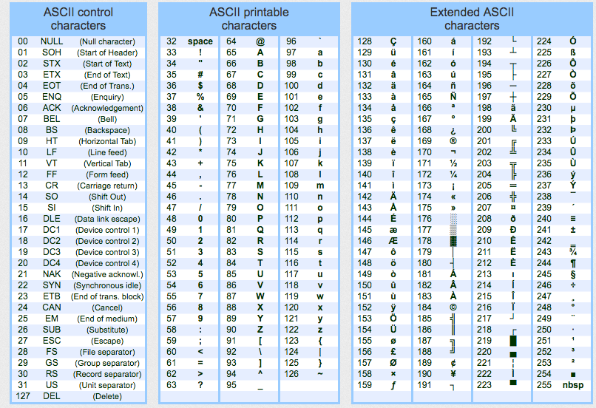
ASCII - American Standard Code for Information Interchange
ASCII codes represent text in computing devices.

Slide 20
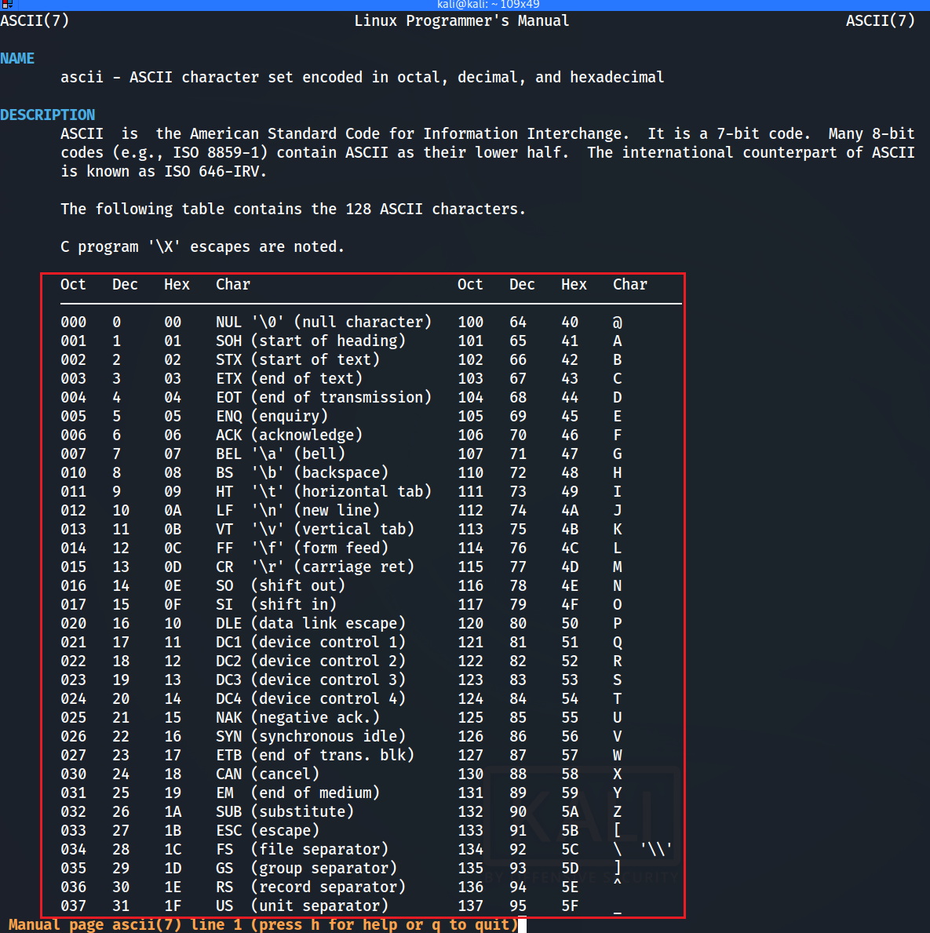


Slide 21
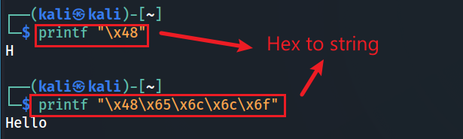

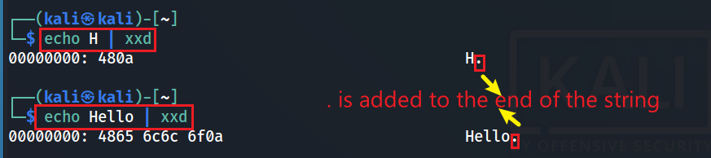
Number and ASCII conversion
Hex to ASCII string
Decimal to ASCII string
ASCII to Hex
Notes:
printf "\x48\x65\x6c\x6c\x6f"

Slide 22
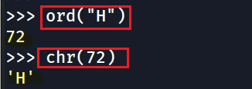
Decimal and ASCII char conversion (Python version)
Decimal to an ASCII char
ord()
ASCII
Dec
chr()

Slide 23

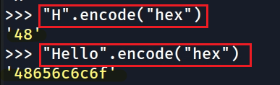

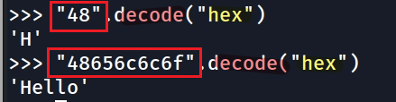
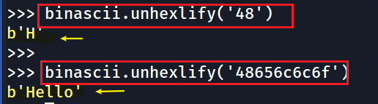
Number and ASCII conversion (Python version)
Python 2
Python 3
ASCII to Hex
ASCII to Hex
Hex to ASCII string
Hex to ASCII
hexlify()
encode(“hex”)
ASCII
Hex
ASCII
Hex
unhexlify()
decode(“hex”)
Notes:
>>> import binascii
>>> binascii.hexlify(b'H')
b'48'
>>>
>>> binascii.hexlify(b'Hello')
b'48656c6c6f'
>>> import codecs
>>> hex_encoder=codecs.getencoder('hex')
>>> hex_encoder(b'H')
(b'48', 1)
>>> hex_encoder(b'H')[0]
b'48'
>>> hex_encoder(b'Hello')
(b'48656c6c6f', 5)
>>> hex_encoder(b'Hello')[0]
b'48656c6c6f

Slide 24
What's the difference between ASCII and UTF-8 Unicode?
Both are character encoding standards used for representing characters
letters, numbers, symbols, etc.
use a series of bits (1s and 0s).
Length difference
ASCII uses 7 bits (128 characters)
UTF-8 uses variable-length encoding (1,112,064 characters)
UTF-8 is a superset of ASCII
all ASCII characters have the same representation in UTF-8.
UTF-8 can represent a wider range of characters, including non-English characters

Slide 25
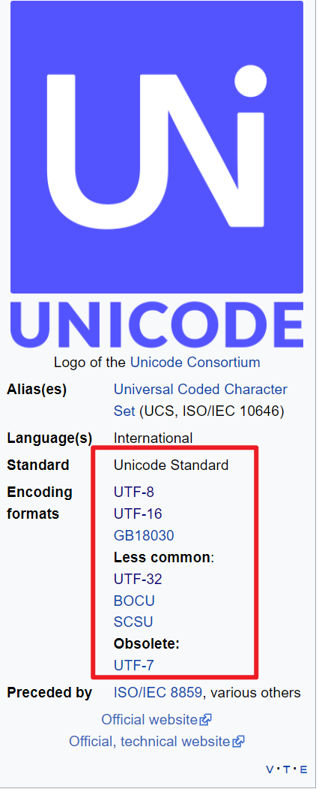
Unicode
Unicode, formally The Unicode Standard is an information technology standard for the consistent encoding, representation, and handling of text expressed in most of the world's writing systems.
https://en.wikipedia.org/wiki/Unicode

Slide 26
Date conversion

Slide 27
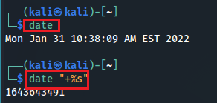
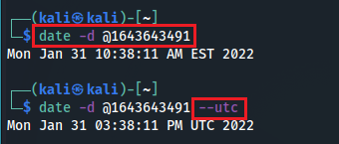
Unix time
Unix time, or POSIX time, is a system for describing points in time.
It is the number of seconds that have elapsed since the Unix epoch,
The Unix epoch is 00:00:00 UTC on 1 January 1970
Current time to Unix time
Unix time to readable time
Notes:
1643643491

Slide 28

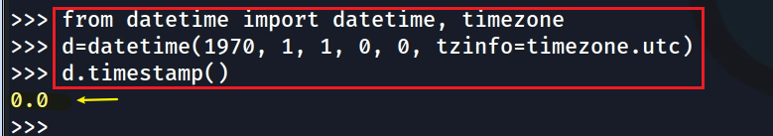
Unix time (Python version)
0 second => UTC Jan, 1st, 1970
A Python module is a .py file that contains Python code.
A Python module contains multiple functions
Use keyword from and import if you only want to import a few functions,
from [module] import [function1, function2]
UTC Jan, 1st, 1970 => 0 second
Notes:
from datetime import datetime, timezone
d=datetime(1970, 1, 1, 0, 0, tzinfo=timezone.utc)
d.timestamp()

Slide 29
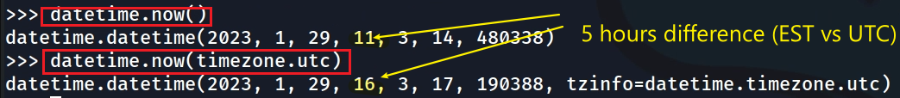

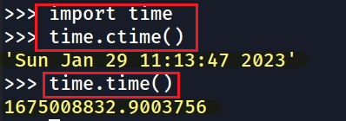
datetime(year, month, day, hour, minute, second, microsecond)
format
Get current time (datetime Module)
Get the current time (time Module)
Get the current time in a human-readable format
Get the current time in seconds. It returns the number of seconds since Jan 1, 1970, 00:00:00.
Notes:
datetime.timezone was added in Python 3.2. So it is normal to get an import error in e.g. Python 2.7.
In Python 2.7, you can use the pytz library.
from datetime import datetime, timezone

Slide 30
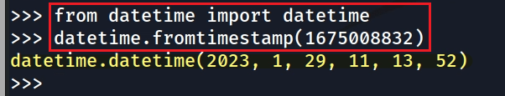

Covert seconds to a readable time (datetime Module)
our default time zone is EST. Pay attention to the 5 hours difference
If the timestamps are in UTC timezone (a common way to store dates) you should use
Notes:
from datetime import datetime
datetime.fromtimestamp(1675008832)

Slide 31
Mac "epoch time" - Cocoa Core Date
Mac uses a different "epoch time" than the UNIX epoch time.
Cocoa Core Date
Mac OS epoch date is Midnight January 1, 2001, UTC
Cocoa Core Data time is the number of seconds elapsed since January 1, 2001, 00:00:00 UTC,
Different is 31 years (978307200 seconds)
Notes:
date - d ‘1970-01-01 00:00:00 UTC’ +%s
date - - date=20010101 +$s
expr 1657166400 - 1609390800
datediff 1970-01-01 2001-01-01 –f %Ss

Slide 32
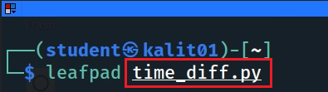
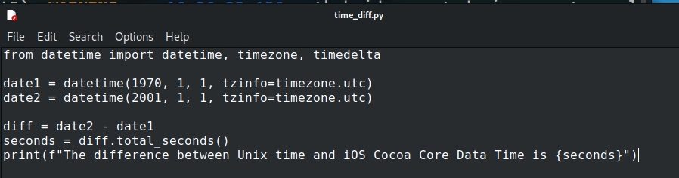
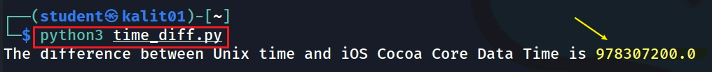
Write a function to compute the difference between Unix time and iOS time
Notes:
from datetime import datetime, timezone, timedelta
date1 = datetime(1970, 1, 1, tzinfo=timezone.utc)
date2 = datetime(2001, 1, 1, tzinfo=timezone.utc)
diff = date2 - date1
seconds = diff.total_seconds()
print(f"The difference between Unix time and iOS Cocoa Core Data Time is {seconds}")

Slide 33
Hash code

Slide 34
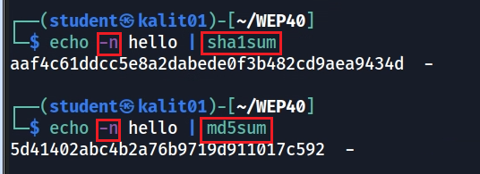
Linux commands
echo appends a \n
Use the -n argument to omit the trailing linebreak
Notes:
https://stackoverflow.com/questions/5693360/why-is-an-md5-hash-created-by-python-different-from-one-created-using-echo-and-m

Slide 35
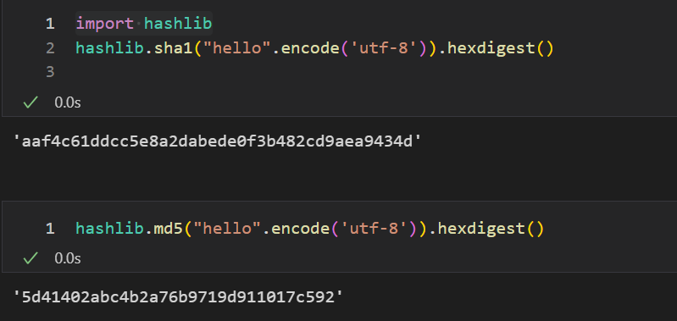
Python

Slide 36
Data stored in memory

Slide 37
Endianness
Endianness is a term that describe the order in which a sequence of bytes (byte order) is stored in memory.
Little-endian
is an order in which the "little end" (least significant value in the sequence) is stored first.
Big-endian
is an order in which the "big end" (most significant value in the sequence) is stored first (at the lowest storage address).

Slide 38
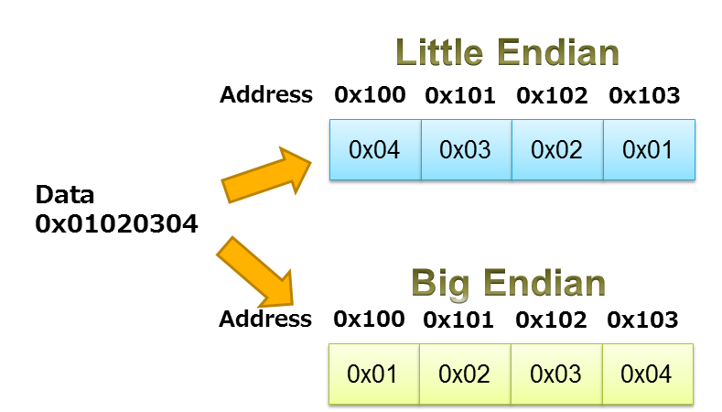





Least significant value
https://www.iar.com/knowledge/learn/programming/migration-techniques-for-different-endianness/
Notes:
Least significant is stored in low address

Slide 39
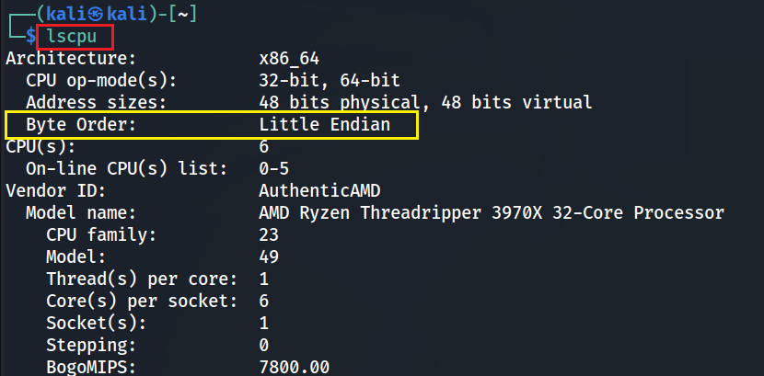
Check Byte order

