Slide 1
Steganography
Notes:
http://www.sleuthkit.org/sleuthkit/docs/api-docs/4.9.0/basicpage.html

Slide 2
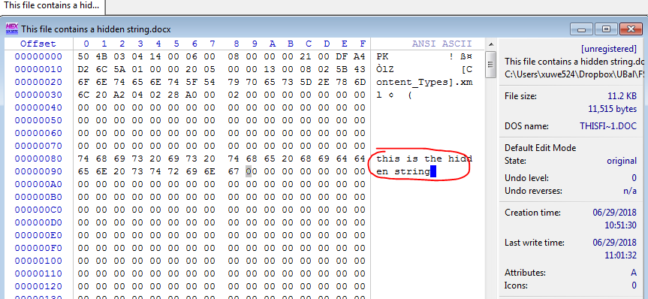
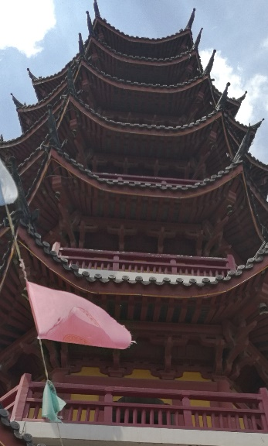

What is steganography?
Steganography hides information inside another file
Insertion
substitution: Replaces bits of the host file with other bits of data
Original image
Image with a secret file

Slide 3
Substitution
Often use BMP(bitmaps) image
other formats are supported as well
Replaces bits of the host file with other bits of data
Usually change the last two LSBs (least significant bit)

Slide 4

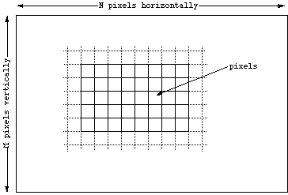
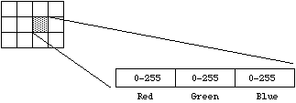
Bitmaps

Slide 5
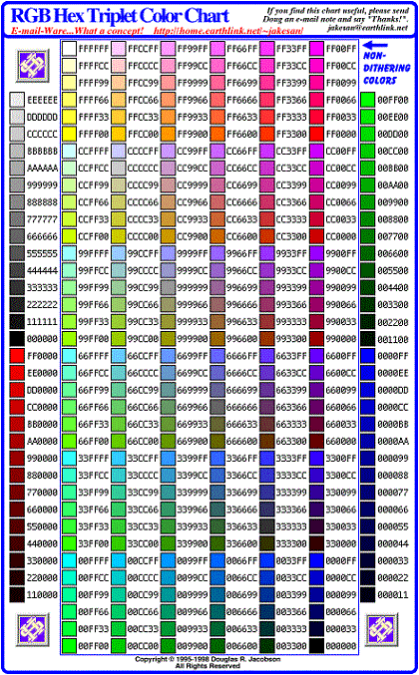
24 bit RGB

Slide 6
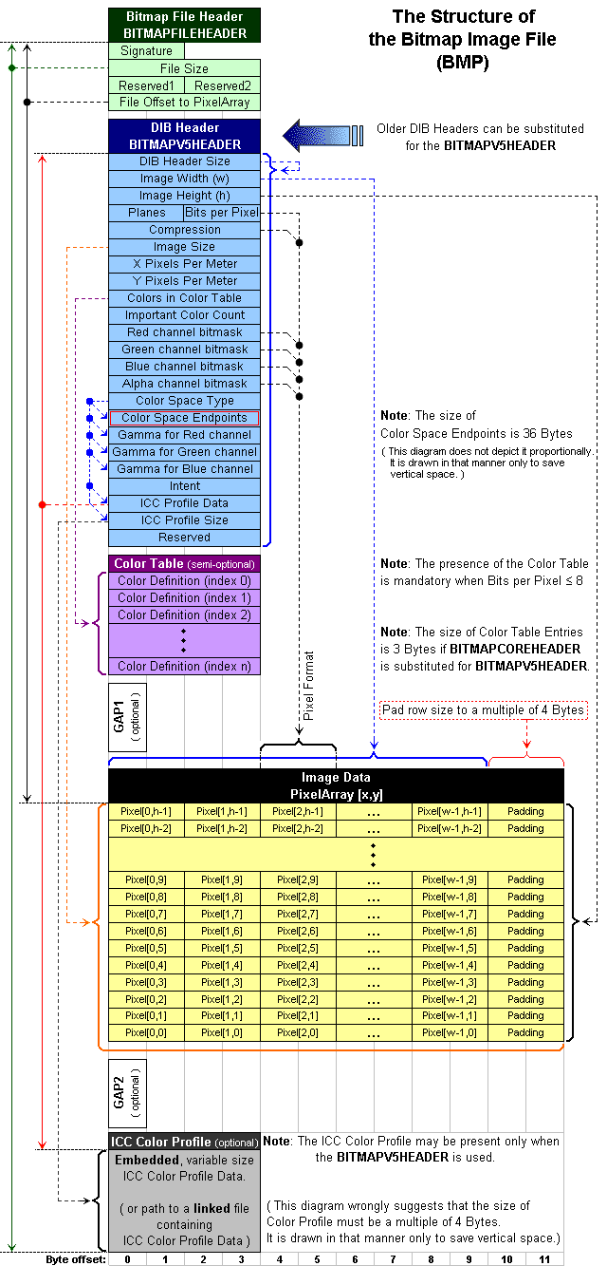

Slide 7
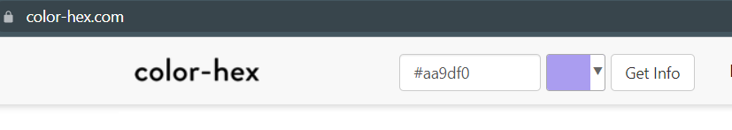
Original Pixel Color |  | Bit breakdown of a secret Letter “A=(01 00 00 01)₂”
1010 10 10 | AA | 1010 10 01 | A9
1001 11 01 | 9D | 1001 11 00 | 9C
1111 00 00 | F0 | 1111 00 00 | F0
0011 11 11 |  | 0011 11 01

Slide 8
Hide a data file using steghide

Slide 9
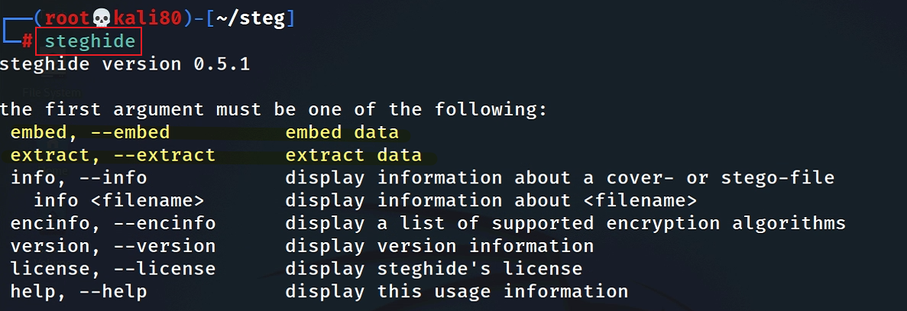
steghide
Hides data file in some of the least significant bits of another file
bmp, jpeg, wav and au files,
Support encryption algorithms

Slide 10
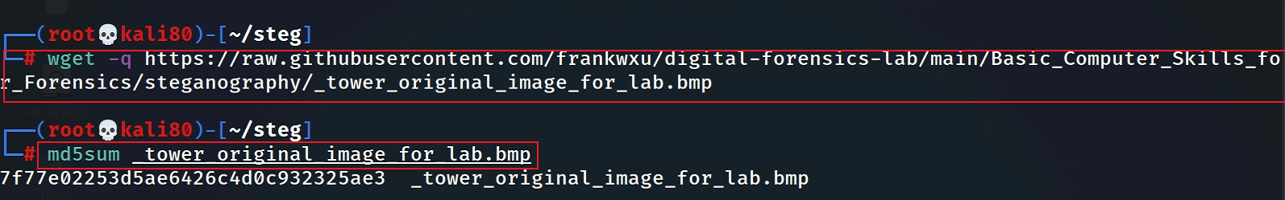
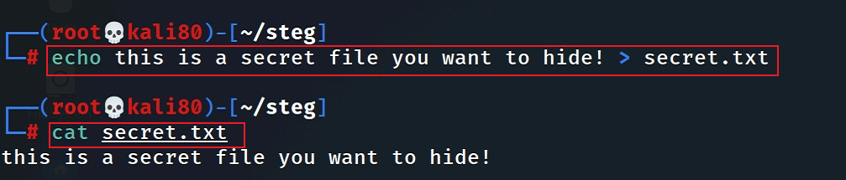
Prepare lab files
Download a bmp picture
Create a file
Notes:
https://raw.githubusercontent.com/frankwxu/digital-forensics-lab/main/Basic_Computer_Skills_for_Forensics/steganography/_tower_original_image_for_lab.bmp

Slide 11
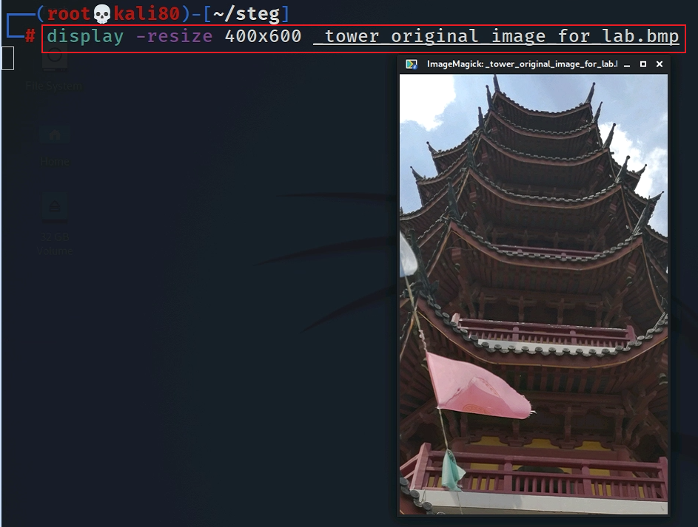

Slide 12
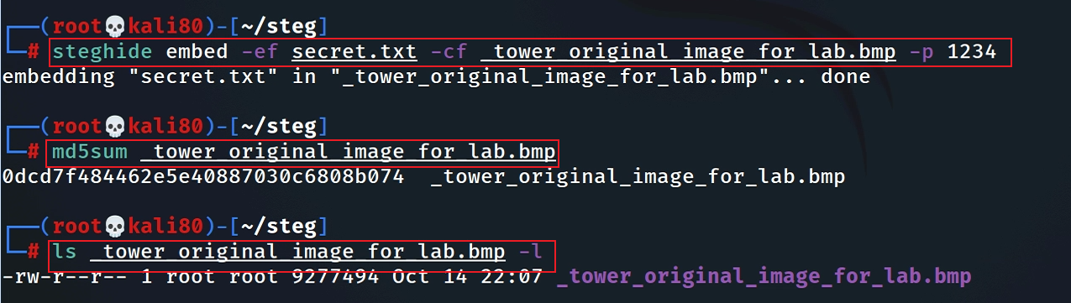
Hide a file
Notes:
steghide embed -ef secret.txt -cf _tower_original_image_for_lab.bmp -p 1234

Slide 13
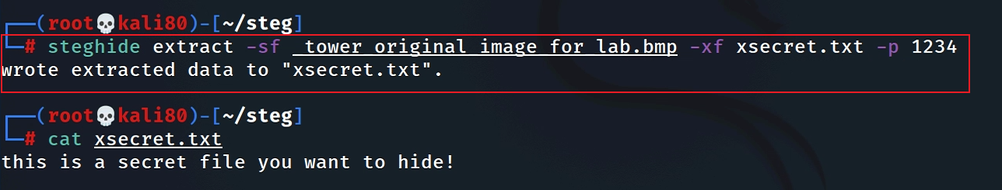
Extract a file

Slide 14
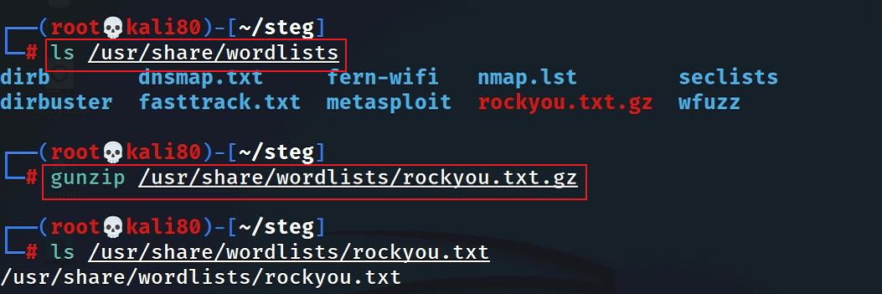
Cracker password
Find a password dictionary

Slide 15
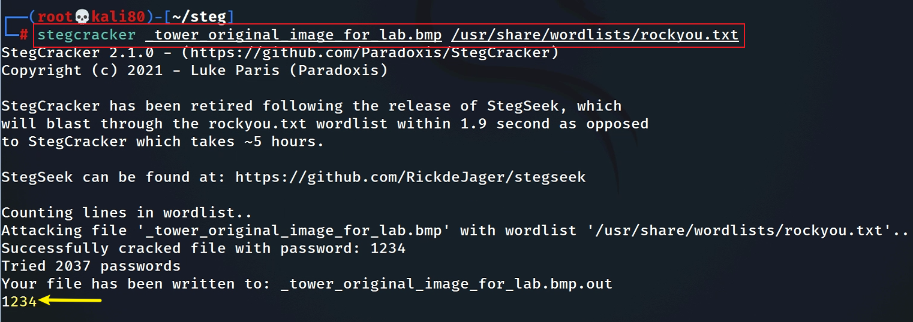

Slide 16
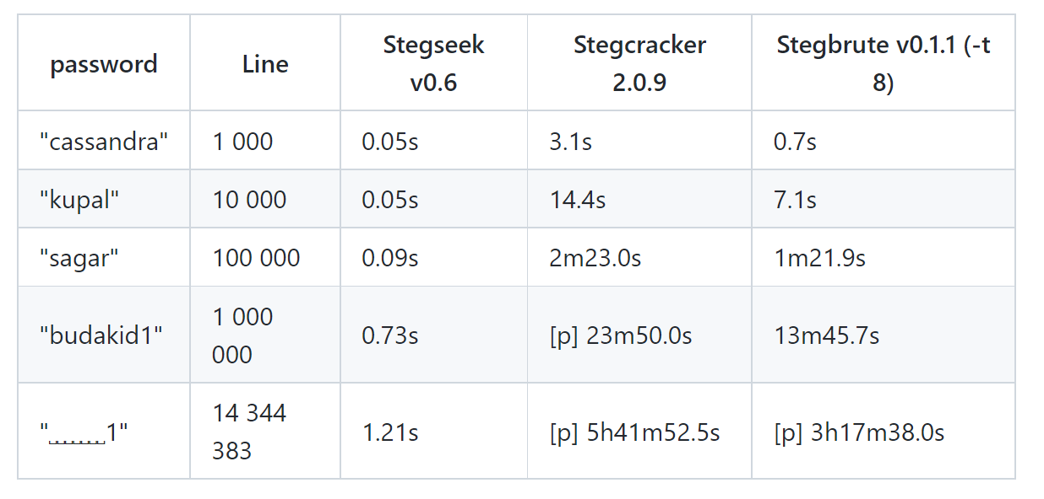
Faster cracking (stegseek)
https://github.com/RickdeJager/stegseek

