Slide 1
ALGORITHM CLASS PROJECT

Slide 2
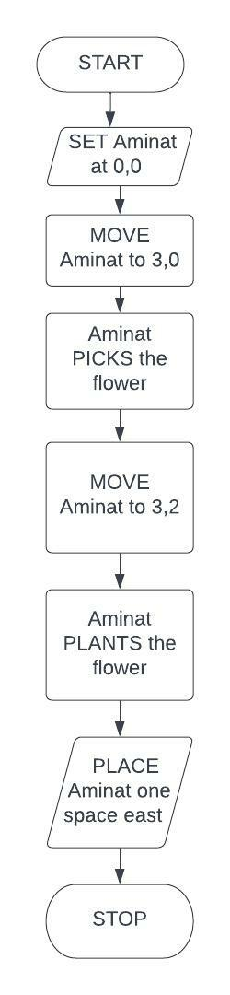
PROJECT 1 FLOWCHART

Slide 3
PROJECT 1 ALGORITHM
START
SET Aminat at (0,0)
MOVE Aminat to (3,0)
Aminat picks the flower
MOVE Aminat to (3,2)
Aminat PLANTS the flower
PLACE Aminat one space east
STOP

Slide 4
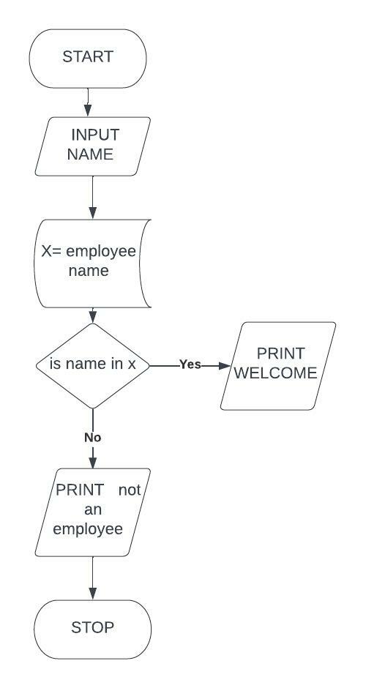
FLOWCHART FOR PROJECT 2

Slide 5
PROJECT 2 ALGORITHM
START
INPUT name
Let X= employee name
If name is in x
PRINT welcome
ELSE PRINT you’re not an employee
STOP

Slide 6
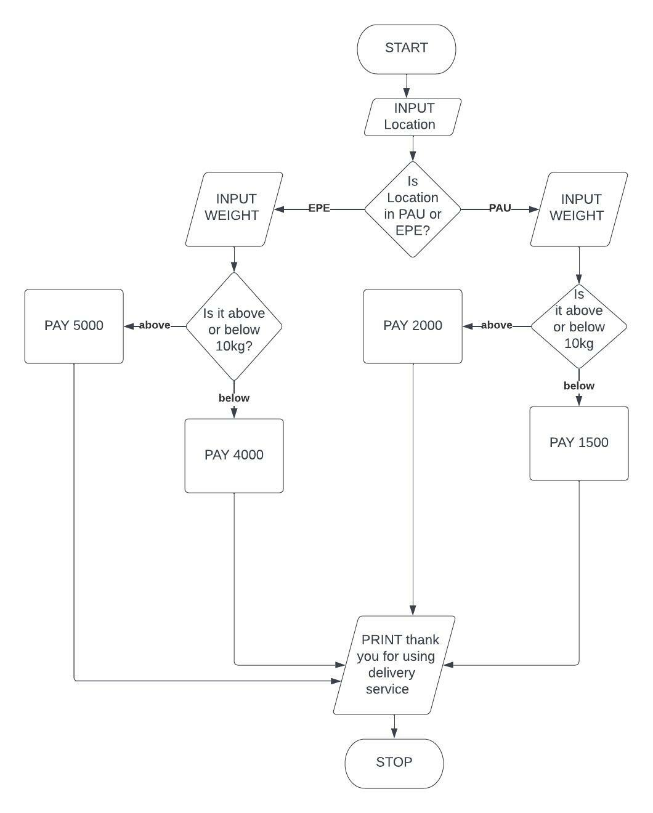
PROJECT 3 FLOWCHART

Slide 7
PROJECT 3 ALGORITHM

