Slide 1
Telco Customer
Churn Prediction
& CLV Analysis
Marketing Analytics Final Project
Siji Akinkugbe, Kenny Roger Munyaneza, Timothy Mandingwa and Gad Rukundo

Slide 2
Agenda
Overview
Five components — problem to action
01
02
03
Problem & Data
Data Exploration
Main Analysis
Define the churn challenge and introduce the IBM Watson dataset
Summary statistics, visualisations, and cleaning steps
Five ML models with nested CV and SMOTE resampling
04
05
Results & Interpretation
CLV & Recommendations
Model comparison, feature importance, threshold tuning
Segment customers, identify at-risk revenue, propose actions

Slide 3




Problem Statement
01 Problem
Customer churn is a revenue problem, not just a prediction task
Business objective
Telecom firms lose recurring revenue when customers leave and replacing them is often more expensive than retaining them. The smarter question is not only who will churn, but which churning customers matter most.
⚠️
Identify churn risk
Detect customers likely to leave
💵
Estimate CLV
Measure revenue importance
Churn hurts revenue
Retention needs focus
Lost customers reduce recurring subscription income and future upsell opportunities.
Not every customer creates the same business impact, so retention must be prioritized.
📌
Prioritize action
Save high-risk, high-value customers

Slide 4
02 Problem
Why this is a marketing analytics problem
Revenue protection
Targeted offers
Budget optimization
Churn directly threatens recurring revenue and customer lifetime value.
Marketing teams can personalize retention campaigns instead of using one-size-fits-all promotions.
Retention spend can be directed where expected impact is highest.
Business question
Decision funnel
Who should we target first to maximize retention impact?
Churn probability
High
Customer value
High
The ideal target is not simply a likely churner, but a customer with meaningful revenue value and a realistic chance of being retained.
Retention priority
Highest

Slide 5
IBM Telco Customer Churn
02 Data
Demographics
Gender, senior citizen, partner, dependents
Service Usage
Phone, internet, streaming, support services
Contract & Tenure
Contract type, monthly tenure, payment method
Financial Data
Monthly charges and total charges
Data Categories
The dataset contains customer demographics, service subscriptions, account information, and billing behavior. It provides a practical foundation for predicting churn and linking that risk to customer value.

Slide 6
Feature Engineering
02 EDA
Average Monthly Spend
Adjusted monthly spending metric Handles new customers with zero tenure
Service Adoption Count
Total number of services a customer uses Measures customer engagement and stickiness
Tenure Group
Categorizes customers by how long they’ve stayed Captures customer lifecycle stages
Charge per Service
Monthly charges divided by number of services Reflects value for money and pricing fairness
Tenure per Service
Tenure adjusted by number of services used Measures loyalty relative to engagement

Slide 7
Preliminary Data Exploration
02 EDA
Churn distribution: full dataset vs. filtered to month-to-month
7,043
26.5%
3,875
42.7%
11
Full Dataset
Churn (Full)
After Filter
Churn (M-t-M)
Missing
Values
Before Filtering — Full Dataset (7,043)
After Filtering — Month-to-Month Only (3,875)
Not Churned
74%
Not Churned
57%
Churned
27%
Churned
43%
Imbalanced: 73.5% retained vs 26.5% churned
Churn jumps to 42.7% — model focused on highest-risk segment
→ Addressed via class_weight & scale_pos_weight tuning
→ Imbalance reduced but present; class weighting retained
Data Cleaning: Converted TotalCharges from string→float (11 blank rows dropped); mapped 'No internet/phone service'→'No' for 7 add-on columns; encoded Churn Yes/No→1/0.

Slide 8
Main Analysis: Model Design
03 Analysis
Why these models?
Churn is a binary classification problem with mixed feature types and a moderately imbalanced target (26.5% positive). The suite spans interpretable baselines (Logistic Regression, Decision Tree), a distance-based learner (KNN), and ensemble methods (Random Forest, XGBoost) to benchmark complexity vs. performance trade-offs.
LR
DT
KNN
RF
XGB
Logistic Regression
Decision Tree
K-Nearest Neighbors
Random Forest
XGBoost
Fully interpretable; rules extractable for CRM automation
Non-parametric; captures local churn clusters
Robust to correlated features; stable importance rankings
State-of-the-art for tabular data; handles feature interactions
Interpretable; odds ratios map directly to churn drivers
Depth-tuned; class_weight balanced
L1/L2 distance; feature scaling required
200 trees; OOB validation
Learning rate + scale_pos_weight tuned
ElasticNet, saga solver; scaled features

Slide 9
Main Analysis: Robustness Check
03 Analysis
Multiple Metrics
Nested Cross Validation
Low Optimism Bias
Used 5 outer folds for generalization performance evaluation
5 inner folds for hyperparameter tuning
Performance was checked with AUC, accuracy, F1 score, recall, and precision instead of relying on only one metric
Reported only a 0.001 non-nested vs nested AUC optimism bias for Logistic Regression

Slide 10
Results: Model Performance Comparison
04 Results
Model
OOF AUC
Std
Accuracy
F1
Recall
Precision
★ Logistic Regression
0.754
0.010
0.698
0.630
0.602
0.660
Random Forest
0.749
0.011
0.749
0.685
0.598
0.640
XGBoost
0.752
0.014
0.748
0.687
0.642
0.632
KNN
0.717
0.017
0.717
0.662
0.606
0.604
Decision Tree
0.716
0.018
0.716
0.666
0.618
0.604
Discussion
All five models scored similarly (AUC 0.72–0.76) — surprising given the range from Decision Tree to XGBoost
Month-to-month churn has a clear, learnable signal — even simple models can detect it
Logistic Regression winning while staying fully interpretable was an unexpected and useful result
In plain terms
Our model correctly flags 3 out of 4 customers who are about to leave
Lowering the alert threshold to 0.30 catches more churners early — retaining a customer costs less than acquiring a new one
Actions
Score all month-to-month customers monthly using Logistic Regression
Flag anyone above 0.30 churn probability for proactive outreach
Re-evaluate threshold quarterly as customer mix changes

Slide 11
Feature Importance & Interpretability
04 Results
Model
Feature 1
Feature 2
Feature 3
Feature 4
Decision Tree
charge_per_svc (0.39)
tenure_per_svc (0.30)
avg_monthly (0.09)
Elec. Check (0.07)
Logistic Reg.
tenure 48-72m (OR 4.79)
tenure 24-48m (OR 2.05)
is_fiber (OR 1.62)
MultipleLines (OR 1.51)
Random Forest
tenure_per_svc (0.13)
charge_per_svc (0.10)
Elec. Check (0.09)
tenure (0.09)
XGBoost
Internet Fiber (0.23)
Elec. Check (0.12)
tenure_per_svc (0.10)
charge_per_svc (0.08)
Discussion
Engineered features (charge_per_service, tenure_per_service) outranked all raw variables — the biggest finding
Customers in months 24–72 had the highest churn odds — surprising, as longer tenure usually signals loyalty
Fiber optic and electronic check appear as high-risk signals across all four models
In plain terms
Customers paying a lot for few services are most likely to leave
Fiber optic + electronic check users are price-sensitive and easy to switch — highest risk profile
Actions
Target fiber optic + electronic check customers with bundle or discount offers
Intervene at the 24-month mark before churn risk peaks
Upsell low-service customers to add-ons — reduces charge_per_service and improves retention

Slide 12
Customer Lifetime Value & Segmentation
05 CLV
Segment
CLV Range
Customers
Avg CLV
Churn Prob
Avg Tenure
Avg Monthly
Low
< $200
1,091
$82
48%
2.1 months
$47.12
Medium
$200 – $600
741
$373
46%
8.3 months
$58.35
High
$600 – $1,500
778
$999
43%
16.4 months
$69.44
★ Premium
> $1,500
1,265
$3,293
35%
38.5 months
$85.86
Discussion
Premium: highest CLV ($3,293) and lowest churn (35%) — most loyal and most valuable simultaneously
Surprising: Low segment has the highest churn (48%) despite generating the least revenue — new customers are hardest to retain
In plain terms
Losing one Premium customer = over $3,000 in lost revenue — top retention priority
The first 3 months are a critical loyalty window for Low segment customers
Actions
Prioritise Premium segment for high-touch, personalised retention offers
Introduce onboarding incentives for Low segment in months 1–3
Use CLV scores to allocate retention budget proportionally across segments

Slide 13
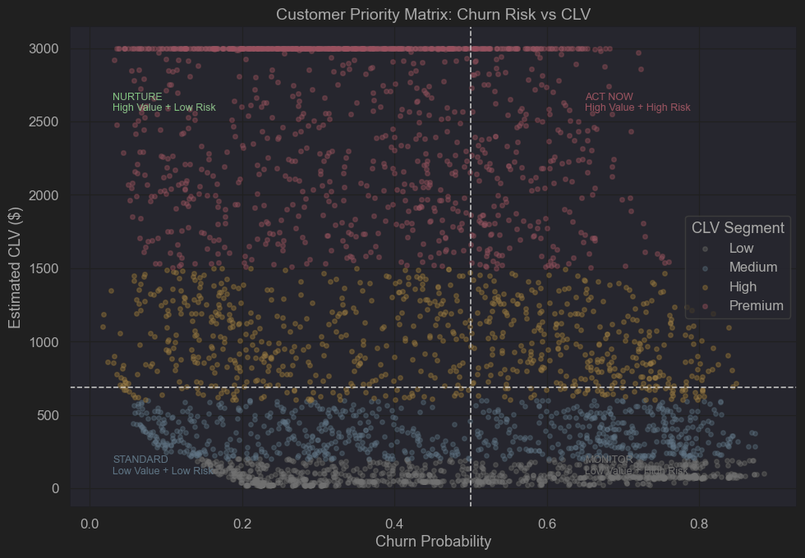
Business Recommendations
05 CLV
Act Now: Retain High CLV + High Churn Risk customers (largest revenue impact)
Nurture: Maintain High CLV + Low Risk customers (protect long-term value)
Monitor: Track Low CLV + High Risk customers (low revenue impact)
Standard: Minimal intervention for Low CLV + Low Risk customers

Slide 14
Critical Reflection
05 Critical
Reflection
CLV approximation: Customer value estimated from charges and tenure rather than full revenue or profit history.
Data limits: The dataset lacks detailed usage patterns, service interactions, and cost information, which limits the ability to model true customer profitability and behavioral drivers of churn.
Model choice: Logistic regression favors interpretability over maximum predictive power.
Future work: Incorporate richer behavioral data and test advanced models for churn prediction.

Slide 15
Thank You

