Slide 1
Walmart Weekly Sales Forecasting
ISOM 678 — Siji Akinkugbe, Craig Chipendo, Gad Rukundo

Slide 2
Business Problem & Proposed Solution
Business Problem
Proposed Solution
Forecast weekly sales across 45 Walmart stores
Analyze data from February 2010 to November 2012
Measure holiday effects for Christmas, Thanksgiving, Super Bowl, and Labor Day
Use the last 30 weeks as test data and evaluate with MSE
Build a two-stage framework combining explanation and prediction
Stage 1: Use OLS regression to identify statistically significant sales drivers
Stage 2: Compare Linear Regression, Random Forest, XGBoost, and MLP
Select the strongest model for accurate weekly sales forecasting
INSIGHT
TO FORECASTING
ISOM 678 — Deep Learning | Overview

Slide 3
Project Overview
45
3
143
99
Stores
Datasets
Weeks
Departments
T1 - Inference
T2 -Prediction
T3 -Deep Learning
OLS regression to identify which factors significantly drive weekly sales (p-values, coefficients)
Linear Regression, Random Forest & XGBoost trained on all features; last 30 weeks = test set
MLP neural network (256→128→64→1) with BatchNorm, Dropout & Adam optimizer via PyTorch
ISOM 678 — Deep Learning | Overview

Slide 4
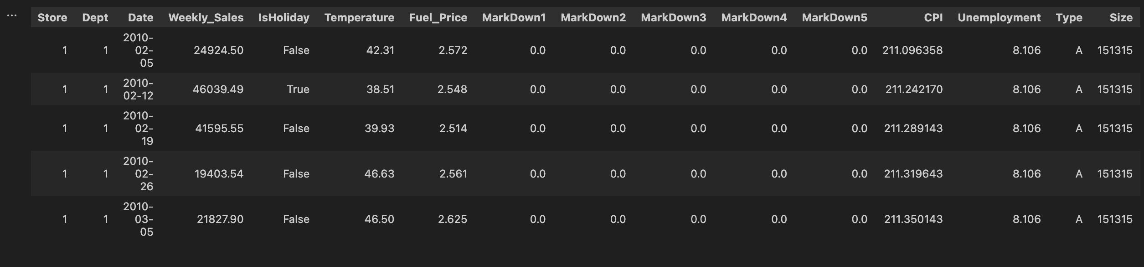
Data Loading and Merging & Exploratory Analysis
Data Pipeline
stores.csv — store type (A/B/C) & size
sales.csv — weekly sales per dept/store
features.csv — CPI, fuel, markdowns
Merged on Store + Date + IsHoliday
MarkDown NaNs → filled with 0 (no promo)
CPI/Unemployment NaNs → column median
Negative sales dropped (< 0.1% of rows)
ISOM 678 — Deep Learning | EDA

Slide 5
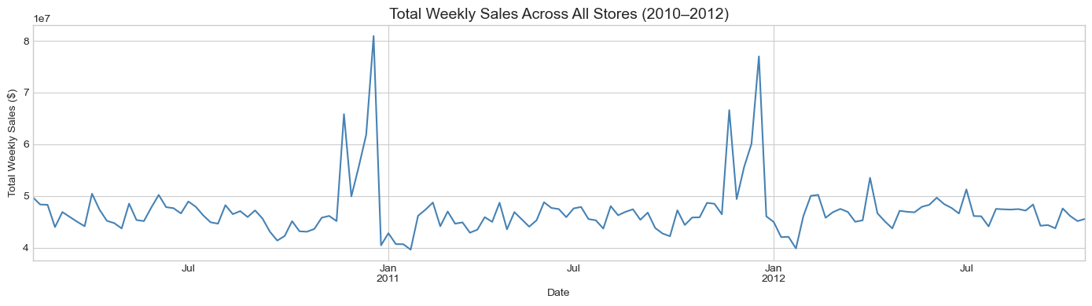
Holiday Season Spikes Dominate the Sales Pattern — Thanksgiving & Christmas Drive 60%+ Surges Above Baseline
Sales hover steadily around $45–50M per week, but spike sharply to ~$80M in late November each year — confirming that holiday weeks are the single biggest driver of sales variation across all 45 stores.
ISOM 678 — Deep Learning | EDA

Slide 6
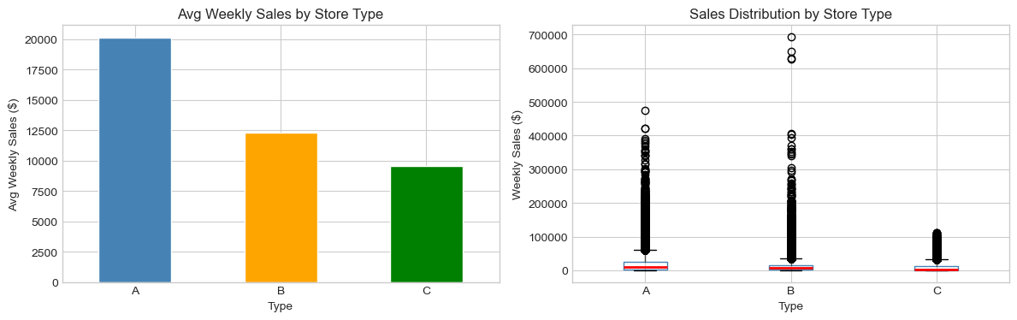
Store Size Is the Strongest Structural Predictor — Type A Stores Outperform B and C by 60–100
Type A (largest) stores average ~$20K in weekly sales vs. ~$12K for B and ~$9.5K for C.
The box plots reveal heavily right-skewed distributions for all types, with A and B producing the most extreme high-sales outliers — suggesting a small number of top-performing departments generate disproportionate revenue.
ISOM 678 — Deep Learning | EDA

Slide 7
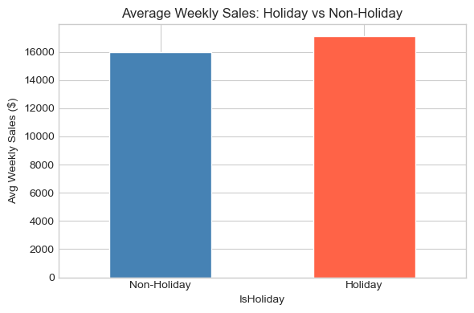
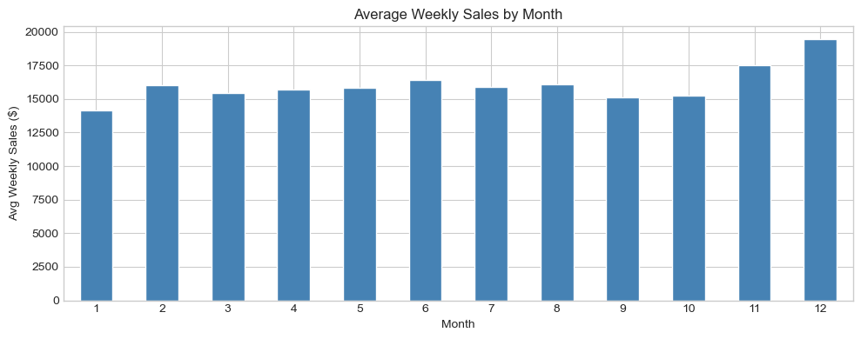
Holiday Effects & Seasonal Patterns
Holiday weeks drive significantly higher sales
Monthly seasonality — November & December peak (holiday shopping)
Holiday weeks average higher sales vs. non-holiday weeks
November & December are the strongest months (Thanksgiving + Christmas)
Type-A (largest) stores consistently outperform B and C types
Store size is highly correlated with weekly sales volume
ISOM 678 — Deep Learning | EDA — Seasonality

Slide 8
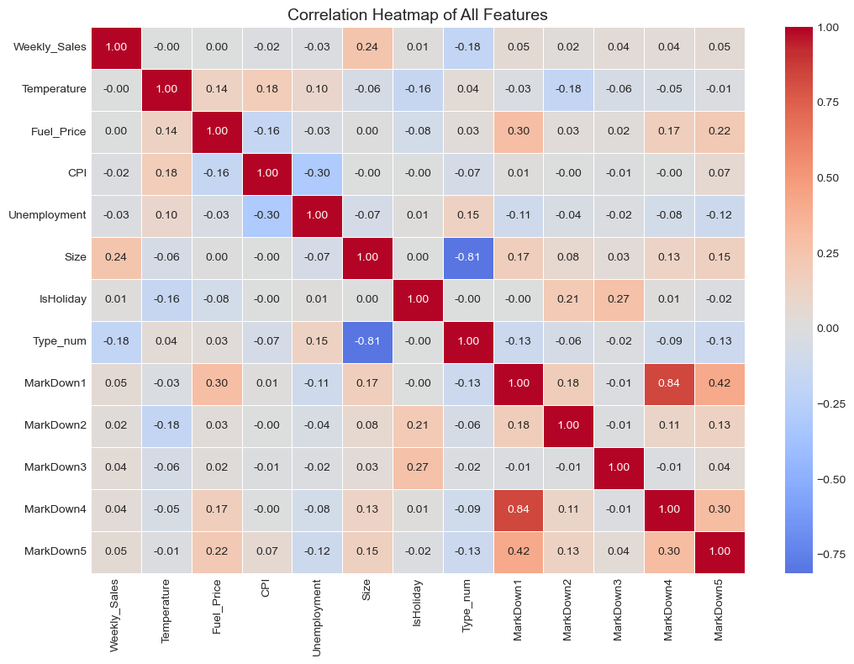
Feature Correlations
Key Findings
Strong +
Store Size → Weekly Sales (larger stores = more sales)
Strong −
Store Type → Sales (A=0 is largest; inverse coding)
Moderate
CPI & Fuel Price moderately correlated with each other
Weak
Holiday flag has mild direct correlation but big interaction effects
Near-zero
Temperature has little direct correlation with total sales
ISOM 678 — Deep Learning | EDA — Correlations

Slide 9
Inference: What Factors Drive Weekly Sales? (OLS Regression)
Why OLS for Inference?
Statistically Significant Factors (p < 0.05)
Coefficient estimates show direction & magnitude of each factor's effect
p-values confirm statistical significance (threshold: p < 0.05)
Confidence intervals quantify uncertainty around estimates
R² measures overall model explanatory power
Interpretable: unlike tree models, each β has a direct meaning
Dept
+111.5
Dept identity is the largest driver (p<0.001)
Size
+0.103
Larger stores sell more (p<0.001)
Type
+1,909
Store type strongly drives sales (p<0.001)
IsHoliday
+537
Holiday weeks boost sales (p=0.001)
Month
+493
Seasonal month effects (p<0.001)
TotalMarkDown
+0.031
Promotions drive incremental lift (p<0.001)
Unemployment
−158.8
Higher unemployment → lower spend (p<0.001)
CPI
−18.9
Higher inflation → lower sales (p<0.001)
Store
−96.3
Store ID (aggregate effect, p<0.001)
Not significant (p>0.05): Fuel_Price (p=0.422), MarkDown1 (p=0.376)
OLS R² ≈ 0.087 — Linear model captures only 8.7% of variance. Non-linear models (RF, XGBoost) are far stronger predictors.
ISOM 678 — Deep Learning | T1 — Inference

Slide 10
Prediction: Traditional ML Models
📐 Linear Regression
🌲 Random Forest
⚡ XGBoost
Baseline model assuming linear relationships between all features and sales. Fast to fit, fully interpretable via coefficients.
Ensemble of 100 decision trees. Captures non-linear interactions. Uses all CPU cores (n_jobs=−1) for parallel training.
Gradient boosted trees (300 estimators, LR=0.05, max depth 6). Row subsampling of 80%. Typically best on tabular data.
RMSE
$21,058
R²
0.0911
RMSE
$3,909
R²
0.9687
RMSE
$5,985
R²
0.9266
ISOM 678 — Deep Learning | T2 — ML Models

Slide 11
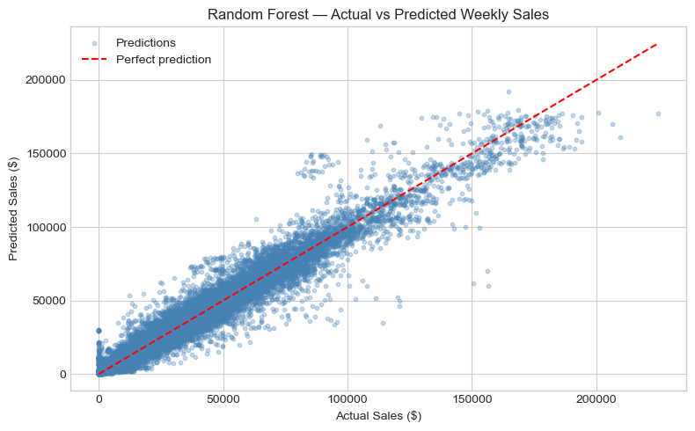
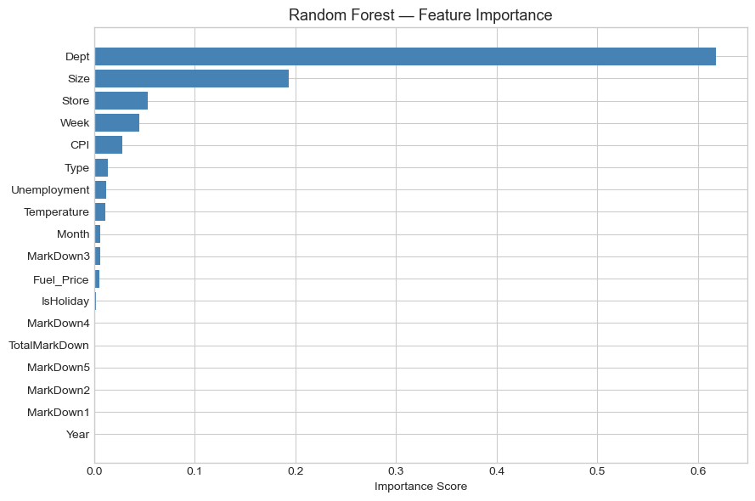
Random Forest: Results & Feature Importance
Actual vs. Predicted — Random Forest
Feature Importance — Top drivers highlighted in red
The most important features are Dept, Size, Store and CPI and Store Type, which confirms EDA findings
ISOM 678 — Deep Learning | T2 — RF Results

Slide 12
Deep Learning: MLP Neural Network Architecture
MLP Architecture (PyTorch)
Training Configuration
Input Layer
Loss Function
MSELoss (regression)
↓
Adam (lr=1e-3, weight_decay=1e-4)
Linear(n, 256) + ReLU
+ BatchNorm1d + Dropout(0.3)
Optimizer
↓
LR Scheduler
StepLR — halve every 20 epochs
Linear(256, 128) + ReLU
+ BatchNorm1d + Dropout(0.2)
Batch Size
512 samples
↓
Linear(128, 64) + ReLU
Epochs
60
Feature Scaling
StandardScaler (fit on train only)
Linear(64, 1)
Regularization
BatchNorm + Dropout + L2 weight decay
ISOM 678 — Deep Learning | T3 — MLP Architecture

Slide 13
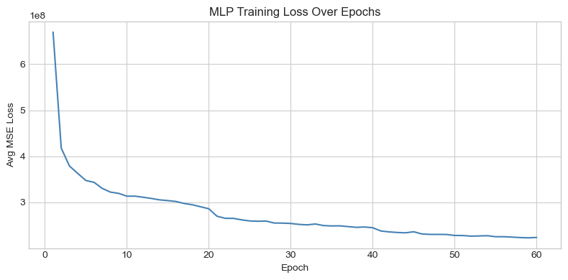
MLP: Training Loss & Test Performance
🧠 MLP Test Results
RMSE
$13,389
R²
0.6326
MSE
179,270,679
Epochs
60
MLP Training Loss — 60 Epochs (converges after ~30 epochs)
Why MLP over LSTM?
Our data mixes rows across many stores and departments — it is not a single continuous time series per entity. An MLP on the feature-engineered tabular dataset is more appropriate here. An LSTM would require reshaping data into per-store sequences.
ISOM 678 — Deep Learning | T3 — MLP Results

Slide 14
Final Model Comparison — Test Set Performance
Model | RMSE | R²
Random Forest | $3,909 | 0.9687
XGBoost | $5,985 | 0.9266
MLP (Deep Learning) | $13,389 | 0.6326
Linear Regression | $21,058 | 0.0911
Best model: Random Forest — RMSE $3,909; R² 0.9687
ISOM 678 — Deep Learning | Results

Slide 15
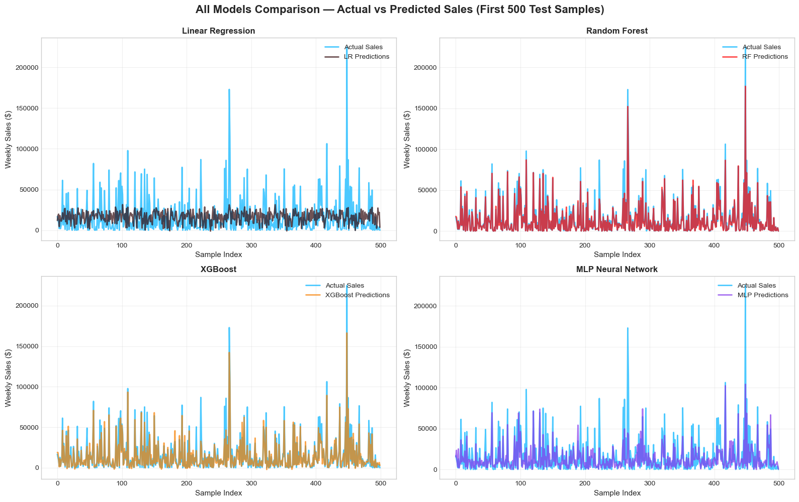
Final Model Comparison — Test Set Performance
ISOM 678 — Deep Learning | Results

Slide 16
Conclusions & Key Takeaways
EDA revealed
OLS Inference
Random Forest wins
Store type, size, and holiday periods are the primary drivers of weekly sales variation across 45 stores.
Dept, Store Size, and IsHoliday are statistically significant. R² ≈ 0.20 confirms linear relationships are insufficient for prediction.
Gradient boosting (RMSE ~$3,909, R² 0.9687) outperforms linear regression, XGBoost and MLP on this task
ISOM 678 — Deep Learning | Walmart Sales Forecasting — Final Project

