Slide 1
Implementing deep learning models for automated plant disease classification
By Samiat bola-matanmi

Slide 2
Content
Problem Statement
Objectives
Research Questions
Methodology
Result

Slide 3
Problem statement
Plant diseases can significantly impact agriculture, food security, and the environment. Accurately identifying and diagnosing plant diseases is essential for effective disease management and control. However, traditional methods of disease diagnosis can be time- consuming, subjective, and prone to human error.
Machine learning techniques have shown promising plant disease detection results in recent years. However, several challenges remain associated with using machine learning for plant disease detection, including the limited availability of high-quality data, difficulty integrating multiple sources of information, and poor performance to real-world data.
The problem of plant disease detection using machine learning is to develop an accurate, fast, and scalable approach for identifying and classifying plant diseases based on images of
13
Plant diseases. The approach should handle complex and variable data, be robust to noisy and incomplete data and provide a clear and interpretable diagnosis.
The solution to this problem would have important implications for agriculture, food security, and the environment, providing a powerful tool for managing and controlling plant diseases, improving crop health, and increasing yields.

Slide 4
Objectives
To train multiple deep learning models on the selected dataset using pre-trained models approach.
To evaluate and compare the performance of each model using different evaluation metrics.

Slide 5
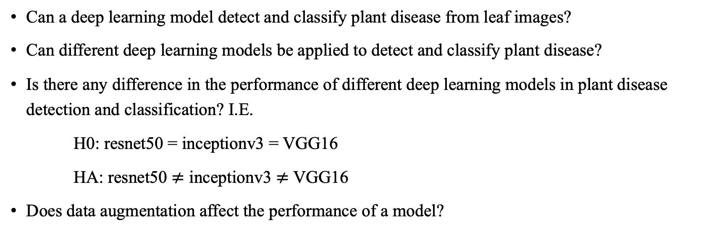
Research questions
Can a deep learning model detect and classify plant disease from leaf images?
Can different deep learning models be applied to detect and classify plant disease?
Is there any difference in the performance of different deep learning models in plant disease detection and classification? I.E.
H0: resnet50 = inceptionv3 = VGG16
HA: resnet50 $≠$ inceptionv3 $≠$ VGG16
Does data augmentation affect the performance of a model?

Slide 6
Methodology
Models trained are RESNET50, INCEPTIONV3 AND VGG16
Data Acquisition
Data Pre-processing
Data Augmentation
Load pre-trained model
Model Evaluation
Model training and validation
Model fine-tuning

Slide 7
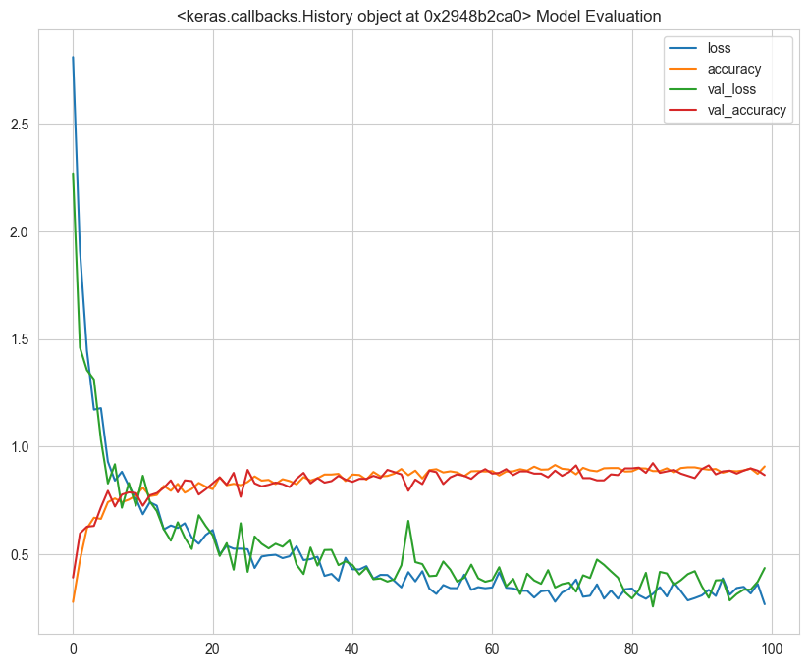
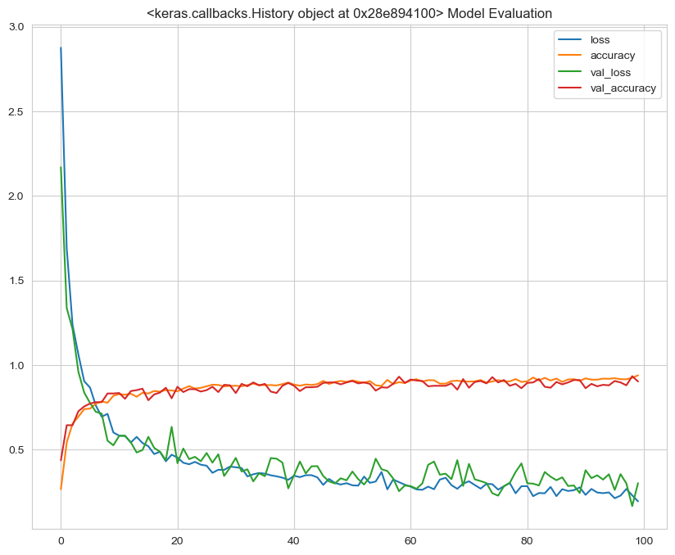
RESULT
Inceptionv3 accuracy and loss on unaugmented dataset
Inceptionv3 accuracy and loss on augmented dataset

Slide 8
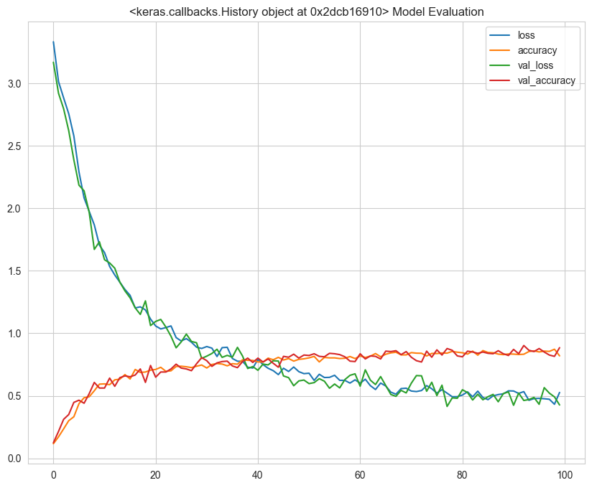
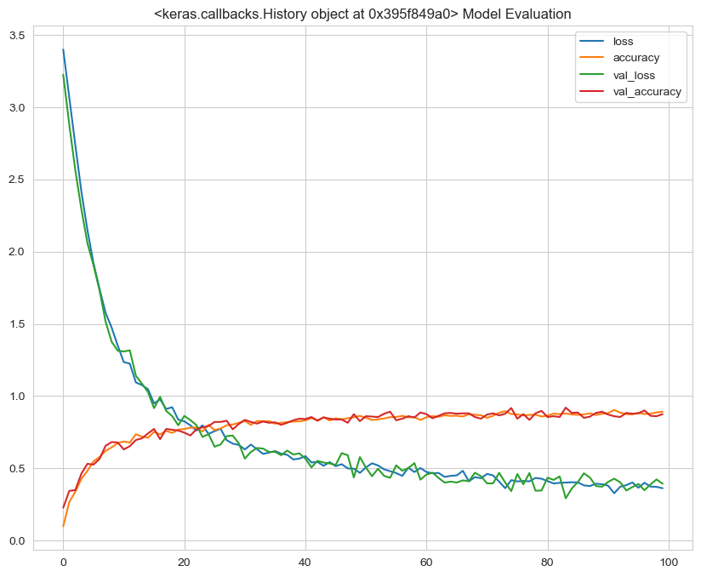
Result (contd.)
VGG16 accuracy and loss for unaugmented dataset
VGG16 accuracy and loss for augmented dataset

Slide 9
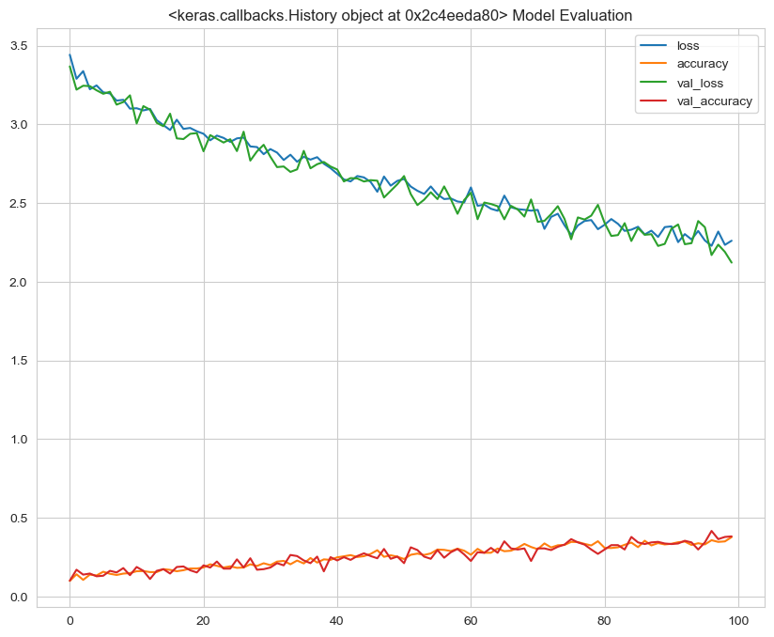
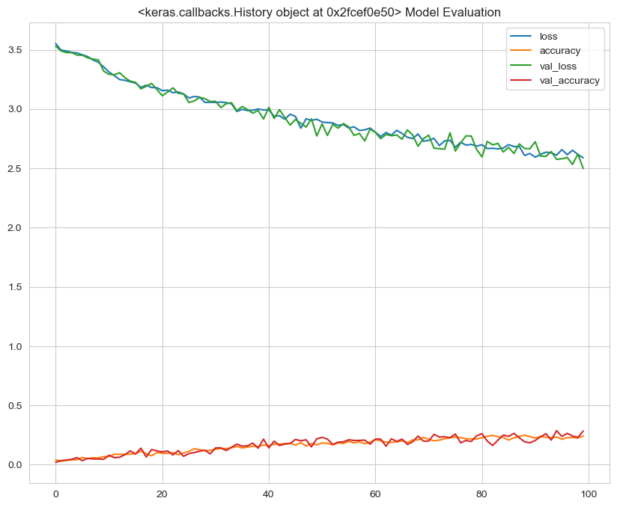
Result (Contd.)
Resnet50 accuracy and loss for unaugmented dataset
Resnet50 accuracy and loss for augmented dataset

Slide 10
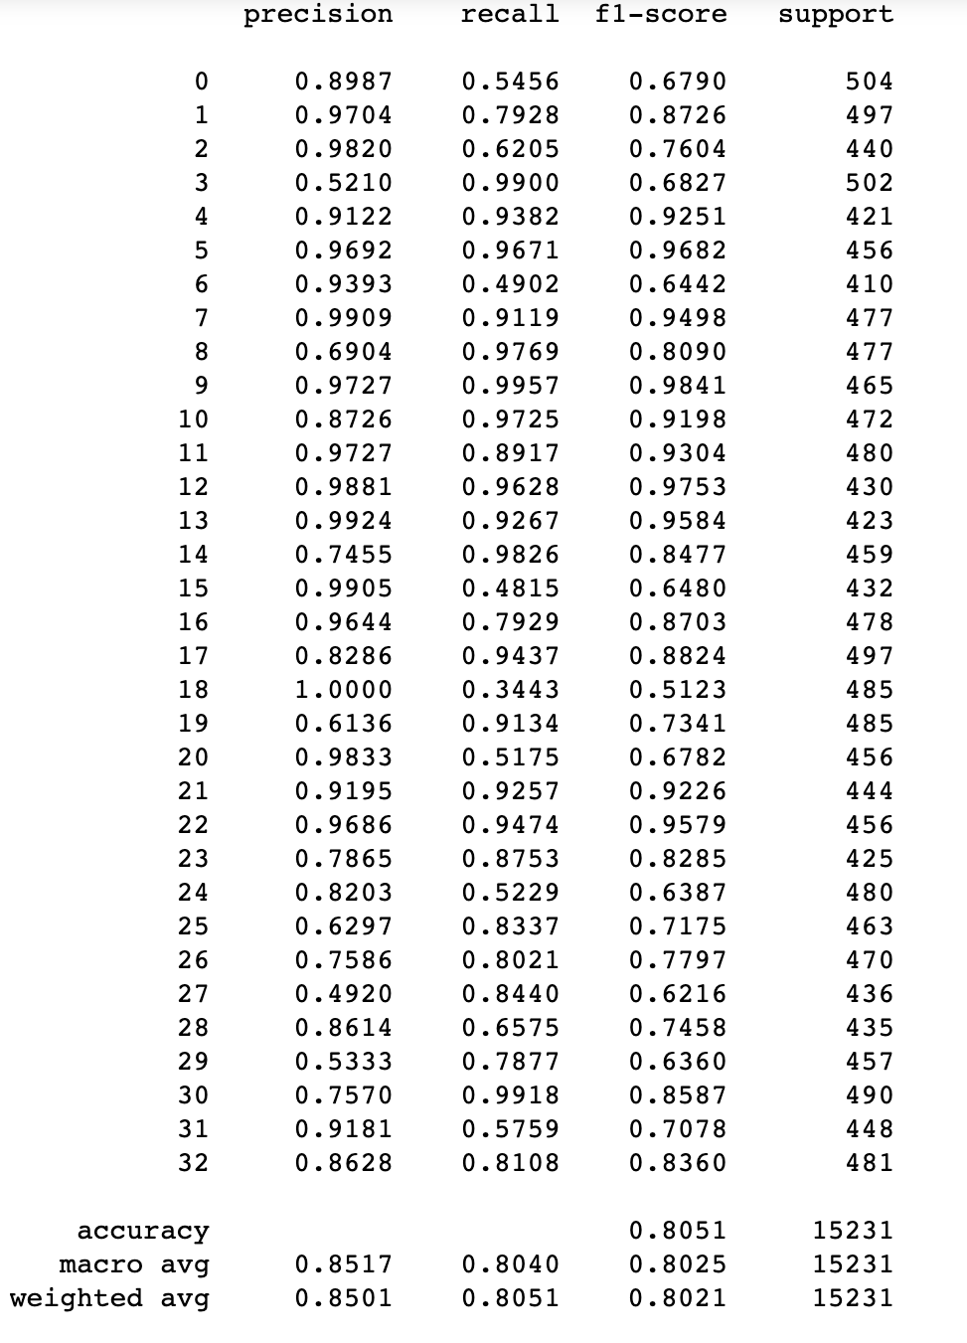
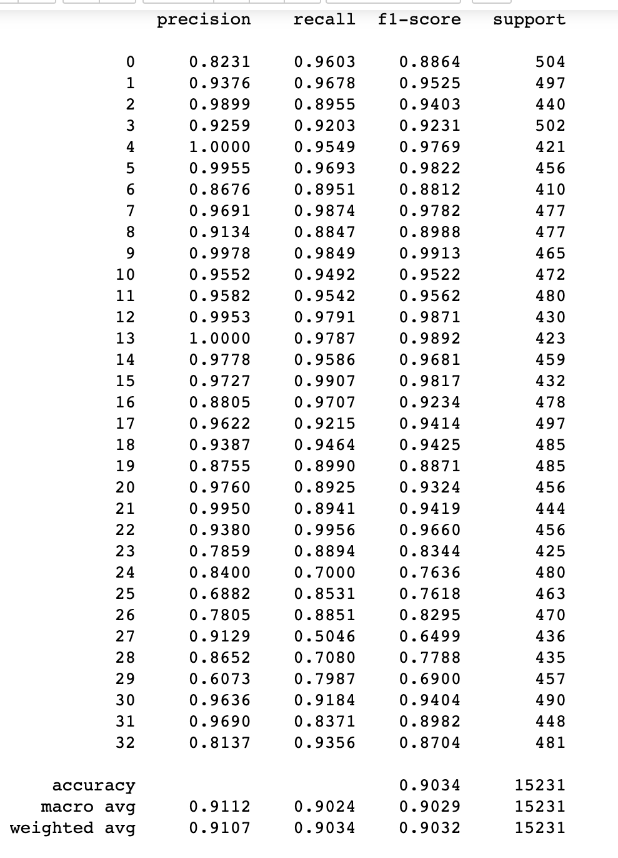
Result (CONTD.)
Classification report for inceptionv3 with unaugmented dataset
Classification report for inceptionv3 on augmented dataset

Slide 11
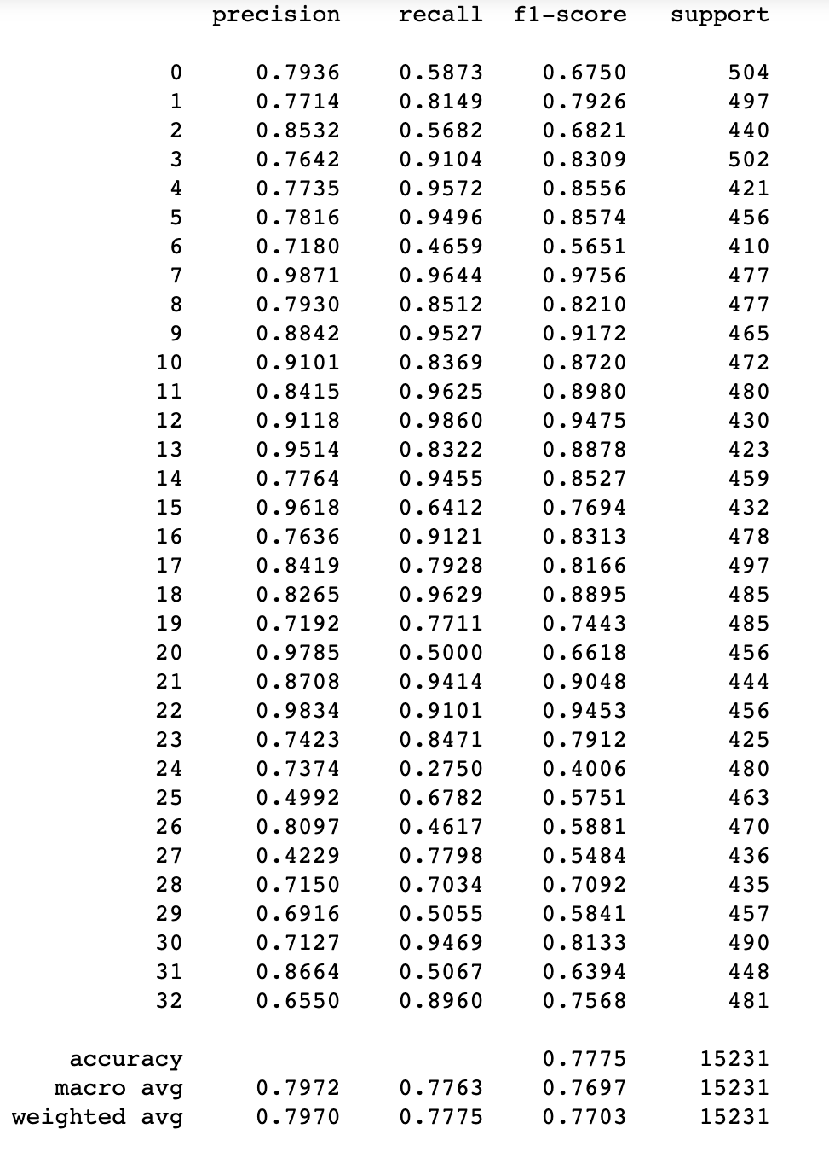
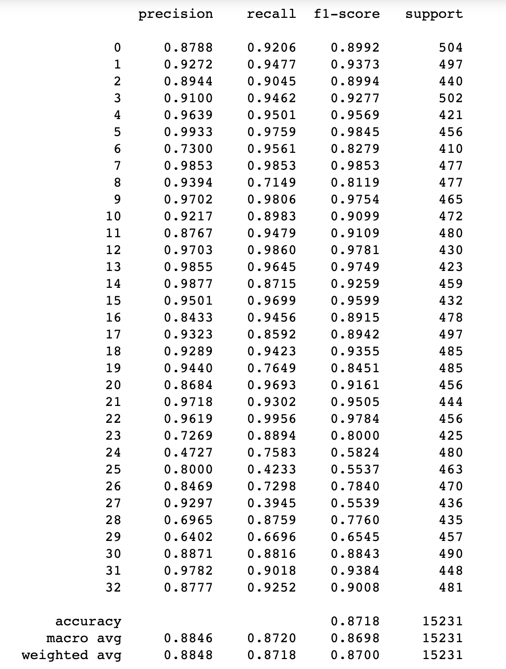
Result (Contd.)
Classification report for VGG16 with unaugmented dataset
Classification report for VGG16 with augmented dataset

Slide 12
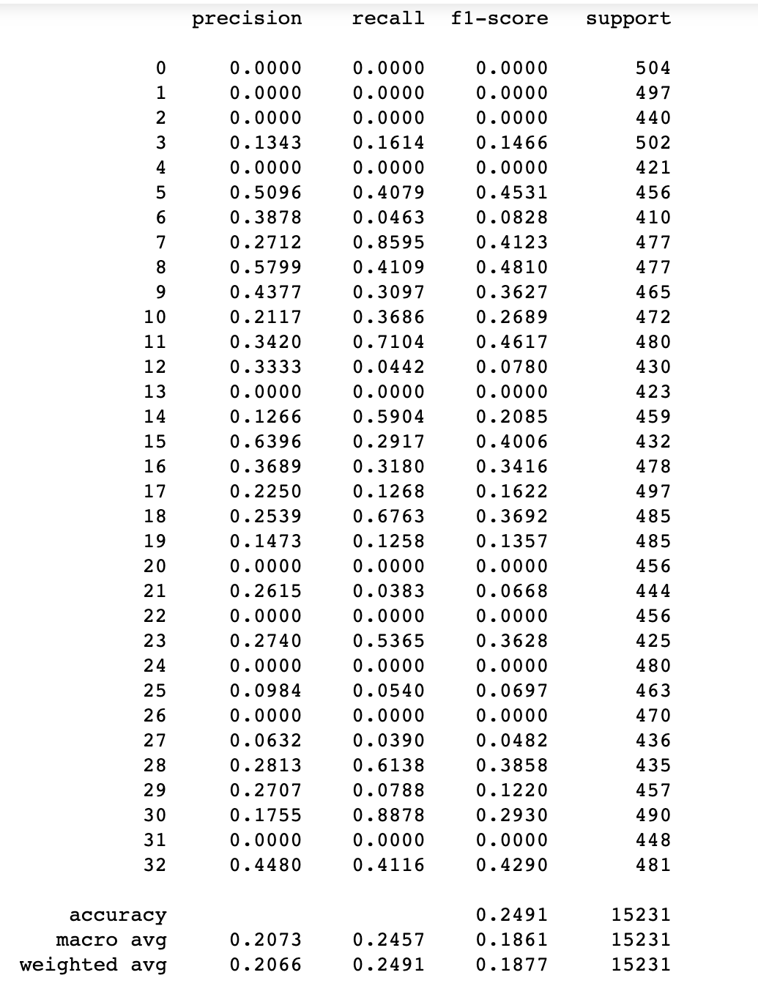
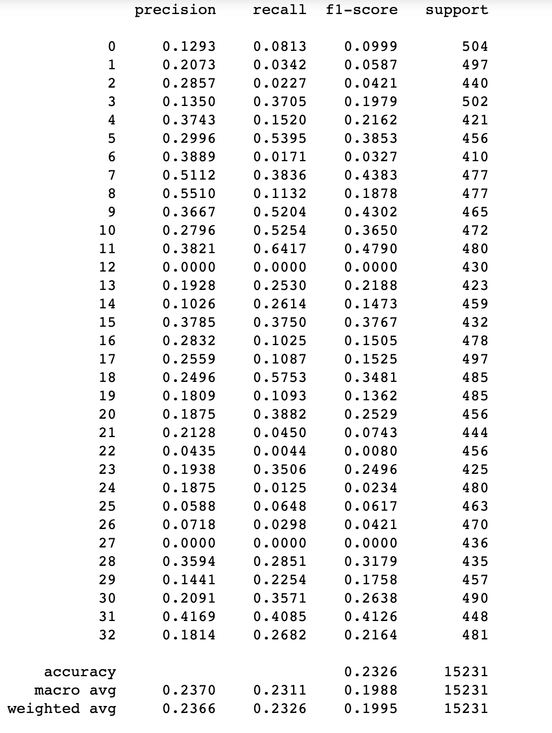
Result (Contd.)
Classification report for resnet50 with unaugmented dataset
Classification report for resnet50 with augmented dataset

Slide 13
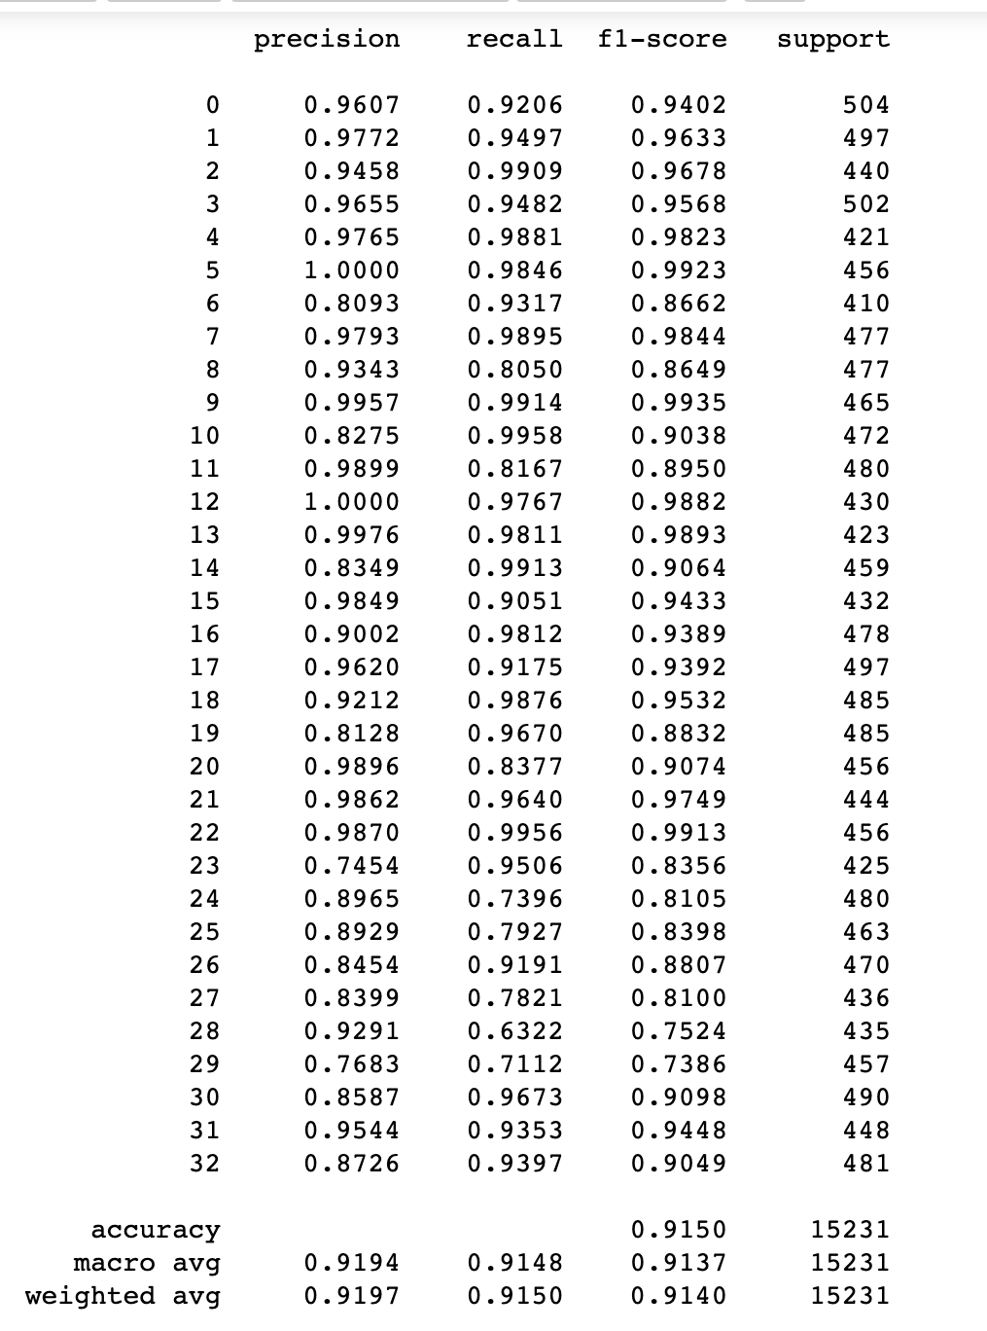
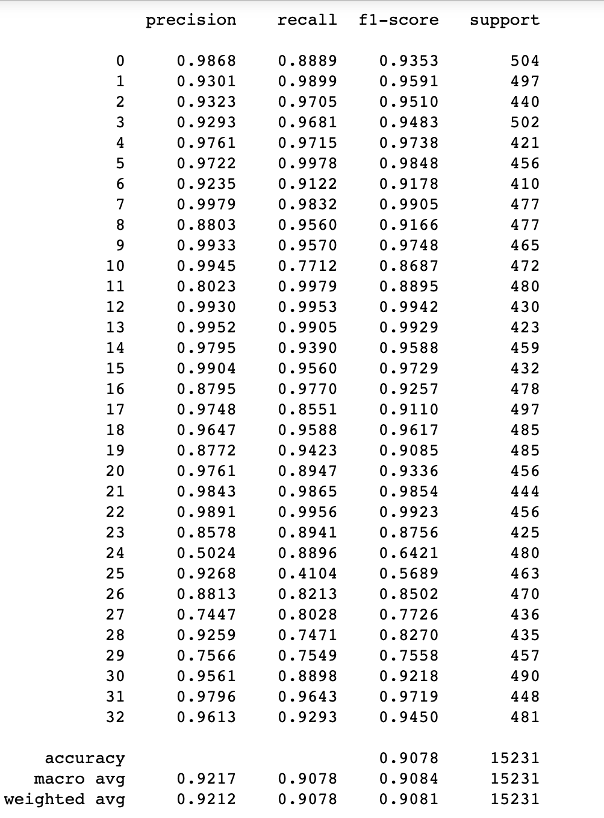
Result (CONTD.)
Inceptionv3 performance after sample weighting
Vgg16 performance after sample weighting

Slide 14
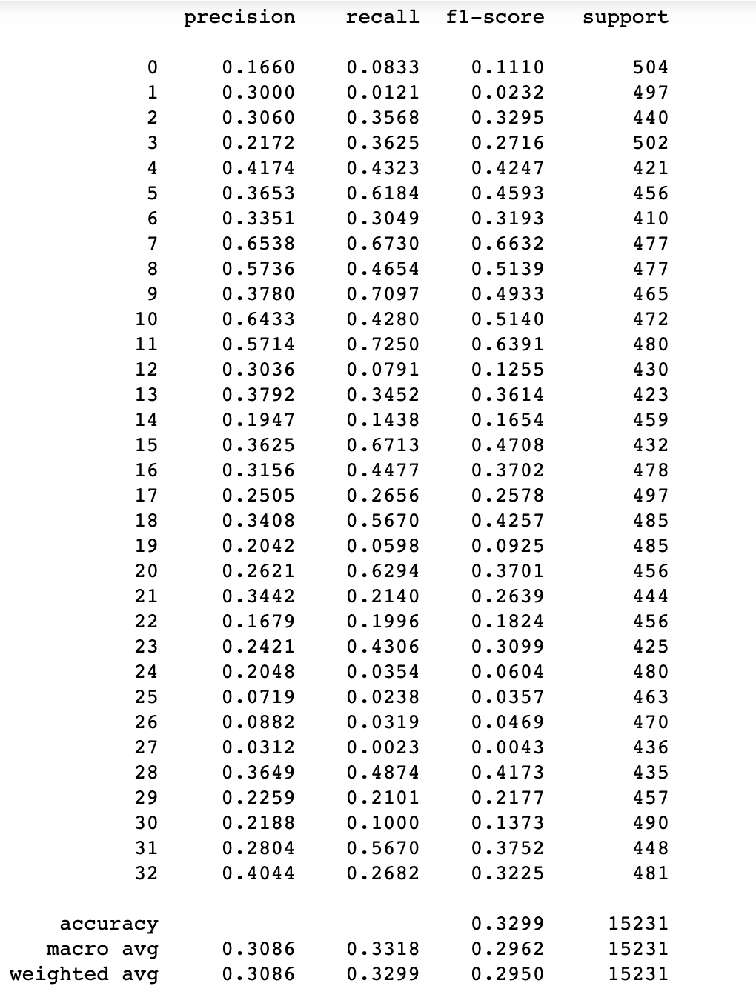
RESULT (CONTD.)
Resnet50 performance after sample weighting

Slide 15
THANK YOU

