Slide 1
LECTURE 4: BUSINESS ARCHITECTURE ASPECTS: BUSINESS PROCESS REDESIGN/ REENGINEERING

Slide 2
Lecture Contents
Where are we now?
Business Process Management Timeline
Recap & More on Business Processes
  Dimensionality & Different levels of change
Process Change in Theory - BP Redesign/ Reengineering:
  Hammer’s Theory of Process Change
  Davenport and Short’s Methodology for Process Change
  IT & Business Processes
Success & Failure in BPR Projects:
  Examples in practice: Private & Public Sector
  What Good Ol’ Meaty Statistics tell us about BPR Success…
A Mention for Robotic Process Automation (RPA)

Slide 3
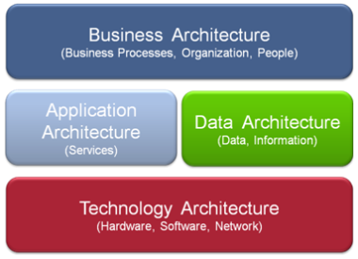
Components of Enterprise Architecture:
Where Are We Now?
The Open Group Architecture Framework (TOGAF)’s
Perspective of Enterprise Architecture
Business Architecture.
  Business processes and workflows. 
  Stakeholders and their roles and relationships. 
  Business model, strategy, drivers, goals, policies, and operating model. ✓
  Business rules that capture the assigned authorities, responsibilities and policies relevant to the BPs. ✓
  Functional decompositions, business capabilities and organizational models.✓
  Funding and operational cycles. ✗
  Third-party suppliers of hardware, software, and services; their roles and responsibilities. ✗
A lot about Process Change (BPR, the Quality Movement etc), BPMN, UML Use Case Models 

Slide 4
SECTION 4.1: INTRODUCTION

Slide 5
BPM Timeline (the Whole Truth)
Origins in manufacturing (1700s):
  Originally one person making an item from start to finish
  Development/Specialisation: division of labour (Adam Smith)
  Analysis of Specialised Tasks/ 'Time & Motion' Studies (1900s)
Workflow (mid-1940s):
  Document-based at a departmental process level
The Quality Era (1980s):
  Continuous improvement (Total Quality Mgmt (TQM)- Deming & Juran, 6Sigma etc)
Business Process Reengineering (BPR) (1990s)
  Revolution V Evolution (Hammer & Champy)
Business Process Management/Modelling (2000s)
  Multilevel, whole organization process integration & modelling
Robot Process Automation (2010s)

Slide 6
Recall: What is a Business Process?
A collection of inter-related work tasks, initiated in response to an event, that achieves a specific result for the customer of the process.
achieves a specific result
for the customer of the process
initiated in response to a specific event
work tasks
a collection of inter-related

Slide 7
Fundamental Question:
Why Change a Business Process?
Business Process Management (BPM):
  Body of principles, methods & tools to design, analyse, execute & monitor BPs
  BPM bridges IT and business, as many/most IT projects in enterprises are ultimately aim at improving a BP
Information
Yields
Technology
Business
Value
Enables
Yields
Index Group (1982)
Process
Change
Notes:
BPM provides a natural ground for bridging IT and business, because many (perhaps most) IT projects in enterprises are ultimately aimed at improving a business process

Slide 8
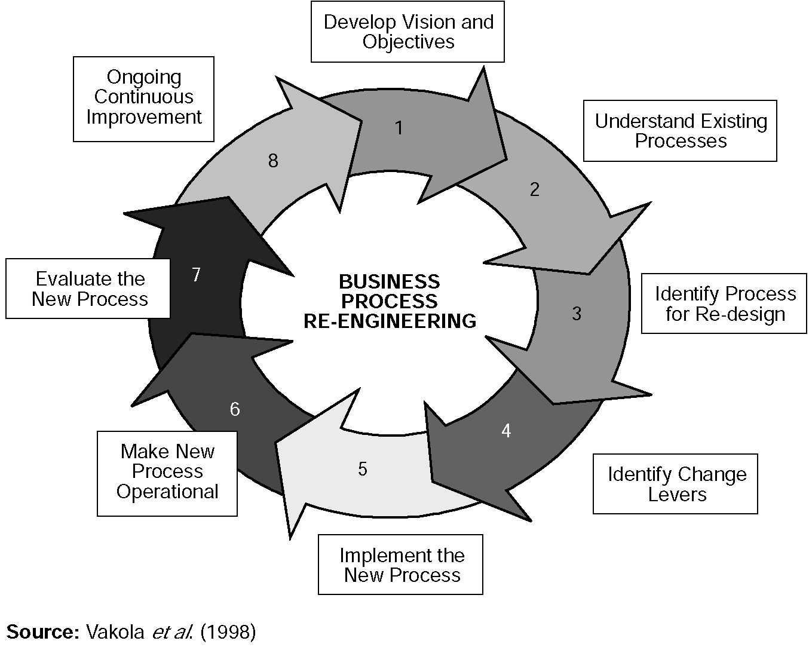
Stages in Business Process Change
This is where we got to
with Workflow Modelling
Notes:
CA4 BPR - Admin

Slide 9
Recap Aside : Some Examples of
What is and What is Not a Business Process
Suggested Process? | Actually Called | If not a Business Process, why not?
Customer Relationship Management | Process Area | Doesn't deliver a single, specific result.
Acquire new Customer | Business Process | Delivers a single, specific result and meets all other criteria. End-to-end BP.
Setup new Customer | Subprocess | Too small – delivers specific results but they are intermediate results in an end-to-end BP.
Calculate Credit Limit | Activity/ step/ task... | Much, much too small – a single step or instruction. Possibly one line in a procedure or step in a use case.
“Oracle CRM Process” | System | Doesn't deliver a single, specific result; a system that supports multiple Business Processes.
“Our e-business process” | Technology | Doesn't deliver a single, specific result; technology employed by multiple BP's.

Slide 10
Dimensionality of Processes
Processes are identified in terms of:
  Beginning/ end points, interfaces, organisation units (esp customer-facing)
They can be defined based on three dimensions:
Entities:
  Processes happen between organisational entities
  i.e. Interorganisational (e.g. e-Commerce), interfunctional or Interpersonal
  Heavily reliant on shared IT (known as Groupware (over))
Objects:
  Processes result in manipulation of objects.
  These objects could be Physical or Informational.
Activities:
  Processes could involve two types of activities:
  i.e. Managerial (e.g. develop a budget) and Operational (e.g. fill a customer order).

Slide 11
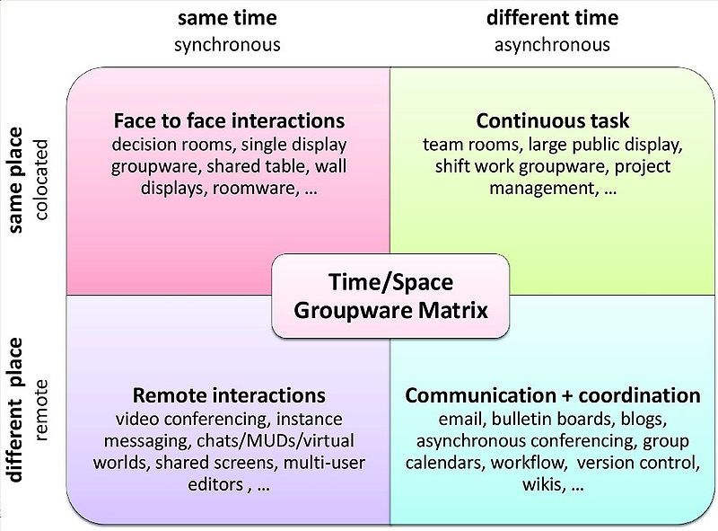
Dimensionality of Processes (/2)
Groupware
  Now many forms depending on space and time synchronicity
By Momo54 at English Wikipedia https://commons.wikimedia.org/w/index.php?curid=6404249

Slide 12
SECTION 4.2: PROCESS CHANGE

Slide 13
Process Change
Levels of process change
Three levels at which to consider process change:
  Business Process re-engineering (BPR)
    Used at strategic level and at high risk
    Often when major threats/ opportunities in external environment
    Usually prompts basic re-think of large-scale core processes critical to value chain.
  Business Process redesign (also BPR)
    Intermediate scale change, apt for medium-sized BPs requiring extensive change.
    Efforts often result in changed job descriptions and intro of some automation.
  Business Process improvement/ Continuous Process Improvement (CPI)
    Tactical level, incremental technique that is appropriate for developing smaller, stable, existing processes.
    It can often be undertaken using a Six Sigma approach.

Slide 14
Process Change (/2)
For efficient & effective process change, it is important that the level of process change is appropriate to the process concerned.
However, the level of process change required is also likely to reflect the process capability maturity of the business
  For a business with mature process capabilities, Process Improvement efforts are more or less continuous, undertaken by managers and process teams.
  If a business has a low degree of process maturity then a Process Redesign effort might be required to establish the initial process capabilities.
  With Process Reengineering should really only consider carrying out process change on 10-15% of processes at any given time, given risk & disruption

Slide 15
Michael Hammer’s Principles of Reengineering
As a key enabler of BPR should use IT to challenge the inherent assumptions from before the advent of modern ICT
Core of reengineering is "discontinuous thinking -- or recognising and breaking away from dated rules/ assumptions underlying operations..."
Key Principles:
  Organise around outcomes, not tasks;
  Have those who use the output of the process perform the process;
  Subsume info-processing work into the real work producing the info;
  Treat geographically dispersed resources as if they were centralised;
  Link parallel activities instead of integrating their results;
  Put decision point where work is done & build control into process;
  Capture information once and at the source.
Notes:
24 Sep 2007
CA4 BPR - Introduction

Slide 16
“The new industrial engineering” (Davenport & Short)
BPR requires broader view of both IT and business activity, and relationships between them:
  IT — more than an automating or mechanising force: to fundamentally reshape the way business is done.
  Business activities — more than a collection of individual or even functional tasks.
IT and BPR have a recursive relationship:
  IT capabilities should support business processes,
  Business Processes should be in terms of potential capabilities of IT.
  Shouldn’t ask: how can we automate the process?
  But: what can new forms of IT bring to the BP?

Slide 17
“The new industrial engineering”
(Davenport & Short) (/2)
How IT capabilities can affect the organisation
  Transactional — transform unstructured BPs into routinized transactions
  Geographical — transform info quickly/ easily across large distances
  Automational — replace or reduce human labour in a BP
  Analytical — bring complex analytical methods to bear on a BP
  Informational — bring vast amounts of detailed data into BP (i.e. Big Data)
  Sequential — can enable changes in the sequence of tasks
  Knowledge Management — allows capture/ dissemination of knowledge
  Tracking — allows detailed tracking of task status
  Disintermediation — connect 2 parties in a BP that would otherwise talk thro an intermediary (more later)

Slide 18
Davenport and Short’s BPR Methodology.
Assuming Organizations want to change a process, how to execute?
Davenport & Short’s five-step (fairly generic) approach to BPR*:
  Develop the Business Vision and Process Objectives:
    Prioritise objectives and set stretch targets
  Identify the Processes to be Redesigned:
    Identify critical or bottleneck processes
  Understand and Measure the Existing Processes:
    Identify current problems and set baseline
  Identify IT Levers:
    Brainstorm new process approaches
  Design and Build a Prototype of the New Process:
    Implement organisational and technical aspects

Slide 19
More on Business Process Redesign & IT
According to Teng, the way related functions participate in a BP (functional coupling of a process) can be differentiated along two dimensions:
  degree of mediation - extent of sequential flow of input and output among participating functions
  degree of collaboration - extent of info exchange & mutual adjustment among functions when participating in same BP.
    Frequency & intensity of info exchange between two functions ranges from none (completely insulated) to extensive (highly collaborative).
    Many BPs can be improved by increasing the degree of collaboration.
    This frequently involves extensive use of Groupware (as seen above)

Slide 20
Degree of Mediation (Teng)
R
K
K
P
P
P
P
Q
Q
Q
Q
P
T
T
T
T
P
X
X
X
X
X
X
6
5
4
3
2
1
HIGH
(Indirect)
Degree of Mediation
LOW
(Direct)
Notes:
24 Sep 2007
CA4 BPR - Introduction

Slide 21
Functional Coupling Framework of Business Processes
Degree of Collaboration
Low
High
Insulated
Collaborative
High
Coupling Pattern: Functions participate in the process sequentially with no mutual information exchange.
Environment: Participating functions are sequentially dependent and face low level of uncertainty in I/O requirements.
Example: Sales function (A) sends customer order to inventory function (B) for shipping.
Coupling Pattern: Functions participate in the process sequentially with mutual information exchange.
Environment: Participating functions are sequentially dependent and face high level of uncertainty in I/O requirements.
Example: Engineering (A) provides manufacturing design specifications to production (B) with frequent consultation between A and B.
A
A
B
B
C
C
Indirect
Degree of Mediation
Coupling Pattern: Functions participate directly in producing the process outcome with no mutual information exchange.
Environment: Participating functions are sequentially independent and face low level of uncertainty in I/O requirements.
Example: Recruiting workers (A) and equipment requisition (B) participate directly in establishing a new plant with no consultation between A and B.
Coupling Pattern: Functions participate directly in producing the process outcome with mutual information exchange.
Environment: Participating functions are sequentially independent and face high level of uncertainty in I/O requirements.
Example: Advertising (A) and production (B) directly participate in launching a new product with frequent consultation between A and B.
A
A
B
B
C
C
Direct
Low
Notes:
24 Sep 2007
CA4 BPR - Introduction

Slide 22

Functional Coupling Framework of BPs(/2)
ICT lowers Degree of Mediation & enhances Degree of Collaboration.
Innovative ICT facilitate new, coordination-intensive structures:
  Making use of Cloud Storage and virtualization
  Utilising Expert systems, Big Data etc
  Groupware
Enables them to coordinate their activities in ways that were not possible before to develop business advantage.
Such coordination-intensive structures raise org's capabilities & responsiveness, can lead to strategic advantages.
Notes:
24 Sep 2007
CA4 BPR - Introduction

Slide 23
Power of Information Technology (aka ICT)
IT creates a “public good” i.e. a resource that can be accessed by many functions.
  Shared info resource not used up by usage, retains value for others
  Provides comprehensive info that facilitates accomplishment of process objectives on a more global basis.
  Caveat: have to be very careful of data (not the same as info!):
    Datasets often huge (PB), multi-dimensional, noisy & unstructured
    So info from this is v challenging harvest even for modern computing resources (AI/ ML for Cloud/HPC resources)
    Also lots of messy ethical, proprietorial issues in data use, storage
Notes:
24 Sep 2007
CA4 BPR - Introduction

Slide 24

A Bit About Big Data/ Data Analytics (DA)
DA works on Big Data to uncover hidden patterns, unknown correlations, market trends, customer preferences and other useful business info.
Some facts about Big Data (from IBM):
Volume
  Up to 2003, created 5 ×10¹⁸ Bytes of Data.
  In 2011, generated the same every 2 days.
  In 2013, same created every 10 min.
  In Future???
Variety
  Types un/structured data (e.g. text, audio, video, -omics).
  Est.d 2 Bn smartphones in 2015 giving out sensor data.
  Govt monitors live video feeds from 5 ×108 of surveillance cameras.
Add the other V’s: Velocity & Veracity
Notes:
24 Sep 2007
CA4 BPR - Introduction

Slide 25
SECTION 4.3: BUSINESS PROCESS RE-ENGINEERING IMPLEMENTATION IN PRACTICE
Notes:
28 Jun 2016
CA4 BPR

Slide 26
What this Topic Focuses On
  Background History to BPR
  Case Studies of BPR Implementation in the Private Sector
    Case Study 1: Ford Procurement
    Case Study 2: IBM Credit
  Motivations for Change in Public Sector (Part 2)
  Reasons for differences between Public Sector Organizations (PSOs) and their Private Sector Counterparts
  Characteristics of Public Sector Organizations
  Case Studies of BPR Implementation in PSOs
    Case Study 3: Housing Development Board in Singapore
    Case Study 4: PubliCorp in Brazil
  Summary
Notes:
28 Jun 2016
CA4 BPR

Slide 27
Background: Some History
  BPR has been widely adopted by private businesses and has been a focus of research since the 1990s.
  Many private sector examples of (not always successful) BPR implementation over last two decades (we will look at two).
  As we will see, BPR still one of the top five management concerns for information technology (IT) executives globally.
  However, public sector adoption of BPR, (especially in developing economies), is relatively recent and little researched.
  We will look at two examples of this (in Part 2 on this topic)
Notes:
28 Jun 2016
CA4 BPR

Slide 28
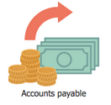
Case Study 1: The Ford Case Study [1]
Background/Problems:
  Ford needed to review its procurement process to:
    Do it cheaper (cut costs)
    Do it faster (reduce turnaround times)
    Do it better (reduce error rates)
  Accounts payable in N. America alone employed > 500 people
  Turnaround times for processing POs/invoices O(weeks)
Possible Fix:
  Automation would bring 20% saving but Ford chose not to - Why?
    technology needed for automation not available?
    cannot develop the technology to automate the process?
    not enough computers/computer-literate employees at Ford?
  Correct answer: Mazda showed how to do it with 15 people! 人馬一体???

Slide 29
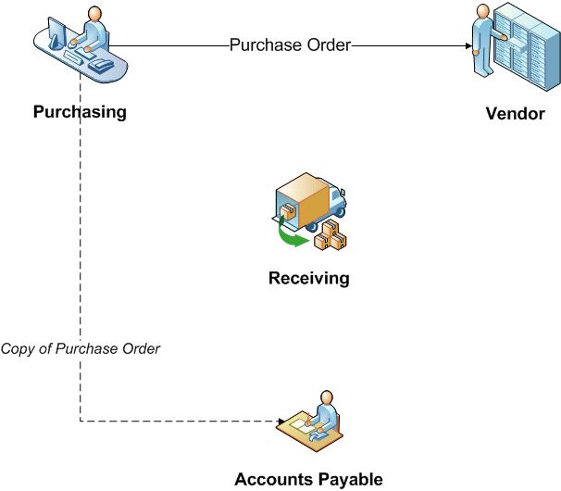
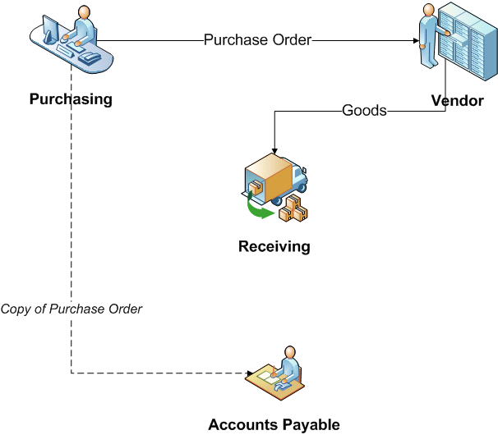
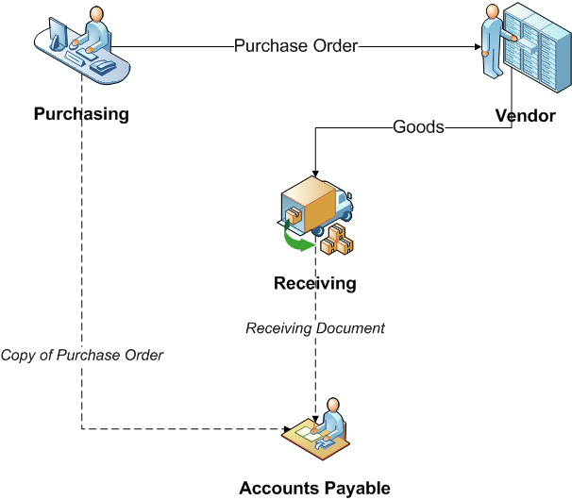
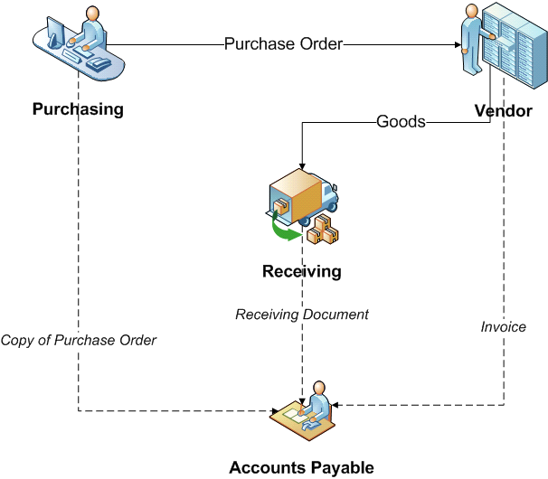
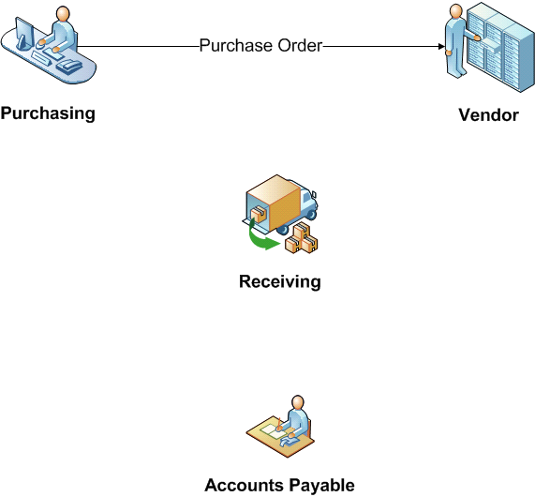
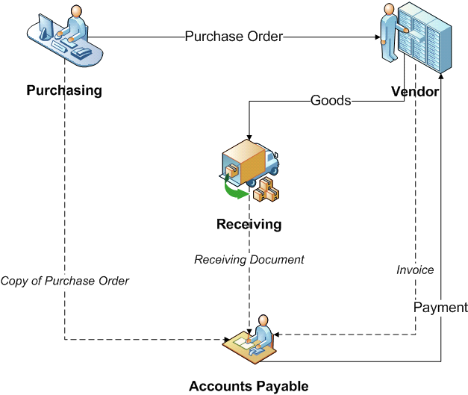
Case Study 1: Ford As-Is Process (cont'd)
Notes:
28 Jun 2016
CA4 BPR

Slide 30
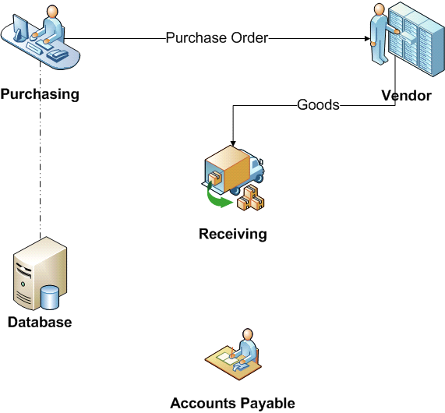
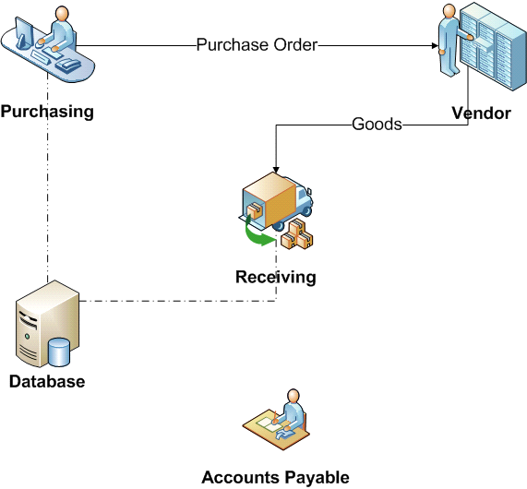

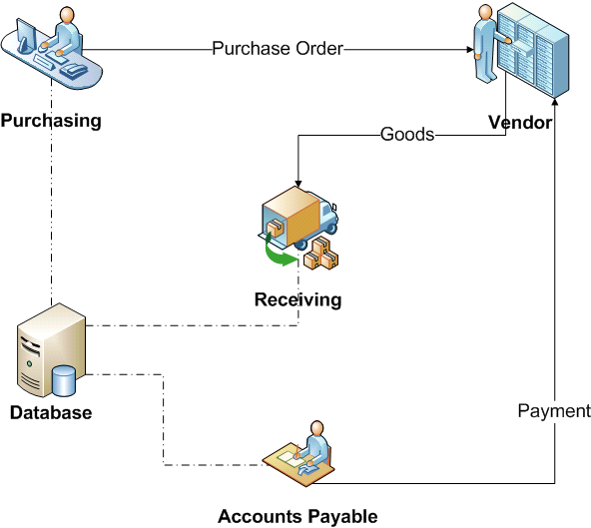
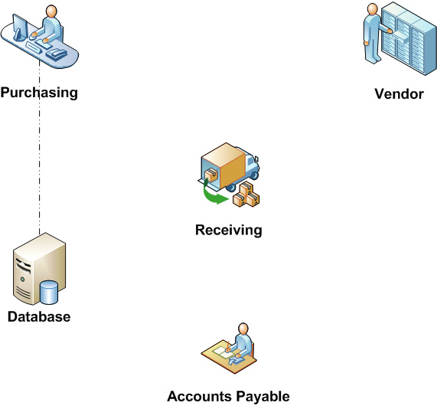
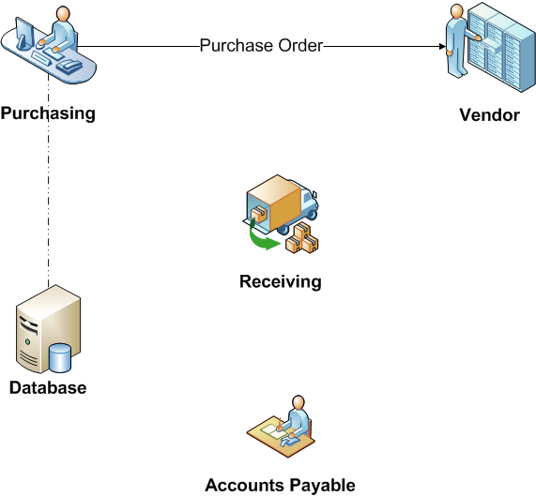
Case Study 2: Ford To-Be Process (cont'd)
Notes:
28 Jun 2016
CA4 BPR

Slide 31
Case Study 1: The Ford Case Study (cont'd)
Ford Motor Corp.
  Old process involved 3 functions - purchasing, receiving and accounts payable
  All participated indirectly
  Sequential document flow
  New process uses shared database
  Every function participates directly
  75% reduction in work-force (500 -> 125)
This is an example of reducing mediation through IT
Notes:
28 Jun 2016
CA4 BPR

Slide 32
Case Study 2: IBM Credit [2]
IBM Credit Corp
  Finances goods and services that IBM sells.
  Five steps:
  On a request from an IBM field sales rep an operator in the central office wrote down the request on a piece of paper.
  Request sent to Credit Dept - specialist checked client creditworthiness,
    Specialist wrote result on piece of paper & sent to Business Practices
  Business Practices customised the standard loan covenant to the client. Special terms attached to the request if necessary.
  Request went to Price Dept where Pricer assigned interest rate.
  Admin dept wrote a quote letter for the field sales rep.
    Field sales rep passed quote letter to client
Notes:
28 Jun 2016
CA4 BPR

Slide 33
Case Study 2: IBM Credit (cont'd)
Field Sales Rep
Central Office
Credit Department
Business Practices Department
Price Department
Admin Department
Make financing request
Go back to customer
Quote to customer
Record request
no
Check credit-worthyness
yes
Customise loan agreement
Determine interest rate
Write a quote
Notes:
28 Jun 2016
CA4 BPR

Slide 34

Case Study 2: IBM Credit – Problems & Attempted Fix
Process took six days on average.
Meantime customer could be seduced by another vendor.
Request couldn’t be tracked.
Attempted Fix
Install a control desk, so they could answer the sale representative's question about the status of the request.
Request not forwarded to the next step in the chain,
Instead, each dept sent request to control to log before sending it out again
Solved tracking problem, but took yet more time.
Notes:
28 Jun 2016
CA4 BPR

Slide 35
Case Study 2: IBM Credit (cont'd)
Field Sales Rep
Central Office
Credit Department
Business Practices Department
Price Department
Admin Department
Make financing request
Go back to customer
Quote to customer
no
Record request
log
log
log
yes
Check credit-worthyness
Customise loan agreement
Determine interest rate
Write a quote
Notes:
28 Jun 2016
CA4 BPR

Slide 36

Case Study 2: IBM Credit (cont'd) –
Investigation & Solution
2 IBM senior mgrs walked a request thro all 5 steps.
Performing the actual work took 90 minutes.
Problem not in tasks/people performing them, but BP structure.
IBM Credit replaced its specialists (credit checkers, pricers) with generalists who process entire request from start to finish.
Old process design assumes every bid request was unique & difficult to process. WRONG! most simple & straightforward:
  Find credit rating in DB; Plug numbers into a model; Pull clauses from a file.
Easily done by single individual supported by an easy-to-use expert system which IBM Credit developed.
In most cases, the system provides guidance and data to generalists.
Otherwise, a few real specialists working in the same team can help.
Notes:
28 Jun 2016
CA4 BPR

Slide 37
Case Study 2: IBM Credit (cont'd) - gains
Turnaround reduced from six days to four hours.
Dramatic performance breakthrough by making a radical change to the process - i.e. reengineering.
IBM Credit didn't ask, "how do we improve the calculation of a financing quote? How do we enhance credit checking?"
Instead, it asked "How to improve entire credit issuance process?“
In making its radical change, IBM Credit shattered the assumption that every request needed specialists.
Notes:
28 Jun 2016
CA4 BPR

Slide 38
PART 2………
Notes:
29 Jun 2016
CA4 BPR - Successful Re-Engineering Projects

