Slide 1


CHILD, MATERNAL & ADOLESCENT HEALTH OUTREACH
Community Health & Outreach Management System (CHOMS)
Replacing paper registers with a secure, offline-first cloud platform.
MatCH (Maternal, Adolescent and Child Health Institute) | Work Integrated Learning 3 (XADAD7112w)
Mhlengi Mathonsi
Junior Sbonakaliso Madlopha
Olwethu Libongwe Cwele
ST10399162
ST10377944
ST10344453

Slide 2








THE PROBLEM AND OUR SOLUTION
Every child counted. Every family reached.
The problem today
Our solution
Paper registers
One secure cloud backend
duplicate clients, no history
Firebase Auth + Firestore
Lost referrals
3 front ends
no outcome tracking
Website, installable PWA, Android app
Delayed visibility
Real-time dashboards
coordinators learn weeks later
live work lists and charts
Manual funder reports
Offline-first sync
compiled by hand every cycle
capture now, sync when signal returns
MatCH community health workers visit mothers, children and adolescents across Durban every day.
CHOMS | 2

Slide 3



WHAT WE DELIVERED
One backend, three matching front ends
Public website
Web / desktop app (PWA)
Native Android app
Landing page with Create account and Sign in. Same child-welfare design as the apps.
Installable, works offline. Full system for CHWs, coordinators and admins.
Java, MVVM + Repository, Material 3. Firebase Auth and Firestore.
Firebase project: match-choms
Authentication + Cloud Firestore (africa-south1, Johannesburg) + server-side Security Rules
CHOMS | 3

Slide 4

HOW IT IS BUILT
System Architecture (N-Tier)
Presentation
Why layers?
HTML/CSS/JS (PWA) + Native Android (Java, MVVM, Material 3)
Each layer has one job
UI never talks to Firestore directly
Rules enforce the same permissions on the server
Logic is plain JavaScript, so it is unit-tested with Jest
Business Logic
Pure JavaScript (utils.js: validation, SA ID, permissions) + Android ViewModels
Data Access
Repository Pattern (repo.js): role-scoped reads, cache, outbox, audited batch writes
Cloud
Firebase Auth, Cloud Firestore (africa-south1) and server-side Security Rules
CHOMS | 4

Slide 5


ROLE-BASED ACCESS CONTROL
Secure by Design
Admin
Coordinator
Full system access, user management, approve reports
View all data, generate and save reports
CHW (Community Health Worker)
Pending
See and edit only their assigned clients and visits
New sign-ups must be approved by an Admin; no data access until approved
Account lifecycle
Sign up
Pending
Admin approves + sets role
Active
Deactivate / delete (audited)
CHOMS | 5

Slide 6
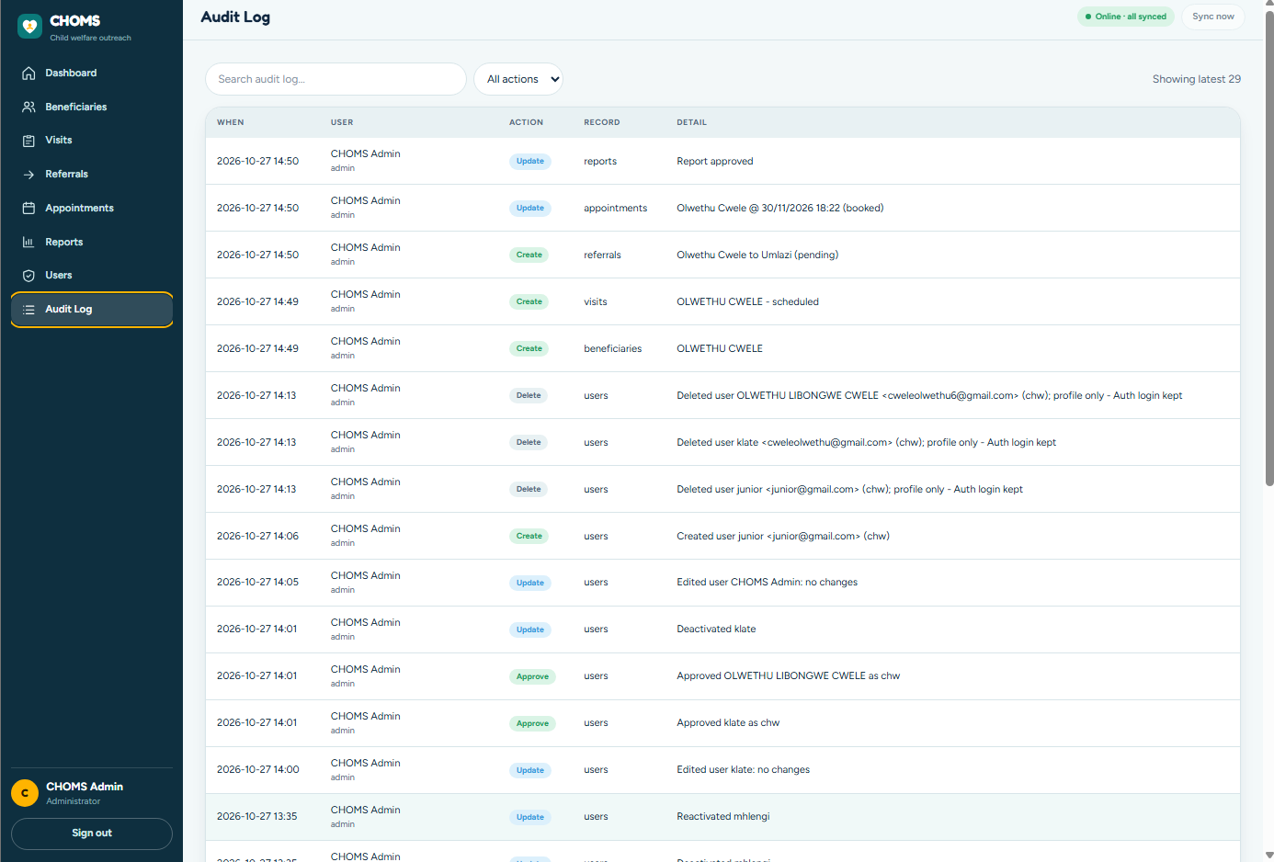

THE IMMUTABLE AUDIT TRAIL
Zero Unaudited Writes
Paired writes
Every create, update and delete is committed in one atomic batch with an auditLogs entry.
Server-enforced
Firestore rules reject the write if the audit entry is missing.
Immutable
Nobody, including Admins, can edit or delete an audit log entry.
Accountable
Who did what and when, for sensitive child health data (POPIA).
Audit log screen: searchable by user and action
CHOMS | 6

Slide 7

OFFLINE-FIRST SYNCHRONISATION
Working Without Signal
No internet
▶
Local outbox
▶
Reconnect
▶
Firebase
CHWs work in areas with no signal
Data saved to localStorage; service worker caches the app shell
Outbox flushes automatically (about every 60 s, or Sync Now)
Synced with its audit entry; failures are flagged, never lost
Pending changes are always visible: a "Sync Now" chip shows how many records are waiting to upload.
CHOMS | 7

Slide 8

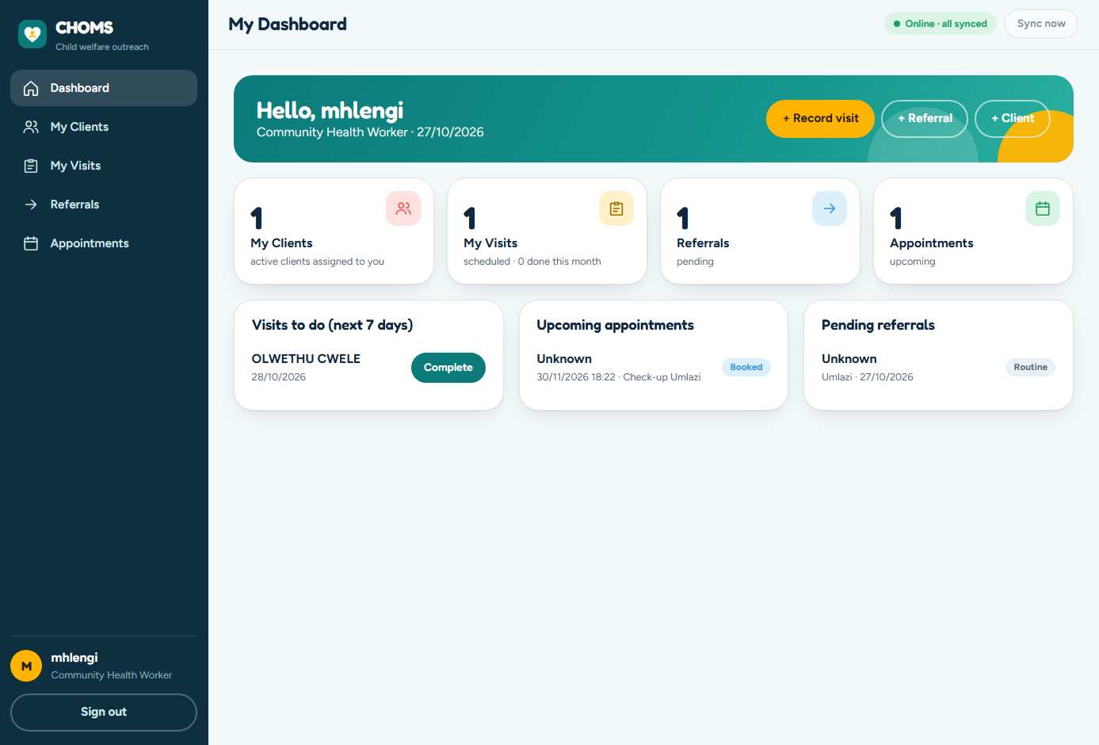

KEY FEATURES AND UI/UX
Built for the Field and the Office
SA ID validation
Auto-fills date of birth and gender, blocks duplicates
Dashboards
Stat cards, work lists, completed visits per CHW chart
Reports
Any date range, export CSV, print / PDF
User management
Approve, edit, deactivate and delete accounts
Friendly errors
Plain-language messages, no technical jargon
CHW dashboard: my clients, visits and referrals at a glance
CHOMS | 8

Slide 9
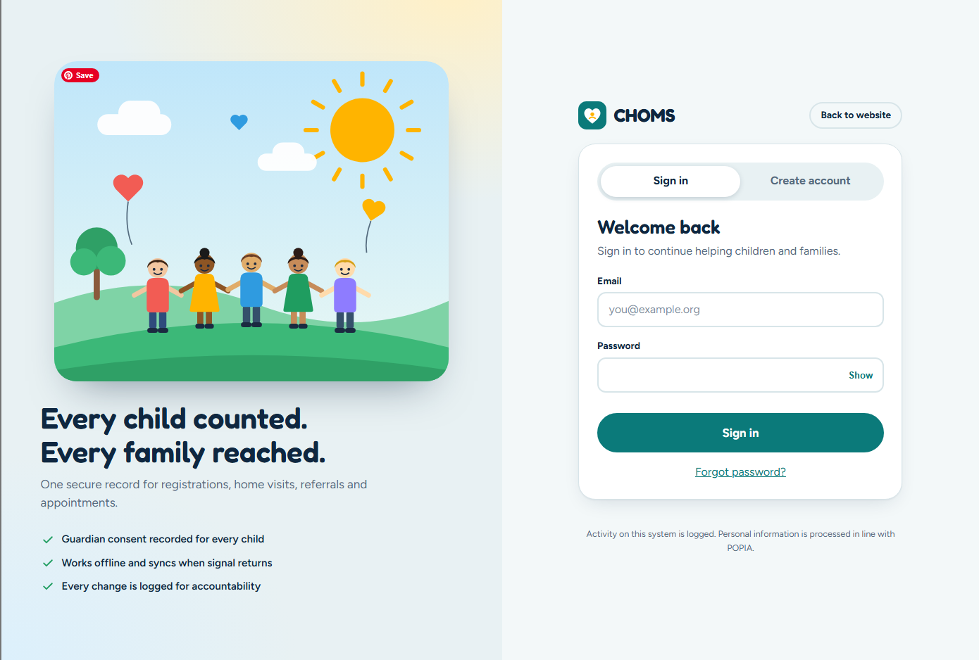
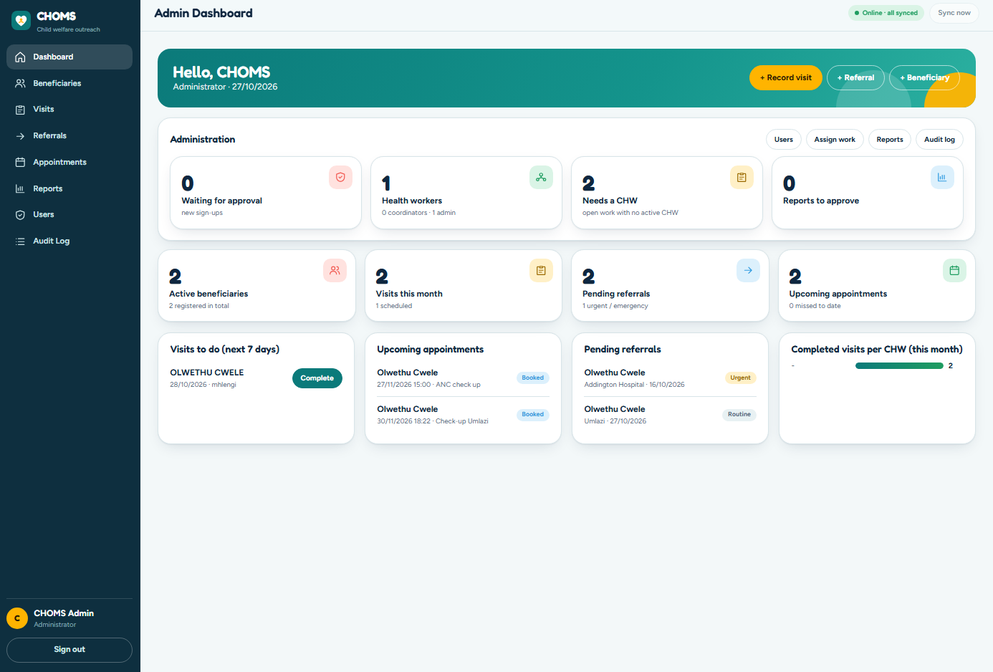
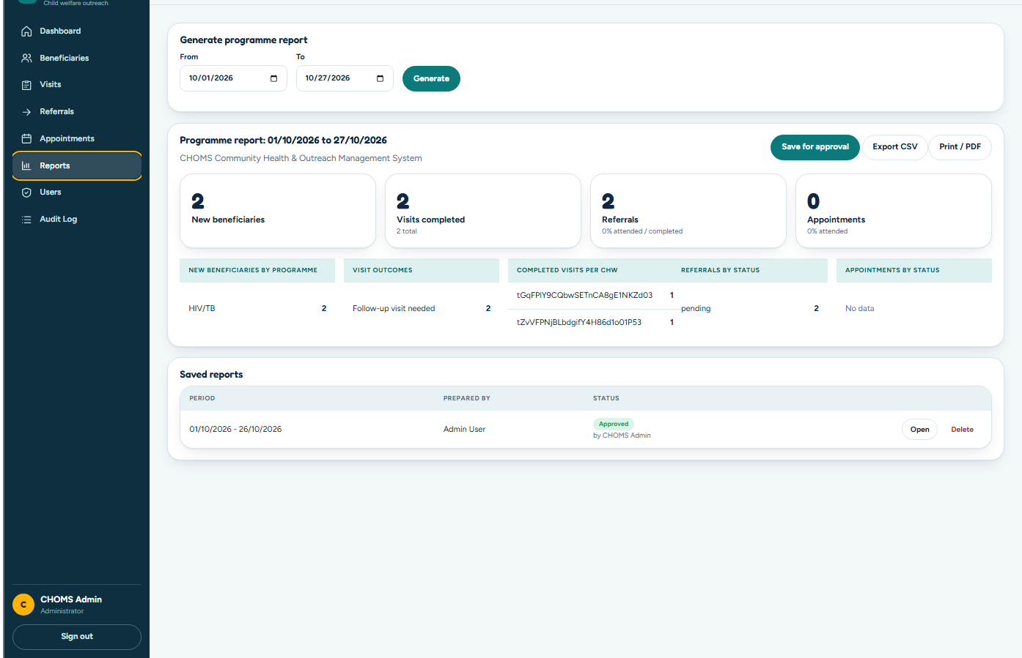
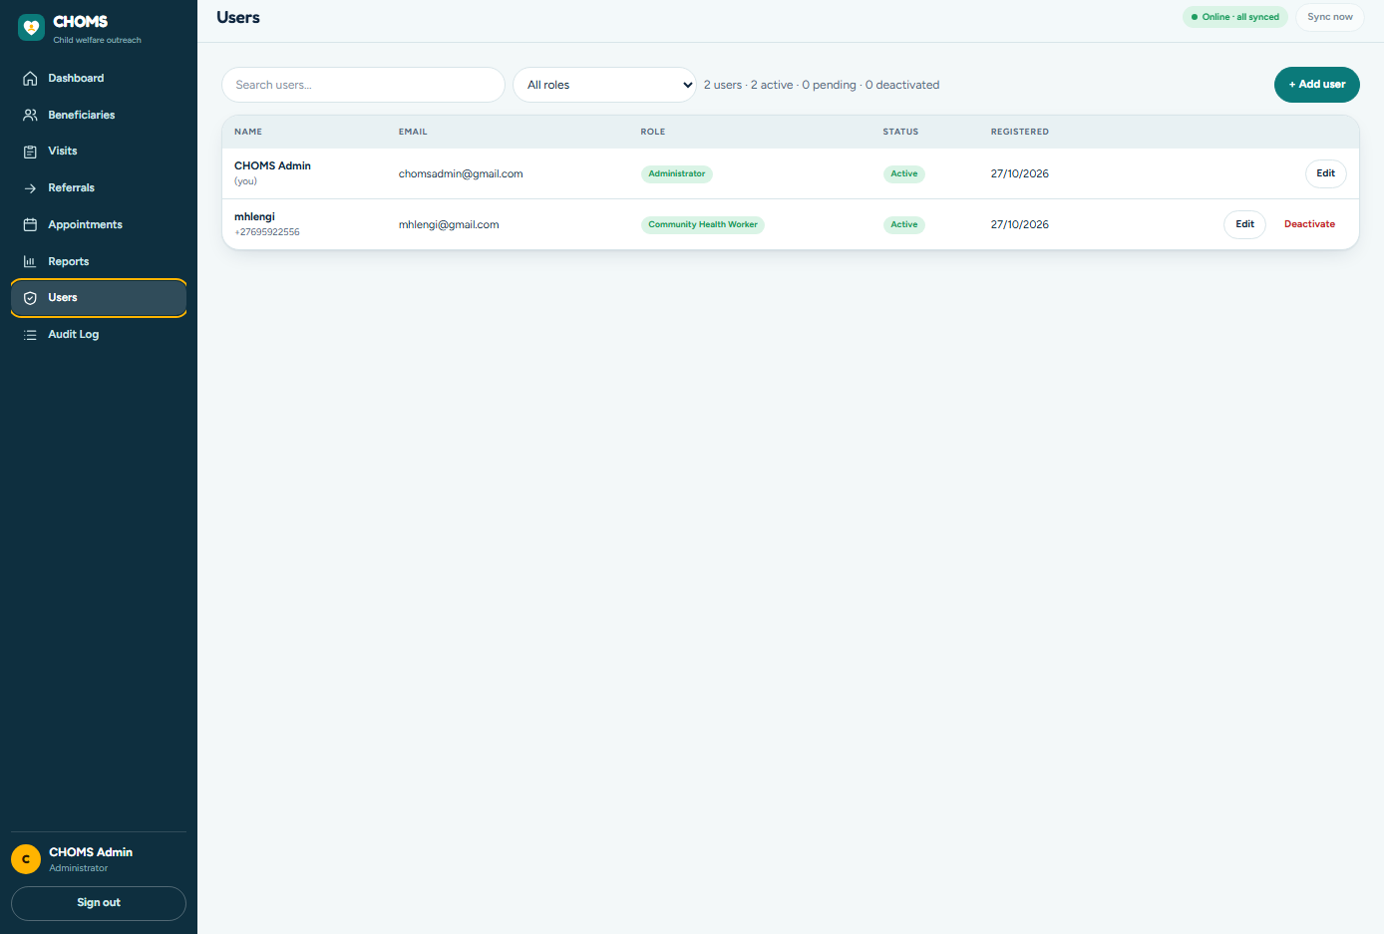
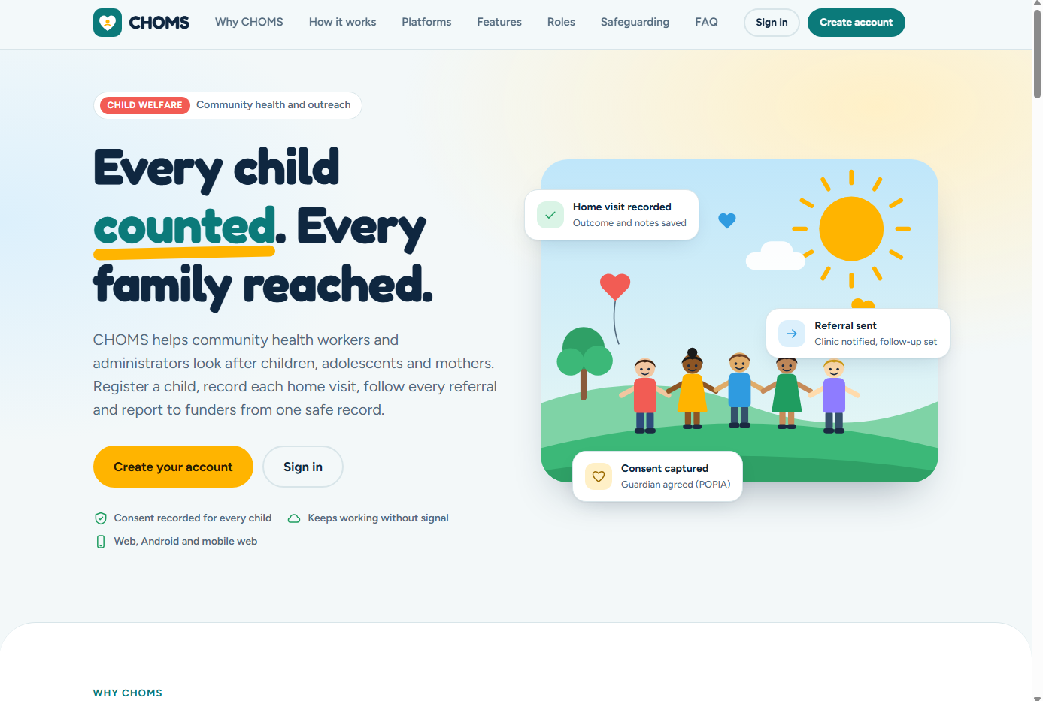
SCREENSHOTS
The system in action
Sign in
Admin dashboard
Reports
User management
Public website
CHOMS | 9

Slide 10


DEVOPS AND TESTING
Verified, Not Assumed
50
21
76
Jest unit tests
JUnit tests
Security rule tests
Business logic: validation, SA ID, permissions
Android app validators and logic
Simulating real attacks on Firestore rules
GitHub Actions CI pipelines automatically test the code on every push
CHOMS | 10

Slide 11
CHALLENGES AND SOLUTIONS
Overcoming Real-World Hurdles
User deletion without a paid Cloud Function
Built a secure admin-only client fallback that removes the profile, revokes access and logs the deletion to the audit trail.
UI white space bug
Fixed CSS container constraints so wide screens get a full-width enterprise layout.
Sign-in loop
Fixed caching issues by always fetching fresh profiles from the server, so pending users cannot loop.
CHOMS | 11

Slide 12


CONCLUSION AND FUTURE WORK
Transforming Health Outreach
CHOMS eliminates paper trails, prevents lost referrals, and ensures 100% data accountability.
Future work
SMS gateway
Native iOS app
Appointment reminders
Same rules and audit contract
Offline-first Android UI
Provincial integration
Local queue with pending indicator
Export to health information systems
CHOMS | 12

Slide 13

THANK YOU
Our Team & Live System
Mhlengi Mathonsi
Junior Sbonakaliso Madlopha
Olwethu Libongwe Cwele
ST10399162
ST10377944
ST10344453
Firebase project: match-choms
Website: http://127.0.0.1:8123/index.html
Web app: http://127.0.0.1:8123/app/index.html
GitHub: github.com/Olwethu7/choms-group-work
Firebase: console.firebase.google.com/project/match-choms
CHOMS | 13

