Slide 1
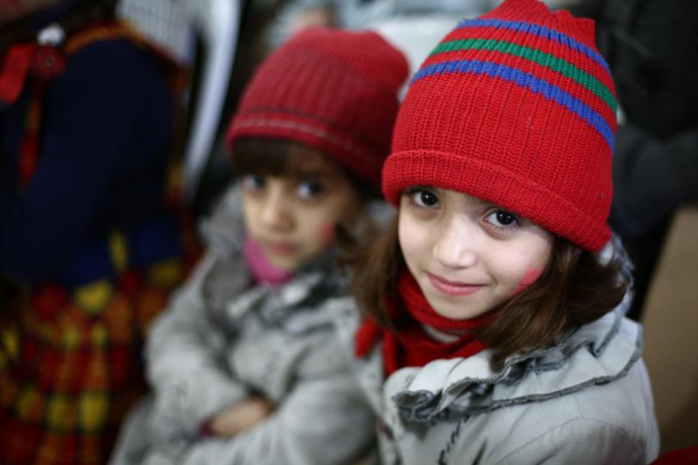
World Refugees

Slide 2
???? How many refugees are there in the world?
Refugee Planet: There Have Never Been This Many Displaced People on Earth. An unprecedented 65.3 million people have been displaced around the world due to war and persecution, the United Nations High Commission for Refugees (UNHCR) reported on Monday.
??? Afghanistan, Syria, Somalia: more than half of the refugees on the planet come from one of these three countries plagued and undermined by years of war and violence. Sadly, as in the past 33 years, Afghanistan remains the country with the most refugees (2,56 million).
????According to the United Nations High Commissioner for Refugees (UNHCR), 4.8 million have fled to Turkey, Lebanon, Jordan, Egypt and Iraq, and 6.6 million are internally displaced within Syria. Meanwhile about one million have requested asylum to Europe

Slide 3
Data - I hope to get some DATA from UN – need to do more research
Questions to ask – reasons why people flee their countries?
Which countries host most refugees, where most refugees come from?
Economical, Political situation etc
Please support our Magic Fund.
https://www.gofundme.com/volunteering-trip-refugee-aid

