Slide 1




A computational model of power in collaborative negotiation dialogues
IVA 2017
Lydia OULD OUALI (LIMSI-CNRS / UPSUD)
Nicolas Sabouret (LIMSI-CNRS / UPSUD)
Charles Rich (CS / WPI)

Slide 2
Plan
Context
Model of collaborative negotiation
Evaluation
Conclusion and future works

Slide 3
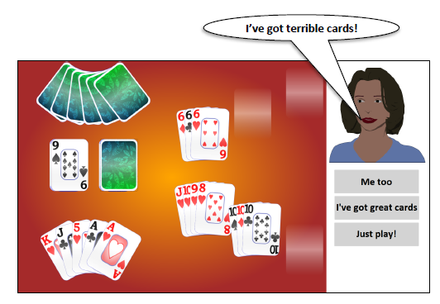
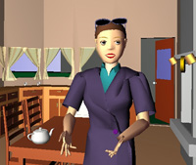

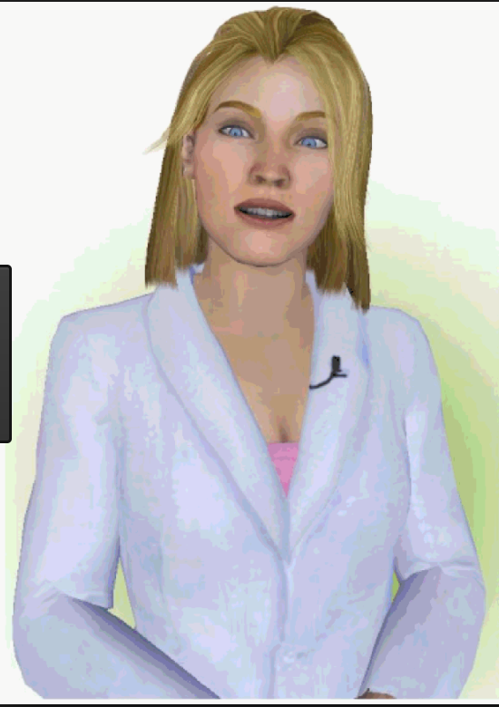
Context: Conversational agents
Context
SimSensei

Slide 4


Collaboration in dialogue
Context
collaboration
Expertise
Expertise
Preferences
Preferences
Notes:
Chaque individu possède des expertises et des Preferences sur la manière de faire une tâche

Slide 5
Collaboration in dialogue
Context
Collaborative
Negotiation
Expertise
Expertise
Preferences
Preferences
Collaborative negotiation
trade-of which best satisfies the interests of both participants, instead of maximizing one participant’s interest. (Chu-Caroll & Carberry, 95)
Notes:
Chaque individu possède des expertises et des Preferences sur la manière de faire une tâche

Slide 6
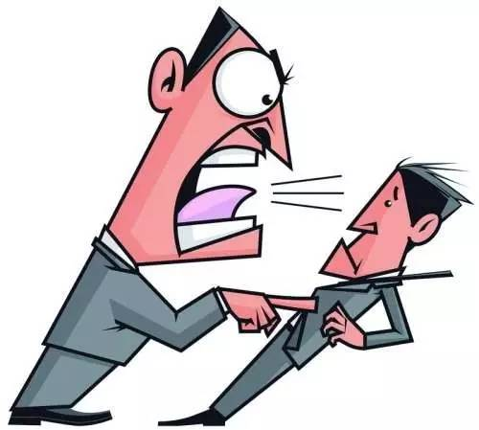
Social aspects in negotiation(Broekens et al, 10)
Context
Dominance
Ability to express behavior of power(Burgoon & Dunbar 98)
Control attempts by one individual are accepted by the interactional partner (Burgoon & Dunbar 98)
Power
Ability to influence the behavior of another person
(Burgoon et al 98)

Slide 7
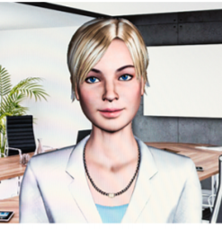
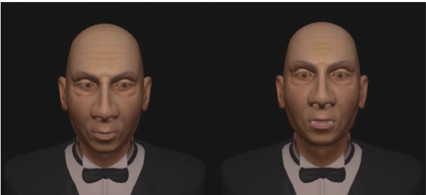
Social aspects in negotiation
Context
Non-verbal behaviors:
(Bee, andré et al, 10)
Gaze and posture
(Gebhard et al,14)
Head tilts
raised head associated to a dominant behavior

Slide 8
Social aspects in negotiation
Context
Verbal behaviors
Linguistic style (Bradac & Mulac, 1984)
Dominant behavior is associated with more assertive style.
Lead of the conversation (Dedreu and VanKleef, 04; Burgoon98)
High-power individuals tends to make the first move
Control of the flow of the conversation
Dictating topic changes
Strategic behaviors (Dedreu and VanKleef, 04)
Self centeredness
Level of demand and concessions

Slide 9
Objectives
Context
Model of social behaviors in the context of collaborative negotiation.
Conversational agent communicates using dialogue acts
Define strategy of collaborative negotiation
Adapt the strategy of negotiation to the relation of power

Slide 10


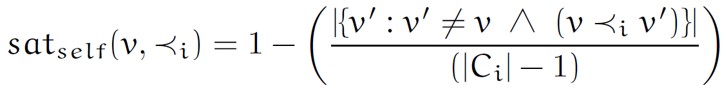
Model of negotiation of preferences
Proposed model
Mental state
Goal choose an option ( ex : Restaurant).
Domain model
Option = {criterion_1, …, criterion_n}
Ex : Restaurant = {cuisine, Price, ambiance}
Preferences
+ Partial order.
+ Score of satisfaction: Inverse of the number of ancestors
Notes:
Une option est défini comme le produit cartesien d’un ensemble de criteres

Slide 11
Model of negotiation of preferences
Proposed model
Communication
Utterance’s type
Share preferences
Negotiation
Notes:
Une option est défini comme le produit cartesien d’un ensemble de criteres

Slide 12
Model of negotiation of preferences
Proposed model
Communication
Share preferences
Share a preference
State Preference(X)
Ask for a preference
Ask Preference(X)
Notes:
Une option est défini comme le produit cartesien d’un ensemble de criteres

Slide 13
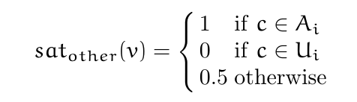

Model of negotiation of preferences
Proposed model
Communication
Share preferences
Share a preference
State Preference(X)
Ask for a preference
Ask Preference(X)
Other preferences
Notes:
Une option est défini comme le produit cartesien d’un ensemble de criteres

Slide 14
Model of negotiation of preferences
Proposed model
Communication
Negotiate
Make a proposal
Propose(X)
Reject a proposal
Reject(X)
Accept a proposal
Accept(X)
Notes:
Une option est défini comme le produit cartesien d’un ensemble de criteres

Slide 15
Model of negotiation of preferences
Proposed model
Communication
Negotiate
Make a proposal
Propose(X)
Reject a proposal
Reject(X)
Accept a proposal
Accept(X)
Proposals
P :Open, T : Accepted, R : Rejeted
Notes:
Une option est défini comme le produit cartesien d’un ensemble de criteres

Slide 16
Model of negotiation based on power
Proposed model
Level of demand and concession(Dedreu et al 95)
Power is associated to a high level of demand and a low level of concessions
Self vs other (Fiske 93, DeDreu et al 95)
High-power individuals are self-centered and only interested in satisfying their own preferences.
Lead of the negotiation (Dedreu and VanKleef, 04)
High-power individuals tends to make the first move
Control of the flow of the negotiation

Slide 17
Model of negotiation based on power
Proposed model
Decision based on power
Mental state
Communication
Decision
pow ∊ [0,1]
Implement 3 principles
Notes:
Une option est défini comme le produit cartesien d’un ensemble de criteres

Slide 18
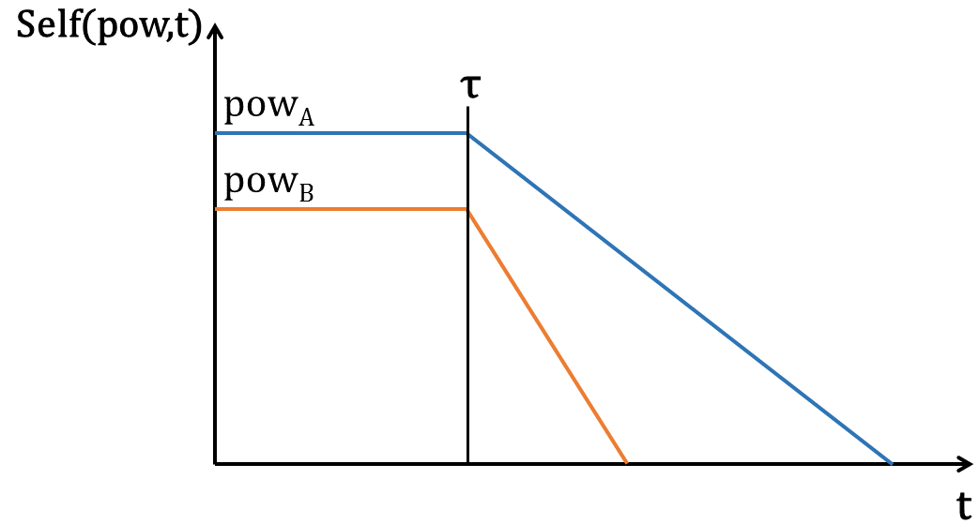
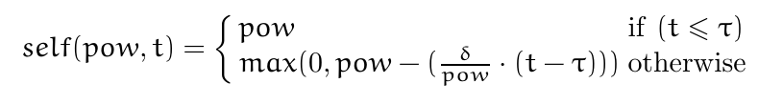
Model of negotiation based on power
Proposed model
Decision based on power
Principle 1
High power agent makes less concessions
Self : Function representing the value of pow over time
Notes:
Une option est défini comme le produit cartesien d’un ensemble de criteres

Slide 19
Model of negotiation based on power
Proposed model
Decision based on power
Principle 1
High-power agent is more demanding
Acc: Define if a value is acceptable for the agent
Ex: Accept(Chinese) / Condition : acc(Chinese) = True
The acceptability of a value depends on the agent’s level of demand
Notes:
Une option est défini comme le produit cartesien d’un ensemble de criteres

Slide 20
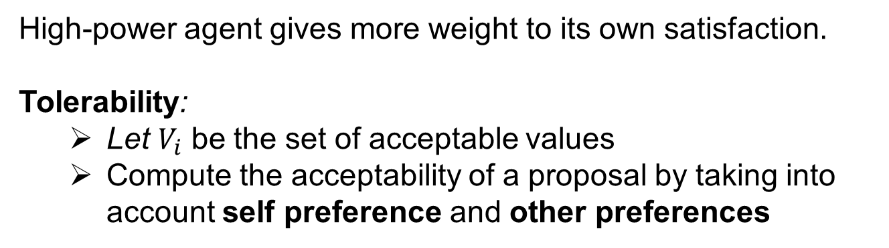
Model of negotiation based on power
Proposed model
Decision based on power
Principle 2
High-power agent gives more weight to its own satisfaction.
Tolerability:
Let $V_{i}$ be the set of acceptable values
Compute the acceptability of a proposal by taking into account self preference and other preferences
Notes:
Une option est défini comme le produit cartesien d’un ensemble de criteres

Slide 21

Model of negotiation based on power
Proposed model
Decision based on power
Principle 2
High-power agent gives more weight to its own satisfaction.
Tolerability: Compute the acceptability of a proposal by considering both interlocutors preferences
The agent proposes the most « tolerable » value
Notes:
Une option est défini comme le produit cartesien d’un ensemble de criteres

Slide 22
Model of negotiation based on power
Proposed model
Decision based on power
Principle 3
High-power agent tends to lead the negotiation
Decision rules
Define a priority in the choice of the utterance
High-power: Negotiation acts
(Propose, Reject, Accept).
Low-power: Statement acts
(StatePreference, AskPreference)
Notes:
Une option est défini comme le produit cartesien d’un ensemble de criteres

Slide 23
Example of dialogue
Proposed model
Pow(Agent1) = 0.9, Pow(Agent2) = 0.4
A: "Let's go to a Chinese restaurant." B: "I don't like Chinese restaurants, let's choose something else." A: "Let's go to the Shanghai. It's a quiet, cheap Chinese restaurant on the south side." B: "Do you like Italian restaurants?" A: "I don't like Italian restaurants." B: "Do you like French restaurants?" A: "Let's go to the Shanghai. It's a quiet, cheap Chinese restaurant on the south side."
B: "Do you like French restaurants?"
A: "I don't like French restaurants." B: "Do you like Korean restaurants?" A: "Let's go to a cheap restaurant." B: "Okay, let's go to a cheap restaurant." A: "Let's go to a restaurant on the south side." B: "Okay, let's go to a restaurant on the south side." A: "Let's go to the Shanghai. It's a quiet, cheap Chinese restaurant on the south side." B: "Okay, let's go to the Shanghai restaurant.“

Slide 24
Example of dialogue
Proposed model
Pow(Agent1) = 0.9, Pow(Agent2) = 0.4
A: "Let's go to a Chinese restaurant." B: "I don't like Chinese restaurants, let's choose something else." A: "Let's go to the Shanghai. It's a quiet, cheap Chinese restaurant on the south side." B: "Do you like Italian restaurants?" A: "I don't like Italian restaurants." B: "Do you like French restaurants?" A: "Let's go to the Shanghai. It's a quiet, cheap Chinese restaurant on the south side."
B: "Do you like French restaurants?"
A: "I don't like French restaurants." B: "Do you like Korean restaurants?" A: "Let's go to a cheap restaurant." B: "Okay, let's go to a cheap restaurant." A: "Let's go to a restaurant on the south side." B: "Okay, let's go to a restaurant on the south side." A: "Let's go to the Shanghai. It's a quiet, cheap Chinese restaurant on the south side." B: "Okay, let's go to the Shanghai restaurant.“

Slide 25
Example of dialogue
Proposed model
Pow(Agent1) = 0.9, Pow(Agent2) = 0.4
A: "Let's go to a Chinese restaurant." B: "I don't like Chinese restaurants, let's choose something else." A: "Let's go to the Shanghai. It's a quiet, cheap Chinese restaurant on the south side." B: "Do you like Italian restaurants?" A: "I don't like Italian restaurants." B: "Do you like French restaurants?" A: "Let's go to the Shanghai. It's a quiet, cheap Chinese restaurant on the south side."
B: "Do you like French restaurants?"
A: "I don't like French restaurants." B: "Do you like Korean restaurants?" A: "Let's go to a cheap restaurant." B: "Okay, let's go to a cheap restaurant." A: "Let's go to a restaurant on the south side." B: "Okay, let's go to a restaurant on the south side." A: "Let's go to the Shanghai. It's a quiet, cheap Chinese restaurant on the south side." B: "Okay, let's go to the Shanghai restaurant.“

Slide 26
Example of dialogue
Proposed model
Pow(Agent1) = 0.9, Pow(Agent2) = 0.4
A: "Let's go to a Chinese restaurant." B: "I don't like Chinese restaurants, let's choose something else." A: "Let's go to the Shanghai. It's a quiet, cheap Chinese restaurant on the south side." B: "Do you like Italian restaurants?" A: "I don't like Italian restaurants." B: "Do you like French restaurants?" A: "Let's go to the Shanghai. It's a quiet, cheap Chinese restaurant on the south side."
B: "Do you like French restaurants?"
A: "I don't like French restaurants." B: "Do you like Korean restaurants?" A: "Let's go to a cheap restaurant." B: "Okay, let's go to a cheap restaurant." A: "Let's go to a restaurant on the south side." B: "Okay, let's go to a restaurant on the south side." A: "Let's go to the Shanghai. It's a quiet, cheap Chinese restaurant on the south side." B: "Okay, let's go to the Shanghai restaurant.“

Slide 27
Evaluation of the model
Evaluation
Evaluate the perception of the implemented behaviors
Conditions
Agent preferences.
Similar preferences
Different preferences
Init of power.
Pow(Agent1) = 0.9, Pow(Agent2) = 0.4
Pow(Agent1) = 0.7, Pow(Agent2) = 0.4
Pow(Agent1) = 0.7, Pow(Agent2) = 0.2

Slide 28
Evaluation of the model
Evaluation
Hypotheses
H1 The higher-power agent will more strongly be perceived as self-centered than the lower-power agent
H2 The lower-power agent will be more strongly perceived as making larger concessions than the higher-power agent
H3 The higher-power agent will more strongly be perceived as demanding than the lower-power agent
H4 he higher-power agent will more strongly be perceived as taking the lead in the negotiation than the lower-power agent

Slide 29
Evaluation of the model
Evaluation
Procedure
a between-subject study on the online site CrowdFlower.com.
Agents described as two friends trying to negotiate a restaurant to have dinner.
Total participants: 120

Slide 30
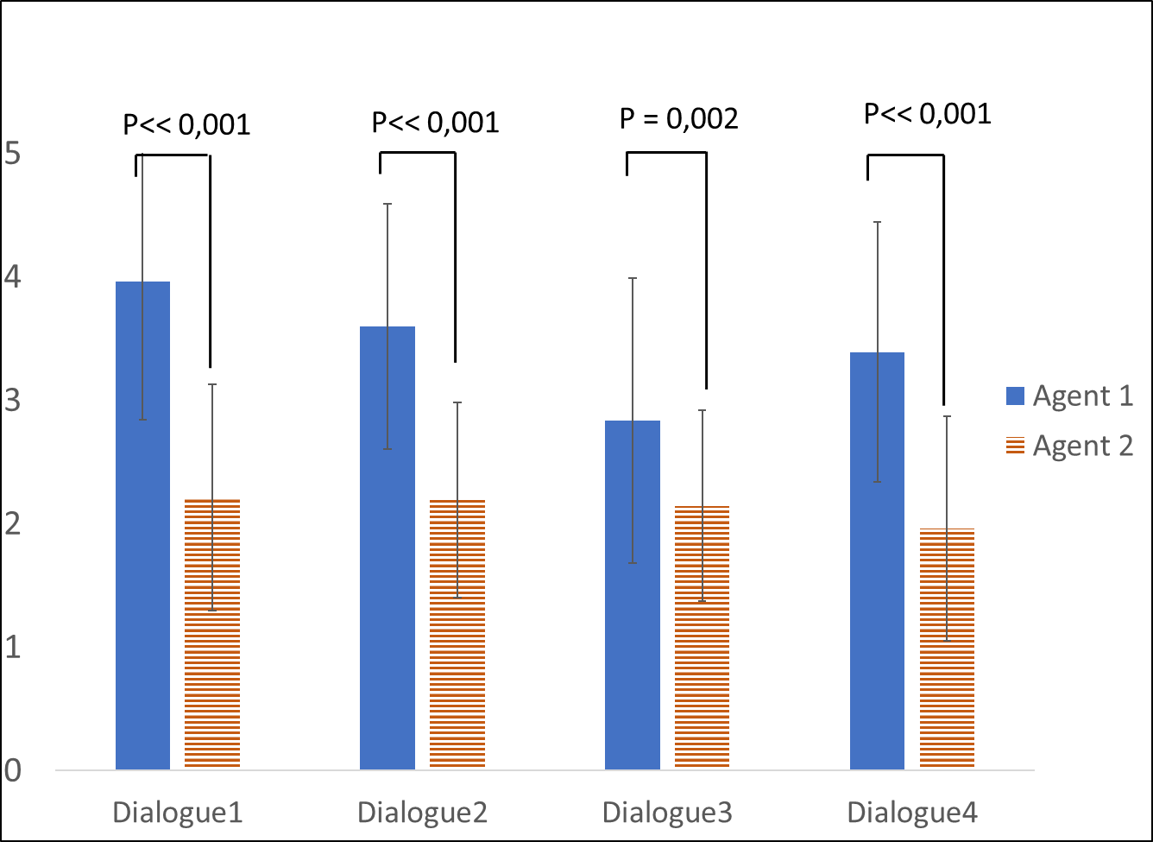
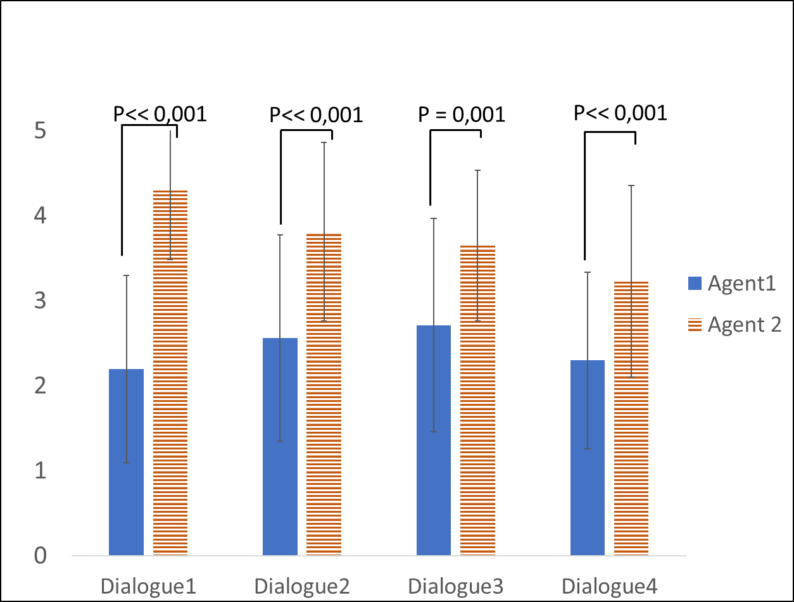
Evaluation of the model
Evaluation
Results
H1
H2
Agent 1 is more self-centered and do not make concessions.
Agent 2 tries to find the best trade-off for both parties, and is able to make larger concessions.

Slide 31
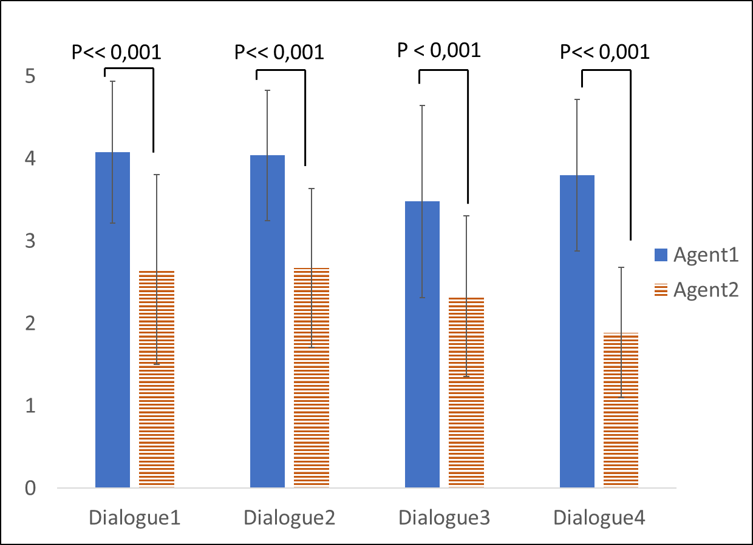
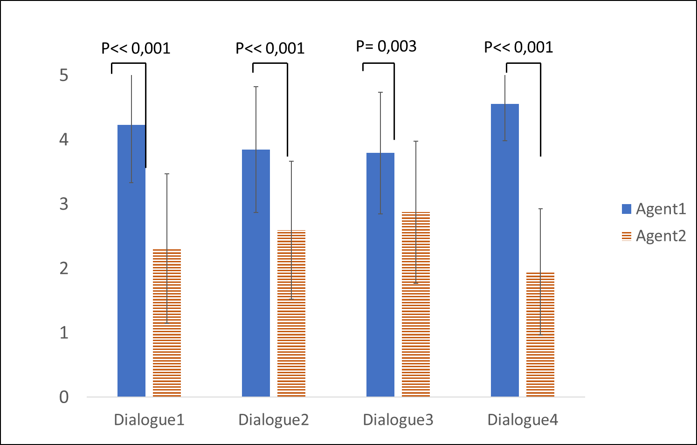
Evaluation of the model
Evaluation
Results
H3
H4
Agent 1 is more demanding than agent 2.
Agent 1 is the one who leads the dialogue.

Slide 32
Conclusion & future Works
Conclusion & future work
Impact of power on the negotiation strategies
Identify 3 principles of behaviors related to power
Define a computational model of collaborative negotiation
Validation of the computation model: Perception of behaviors by external observers
Validate the model in a human machine interaction
Define the relation of dominance:
Add a model of ToM
Test the model in a human machine interaction

Slide 33
Thank you for your attention

