Slide 1





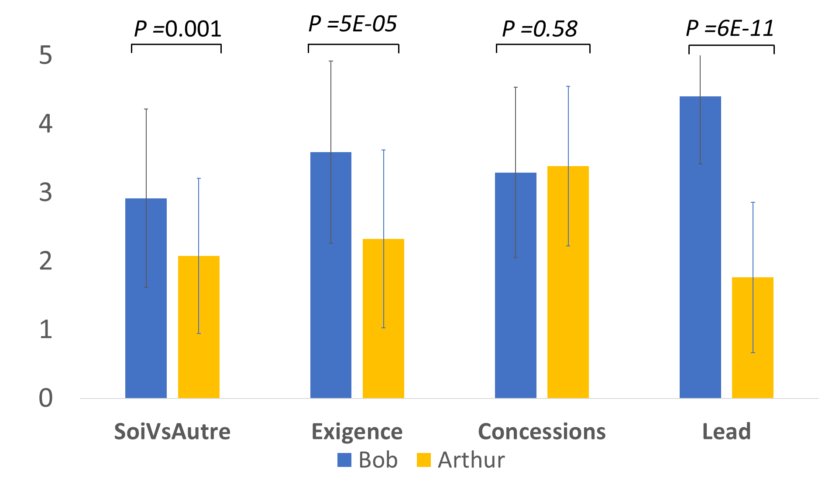




I'VE GOT THE POWER'S VALUE! A COMPUTATIONAL MODEL TO EVALUATE
THE INTERLOCUTOR'S BEHAVIORS IN COLLABORATIVE NEGOTIATION
Lydia Ould Ouali¹, Nicolas Sabouret¹ and Charles Rich²
¹ LIMSI-CNRS, Orsay, France, {ouldouali, nicolas.sabouret } @limsi.fr }
² Worcester Polytechnic Institute, rich@wpi.edu
AAMAS 18
STOCKHOLM, JULY 2018
1
GENERAL CONTEXT
Interpersonal relation of DOMINANCE
Communication
Share preferences
Propose
Share a preference
  State Preference(X)
Ask for a preference
  Ask Preference(X)
Make a proposal
Propose(X)
Reject a proposal
Reject(X)
Accept a proposal
Accept(X)
COLLABORATIVE
NEGOTIATION
Mental State
POW ∊ [0,1]
Partial order
of preferences
2
BEHAVIORS OF POWER IN NEGOTIATION
3
GUESS THE OTHER’S POWER
Dominant behaviors
Submissive behaviors
High level of demand & few concessions [1]
Self centeredness [2]
Lead of the negotiation [3]
Low level of demand & higher concessions [1]
Takes into account the preferences of the partner [2]
Lack of initiative [3]
State
SELF
DECISIONAL MODEL
Other
Pow
Hypotheses
Mental
State
?
ADAPTATION
Example
SIMULATION THEORY
Bob: "Let's go to a French restaurant ."
Arthur: "I don't like restaurants at French, let's choose something else."
Bob: "Let's go to the Maison blanche restaurant. It's a modern, cheap French restaurant at Montparnasse."
Arthur: "Do you like restaurants at Père lachaise?"
Bob: "I don't like restaurants at Père lachaise."
Arthur: "Do you like restaurants in the center of Paris?"
Bob: "Let's go to the Maison blanche restaurant. It's a modern, cheap French restaurant on the Montparnasse."
Arthur: "Okay, let's go to the Maison blanche restaurant."
Simulation theory
Understanding others through simulation :
We understand others’ mental and emotional states and intentions by simulating their state in our own mind [4]
4
RESULTS & PERSPECTIVES
Perception of behaviors related to power
Residual variation | 0.12
Root mean square error | 0.015
Time execution | 0.12 ms
Arthur: Pow = 0.4
Bob: Pow = 0.8
Perspectives
Simulate an interpersonal relation of dominance between an agent and human user.
HRI evaluation
References
[1] De Dreu, C. K., & Van Lange, P. A. (1995). The impact of social value orientations on negotiator cognition and behavior. Personality and Social Psychology Bulletin, 21
[2] Galinsky, A. D., Gruenfeld, D. H., & Magee, J. C. (2003). From power to action. Journal of personality and social psychology, 85(3), 453.(11), 1178-1188.
[3] Van Kleef, G. A., De Dreu, C. K., Pietroni, D., & Manstead, A. S. (2006). Power and emotion in negotiation: Power moderates the interpersonal effects of anger and happiness on concession making.
[4] Goldman, A. I. (2006). Simulating minds: The philosophy, psychology, and neuroscience of mindreading. Oxford University Press.

