Slide 1




Guess my power:
A computational model
to simulate a partner’s behavior
in the context of collaborative negotiation
Lydia OULD OUALI (LIMSI-CNRS / UPSUD)
Nicolas Sabouret (LIMSI-CNRS / UPSUD)
Charles Rich (CS / WPI)

Slide 2
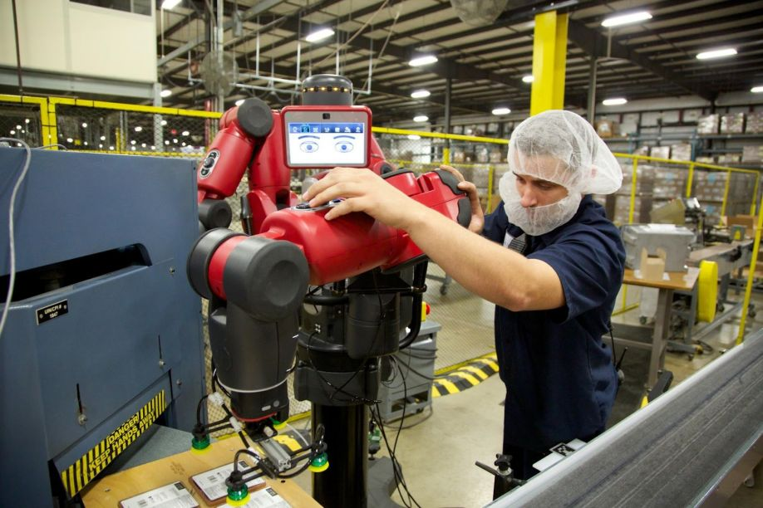
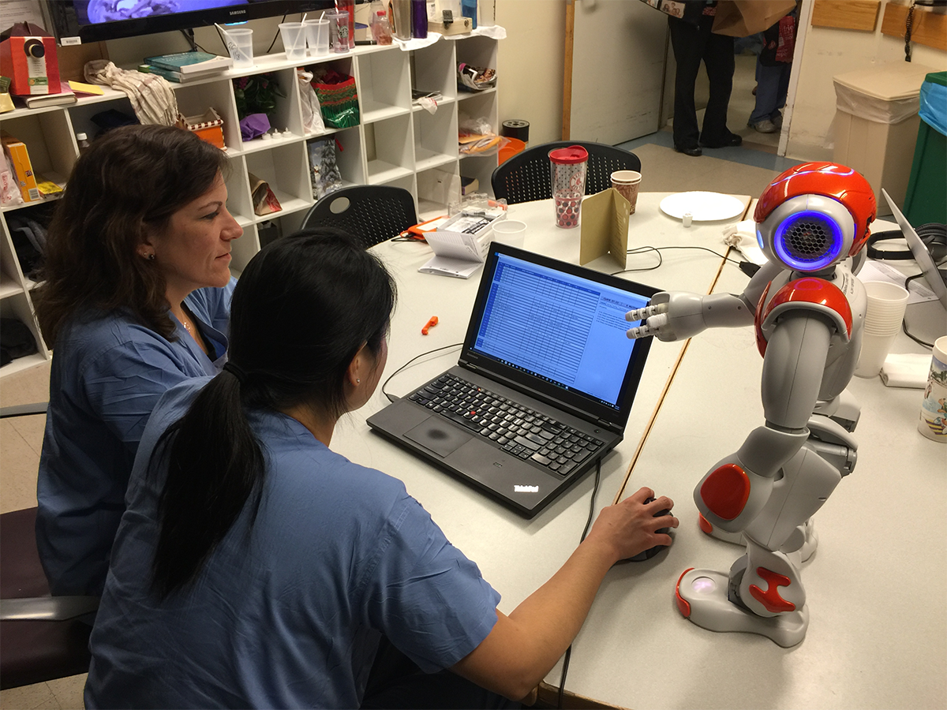
Context: COLLABORATIVE negotiation
LYDIA OULD OUALI
Rethink robotics
Nurses collaborating with MIT Nao Robot
COLLABORATIVE NEGOTIATION
INTERPERSONAL RELATIONSHIP
Facilitate mutual understanding
Impact of interpersonal relation on the negotiation
Agreement making
Generation of new ideas
Focus on DOMINANCE
Notes:
The field of conversationals agents is proposing several implementations allowing the human user to interact with an anget.
The context of thoses interactions are task oriented in where agent and user sahre common tasks and goals.
Each interlocutor has its own expertise and preferences, and often thay have to negotiate in order to find a compromise that best satifies them
This type of nego is called collaborative negotiation.
Positive imapcts
In parallel, social psychology which studies human / human interactions showed that the interpersonal relation that interlocutors build affect their way to interact and their negotiation strategy

Slide 3

INTERPERSONAL RELATION OF DOMINANCE
LYDIA OULD OUALI
Ability to influence the behavior of another person (Burgoon et al 98)
Control attempts by one individual are accepted by the interactional partner (Burgoon & Dunbar 98)
BEHAVIOURS OF DOMINANCE IN NEGOTIATION
SUBMISSIVE
1
Level of demand and concession (Dedreu et al 95)
DOMINANT
Dominance is associated to a high level of demand and a low level of concessions
2
Self vs other (Fiske 93, DeDreu et al 95)
Dominant individuals are self-centered and only interested in satisfying their own preferences.
3
Lead of the negotiation (Dedreu & VanKleef, 04)
Dominant individuals tends to make the first move
Control of the flow of the negotiation
Notes:
PRENDS DES PAUSES
RESPIIIIRES

Slide 4


OVERVIEW OF THE MODEL OF NEGOTIATION
LYDIA OULD OUALI
1
Mental model
Mental model
3
Pow
Pow
Preferences
Pow
Preferences
2
Model of the other
Decisional model
Decisional model
Mental model
Adaptation
Pow
Preferences
Decisional model
Utterance_{Self}
Utterance_{other}
Notes:
Propose a negotiation model in which an agent can reason like a human
It has its preferences and a perception of dominance that affects its negotiation strategy
However, in order to simulate an interpersonal relation of dominance where one is dominant and the second submissive the agent has to understand the behaviors of dominance expessed by its interlocutor in order to adapt its strategye
Therefore, we propose to implement a model that simulate the user behavior using the ToM based on simulation that suggests that individuals simulate the mental activity of their partners with our own capacities for practical reasoning.

Slide 5
Mental model
LYDIA OULD OUALI
Preferences
Power
Negotiation on the topic of restaurants
Initial value of dominance : POW ∊ [O,1]
French
Satisfiability
S: Set of satisfiable values
Express the liking of the agent (StatePreference)
Italian
Mexican
Korean
Indian
Notes:
Intial value of power
Preference over the values of each criterion
It allow the agent to compute values of satisfiability of each value and is able to sort them in the order of his preferences

Slide 6
Mental model
LYDIA OULD OUALI
Preferences
Power
POW
Initial value of dominance : POW ∊ [O,1]
1
French
Satisfiability
Values the agent like
Italian
Example
Mexican
I like French cuisine
I don’t like Mexican cuisine
Values the agent doesn’t like
Korean
Indian
0
Notes:
The value of power will first affect the level of demand of the agent. The more the agent is dominant the more he’s demanding

Slide 7
Mental model
LYDIA OULD OUALI
Preferences
Power
POW
Initial value of dominance : POW ∊ [O,1]
1
French
Satisfiability
Values the agent like
Italian
Example
Mexican
I like French cuisine
I don’t like Indian cuisine
Values the agent doesn’t like
Korean
Indian
0
Notes:
Enlever le texte
Remettre avec l’exemple du resto

Slide 8
Mental model
LYDIA OULD OUALI
Preferences
Power
POW
Initial value of dominance : POW ∊ [O,1]
1
Acceptable values
French
2. Acceptability
Italian
Expressing concessions during negotiation
Mexican
Example
Concessions
Okay, let’s choose French restaurant
I don’t want to go to a Korean restaurant. Let’s rather choose something else
Korean
Indian
0
Notes:
We build an algorithm that control the concessions expressed by the agent regarding to his value of power.
The more the agent is submissibe the quicker he makes concessions.
It means that at the begining the agent only accept satisfiable values.
Concession bla bla

Slide 9
Example of dialogue
LYDIA OULD OUALI
Agent A Dominant
Agent B Submissive
A: "Let's go to a Chinese restaurant." B: "I don't like Chinese restaurants, let's choose something else." A: "Let's go to the Shanghai. It's a quiet, cheap Chinese restaurant on the south side." B: "Do you like Italian restaurants?" A: "I don't like Italian restaurants." B: "Do you like French restaurants?" A: "Let's go to the Shanghai. It's a quiet, cheap Chinese restaurant on the south side.“
B: "Do you like French restaurants?"
A: "I don't like French restaurants." B: "Do you like Korean restaurants?" A: "Let's go to a cheap restaurant." B: "Okay, let's go to a cheap restaurant." A: "Let's go to a restaurant on the south side." B: "Okay, let's go to a restaurant on the south side." A: "Let's go to the Shanghai. It's a quiet, cheap Chinese restaurant on the south side." B: "Okay, let's go to the Shanghai restaurant.“

Slide 10
OVERVIEW OF THE MODEL OF NEGOTIATION
LYDIA OULD OUALI
1
Mental model
Mental model
3
Pow
Pow
Preferences
Pow
Preferences
2
Model of the other
Decisional model
Decisional model
Mental model
Adaptation
Pow
Preferences
Decisional model
Utterance_{Self}
Utterance_{other}

Slide 11

LYDIA OULD OUALI
Model of the other: Naïve approach
Pow 1
X
X
Utterance₁
. . .
. . .
SELF
DECISIONAL MODEL
. . .
Possible
pow_{i}
Pow N
X
Utterance_{N}
Revision
Compare
Utterance_{other}
SIMULATION THEORY
Notes:
Concretly, reasoning on the other mental state has the aim to pre

Slide 12
LYDIA OULD OUALI
Model of the other: Naïve approach
Pow 1
X
X
Utterance₁
. . .
. . .
SELF
DECISIONAL MODEL
. . .
Possible
pow_{i}
Pow N
X
Utterance_{N}
Revision
COMBINATORY EXPLOSION
Compare
Utterance_{other}
SIMULATION THEORY
Notes:
Concretly, reasoning on the other mental state has the aim to pre

Slide 13

Model of the other: reasoning with uncertainty
LYDIA OULD OUALI
1
For each Pow_{i}
Compute the number of satisfiable values
SIMULATION THEORY
2
Extract hypotheses
French
Korean
French
Indian
Korean
French
Italian
Italian
Italian
Italian
Korean
Korean
Indian
Mexican
Indian
French
Mexican
H1
Indian
H2
Mexican
H3
Mexican
H4
3
Adapt decisional model
4
Revision
Satisfiability
Highest number of accurate hypotheses
Acceptability
Utterance type

Slide 14



Evaluation: reasoning with uncertainty
LYDIA OULD OUALI
1
Goal
Evaluate the accuracy of predictions
Utt2
Utt1
Submissive
2
Conditions:
Dominant
Initial value of power
Initial preferences
Submissive | 0.3 0.4 0.5
Dominant | 0.6 0.7 0.8 0.9
Domain size | Nb possible hypotheses
Small | 1296
Medium | 4.14 x 10⁵
Large | 2.6 x 10⁹
Total dialogues : 1080

Slide 15
Results: accuracy of predictions
LYDIA OULD OUALI
True
Pow
Pow_{other}
1
Accuracy
Root mean square error | 0.12
Residual variation (rv) | 0.015
Comparison
2
Number of dialogue turns to reach a correct prediction
3
Frequency of correct predictions
2130 correct predictions over 2160 predictions
97.4%
Correct prediction | Rv< 0.02 | Best prediction
2.53 | 3.25 | 3.79

Slide 16
Conclusion and future works:
LYDIA OULD OUALI
1
Simulation of other
Simulation theory is able to reason about other with partial knowledge
Validation of the model in the context of agent / agent interaction
2
Interpersonal relation of dominance
Simulate an interpersonal relation of dominance.
Predict and adapt a complementary behavior
Evaluation of the model with a human user
Notes:
Domaines applications possibles pour c modèles

Slide 17
Lydia.ouldouali@gmail.com

Slide 18
Model of the other: reasoning with uncertainty
LYDIA OULD OUALI
1
Total order on preferences
2
For each Pow_{i}
3
Extract hypotheses
French
Set of possible sat values
S = {Jap,It ,Ch, Fr}
S= {Ind, Mex, Kor, Ch}
S ={ Fr, It, Ch, Jap}
. . .
1
Compute nb Sat values
Pow = 0.6
|S| = 4
Italian
Mexican
0.83
Indian
0.66
0.5
Korean
0.33
Chinese
Japanese
0
0.16
5
Revision
4
Adapt decisional model
SIMULATION THEORY
Highest number of accurate hypotheses
Satisfiability
Acceptability
Utterance type

Slide 19
Model of collaborative negotiation: decision based on behavior of dominance

Slide 20
Mental model
Preferences
Power
Pow = 0.6
Initial value of dominance : POW ∊ [O,1]
G
1
Satisfiability
F
0.83
S: Set of satisfiable values
Express the liking of the agent (StatePreference)
D
E
0.66
0.66
B
0.33
C
A
0.5
0.16
Score of satisfaction (sat(v)):
Inverse of the number of ancestors

Slide 21
Mental model
LYDIA OULD OUALI
Preferences
Pow = 0.7
Power
Initial value of dominance : POW ∊ [O,1]
G
1
2. Acceptability
F
0.83
S: Set of satisfiable values
Ac : Set of acceptable values
M = S + Ac
D
E
0.66
0.66
B
Current context of negotiation
R: Set of rejected values
A: Set of accepted values
0.33
Self(pow,t)
C
A
pow_{a}
τ
0.5
0.16
pow_{b}
(Self(pow, t)):
Level of concessions to be expressed
t

Slide 22
Mental model
LYDIA OULD OUALI
Preferences
Pow = 0.7
Power
Acceptable values
Initial value of dominance : POW ∊ [O,1]
Self(pow, 0) = 0.7
French
2. Acceptability
1
Self(pow, t_{i}) = 0.6
(Self(pow, t)):
Level of concessions to be expressed
Italian
0.83
Mexican
Indian
Example
0.66
0.66
Accept(F) : Okay, let’s choose F
Reject(B) :Let’s rather choose something else
Korean
0.33
Chinese
Japanese
0.5
0.16
Notes:
VALIDATION ETUDE AGENT AGENT ET AGENT HUMAIN

Slide 23
Results: Evolution of prediction after each turn
LYDIA OULD OUALI

