Slide 1

Utterance
Mental state
Pow
Preferences
Decisional model
Utterance

Slide 2
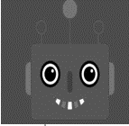
Mental state
Model of other
Simulation
Decisional model
Utterance
Other_pow
Adaptation
Model of the agent
Pow
Preferences
Decisional model
Utterance

