Slide 1
Symbolic Modeling, Planning and Dialogue

Slide 2


In collaboration with:
Nicolas Sabouret
Lydia Ould Ouali
(MS Thesis)
University of Paris-South / CNRS

Slide 3
A Tale of ...
Good Old-Fashioned AI
(GOFAI)
knowledge
knowledge representation
Knowledge acquisition
procedural vs. declarative knowledge

Slide 4
Hierarchical Task Networks (HTNs)
widely used for controlling intelligent agents (and robots)
closely related to behavior trees in game AI (for non-player characters)
typically hand-authored* (“knowledge acquisition”)
* recently, learning from demonstration

Slide 5
Hierarchical Task Networks (HTNs)
Mohseni Kabir, Rich, Chernova, Sidner & Miller, Human-Robot Interaction 2015

Slide 6
Hierarchical Task Networks (HTNs)
Rich & Sidner, Intelligent Virtual Agents 2012

Slide 7
HTN Execution
A
r1
r2
r3
. . .
b
C
d
E
r4
r5
r6
f
g
h
i
j
k

Slide 8
Reactive via Procedural Conditions
Python,
JavaScript,
Lua, etc.,
that return
T or F
precondition
A
postcondition
applicability
condition
r1
applicability
condition
r2
applicability
condition
r3
. . .
b
C
d
E
r4
r5
r6
f
g
h
i
j
k

Slide 9
Reactive HTN Execution
T
A
T
T
r1
r2
r3
. . .
T
b
T
T
C
T
d
E
r4
r5
T
r6
f
g
h
i
j
k
T
T
T
T
T
T

Slide 10
Breakdown: Failed Postcondition
T
A
T
r1
r2
r3
. . .
T
b
T
T
C
d
E
r4
r5
T
r6
f
g
h
i
j
k
T
F

Slide 11
Breakdown: Failed Precondition
T
A
T
r1
r2
r3
. . .
T
b
T
F
C
d
E
r4
r5
r6
f
g
h
b
f
h

Slide 12
Breakdown: Failed Applicability Conditions
T
A
F
r1
F
r2
F
r3
. . .
b
C
d
E
r4
r5
r6
f
g
h
b
f
h

Slide 13
A Motivating Example
T
T
T
pickup
T
T
Transport
putdown
T
T
unlock
open
walkthru
T
T
T
F

Slide 14
It’s a real problem... ☺
Recently, in the DARPA Robotics Challenge, (DRC) re the winning robot:
“However, team Schaft lost points when a gust of wind blew a door out of the robot’s hand and the robot was unable to exit a vehicle after navigated a driving course successfully.”
https://herox.com/news/148-the-darpa-robotics-challenge

Slide 15
Underlying Causes of Breakdowns?
(1) An “external” (non-modeled) agent changes the environment (e.g., the wind)
(2) “Bug” in the HTN -wrong (order of) actions -incorrectly coded condition
Both of these manifest the same, i.e., there are no executable nodes in the HTN

Slide 16
Recovering from the Breakdown
unlock
open
unlock
open
walkthru
Could we do this automatically?

Slide 17
Recovering from the Breakdown
YES! If these pre/postconditions were “symbolic” features (instead of procedural calls)
+locked
unlock
!isLocked()
walkthru
-locked
isOpen()
isLocked()
+open
-open, -locked
open
!isOpen()
&& !isLocked()
isOpen()
+open

Slide 18
Recovery using Symbolic Planning
Then this is a very simple linear (STRIPS-like) planning problem
Initial State (current world state!): -open, +locked
+locked
unlock
-locked
Final State:
+open
walkthru
-open, -locked
open
+open

Slide 19
Recovery Using STRIPS Planning
Initial State: {-open, +locked}
Final State: {+open}
Operators:
unlock: +locked ➔ -locked
open: -open, -locked ➔ +open
walkthru: +open ➔...
...
{...}
{...}
{-open, +locked}
unlock
{-open, -locked}
open
{+open}
unlock
open
{...}
{...}

Slide 20
Recovering from the Breakdown
unlock
open
unlock
open
walkthru
T
T
T
T
T
T

Slide 21
But wait a minute!
Why not just use the linear symbolic planner all the time?
Because that would require you to have complete and correct symbolic descriptions for all the primitive actions in your domain.
And that is hard, and often practically impossible...

Slide 22
Knowledge...
Where’s the knowledge in different kinds of systems?
In particular, the knowledge that allows an intelligent agent to predict the future?

Slide 23
Knowledge in Symbolic Planners
Symbolic planners rely on a correct and complete “axiomatization” of the world, e.g.,
add/delete lists for all operators (STRIPS)
Planning Domain Definition Language (PDDL)
other logical/symbolic (“declarative”) formalisms
If the axiomization is incorrect or incomplete (relative to reality) the generated plans will fail! (The poorer the axiomitization, the less reliable the plans.)
A correct and complete axiomitization (“declarative description”) of some domain is the “gold standard”

Slide 24
Symbolic Description is HARD
This is the conclusion of decades of AI research
People spend years working on axiomitizing small problem domains, such as pouring liquids
If you are doing something like the DRC, you don’t remotely have time to do this for your problem
This is why formalisms like reactive HTNs were invented...

Slide 25
Knowledge in Reactive HTNs
In the structure of the network
a conditionalized plan for acting in the future
In the code for the procedural conditions
especially the recipe applicability conditions

Slide 26
Knowledge in Reactive HTNs
Is it easier to write an HTN than a complete and correct axiomitization?
As a practical/empirical matter, yes (because people use HTNs so much)
Why is it easier?
the hierarchy helps with organizing your thoughts
procedural conditions are only applied to the current world state, whereas a logic axiom must be applicable in all possible worlds
But, of course, as we saw, HTNs can break down!

Slide 27
A Hybrid Approach
Use reactive HTNs as usual to avoid the need for correct and complete axiomitization of complex domains
Add some symbolic conditions (especially for primitives)
Use a simple linear symbolic planner for local recovery from HTN breakdowns
the planner makes use of whatever symbolic information it has available

Slide 28
Hasn’t anyone thought of this before?
No, not to our knowledge
we scoured the literature
we talked to leaders in planning community
There’s a lot of stuff on plan repair in HTNs, but it all has to do with completely symbolic HTNs:
where you have a hierarchical plan instead of a linear plan (as in STRIPS)
but everything else is essentially the same, i.e., you need symbolic descriptions of all of your actions (both primitive and non-primitive)

Slide 29
Implementation - Discolog
breakdown recovery planning
problem candidate
initial/final state
symbolic operators
Disco
(HTN
execution
engine)
STRIPS
in
Prolog
linear repair plan
(or null)
STRIPS implementation in Prolog is short, elegant, and easily allows addition of additional domain reasoning rules

Slide 30
Generating Recovery Problem Candidates
Failed Postcondition
Failed Precondition
Initial State = current world state!
Failed Applicability Conditions

Slide 31
Generating Recovery Problem Candidates
Candidate Final State is any future condition in HTN where symbolic information is given
A
r1
r2
+P1
r3
b
-P2
C
-P3
d
+P3
E
r4
r5
r6
f
+P4
g
-P5
h
i
-P6
j
+P6
k
+P7

Slide 32
Experimental Evaluation
Using randomly generated synthetic HTNs: D x R x S
D = depth (of task nodes)
R = recipe branching factor
S = subtask branching factor
1
R
1
...
1
...
S
...
...
D
Three different levels of symbolic information: 25%, 50%, 75%
percentage of conditions (pre-, post-, or applicability) that are provided in symbolic form

Slide 33
Experimental Evaluation
Randomly introduced all three types of execution breakdowns into HTN execution
Confirmed basic hypothesis:
The higher the level of symbolic information, the more successful the hybrid system will be in recovering from breakdowns.

Slide 34
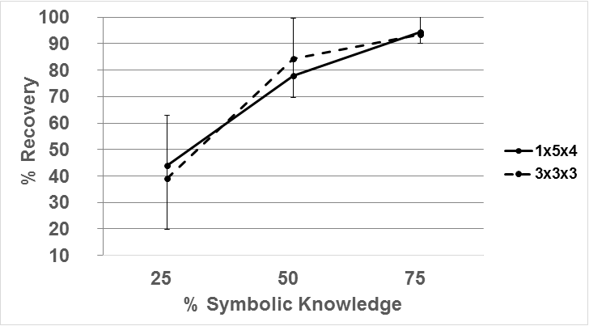
Recovery vs. Symbolic Knowledge

Slide 35
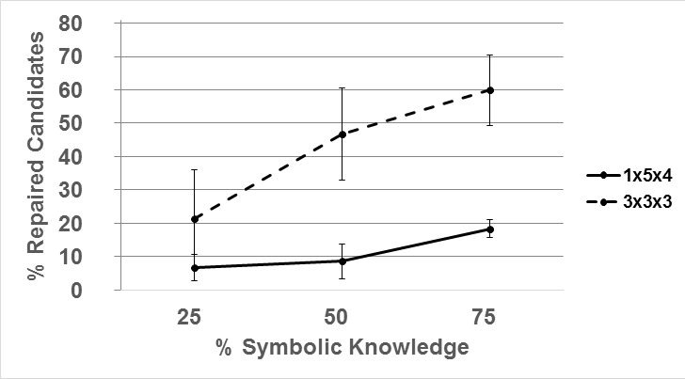
Repaired Candidates versus Symbolic Knowledge

Slide 36
Next Steps
Automatically “coerce” some procedural conditions to symbolic when needed
Real experience
complex robot procedures (ONR project re equipment maintenance)
adaptable social dialogue (Ould Ouali PhD)

Slide 37
Procedural to Declarative “Coercion”
unlock
!isLocked()
walkthru
isOpen()
-isLocked
+isOpen
open
!isLocked()
&& !isOpen()
isOpen()
+isOpen
-isLocked, -isOpen

Slide 38
Adaptable Social Dialogue
dialogue alternatives
recipe choices
focus of attention
Disco
(HTN
execution
engine)
STRIPS
in
Prolog
dialogue decisions
Use Prolog as general background reasoner (especially re social goals) to control choice of alternatives in an HTN-based dialogue tree

Slide 39
Thank you!
Disco
Prolog

