Slide 1




A computational model of power in collaborative negotiation dialogues
IVA 2017
Lydia OULD OUALI (LIMSI-CNRS / UPSUD)
Nicolas Sabouret (LIMSI-CNRS / UPSUD)
Charles Rich (CS / WPI)
Notes:
This talk is about the impact of power in collaborative negotiation dialogues

Slide 2
Plan
Context & related work
Computational model of collaborative negotiation
Negotiation based on power
Evaluation
Conclusion and future work

Slide 3
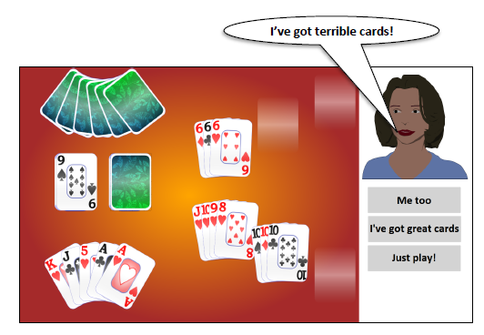

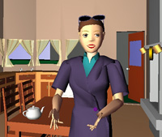
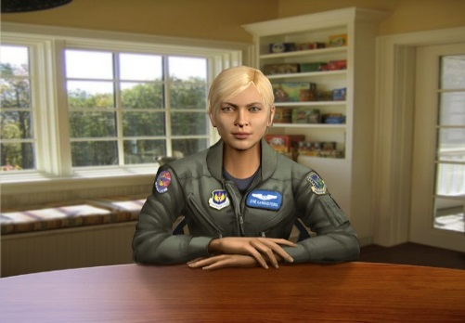

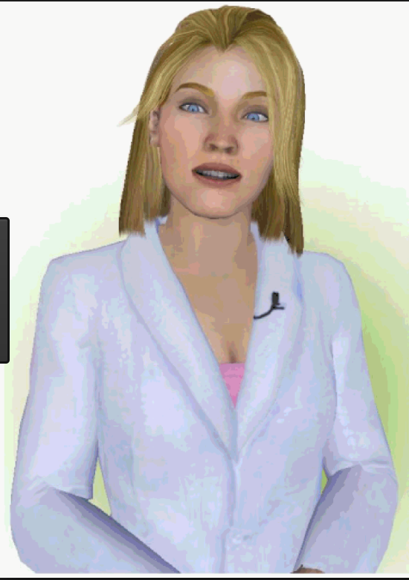
Context: Conversational agents
Context
Companion
Tutor
Partner
SimSensei
DeVault et al, 14
REA
Bickmore et al, 02
AlwaysOn
Sidner et al, 14
SimCoach
Rizzo et al, 11
Louise
Davi
Smith et al, 10
Collaboration User/Agent
Notes:
Raise of popularity in different fields
Playing different roles as companion tutor or collaborator
During the interaction Agent able to express and understand social behaviors
An other important aspect in the intercation is the collaboration
Our goal to enhance the social abilities the context of collaboration
We focus on the verbal behaviors and more precisly on the dialogue strategy
Share goal or task

Slide 4


Collaboration in dialogue
Context
Collaborative
Negotiation
Expertise
Expertise
Preferences
Preferences
Collaborative negotiation
trade-of which best satisfies the interests of both participants, instead of maximizing one participant’s interest. (Chu-Caroll & Carberry, 95)
Notes:
Resort on specific expretise or preferences in achieving the goal

Slide 5
Collaboration in dialogue
Context & goal
Collaborative
Negotiation
Expertise
Expertise
Social Relation
Preferences
Preferences
Impact of the social relation
on the negotiation strategy
Notes:
In addition, research in social psycology showed the the social relationship affect the interlocutors negotiation strategy

Slide 6
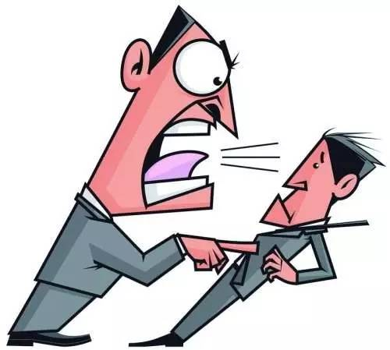
Social aspects in negotiation(Broekens et al, 10)
Context
Dominance
Ability to express behavior of power(Burgoon & Dunbar 98)
Power Ability to influence the behavior of another person (Burgoon et al 98)
Control attempts by one individual are accepted by the interactional partner (Burgoon & Dunbar 98)
Notes:
In addition, several researches have already proven that emotions affect our way to negotiate
Dominance is among the fundamental dimensions of interpersonal relations ships which was widely studied in social psychology and communication

Slide 7
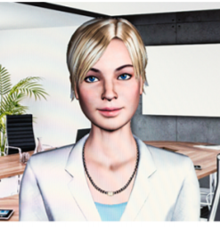
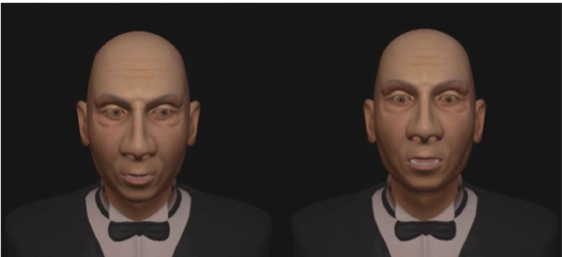
Social aspects in negotiation
Context
Non-verbal behaviors:
(Bee, André et al, 10)
Gaze and posture
(Gebhard et al,14)
Head tilts
raised head associated to a dominant behavior
Notes:
Power appears in a dialogue as verbal and non verbal cues,
In the context of non verbal behaviors psycologits detected several cues, such as gaze duration, or head tilts and computational models were proposed implementing thoses behaviors

Slide 8
Social aspects in negotiation
Context
Verbal behaviors
Linguistic style (Bradac & Mulac, 1984)
Dominant behavior is associated with more assertive style.
Lead of the conversation (Dedreu and VanKleef, 04; Burgoon98)
High-power individuals tends to make the first move
Control of the flow of the conversation
Dictating topic changes
Strategic behaviors (Dedreu and VanKleef, 04)
Self centeredness
Level of demand and concessions
Notes:
At the verbal level, there a variety of influence strategies that individuals use such as the linguistic style

Slide 9
Plan
Context & related work
Computational model of collaborative negotiation
Model of preferences
Model of communication
Negotiation based on power
Evaluation
Conclusion and future work

Slide 10


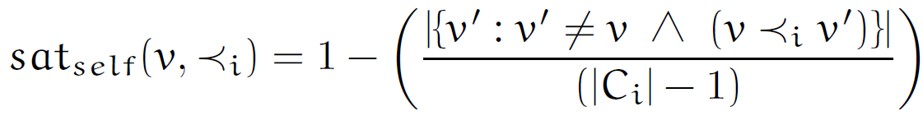
Model of negotiation of preferences
Computational model
Mental state
Goal choose an option ( ex : Restaurant).
Domain model
Option = {criterion_1, …, criterion_n}
Ex : Restaurant = {cuisine, Price, ambiance}
Preferences
+ Partial order and transitive.
+ Score of satisfaction
Inverse of the number of ancestors
Notes:
Une option est défini comme le produit cartesien d’un ensemble de criteres

Slide 11
Model of negotiation of preferences
Computational model
Communication
Preferences
Utterance’s type
Share preferences
Negotiation
Notes:
Une option est défini comme le produit cartesien d’un ensemble de criteres

Slide 12
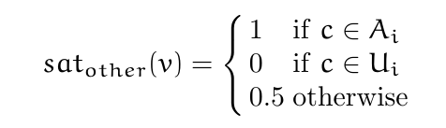
Model of negotiation of preferences
Computational model
Communication
Share preferences
Preferences
Share a preference
State Preference(X)
Ask for a preference
Ask Preference(X)
Other preferences
I like v
I don’t like v
Notes:
Une option est défini comme le produit cartesien d’un ensemble de criteres

Slide 13
Model of negotiation of preferences
Computational model
Communication
Negotiate
Make a proposal
Propose(X)
Reject a proposal
Reject(X)
Accept a proposal
Accept(X)
Preferences
Other preferences
Shared proposals
P :Open, T : Accepted, R : Rejeted
Notes:
Une option est défini comme le produit cartesien d’un ensemble de criteres

Slide 14
Plan
Context & related work
Computational model of collaborative negotiation
Negotiation based on power
Behaviors related to power in social psychology
Computational model of decision based on power
Evaluation
Conclusion and future work

Slide 15

Model of negotiation based on power
Decision based on power
Principle 1: Level of demand and concession (Dedreu et al 95)
Power is associated to a high level of demand and a low level of concessions
Principle 2: Self vs other (Fiske 93, DeDreu et al 95)
High-power individuals are self-centered and only interested in satisfying their own preferences.
Principle 3: Lead of the negotiation (Dedreu,VanKleef, 04)
High-power individuals tends to make the first move
Control of the flow of the negotiation

Slide 16
Model of negotiation based on power
Decision based on power
Decision based on power
Mental state
Communication
Decision
Preferences
pow ∊ [0,1]
3 principles
Share preferences
Other preferences
Negotiation
Shared proposals
Notes:
Une option est défini comme le produit cartesien d’un ensemble de criteres

Slide 17
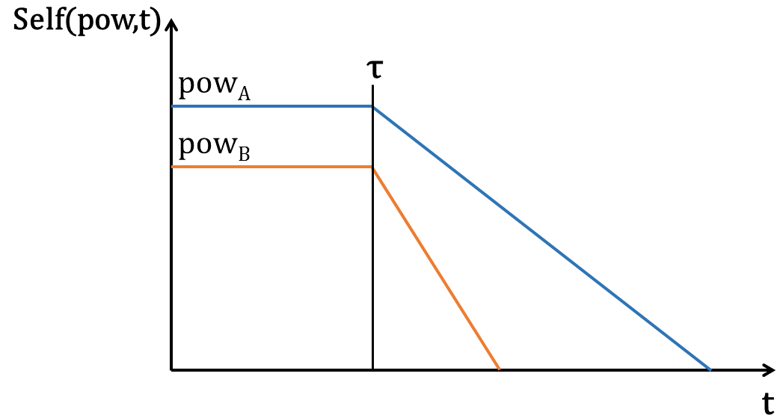

Model of negotiation based on power
Decision based on power
Principle 1: Power is associated to a high level of demand and a low level of concessions
Implementation: Conditions to accept a proposal
Concessions
- pow ⇾ self(t)
- Self decreases over time
pow_{A}=0.7 pow_{B}=0.4
Level of demand
Notes:
Une option est défini comme le produit cartesien d’un ensemble de criteres

Slide 18
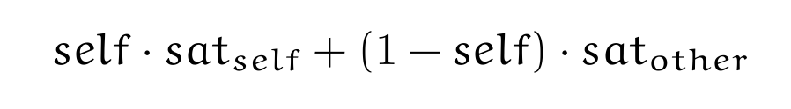
Model of negotiation based on power
Decision based on power
Principle 2: High-power individuals are self-centered
Implementation: Choose the value of a proposal
+ Take into account self preferences and other preferences
Notes:
Une option est défini comme le produit cartesien d’un ensemble de criteres
+ The higher self(t) is, the more an agent gives weight to its preferences

Slide 19
Model of negotiation based on power
Decision based on power
Principle 3: High-power agent leads the negotiation
Implementation: Choose the next utterance
Decision rules
Define a priority in the choice of the utterance
High-power: Negotiation acts (Propose, CounterPropose)
Low-power: Information acts (AskPreference)

Slide 20
Example of dialogue
Proposed model
Pow(A) = 0.9, Pow(B) = 0.4
A: "Let's go to a Chinese restaurant." B: "I don't like Chinese restaurants, let's choose something else." A: "Let's go to the Shanghai. It's a quiet, cheap Chinese restaurant on the south side." B: "Do you like Italian restaurants?" A: "I don't like Italian restaurants." B: "Do you like French restaurants?" A: "Let's go to the Shanghai. It's a quiet, cheap Chinese restaurant on the south side."
B: "Do you like French restaurants?"
A: "I don't like French restaurants." B: "Do you like Korean restaurants?" A: "Let's go to a cheap restaurant." B: "Okay, let's go to a cheap restaurant." A: "Let's go to a restaurant on the south side." B: "Okay, let's go to a restaurant on the south side." A: "Let's go to the Shanghai. It's a quiet, cheap Chinese restaurant on the south side." B: "Okay, let's go to the Shanghai restaurant.“

Slide 21
Example of dialogue
Proposed model
Pow(A) = 0.9, Pow(B) = 0.4
Principle 1:Level of demand & concessions
A: "Let's go to a Chinese restaurant." B: "I don't like Chinese restaurants, let's choose something else." A: "Let's go to the Shanghai. It's a quiet, cheap Chinese restaurant on the south side." B: "Do you like Italian restaurants?" A: "I don't like Italian restaurants." B: "Do you like French restaurants?" A: "Let's go to the Shanghai. It's a quiet, cheap Chinese restaurant on the south side."
B: "Do you like French restaurants?"
A: "I don't like French restaurants." B: "Do you like Korean restaurants?" A: "Let's go to a cheap restaurant." B: "Okay, let's go to a cheap restaurant." A: "Let's go to a restaurant on the south side." B: "Okay, let's go to a restaurant on the south side." A: "Let's go to the Shanghai. It's a quiet, cheap Chinese restaurant on the south side." B: "Okay, let's go to the Shanghai restaurant.”

Slide 22
Example of dialogue
Proposed model
Pow(A) = 0.9, Pow(B) = 0.4
Principle 2: self-centeredness
A: "Let's go to a Chinese restaurant." B: "I don't like Chinese restaurants, let's choose something else." A: "Let's go to the Shanghai. It's a quiet, cheap Chinese restaurant on the south side." B: "Do you like Italian restaurants?" A: "I don't like Italian restaurants." B: "Do you like French restaurants?" A: "Let's go to the Shanghai. It's a quiet, cheap Chinese restaurant on the south side."
B: "Do you like French restaurants?"
A: "I don't like French restaurants." B: "Do you like Korean restaurants?" A: "Let's go to a cheap restaurant." B: "Okay, let's go to a cheap restaurant." A: "Let's go to a restaurant on the south side." B: "Okay, let's go to a restaurant on the south side." A: "Let's go to the Shanghai. It's a quiet, cheap Chinese restaurant on the south side." B: "Okay, let's go to the Shanghai restaurant.”

Slide 23
Example of dialogue
Proposed model
Pow(A) = 0.9, Pow(B) = 0.4
Principle 3:
Lead of the dialogue
A: "Let's go to a Chinese restaurant." B: "I don't like Chinese restaurants, let's choose something else." A: "Let's go to the Shanghai. It's a quiet, cheap Chinese restaurant on the south side." B: "Do you like Italian restaurants?" A: "I don't like Italian restaurants." B: "Do you like French restaurants?" A: "Let's go to the Shanghai. It's a quiet, cheap Chinese restaurant on the south side."
B: "Do you like French restaurants?"
A: "I don't like French restaurants." B: "Do you like Korean restaurants?" A: "Let's go to a cheap restaurant." B: "Okay, let's go to a cheap restaurant." A: "Let's go to a restaurant on the south side." B: "Okay, let's go to a restaurant on the south side." A: "Let's go to the Shanghai. It's a quiet, cheap Chinese restaurant on the south side." B: "Okay, let's go to the Shanghai restaurant.“

Slide 24
Example of dialogue
Proposed model
Pow(A) = 0.9, Pow(B) = 0.4
Principle 3:
Lead of the dialogue
A: "Let's go to a Chinese restaurant." B: "I don't like Chinese restaurants, let's choose something else." A: "Let's go to the Shanghai. It's a quiet, cheap Chinese restaurant on the south side." B: "Do you like Italian restaurants?" A: "I don't like Italian restaurants." B: "Do you like French restaurants?" A: "Let's go to the Shanghai. It's a quiet, cheap Chinese restaurant on the south side."
B: "Do you like French restaurants?"
A: "I don't like French restaurants." B: "Do you like Korean restaurants?" A: "Let's go to a cheap restaurant." B: "Okay, let's go to a cheap restaurant." A: "Let's go to a restaurant on the south side." B: "Okay, let's go to a restaurant on the south side." A: "Let's go to the Shanghai. It's a quiet, cheap Chinese restaurant on the south side." B: "Okay, let's go to the Shanghai restaurant.“

Slide 25
Plan
Context & related work
Computational model of collaborative negotiation
Negotiation based on power
Evaluation
Conclusion and future work
Notes:
Our evaluation aims at proving that the dialogues produced by the model correclty exibit the behaviors of power, as described by the principles

Slide 26
Evaluation of the model
Evaluation
Evaluate the perception of behaviors related of power.
Hypotheses
H1 The higher-power agent will more strongly be perceived as self-centered than the lower-power agent
H2 The lower-power agent will be more strongly perceived as making larger concessions than the higher-power agent
H3 The higher-power agent will more strongly be perceived as demanding than the lower-power agent
H4 The higher-power agent will more strongly be perceived as taking the lead in the negotiation than the lower-power agent
Prin. 2
Prin. 1
Prin. 3

Slide 27


Evaluation of the model
Evaluation
Conditions
Procedure
External judges evaluate both agent behaviors during their negotiation.
A between-subject study on the online site CrowdFlower.com.
Agents described as two friends negotiating about restaurant where to have dinner.
Total participants: 120
Init of power
Pow(A) = 0.9, Pow(B) = 0.4
Pow(A) = 0.7, Pow(B) = 0.4
Pow(A) = 0.7, Pow(B) = 0.2
Agent preferences.
Similar preferences
Different preferences

Slide 28
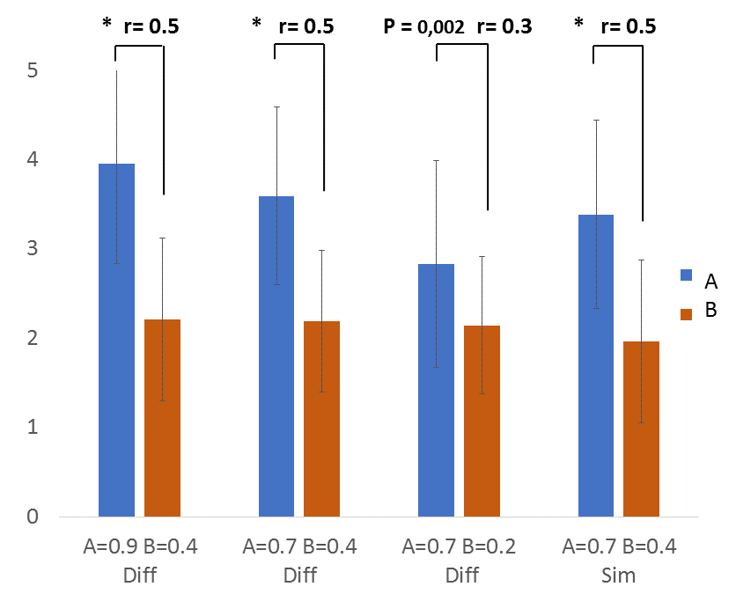
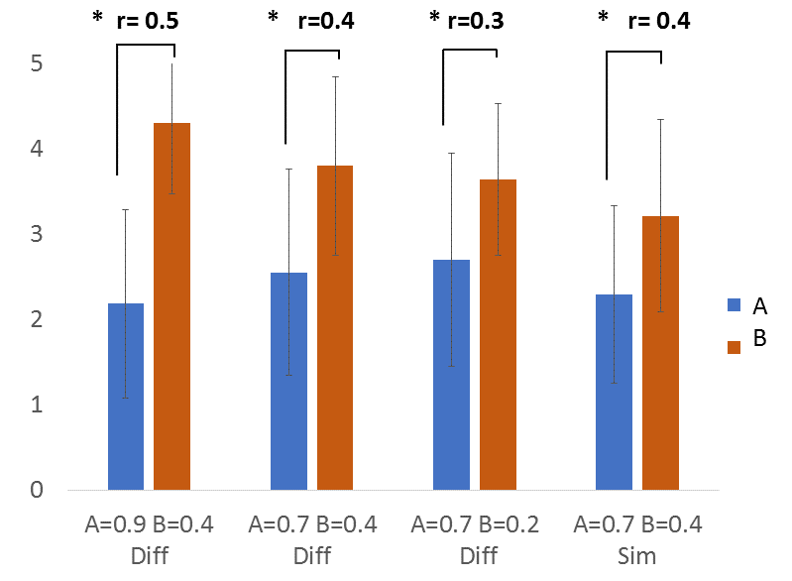
Evaluation of the model
Evaluation
H1: Self centeredness
H2: Concessions
Agent A is more self-centered and makes less concessions.
Agent B tries to find the best trade-off for both parties, and is able to make larger concessions.

Slide 29
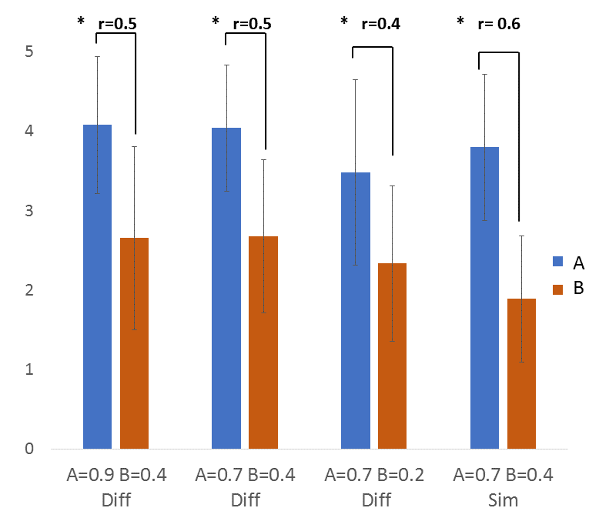
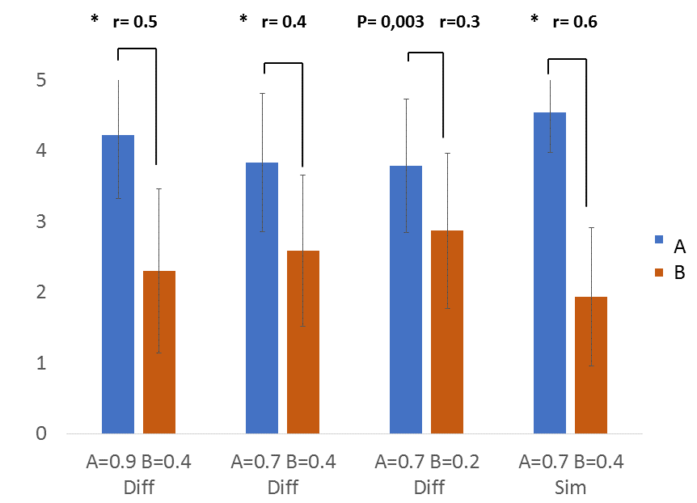
Evaluation of the model
Evaluation
H3: Level of demand
H4: Lead of the dialogue
Agent A is more demanding than agent B.
Agent A is the one who leads the dialogue. (even in the similar condition)

Slide 30
Synthese des resultats
Objectifs
Resultats de ces objectifs

Slide 31
Conclusion
Conclusion & future work
Goal: Impact of dominance on the negotiation strategies.
Identify 3 principles of behaviors related to power
Computational model of collaborative negotiation
Decision model based on power
Validation of behaviors of power by external judges

Slide 32
Future work
Conclusion & future work
Goal: Impact of dominance on the negotiation strategies.
Validation of the model in HMI
Build the relation of dominance during the negotiation
Adapt the agent to the user behavior
Validate the model in the context of HMI

Slide 33
Thank you for your attention

