Slide 1

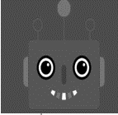
Mental state
Model of other
Simulation
Decisional model
Utterance
ToM
Other_pow
Adaptation
Model of the agent
Pow
Preferences
Decisional model
Utterance

