Slide 1




A computational model of power in collaborative negotiation dialogues
IVA 2017
Lydia OULD OUALI
Nicolas Sabouret (LIMSI-CNRS)
Charles Rich (WPI)

Slide 2
Plan
Context
Model of collaborative negotiation
Evaluation
Conclusion and futur work

Slide 3
Context: Conversational agents
Context
Raise of popularity in different fields.
Chatbots (SIRI, Google now ….)
Companion for the eldery (Bickmore, 05)
Tutoring agents (Kerly et al, 08)
…
Collaborate with user in order to satisfy tasks.
Ex tutoring agents:
Knowledge comparison for a better learning
Personalized teaching to the learner.

Slide 4


Collaboration in dialogue
Context
collaboration
Expertise
Expertise
Preferences
Preferences
Notes:
Chaque individu possède des expertises et des Preferences sur la manière de faire une tâche

Slide 5
Collaboration in dialogue
Context
Collaborative
Negotiation
Expertise
Expertises
Preferences
Preferences
Collaborative negotiation
trade-of which best satisfies the interests of both participants, instead of maximizing one participant’s interest. (Chu-Caroll & Carberry, 95)
Notes:
Chaque individu possède des expertises et des Preferences sur la manière de faire une tâche

Slide 6
Social aspects in negotiation
Context
Negotiation involves social interaction:(Broekens et al, 10)
Affects
Social behaviors.
Dominance:
Ability to express behavior of power(Burgoon & Dunbar 98)
control attempts by one individual are accepted by the interactional partner (Burgoon & Dunbar 98)
Power: the ability to influence the behavior of another person (Burgoon et al 98)

Slide 7
Social aspects in negotiation
Context
Non-verbal behaviors:
Body movement:
Posture, relaxation etc …
Computational model (Mignault and chaudhuri, 03)
Head tilts
raised head is associated to a dominant behavior
Computational model (Gebhard, 14)
Gaze
Computational model (Lance and Marsella, 08)
…

Slide 8
Social aspects in negotiation
Context
Verbal behaviors→ 3 principles
Level of demand and concession(Dedreu et al 95)
Power is associated to a high level of demand and a low level of concessions
Self vs other (Fiske 93, DeDreu et al 95)
High-power individuals are self-centered and only interested in satisfying their own preferences.
Lead of the negotiation (Dedreu and VanKleef, 04)
High-power individuals tends to make the first move
Control of the flow of the negotiation

Slide 9
Objectives
Context
Model of social behaviors in the context of collaborative negotiation.
Conversational agent communicates using actes of dialogue
Define strategies of collaborative negotiation
Adapt the strategies of negotiation to the relation of power

Slide 10
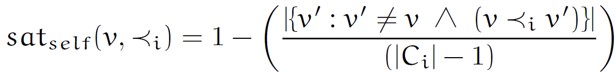
Model of negotiation based on power
Proposed model
Domain model
Goal : choose an option ( ex : Restaurant).
Option = {Criterion_1, …, Criterion_n}
Ex : Restaurant = {cuisine, Price, ambiance}
Preferences on criteria’s values
Partial order.
Score of satisfaction based on the preferences
Inverse of the number of ancestors
Notes:
Une option est défini comme le produit cartesien d’un ensemble de criteres

Slide 11
Model of negotiation based on power
Proposed model
Communication: Dialogue acts
Share preferences
Negotiation
Share a preference
State Preference(X)
Ask for a preference
Ask Preference(X)
Make a proposal
Propose(X)
Reject a proposal
Reject(X)
Accept a proposal
Accept(X)
Notes:
Une option est défini comme le produit cartesien d’un ensemble de criteres

Slide 12
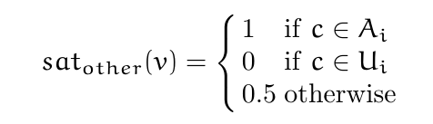
Model of negotiation based on power
Proposed model
Dialogue model
Shared knowledge during the negotiation:
Proposals
P : Open, T : Accepted, R : Rejeted
Shared preferences
Other preferences
Notes:
Une option est défini comme le produit cartesien d’un ensemble de criteres

Slide 13
Model of negotiation based on power
Proposed model
Dialogue model
Shared knowledge during the negotiation:
Proposals
P : Open, T : Accepted, R : Rejeted
Shared preferences
Other preferences
I like v
I don’t like v
Notes:
Une option est défini comme le produit cartesien d’un ensemble de criteres

Slide 14
Model of negotiation based on power
Proposed model
Decision based on power
Implementation of the three principles
Agent is initiated with a value of power
pow ∊ [0,1]
Submissive
Powerful
0
1
Notes:
Une option est défini comme le produit cartesien d’un ensemble de criteres

Slide 15
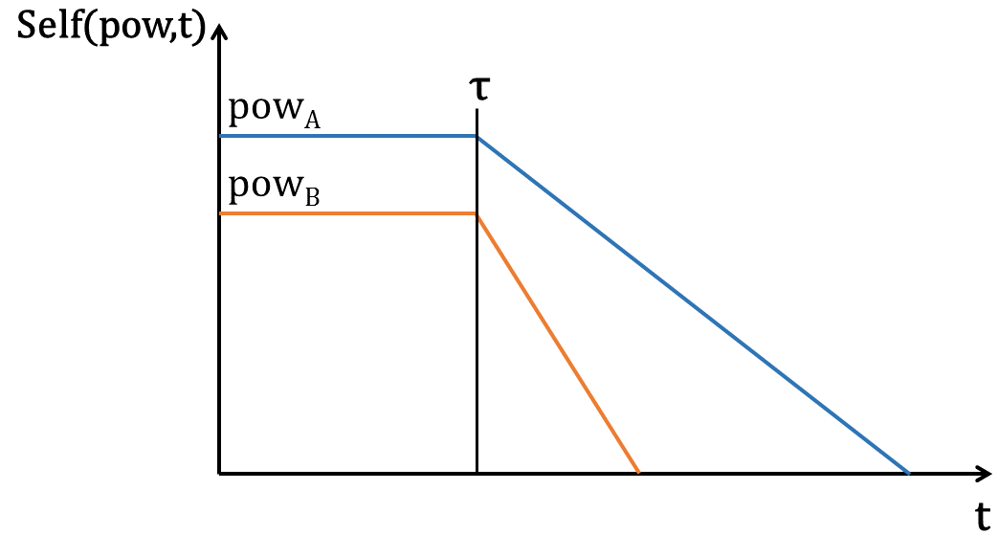
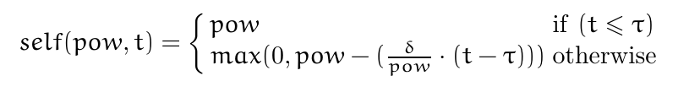
Model of negotiation based on power
Proposed model
Decision based on power
Principle 1
High power agent makes less concessions
Self : Function representing the value of pow over time
Notes:
Une option est défini comme le produit cartesien d’un ensemble de criteres

Slide 16
Model of negotiation based on power
Proposed model
Decision based on power
Principle 1
High-power agent is more demanding
Acc: Define if a value is acceptable for the agent
Ex: Accept(Chinese) / Condition : acc(Chinese) = True
The acceptability of a value depends on the agent’s level of demand
Notes:
Une option est défini comme le produit cartesien d’un ensemble de criteres

Slide 17
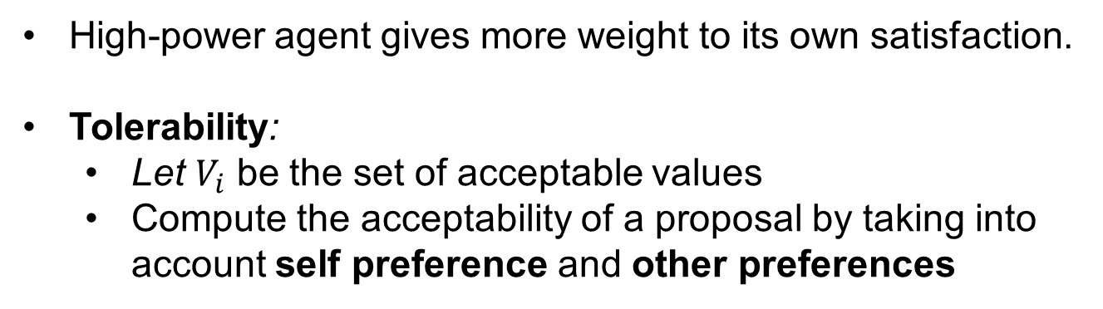
Model of negotiation based on power
Proposed model
Decision based on power
Principle 2
High-power agent gives more weight to its own satisfaction.
Tolerability:
Let $V_{i}$ be the set of acceptable values
Compute the acceptability of a proposal by taking into account self preference and other preferences
Notes:
Une option est défini comme le produit cartesien d’un ensemble de criteres

Slide 18

Model of negotiation based on power
Proposed model
Decision based on power
Principe 2
High-power agent gives more weight to its own satisfaction.
Tolerability: Compute the acceptability of a proposal by considering both interlocutors preferences
The agent proposes the most « tolerable » value
Notes:
Une option est défini comme le produit cartesien d’un ensemble de criteres

Slide 19
Model of negotiation based on power
Proposed model
Decision based on power
Principle 3
Mental state
Preferences
Pow (Power)
Decision based on power
Decision on preferences. (P1, P2)
Decision on the choice of an utterance (P3)
Negotiation context
Proposalss (P,T,R)
Other (A,U)
History of utterances
Notes:
Une option est défini comme le produit cartesien d’un ensemble de criteres

Slide 20
Model of negotiation based on power
Proposed model
Decision based on power
Principle 3
high-power agent tends to lead the negotiation
Decision rules
Define a priority in the choice of the utterance
High-power: Negotiation acts
(Propose, Reject, Accept).
Low-power: Statement acts
(StatePreference, AskPreference)
Notes:
Une option est défini comme le produit cartesien d’un ensemble de criteres

Slide 21
Example of dialogue
Proposed model
Pow(Agent1) = 0.9, Pow(Agent2) = 0.4
A: "Let's go to a Chinese restaurant." B: "I don't like Chinese restaurants, let's choose something else." A: "Let's go to the Shanghai. It's a quiet, cheap Chinese restaurant on the south side." B: "Do you like Italian restaurants?" A: "I don't like Italian restaurants." B: "Do you like French restaurants?" A: "Let's go to the Shanghai. It's a quiet, cheap Chinese restaurant on the south side."
B: "Do you like French restaurants?"
A: "I don't like French restaurants." B: "Do you like Korean restaurants?" A: "Let's go to a cheap restaurant." B: "Okay, let's go to a cheap restaurant." A: "Let's go to a restaurant on the south side." B: "Okay, let's go to a restaurant on the south side." A: "Let's go to the Shanghai. It's a quiet, cheap Chinese restaurant on the south side." B: "Okay, let's go to the Shanghai restaurant.“

Slide 22
Example of dialogue
Proposed model
Pow(Agent1) = 0.9, Pow(Agent2) = 0.4
A: "Let's go to a Chinese restaurant." B: "I don't like Chinese restaurants, let's choose something else." A: "Let's go to the Shanghai. It's a quiet, cheap Chinese restaurant on the south side." B: "Do you like Italian restaurants?" A: "I don't like Italian restaurants." B: "Do you like French restaurants?" A: "Let's go to the Shanghai. It's a quiet, cheap Chinese restaurant on the south side."
B: "Do you like French restaurants?"
A: "I don't like French restaurants." B: "Do you like Korean restaurants?" A: "Let's go to a cheap restaurant." B: "Okay, let's go to a cheap restaurant." A: "Let's go to a restaurant on the south side." B: "Okay, let's go to a restaurant on the south side." A: "Let's go to the Shanghai. It's a quiet, cheap Chinese restaurant on the south side." B: "Okay, let's go to the Shanghai restaurant.“

Slide 23
Example of dialogue
Proposed model
Pow(Agent1) = 0.9, Pow(Agent2) = 0.4
A: "Let's go to a Chinese restaurant." B: "I don't like Chinese restaurants, let's choose something else." A: "Let's go to the Shanghai. It's a quiet, cheap Chinese restaurant on the south side." B: "Do you like Italian restaurants?" A: "I don't like Italian restaurants." B: "Do you like French restaurants?" A: "Let's go to the Shanghai. It's a quiet, cheap Chinese restaurant on the south side."
B: "Do you like French restaurants?"
A: "I don't like French restaurants." B: "Do you like Korean restaurants?" A: "Let's go to a cheap restaurant." B: "Okay, let's go to a cheap restaurant." A: "Let's go to a restaurant on the south side." B: "Okay, let's go to a restaurant on the south side." A: "Let's go to the Shanghai. It's a quiet, cheap Chinese restaurant on the south side." B: "Okay, let's go to the Shanghai restaurant.“

Slide 24
Example of dialogue
Proposed model
Pow(Agent1) = 0.9, Pow(Agent2) = 0.4
A: "Let's go to a Chinese restaurant." B: "I don't like Chinese restaurants, let's choose something else." A: "Let's go to the Shanghai. It's a quiet, cheap Chinese restaurant on the south side." B: "Do you like Italian restaurants?" A: "I don't like Italian restaurants." B: "Do you like French restaurants?" A: "Let's go to the Shanghai. It's a quiet, cheap Chinese restaurant on the south side."
B: "Do you like French restaurants?"
A: "I don't like French restaurants." B: "Do you like Korean restaurants?" A: "Let's go to a cheap restaurant." B: "Okay, let's go to a cheap restaurant." A: "Let's go to a restaurant on the south side." B: "Okay, let's go to a restaurant on the south side." A: "Let's go to the Shanghai. It's a quiet, cheap Chinese restaurant on the south side." B: "Okay, let's go to the Shanghai restaurant.“

Slide 25
Evaluation of the model
Evaluation
Evaluate the perception of the implemented behaviors
Conditions
Agent preferences.
Similar preferences
Different preferences
Init of power.
Pow(Agent1) = 0.9, Pow(Agent2) = 0.4
Pow(Agent1) = 0.7, Pow(Agent2) = 0.4
Pow(Agent1) = 0.7, Pow(Agent2) = 0.2

Slide 26
Evaluation of the model
Evaluation
Hypotheses
H1 The higher-power agent will more strongly be perceived as self-centered than the lower-power agent
H2 The lower-power agent will be more strongly perceived as making larger concessions than the higher-power agent
H3 The higher-power agent will more strongly be perceived as demanding than the lower-power agent
H4 he higher-power agent will more strongly be perceived as taking the lead in the negotiation than the lower-power agent

Slide 27
Evaluation of the model
Evaluation
Procedure
a between-subject study on the online site CrowdFlower.com.
Agents described as two friends trying to negotiate a restaurant to have dinner.
Total participants: 120

Slide 28
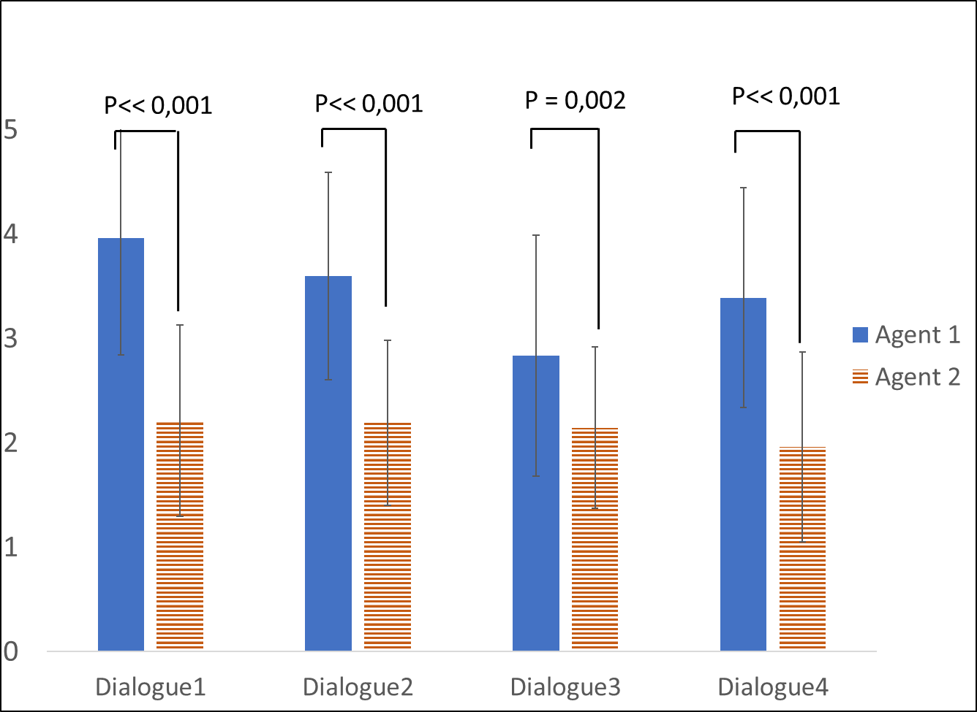
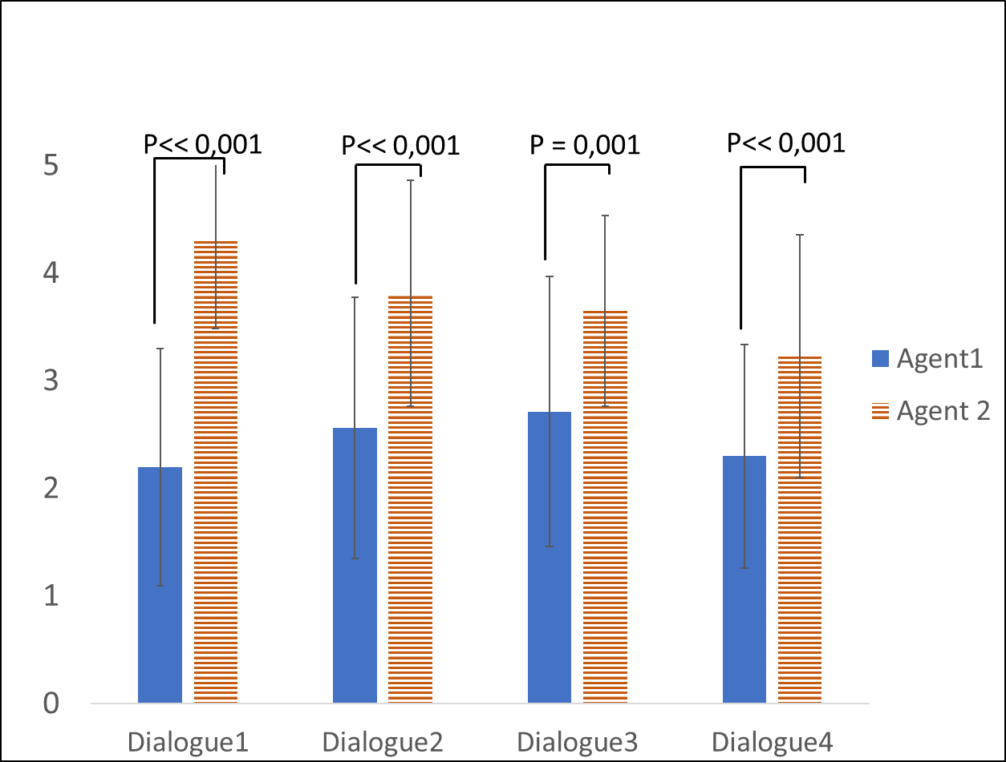
Evaluation of the model
Evaluation
Results
H1
H2
Agent 1 is more self-centered and do not make concessions.
Agent 2 tries to find the best trade-off for both parties, and is able to make larger concessions.

Slide 29
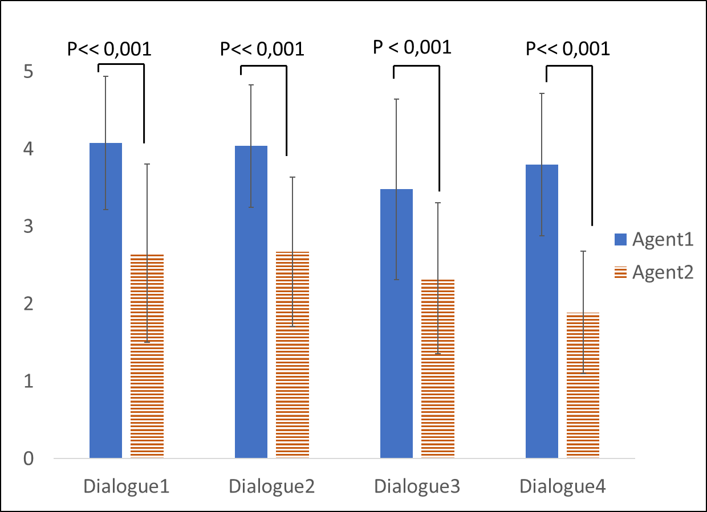
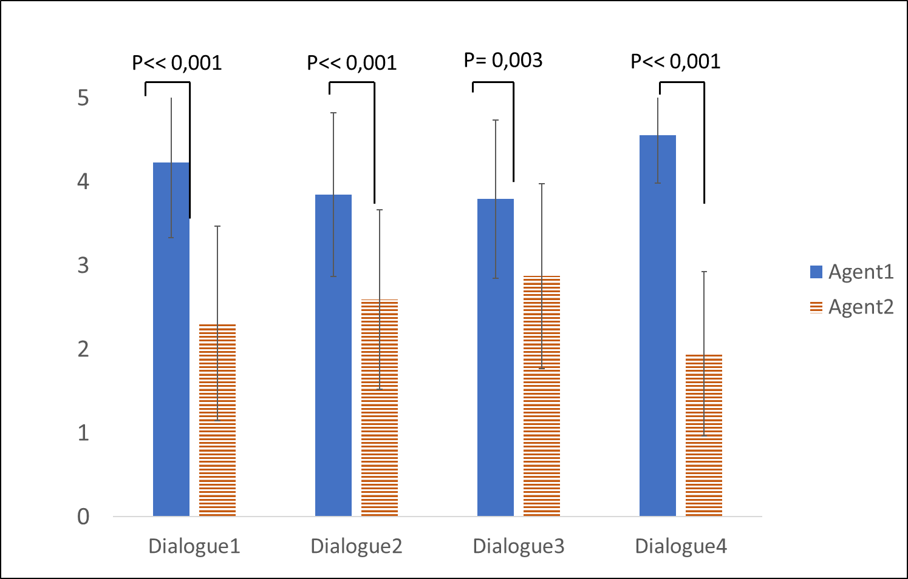
Evaluation of the model
Evaluation
Results
H3
H4
Agent 1 is more demanding than agent 2.
Agent 1 is the one who leads the dialogue.

Slide 30
Conclusion & futur work
Conclusion & futur work
Impact of power on the negotiation strategies
Identify 3 principles of behaviors related to power
Define a computational model of collaborative negotiation
Validation of the computation model: Perception of behaviors by external observers
Validate the model in a human machine interaction
Define the relation of dominance:
Add a model of ToM
Test the model in a human machine interaction

Slide 31
Thank you for your attention

