Slide 1
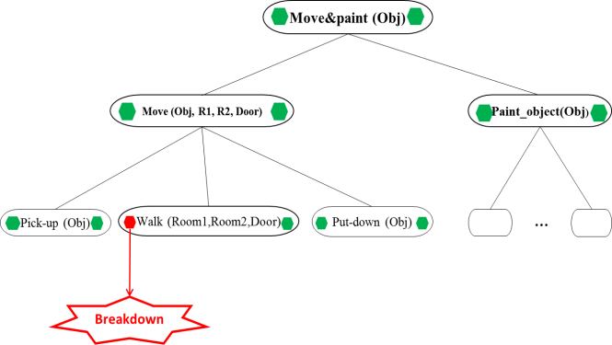

Discolog
STRIPS
TUprolog
Disco
Declarative DC
Reactive DC
Paintobject(obj)
Walk(r1,r2,d)
unlock(d)
open(d)
Paint_object(Obj)
Walk(R1,R2,D)
Unlock(D)
Open(D)
Convert the DM
Input
CurrentState(notisOpen(D))
Goal
STRIPS
engine
GoalState(isOpen(D))
Output

Slide 2
Discolog
STRIPS/Prolog
TUprolog
Disco / Java+JavaScript
Declarative DK
Generate STRIPS Input procedure
Reactive DK
preconditions(unlock,[islocked]).
achieves(unlock,notislocked).
deletes(unlock,islocked).
preconditions(open,[notislocked]).
achieves(open,isopen).
Move(Obj,R1,R2,Door)
Unlock(D)
Open(D)
… etc
Convert the Domain Knowledge
Input:holds(islocked,init).
GetCurrentState(isLocked(D))
test(Plan):-solve([isopen],7,Plan)
STRIPS
engine
GetGoalState(Candidates)
Output

Slide 3
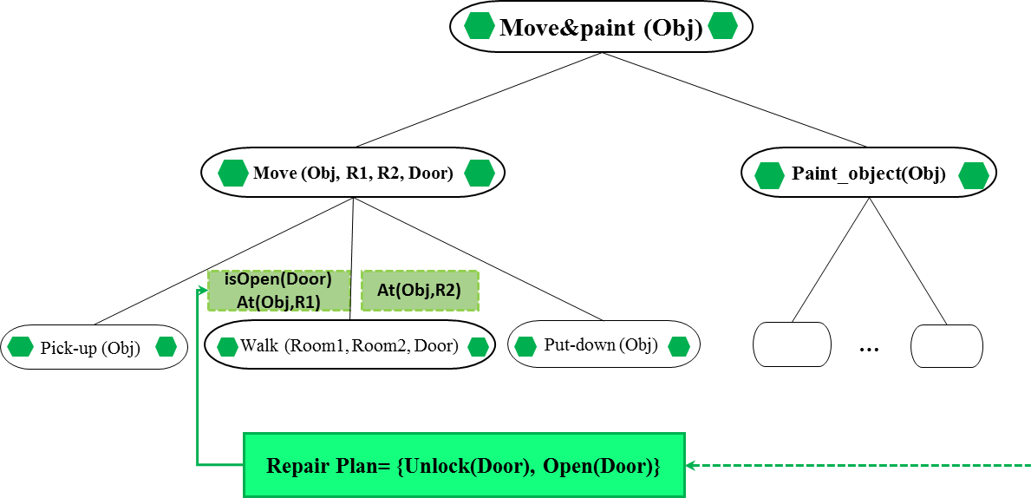
Discolog
STRIPS/Prolog
TUprolog
Disco / Java+JavaScript
Declarative DK
Reactive DK
preconditions(unlock,[islocked]).
achieves(unlock,notislocked).
deletes(unlock,islocked).
preconditions(open,[notislocked]).
achieves(open,isopen).
Move(Obj,R1,R2,Door)
Unlock(D)
Open(D)
… etc
Get STRIPS Output procedure
Input:holds(islocked,init).
test(Plan):-solve([isopen],7,Plan)
Decompose(Plan)
STRIPS
engine
ConvertToDisco(Unlock, open)
Plan:do(unlock,do(open)).

Slide 4
Discolog
STRIPS/Prolog
TUprolog
Disco/Java+JavaScript
Declarative DC
Reactive DC
Paintobject(obj)
Walk(r1,r2,d)
unlock(d)
open(d)
Paint_object(Obj)
Walk(R1,R2,D)
Unlock(D)
Open(D)
Input
Goal
STRIPS
engine
Output

