Slide 1




Guess my power: A computational model to simulate a partner’s behavior in the context of collaborative negotiation
Lydia OULD OUALI (LIMSI-CNRS / UPSUD)
Nicolas Sabouret (LIMSI-CNRS / UPSUD)
Charles Rich (CS / WPI)

Slide 2



Context: COLLABORATIVE negotiation
COLLABORATION
Cooperation to achieve common goals
COLLABORATIVE NEGOTIATION
INTERPERSONAL RELATIONSHIP
Facilitate mutual understanding
Impact of interpersonal relation on the negotiation
Agreement making
Generation of new ideas
Focus on DOMINANCE

Slide 3

INTERPERSONAL RELATION OF DOMINANCE
Ability to influence the behavior of another person (Burgoon et al 98)
Control attempts by one individual are accepted by the interactional partner (Burgoon & Dunbar 98)
BEHAVIOURS OF DOMINANCE IN NEGOTIATION
SUBMISSIVE
1
Level of demand and concession (Dedreu et al 95)
DOMINANT
Dominance is associated to a high level of demand and a low level of concessions
2
Self vs other (Fiske 93, DeDreu et al 95)
Dominant individuals are self-centered and only interested in satisfying their own preferences.
3
Lead of the negotiation (Dedreu,VanKleef, 04)
Dominant individuals tends to make the first move
Control of the flow of the negotiation

Slide 4
Model of collaborative negotiation: decision based on behavior of dominance

Slide 5
OVERVIEW OF THE MODEL OF NEGOTIATION
1
Mental model
Mental model
3
Pow
Pow
Preferences
Pow
Preferences
2
Model of the other
Decisional model
Decisional model
Mental model
Adaptation
Pow
Preferences
Decisional model
Utterance_{Self}
Utterance_{other}

Slide 6
Mental model
Preferences
Power
Initial value of dominance : POW ∊ [O,1]
G
1
Satisfiability
F
0.83
S: Set of satisfiable values
Express the liking of the agent (StatePreference)
D
E
0.66
0.66
B
0.33
C
A
0.5
0.16
Score of satisfaction (sat(v)):
Inverse of the number of ancestors

Slide 7
Mental model
Preferences
Power
Pow = 0.6
Initial value of dominance : POW ∊ [O,1]
G
1
Satisfiability
F
0.83
S: Set of satisfiable values
Express the liking of the agent (StatePreference)
D
E
0.66
0.66
B
0.33
C
A
0.5
0.16
Score of satisfaction (sat(v)):
Inverse of the number of ancestors

Slide 8
Mental model
Preferences
Pow = 0.7
Power
Initial value of dominance : POW ∊ [O,1]
G
1
Values the agent like
Satisfiability
F
0.83
S: Set of satisfiable values
Express the liking of the agent (StatePreference)
D
E
0.66
0.66
B
Values the agent doesn’t like
0.33
C
A
Example
0.5
0.16
StatePreference(G): I like G
StatePreference(B): I don’t like B
Score of satisfaction (sat(v)):
Inverse of the number of ancestors

Slide 9
Mental model
Preferences
Pow = 0.7
Power
Initial value of dominance : POW ∊ [O,1]
G
1
2. Acceptability
F
0.83
S: Set of satisfiable values
Ac : Set of acceptable values
M = S + Ac
D
E
0.66
0.66
B
Current context of negotiation
R: Set of rejected values
A: Set of accepted values
0.33
Self(pow,t)
C
A
pow_{a}
τ
0.5
0.16
pow_{b}
(Self(pow, t)):
Level of concessions to be expressed
t

Slide 10
Mental model
Preferences
Pow = 0.7
Power
Self(pow, 0) = 0.7
Initial value of dominance : POW ∊ [O,1]
G
1
Acceptable values
2. Acceptability
F
Self(pow, t_{i}) = 0.6
0.83
S: Set of satisfiable values
Ac : Set of acceptable values
M = S + Ac
D
E
0.66
0.66
B
Current context of negotiation
R: Set of rejected values
A: Set of accepted values
0.33
C
A
0.5
0.16
Example
(Self(pow, t)):
Level of concessions to be expressed
Accept(F) : Okay, let’s choose F
Reject(B) :Let’s rather choose something else
Notes:
VALIDATION ETUDE AGENT AGENT ET AGENT HUMAIN

Slide 11
OVERVIEW OF THE MODEL OF NEGOTIATION
1
Mental model
Mental model
3
Pow
Pow
Preferences
Pow
Preferences
2
Model of the other
Decisional model
Decisional model
Mental model
Adaptation
Pow
Preferences
Decisional model
Utterance_{Self}
Utterance_{other}

Slide 12

Model of the other: Naïve approach
X
Pow₁
Utterance₁
SELF
DECISIONAL MODEL
. . .
. . .
. . .
Possible
pow_{i}
X
Pow_{N}
Utterance_{N}
Revision
Utterance_{other}
SIMULATION THEORY
Notes:
Concretly, reasoning on the other mental state has the aim to pre

Slide 13
Model of the other: Naïve approach
Pow₁
Utterance₁
SELF
DECISIONAL MODEL
. . .
. . .
. . .
Possible
pow_{i}
Pow_{N}
Utterance_{N}
Revision
COMBINATORY EXPLOSION
Utterance_{other}
SIMULATION THEORY
Notes:
Concretly, reasoning on the other mental state has the aim to pre

Slide 14
Model of the other: reasoning with uncertainty
1
Total order on preferences
2
For each Pow_{i}
3
Extract hypotheses
Set of possible sat values
S = {F,D,E}
S= {D,B,C}
S ={ A,B,C}
. . .
F
Compute nb Sat values
Pow = 0.6
|S| = 3
D
E
B
C
A
5
Revision
4
Adapt decisional model
Highest number of accurate hypotheses
SIMULATION THEORY
Satisfiability
Acceptability
Utterance type

Slide 15
Evaluation: reasoning with uncertainty
1
Goal
Evaluate the accuracy of predictions
Time execution for each prediction
Utt2
Utt1
Submissive
2
Conditions:
Dominant
Initial value of power
Initial preferences
Dominant | 0.3 0.4 0.5
Submissive | 0.6 0.7 0.8 0.9
Domain size | Nb possible hypotheses
Small | 1296
Medium | 4.14 x 10⁵
Large | 2.6 x 10⁹
Total dialogues : 1080

Slide 16
Results: accuracy of predictions
True
Pow
Pow_{other}
1
Accuracy
Root mean square error | 0.12
Residual variation (rv) | 0.015
Comparison
2
Number of dialogue turns to reach a correct prediction
3
Frequency of false prediction
30 false predictions of 2160 predictions
2.6% of false
Correct prediction | Rv< 0.02 | Best prediction
2.53 | 3.25 | 3.79

Slide 17
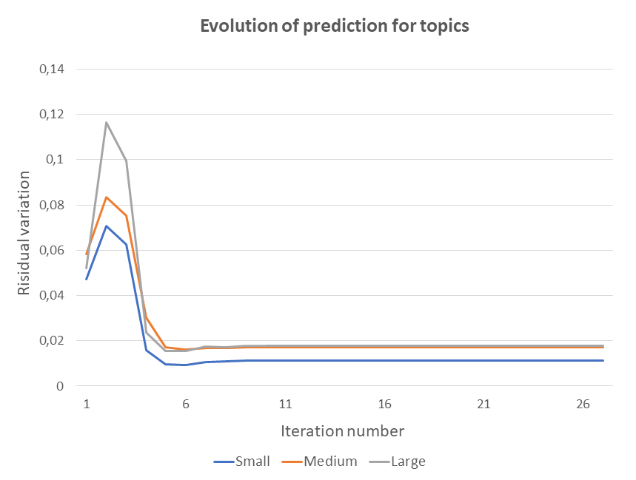
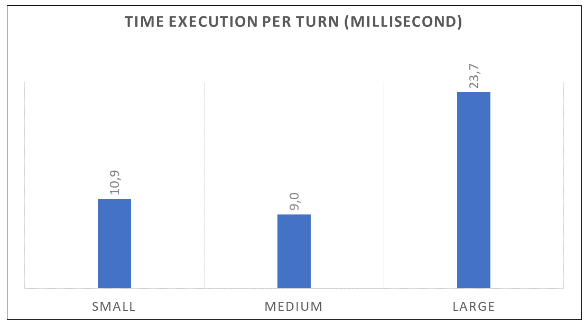
Results: time execution
1
Evolution of prediction after each turn
2
Time of prediction and revision of hypotheses

Slide 18
Conclusion and future works:
1
Simulation of other
Simulation theory is able to reason about other with partial knowledge
Validation of the model in the context of agent/ agent interaction
2
Interpersonal relation of dominance
Simulate an interpersonal relation of dominance.
Predict and adapt a complementary behavior
Evaluation of the model with a human user

