Slide 1
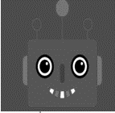

Model of other (ToM)
Mental model
Dialogue

