Slide 1
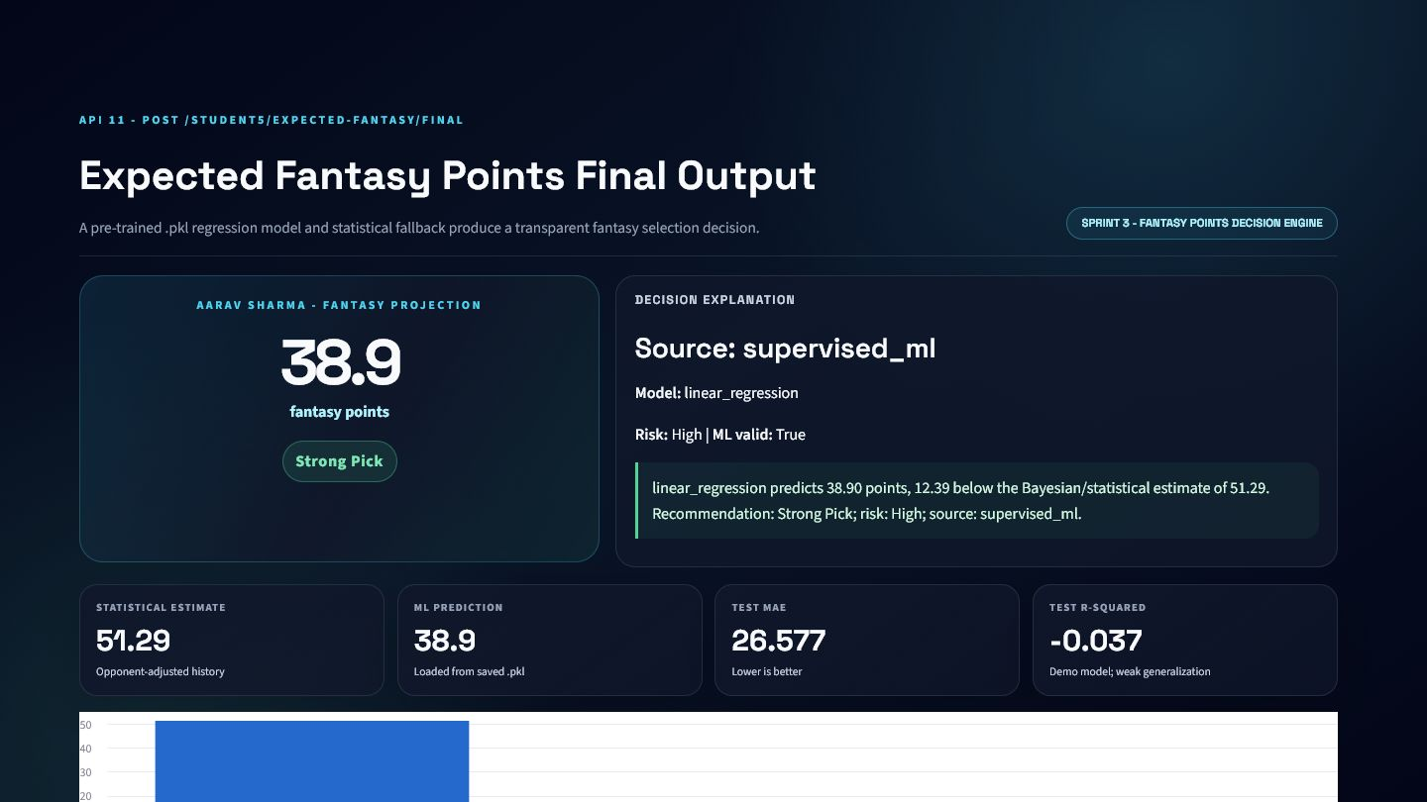
KHEL AI
Cricket Intelligence
API Platform
11 APIs. 3 sprints. One explainable decision pipeline.
Mentor review edition • Student 5 • Om Batavia
11
3
11
1
APIS
SPRINTS
DASHBOARDS
PUBLIC MODEL API

Slide 2
CONTENTS
Presentation map
A technical walkthrough that moves from live match state to fantasy selection.
01
Live Match Intelligence
5 APIs
SLIDES 6-32
02
Player Performance Analytics
4 APIs
SLIDES 33-54
03
Fantasy Decision Engine
2 APIs
SLIDES 55-67
04
One Explainable Pipeline
Conclusion
SLIDE 68

Slide 3
PROBLEM CONTEXT
Cricket data is rich, but not immediately useful
Khel AI needs a layer that converts raw events into consistent, product-ready intelligence.
01
Fragmented
02
Too granular
Match, innings, player and delivery data live at different grains.
Ball events need aggregation before a user can understand the match.
03
Inconsistent
04
Hard to trust
Different clients can calculate overs, rates and labels differently.
Predictions need provenance, metrics, validation and fallback behavior.

Slide 4
SYSTEM ARCHITECTURE
One platform, three intelligence layers
Specialised APIs remain independently testable, reusable and explainable.
SPRINT 1
SPRINT 2
SPRINT 3
What is happening?
How is the player trending?
What should Khel AI recommend?
Delivery events → match state
History → context and confidence
Expected value → selection
VALIDATE → CALCULATE → EXPLAIN → INTEGRATE

Slide 5
EVIDENCE AND PROVENANCE
What is real in this presentation?
Every visible number is tied to the implementation, while dataset limits remain explicit.
1
DATA
2
IMPLEMENTATION
3
EVIDENCE
HimanshuKhale/datasets_cricket
4 teams • 12 synthetic T20 matches
24 innings • 2,846 ball events
Real schemas.py and services.py
Actual response objects
No random presentation values
11 dashboard screenshots
API 11 deployed on Render
GitHub source and PPTX assets
Important: this is a synthetic/faux demonstration dataset, not real-world production cricket data.

Slide 6
SPRINT 1
Live Match Intelligence
05
Five APIs transform delivery events into score, chase, pressure and outlook intelligence.
APIs

Slide 7
SPRINT 1
API 01
1
Live Match Scoreboard API
GET /STUDENT5/LIVE-SCOREBOARD/{MATCH_ID}
LIVE MATCH
PURPOSE
Aggregate a live match snapshot into one frontend-ready scoreboard response.
WHERE KHEL AI USES IT
Raw match, innings, player, and delivery rows are fragmented; a frontend should not rebuild cricket state independently.
Live match dashboard • Broadcast overlay • AI commentary context

Slide 8
PROCESSING LOGIC
Live Match Scoreboard API: how it works
A visible path from validated cricket input to explainable output.
1
2
3
4
5
Receive match_id
Load saved match and innings
Aggregate legal balls, runs, wickets
Rank top performers
Return recent-ball context
MAIN FORMULAS AND RULES
ENGINEERING APPROACH
total_runs = sum(runs_off_bat + extras)
Pydantic validates the contract
overs = legal_balls // 6 + remainder notation
Service logic handles cricket rules
Response includes interpretation
run_rate = total_runs / legal_balls x 6

Slide 9
INPUT AND OUTPUT SCHEMA
Live Match Scoreboard API: API contract
The frontend and model service agree on one explicit, validated contract.
REQUEST
RESPONSE
Field | Type | Rule | Meaning
match_id | path parameter | Required | Unique match identifier
Field | Type | Rule | Meaning
match | str | Required | match
venue | str | Required | venue
innings_number | int | Required | innings number
batting_team | str | Required | batting team
bowling_team | str | Required | bowling team
score | str | Required | score
overs | str | Required | overs
Field
Type
Rule
Meaning
Field
Type
Rule
Meaning
Nested records are summarized for presentation. The complete machine-readable contract remains available through FastAPI OpenAPI.

Slide 10
VALIDATION AND EXAMPLE
Live Match Scoreboard API: request to response
The example is generated from the same local service logic used by the dashboard.
SAMPLE REQUEST
SAMPLE RESPONSE
GUARDRAILS
{
"match_id": "1"
}
{
"match": "Match 1: INDI vs BHOP",
"venue": "Holkar Cricket Stadium",
"innings_number": 2,
"batting_team": "Bhopal Blazers",
"bowling_team": "Indore Invincibles",
"score": "95/3"
}
match_id is required
Unknown match returns HTTP 404
Missing database returns HTTP 500
Wickets are capped at 10
Clear 4xx/5xx errors, never silent failure

Slide 11
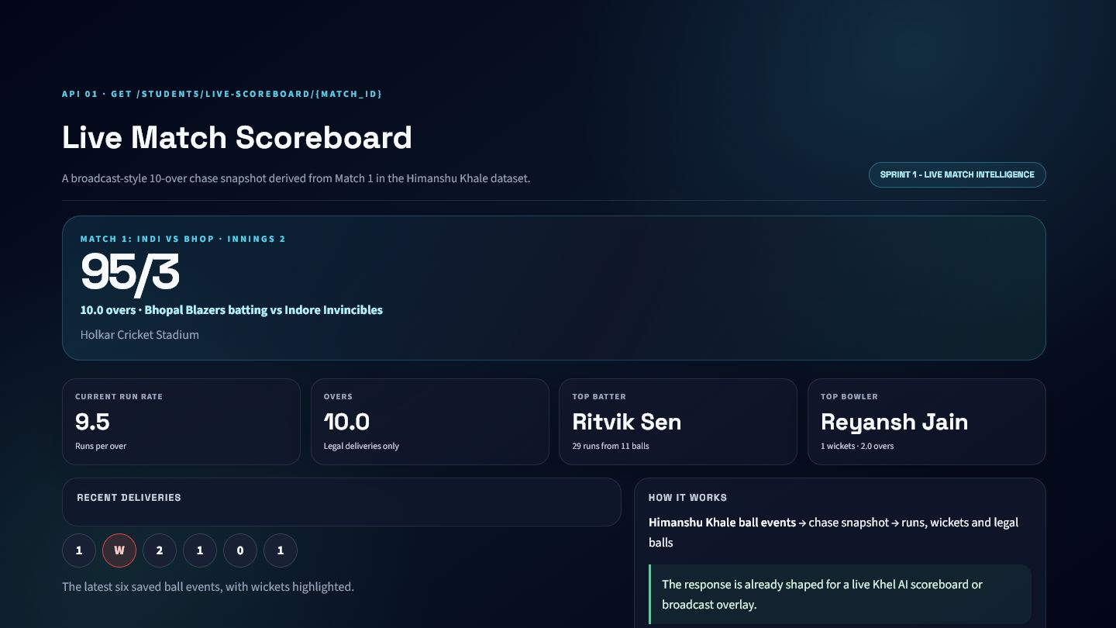
DASHBOARD INTEGRATION
Live Match Scoreboard API: visual evidence
Presentation-ready output produced from the real API service response.
PRODUCT PLACEMENT
Live match dashboard
Broadcast overlay
AI commentary context
HONEST LIMITATIONS
Snapshot uses stored data rather than a streaming feed
Top-performer ranking is descriptive, not predictive
95/3
10.0
9.5
Ritvik Sen
SCORE
OVERS
RUN RATE
TOP BATTER

Slide 12
SPRINT 1
API 02
2
Innings Summary API
GET /STUDENT5/INNINGS-SUMMARY/{INNINGS_ID}
LIVE MATCH
PURPOSE
Transform one completed innings into scorecard, efficiency, and top-performer summaries.
WHERE KHEL AI USES IT
Ball events are too granular for post-innings analysis and must be reconciled into batter and bowler records.
Scorecard tab • Post-innings report • Player performance cards

Slide 13
PROCESSING LOGIC
Innings Summary API: how it works
A visible path from validated cricket input to explainable output.
1
2
3
4
5
Receive innings_id
Load saved deliveries
Aggregate team total
Build batter and bowler tables
Select top performers
MAIN FORMULAS AND RULES
ENGINEERING APPROACH
strike_rate = runs / balls_faced x 100
Pydantic validates the contract
economy = runs_conceded / legal_balls x 6
Service logic handles cricket rules
Response includes interpretation
innings_run_rate = total_runs / legal_balls x 6

Slide 14
INPUT AND OUTPUT SCHEMA
Innings Summary API: API contract
The frontend and model service agree on one explicit, validated contract.
REQUEST
RESPONSE
Field | Type | Rule | Meaning
innings_id | path parameter | Required | Unique innings identifier
Field | Type | Rule | Meaning
innings_id | int | Required | Unique innings identifier
total_runs | int | Required | total runs
wickets | int | Required | wickets
legal_balls | int | Required | legal balls
overs | str | Required | overs
run_rate | float | Required | run rate
batters | list | Required | batters
Field
Type
Rule
Meaning
Field
Type
Rule
Meaning
Nested records are summarized for presentation. The complete machine-readable contract remains available through FastAPI OpenAPI.

Slide 15
VALIDATION AND EXAMPLE
Innings Summary API: request to response
The example is generated from the same local service logic used by the dashboard.
SAMPLE REQUEST
SAMPLE RESPONSE
GUARDRAILS
{
"innings_id": "1"
}
{
"innings_id": 1,
"total_runs": 206,
"wickets": 3,
"legal_balls": 120,
"overs": "20.0",
"run_rate": 10.3
}
innings_id must be positive
Unknown innings returns HTTP 404
Safe division handles zero balls
Only legal balls count toward overs
Clear 4xx/5xx errors, never silent failure

Slide 16
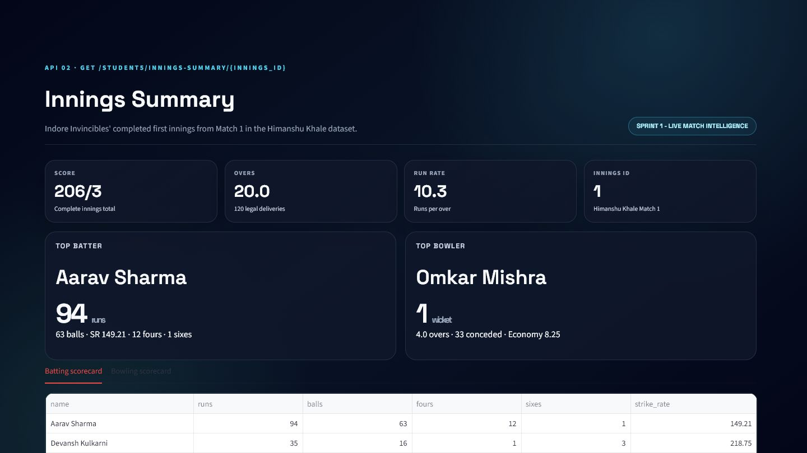
DASHBOARD INTEGRATION
Innings Summary API: visual evidence
Presentation-ready output produced from the real API service response.
PRODUCT PLACEMENT
Scorecard tab
Post-innings report
Player performance cards
HONEST LIMITATIONS
Depends on complete saved ball-event history
Fielding analysis is outside this endpoint
206/3
20.0
10.3
Aarav Sharma
SCORE
OVERS
RUN RATE
TOP BATTER

Slide 17
SPRINT 1
API 03
3
Current Match State API
POST /STUDENT5/MATCH-STATE
LIVE MATCH
PURPOSE
Explain the current chase using target, score, time, wickets, and scoring pressure.
WHERE KHEL AI USES IT
A score alone does not explain whether the chase is ahead, behind, or under resource pressure.
Chase progress card • Live commentary • Match-state agent tool

Slide 18
PROCESSING LOGIC
Current Match State API: how it works
A visible path from validated cricket input to explainable output.
1
2
3
4
5
Validate match and innings context
Aggregate current score
Count legal balls and wickets
Calculate chase resources
Create cricket-language status
MAIN FORMULAS AND RULES
ENGINEERING APPROACH
runs_needed = max(target - score, 0)
Pydantic validates the contract
balls_remaining = total_balls - legal_balls
Service logic handles cricket rules
wickets_remaining = 10 - wickets
Response includes interpretation
CRR and RRR use six-ball rates

Slide 19
INPUT AND OUTPUT SCHEMA
Current Match State API: API contract
The frontend and model service agree on one explicit, validated contract.
REQUEST
RESPONSE
Field | Type | Rule | Meaning
match | khel_showcase_match_state_ | Optional | match
innings | khel_showcase_match_state_ | Optional | innings
balls | list[khel_showcase_match_s | Optional | Ordered delivery-event list
Field | Type | Rule | Meaning
match | str | Required | match
innings_number | int | None | Optional | innings number
score | str | Required | score
overs | str | Required | overs
wickets | int | Required | wickets
batting_team | str | None | Optional | batting team
bowling_team | str | None | Optional | bowling team
Field
Type
Rule
Meaning
Field
Type
Rule
Meaning
Nested records are summarized for presentation. The complete machine-readable contract remains available through FastAPI OpenAPI.

Slide 20
VALIDATION AND EXAMPLE
Current Match State API: request to response
The example is generated from the same local service logic used by the dashboard.
SAMPLE REQUEST
SAMPLE RESPONSE
GUARDRAILS
{
"match": {
"match_id": "1",
"title": "Match 1: INDI vs BHOP",
"total_overs": 20,
"target": 207
},
"innings": {
"innings_number": 2,
"batting_team": "Bhopal Blazers",
"bowling_team": "Indore Invincibles",
"total_overs_limit": 20
},
"balls": [
{
"over_number": {
"more": "…"
},
"ball_number": {
"more": "…"
},
"runs_off_bat": {
"more": "…"
},
"extras": {
"more": "…"
}
},
"…"
]
}
{
"match": "Match 1: INDI vs BHOP",
"innings_number": 2,
"score": "95/3",
"overs": "10.0",
"wickets": 3,
"batting_team": "Bhopal Blazers"
}
Non-negative runs and extras
Positive target and overs limit
Ball number >= 1
Empty ball list returns a valid initial state
Clear 4xx/5xx errors, never silent failure

Slide 21
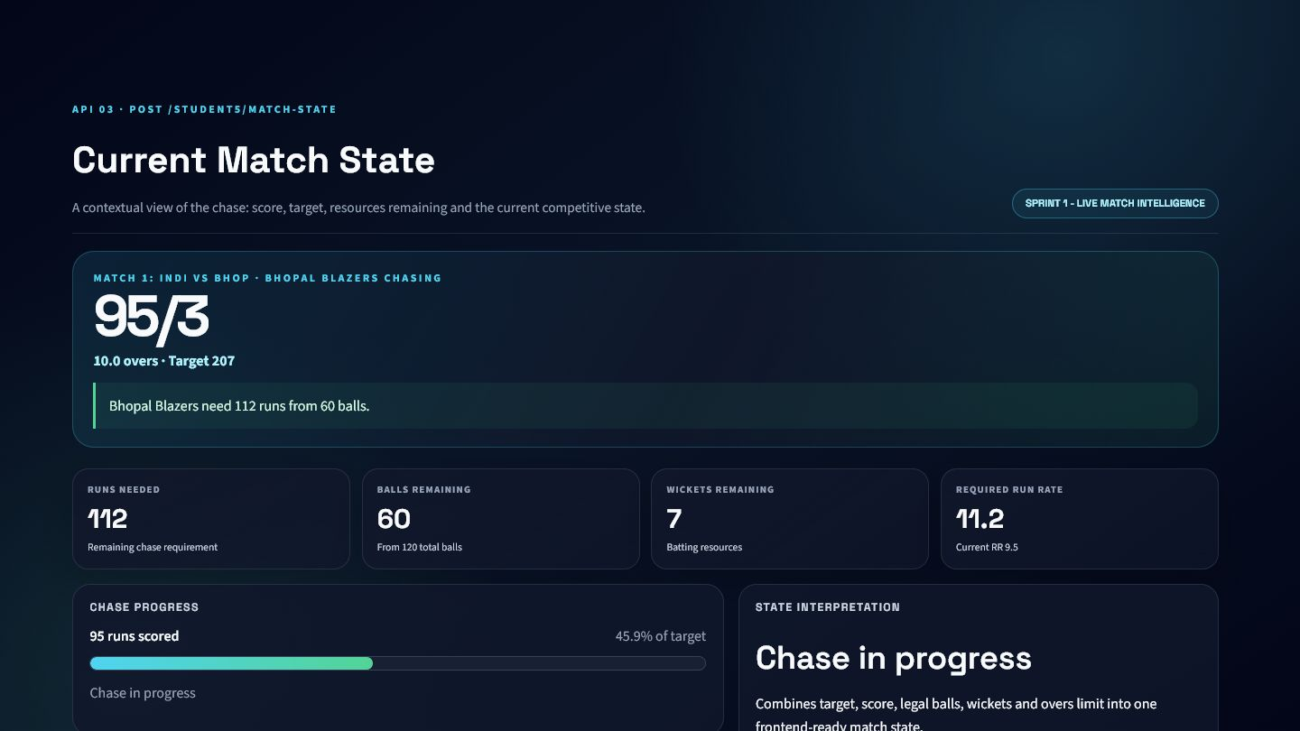
DASHBOARD INTEGRATION
Current Match State API: visual evidence
Presentation-ready output produced from the real API service response.
PRODUCT PLACEMENT
Chase progress card
Live commentary
Match-state agent tool
HONEST LIMITATIONS
No weather or DLS adjustment
Assumes standard ten-wicket innings
95/3
112
60
11.2
SCORE
RUNS NEEDED
BALLS LEFT
RRR

Slide 22
SPRINT 1
API 04
4
Required Run Rate API
POST /STUDENT5/REQUIRED-RUN-RATE
LIVE MATCH
PURPOSE
Return the exact scoring pace required to complete a chase.
WHERE KHEL AI USES IT
Clients often calculate RRR inconsistently, especially when wides and no-balls are present.
Live pressure panel • Commentary sentence • Mobile scorecard

Slide 23
PROCESSING LOGIC
Required Run Rate API: how it works
A visible path from validated cricket input to explainable output.
1
2
3
4
5
Read target and delivery history
Aggregate score
Count legal balls only
Calculate remaining requirement
Return substituted equation
MAIN FORMULAS AND RULES
ENGINEERING APPROACH
RRR = runs_needed / balls_remaining x 6
Pydantic validates the contract
runs_needed = max(target - current_score, 0)
Service logic handles cricket rules
Response includes interpretation

Slide 24
INPUT AND OUTPUT SCHEMA
Required Run Rate API: API contract
The frontend and model service agree on one explicit, validated contract.
REQUEST
RESPONSE
Field | Type | Rule | Meaning
match | khel_showcase_required_rat | Optional | match
innings | khel_showcase_required_rat | Optional | innings
balls | list[khel_showcase_require | Optional | Ordered delivery-event list
Field | Type | Rule | Meaning
target | int | None | Optional | target
current_score | str | Required | current score
runs_needed | int | Required | runs needed
balls_remaining | int | Required | balls remaining
required_run_rate | float | Required | required run rate
equation | str | Required | equation
message | str | Required | message
Field
Type
Rule
Meaning
Field
Type
Rule
Meaning
Nested records are summarized for presentation. The complete machine-readable contract remains available through FastAPI OpenAPI.

Slide 25
VALIDATION AND EXAMPLE
Required Run Rate API: request to response
The example is generated from the same local service logic used by the dashboard.
SAMPLE REQUEST
SAMPLE RESPONSE
GUARDRAILS
{
"match": {
"match_id": "1",
"title": "Match 1: INDI vs BHOP",
"total_overs": 20,
"target": 207
},
"innings": {
"innings_number": 2,
"batting_team": "Bhopal Blazers",
"bowling_team": "Indore Invincibles",
"total_overs_limit": 20
},
"balls": [
{
"over_number": {
"more": "…"
},
"ball_number": {
"more": "…"
},
"runs_off_bat": {
"more": "…"
},
"extras": {
"more": "…"
}
},
"…"
]
}
{
"target": 207,
"current_score": "95/3",
"runs_needed": 112,
"balls_remaining": 60,
"required_run_rate": 11.2,
"equation": "Required run rate = (112 runs needed / 60 balls remaining) x 6 = 11.2"
}
Target must be positive when present
Overs limit must be positive
Illegal deliveries do not consume a ball
No target returns an explicit non-chase response
Clear 4xx/5xx errors, never silent failure

Slide 26
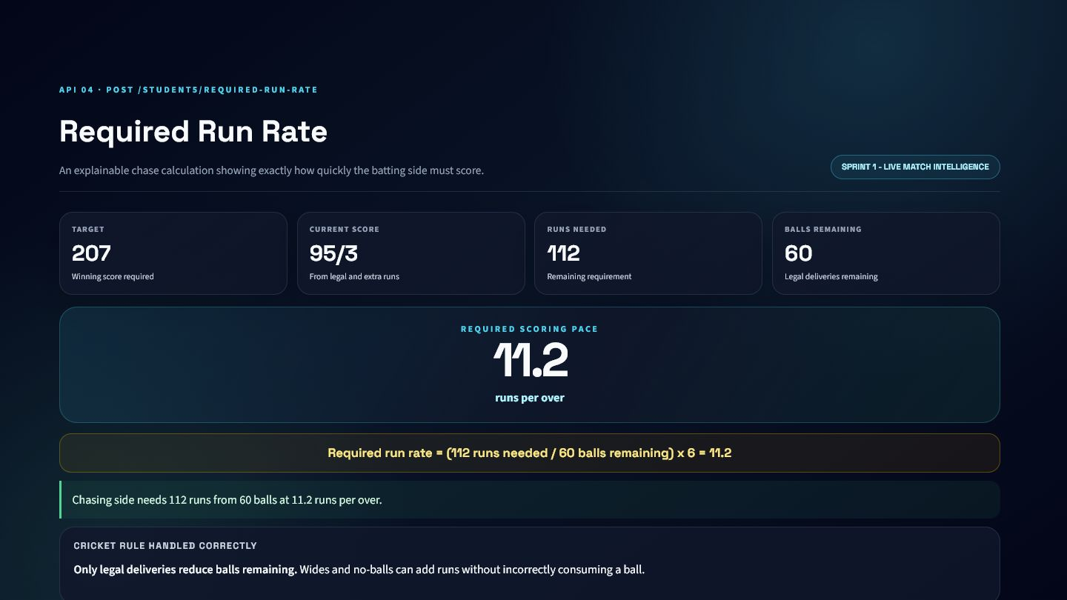
DASHBOARD INTEGRATION
Required Run Rate API: visual evidence
Presentation-ready output produced from the real API service response.
PRODUCT PLACEMENT
Live pressure panel
Commentary sentence
Mobile scorecard
HONEST LIMITATIONS
No DLS/par-score support
Does not itself classify win chance
207
95/3
112
11.2
TARGET
SCORE
RUNS NEEDED
RRR

Slide 27
SPRINT 1
API 05
5
Win Probability Label API
POST /STUDENT5/MATCH-OUTLOOK
LIVE MATCH
PURPOSE
Classify the chase as High, Medium, or Low Chance using transparent cricket rules.
WHERE KHEL AI USES IT
Users need an interpretable match outlook, but an uncalibrated numeric probability would be misleading.
Live outlook badge • Explainable AI commentary • Match dashboard alert

Slide 28
PROCESSING LOGIC
Win Probability Label API: how it works
A visible path from validated cricket input to explainable output.
1
2
3
4
5
Calculate match state
Compare RRR with CRR
Inspect wickets and balls
Apply declared thresholds
Return label and reason
MAIN FORMULAS AND RULES
ENGINEERING APPROACH
High: RRR <= CRR + 1.5 and wickets >= 4
Pydantic validates the contract
Low: RRR > CRR + 4 or critical wickets/resources
Service logic handles cricket rules
Response includes interpretation
Otherwise: Medium

Slide 29
INPUT AND OUTPUT SCHEMA
Win Probability Label API: API contract
The frontend and model service agree on one explicit, validated contract.
REQUEST
RESPONSE
Field | Type | Rule | Meaning
match | khel_showcase_outlook_sche | Optional | match
innings | khel_showcase_outlook_sche | Optional | innings
balls | list[khel_showcase_outlook | Optional | Ordered delivery-event list
Field | Type | Rule | Meaning
runs_needed | int | Required | runs needed
balls_remaining | int | Required | balls remaining
required_run_rate | float | Required | required run rate
prediction | str | Required | prediction
wickets_in_hand | int | Required | wickets in hand
overs_left | str | Required | overs left
current_run_rate | float | Required | current run rate
Field
Type
Rule
Meaning
Field
Type
Rule
Meaning
Nested records are summarized for presentation. The complete machine-readable contract remains available through FastAPI OpenAPI.

Slide 30
VALIDATION AND EXAMPLE
Win Probability Label API: request to response
The example is generated from the same local service logic used by the dashboard.
SAMPLE REQUEST
SAMPLE RESPONSE
GUARDRAILS
{
"match": {
"match_id": "1",
"title": "Match 1: INDI vs BHOP",
"total_overs": 20,
"target": 207
},
"innings": {
"innings_number": 2,
"batting_team": "Bhopal Blazers",
"bowling_team": "Indore Invincibles",
"total_overs_limit": 20
},
"balls": [
{
"over_number": {
"more": "…"
},
"ball_number": {
"more": "…"
},
"runs_off_bat": {
"more": "…"
},
"extras": {
"more": "…"
}
},
"…"
]
}
{
"runs_needed": 112,
"balls_remaining": 60,
"required_run_rate": 11.2,
"prediction": "Medium Chance",
"wickets_in_hand": 7,
"overs_left": "10.0"
}
Uses validated match-state payload
Target reached returns High Chance
No target returns context-safe output
Reason and heuristic accompany every label
Clear 4xx/5xx errors, never silent failure

Slide 31
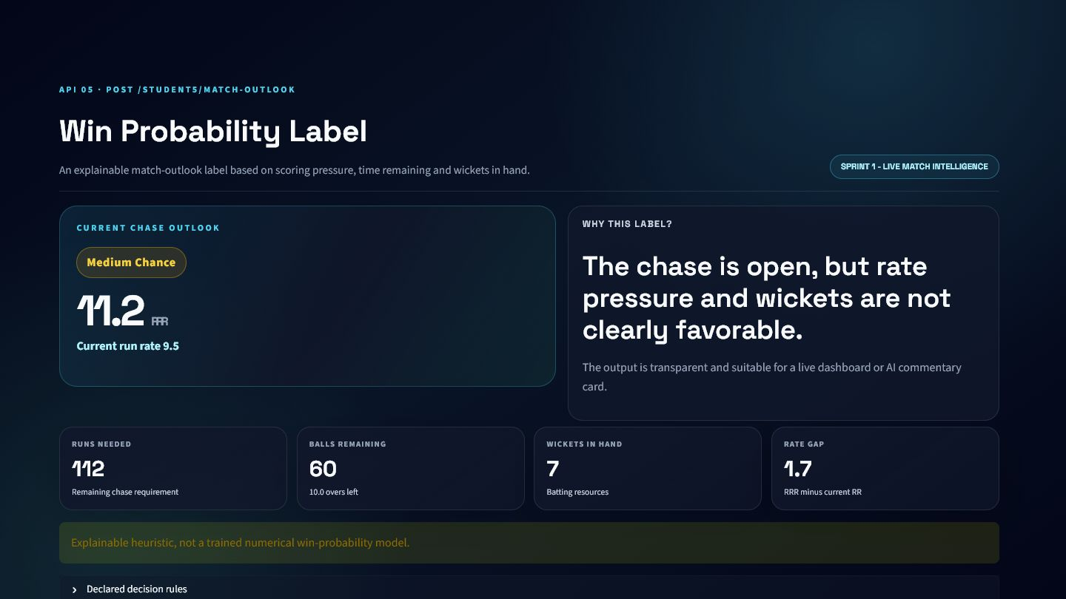
DASHBOARD INTEGRATION
Win Probability Label API: visual evidence
Presentation-ready output produced from the real API service response.
PRODUCT PLACEMENT
Live outlook badge
Explainable AI commentary
Match dashboard alert
HONEST LIMITATIONS
Heuristic, not trained probability
Thresholds need calibration on real match data
Medium Chance
11.2
9.5
7
OUTLOOK
RRR
CRR
WICKETS

Slide 32
INTEGRATION SUMMARY
Sprint 1: the complete story
From raw deliveries to live match understanding
API MODULES
WHAT THIS SPRINT ADDS TO KHEL AI
1
Live Match Scoreboard API
One legal-ball calculation standard across endpoints
2
Innings Summary API
Frontend-ready score, innings, chase and outlook responses
3
Current Match State API
Transparent formulas and rule-based explanations
4
Required Run Rate API
Reusable context for dashboards and AI agents
5
Win Probability Label API
5 INDEPENDENTLY REUSABLE ENDPOINTS

Slide 33
SPRINT 2
Player Performance Analytics
04
Four APIs explain form direction and opponent-specific matchup effects.
APIs

Slide 34
SPRINT 2
API 06
6
Form Trend Derived Variables API
POST /STUDENT5/FORM-TREND
PLAYER CONTEXT
PURPOSE
Measure player form direction, volatility, linear fit, and confidence from recent performances.
WHERE KHEL AI USES IT
A recent average cannot reveal whether performance is improving, declining, or unstable.
Player form chart • Trend filter • Upstream fantasy feature

Slide 35
PROCESSING LOGIC
Form Trend Derived Variables API: how it works
A visible path from validated cricket input to explainable output.
1
2
3
4
5
Sort performances chronologically
Derive or accept performance score
Fit OLS regression
Measure volatility and R-squared
Classify normalized slope
MAIN FORMULAS AND RULES
ENGINEERING APPROACH
performance = runs + 0.10 x strike_rate - dismissal_penalty
Pydantic validates the contract
slope = covariance(x,y) / variance(x)
Service logic handles cricket rules
normalized_trend = slope / average
Response includes interpretation
confidence = R2 x noise adjustment

Slide 36
INPUT AND OUTPUT SCHEMA
Form Trend Derived Variables API: API contract
The frontend and model service agree on one explicit, validated contract.
REQUEST
RESPONSE
Field | Type | Rule | Meaning
player | khel_showcase_form_variabl | Optional | Player identity and role
recent_performances | list[khel_showcase_form_va | Required | Chronological recent records
stable_slope_threshold | float | Optional | Trend-label threshold
Field | Type | Rule | Meaning
metric | str | Required | metric
label | str | Required | label
explanation | str | Required | explanation
recent_match_sequence | list[float] | Required | recent match sequence
regression_slope | float | Required | regression slope
recent_average | float | Required | recent average
volatility | float | Required | volatility
Field
Type
Rule
Meaning
Field
Type
Rule
Meaning
Nested records are summarized for presentation. The complete machine-readable contract remains available through FastAPI OpenAPI.

Slide 37
VALIDATION AND EXAMPLE
Form Trend Derived Variables API: request to response
The example is generated from the same local service logic used by the dashboard.
SAMPLE REQUEST
SAMPLE RESPONSE
GUARDRAILS
{
"player": {
"player_id": "1",
"player_name": "Aarav Sharma",
"role": "batter"
},
"recent_performances": [
{
"match_id": {
"more": "…"
},
"sequence_number": {
"more": "…"
},
"runs_scored": {
"more": "…"
},
"balls_faced": {
"more": "…"
}
},
"…"
],
"stable_slope_threshold": 0.15
}
{
"metric": "form_trend",
"label": "Declining",
"explanation": "Recent form is dropping because the regression slope is negative (-16.629) and meaningfully below the stable threshold.",
"recent_match_sequence": [
108,
"…"
],
"regression_slope": -16.629,
"recent_average": 50.67
}
At least three performances
Unique positive sequence numbers
Non-negative runs and scores
Positive stable-slope threshold
Clear 4xx/5xx errors, never silent failure

Slide 38
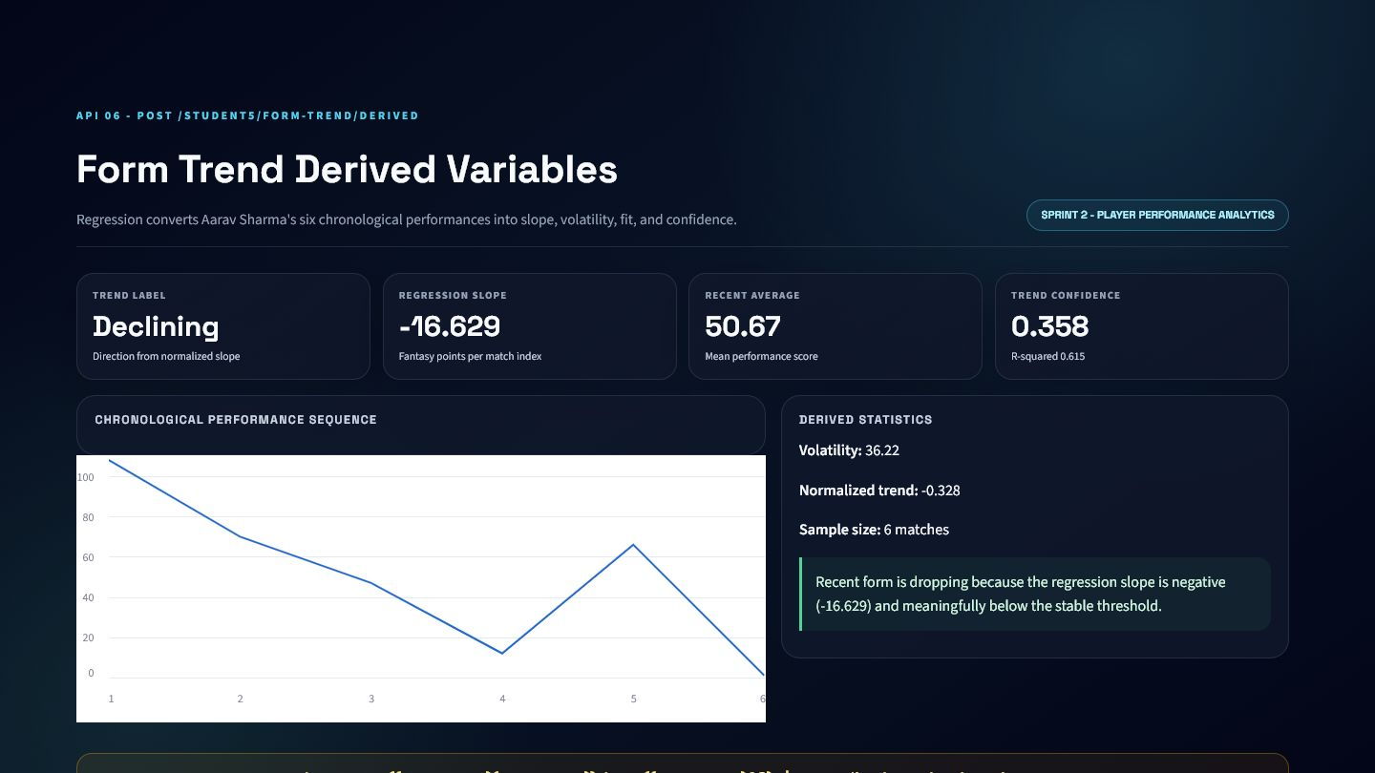
DASHBOARD INTEGRATION
Form Trend Derived Variables API: visual evidence
Presentation-ready output produced from the real API service response.
PRODUCT PLACEMENT
Player form chart
Trend filter
Upstream fantasy feature
HONEST LIMITATIONS
Linear trend misses nonlinear form
Six-match sample is small
Declining
-16.629
50.67
0.358
LABEL
SLOPE
AVERAGE
CONFIDENCE

Slide 39
SPRINT 2
API 07
7
Form Trend Final Output API
POST /STUDENT5/FORM-TREND-FINAL
PLAYER CONTEXT
PURPOSE
Convert form statistics into a 0-100 score, label, confidence, and explanation.
WHERE KHEL AI USES IT
Frontends should not independently interpret raw regression values or duplicate threshold logic.
Player dashboard badge • Selection ranking • AI-agent explanation

Slide 40
PROCESSING LOGIC
Form Trend Final Output API: how it works
A visible path from validated cricket input to explainable output.
1
2
3
4
5
Accept recent or player-match rows
Exclude target leakage
Calculate derived variables
Map normalized slope to score
Return label and explanation
MAIN FORMULAS AND RULES
ENGINEERING APPROACH
form_score = clamp(50 + normalized_trend x 100, 0, 100)
Pydantic validates the contract
Rising > +threshold; Declining < -threshold; else Stable
Service logic handles cricket rules
Response includes interpretation

Slide 41
INPUT AND OUTPUT SCHEMA
Form Trend Final Output API: API contract
The frontend and model service agree on one explicit, validated contract.
REQUEST
RESPONSE
Field | Type | Rule | Meaning
player | khel_showcase_form_final_s | Optional | Player identity and role
recent_performances | list[khel_showcase_form_fi | Optional | Chronological recent records
player_match_rows | list[khel_showcase_form_fi | Optional | Historical player-match rows
pressure_confidence_rows | list[khel_showcase_form_fi | Optional | pressure confidence rows
recent_match_limit | int | Optional | recent match limit
stable_slope_threshold | float | Optional | Trend-label threshold
Field | Type | Rule | Meaning
metric | str | Required | metric
label | str | Required | label
form_trend_score | float | Required | Upstream API 7 form score
trend_label | str | Required | trend label
trend_confidence | float | Required | trend confidence
derived_variables_used | khel_showcase_form_final_s | Required | derived variables used
explanation | str | Required | explanation
Field
Type
Rule
Meaning
Field
Type
Rule
Meaning
Nested records are summarized for presentation. The complete machine-readable contract remains available through FastAPI OpenAPI.

Slide 42
VALIDATION AND EXAMPLE
Form Trend Final Output API: request to response
The example is generated from the same local service logic used by the dashboard.
SAMPLE REQUEST
SAMPLE RESPONSE
GUARDRAILS
{
"player": {
"player_id": "1",
"player_name": "Aarav Sharma",
"role": "batter"
},
"player_match_rows": [
{
"match_id": {
"more": "…"
},
"player_id": {
"more": "…"
},
"player_name": {
"more": "…"
},
"team_id": {
"more": "…"
}
},
"…"
],
"recent_match_limit": 6,
"stable_slope_threshold": 0.15
}
{
"metric": "form_trend_final_output",
"label": "Declining",
"form_trend_score": 17.18,
"trend_label": "Declining",
"trend_confidence": 0.358,
"derived_variables_used": {
"recent_match_sequence": [
{
"more": "…"
},
"…"
],
"regression_slope": -16.629,
"recent_average": 50.67,
"volatility": 36.22
}
}
Recent performances or player rows required
Minimum three records
Player rows must match requested player
Target row must not enter history
Clear 4xx/5xx errors, never silent failure

Slide 43
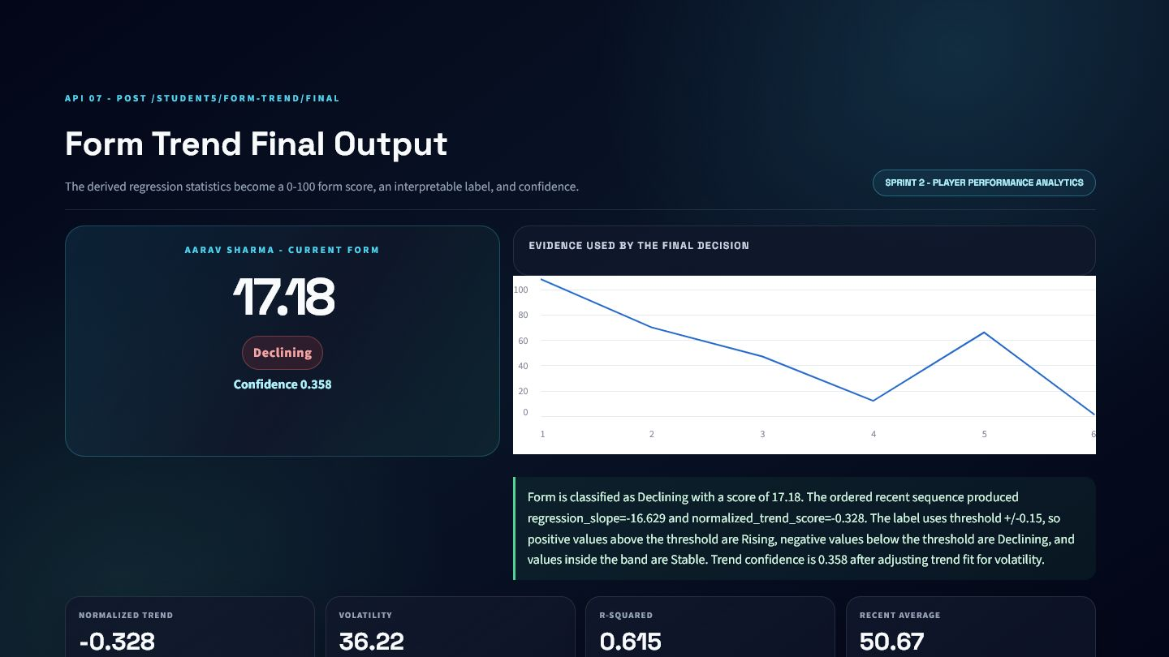
DASHBOARD INTEGRATION
Form Trend Final Output API: visual evidence
Presentation-ready output produced from the real API service response.
PRODUCT PLACEMENT
Player dashboard badge
Selection ranking
AI-agent explanation
HONEST LIMITATIONS
Score mapping is rule-based
Confidence can remain low despite a strong direction
17.18
Declining
0.358
50.67
SCORE
LABEL
CONFIDENCE
AVERAGE

Slide 44
SPRINT 2
API 08
8
Opponent Bayesian Derived Variables API
POST /STUDENT5/OPPONENT-BAYESIAN-DERIVED
PLAYER CONTEXT
PURPOSE
Update a player's overall performance expectation using opponent-specific evidence.
WHERE KHEL AI USES IT
Overall form can hide favorable or difficult matchup history, while one opponent result is too noisy to trust alone.
Opponent matchup card • Pre-match report • Fantasy context feature

Slide 45
PROCESSING LOGIC
Opponent Bayesian Derived Variables API: how it works
A visible path from validated cricket input to explainable output.
1
2
3
4
5
Calculate overall prior
Calculate opponent mean
Measure opponent volatility
Compute evidence strength
Produce weighted posterior
MAIN FORMULAS AND RULES
ENGINEERING APPROACH
consistency = 1 - volatility / (average + volatility)
Pydantic validates the contract
evidence_strength = capped_n x consistency
Service logic handles cricket rules
Response includes interpretation
posterior = weighted prior + opponent evidence

Slide 46
INPUT AND OUTPUT SCHEMA
Opponent Bayesian Derived Variables API: API contract
The frontend and model service agree on one explicit, validated contract.
REQUEST
RESPONSE
Field | Type | Rule | Meaning
player | khel_showcase_bayesian_var | Optional | Player identity and role
opponent_team_id | str | None | Optional | opponent team id
opponent_team_name | str | None | Optional | opponent team name
prior_performances | list[khel_showcase_bayesia | Required | Overall historical samples
opponent_performances | list[khel_showcase_bayesia | Required | Samples against opponent
prior_weight | float | Optional | Weight assigned to prior
max_evidence_weight | float | Optional | Opponent evidence cap
Field | Type | Rule | Meaning
metric | str | Required | metric
label | str | Required | label
explanation | str | Required | explanation
prior_performance_estimate | float | Required | prior performance estimate
opponent_specific_evidence | float | Required | opponent specific evidence
evidence_strength | float | Required | evidence strength
posterior_estimate | float | Required | posterior estimate
Field
Type
Rule
Meaning
Field
Type
Rule
Meaning
Nested records are summarized for presentation. The complete machine-readable contract remains available through FastAPI OpenAPI.

Slide 47
VALIDATION AND EXAMPLE
Opponent Bayesian Derived Variables API: request to response
The example is generated from the same local service logic used by the dashboard.
SAMPLE REQUEST
SAMPLE RESPONSE
GUARDRAILS
{
"player": {
"player_id": "1",
"player_name": "Aarav Sharma",
"role": "batter"
},
"opponent_team_id": "4",
"opponent_team_name": "Gwalior Guardians",
"prior_performances": [
{
"match_id": {
"more": "…"
},
"runs_scored": {
"more": "…"
},
"balls_faced": {
"more": "…"
},
"was_out": {
"more": "…"
}
},
"…"
],
"opponent_performances": [
{
"match_id": {
"more": "…"
},
"runs_scored": {
"more": "…"
},
"balls_faced": {
"more": "…"
},
"was_out"
"more": "…"
}
{
"metric": "opponent_bayesian_performance_derived_variables",
"label": "Neutral Opponent Adjustment",
"explanation": "The prior performance estimate is 50.67. Opponent-specific evidence is 24.0 with evidence strength 1.021. The Bayesian weighted update gives posterior_estimate=46.79 and confidence=0.356. The final label is Neutral Opponent Adjustment, so the result updates prior belief using opponent evidence instead of guessing from a single match.",
"prior_performance_estimate": 50.67,
"opponent_specific_evidence": 24,
"evidence_strength": 1.021
}
At least three prior samples
At least one opponent sample
Positive prior and evidence weights
Non-negative performance values
Clear 4xx/5xx errors, never silent failure

Slide 48
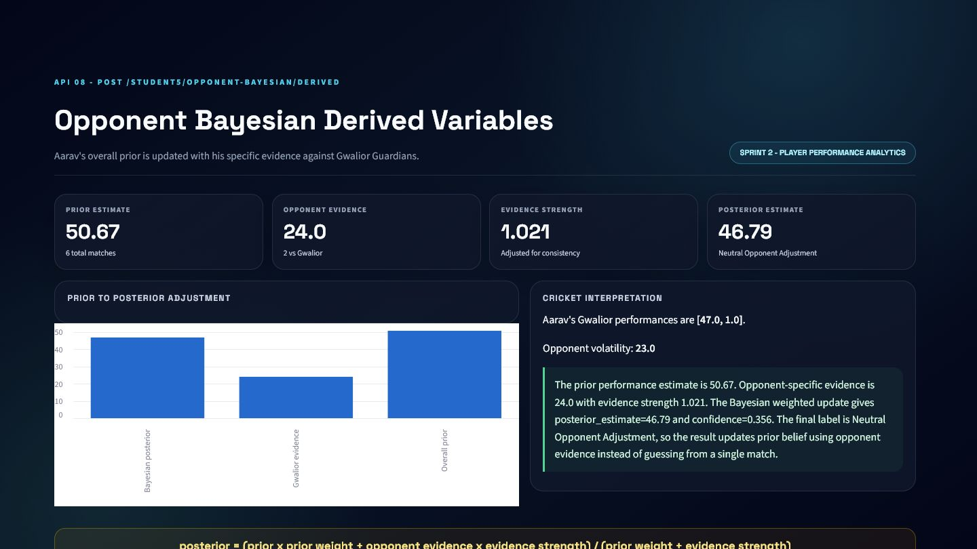
DASHBOARD INTEGRATION
Opponent Bayesian Derived Variables API: visual evidence
Presentation-ready output produced from the real API service response.
PRODUCT PLACEMENT
Opponent matchup card
Pre-match report
Fantasy context feature
HONEST LIMITATIONS
Two opponent samples are fragile
Posterior depends on chosen weights
50.67
24
1.021
46.79
PRIOR
EVIDENCE
STRENGTH
POSTERIOR

Slide 49
SPRINT 2
API 09
9
Opponent Bayesian Final Output API
POST /STUDENT5/OPPONENT-BAYESIAN-FINAL
PLAYER CONTEXT
PURPOSE
Return an opponent-adjusted performance score, matchup label, and confidence.
WHERE KHEL AI USES IT
A posterior number needs a decision label, change explanation, and evidence warning before product use.
Pre-match player panel • Opponent-adjusted fantasy input • AI matchup explanation

Slide 50
PROCESSING LOGIC
Opponent Bayesian Final Output API: how it works
A visible path from validated cricket input to explainable output.
1
2
3
4
5
Filter player history before target date
Separate opponent rows
Calculate smoothed posterior
Measure prior change
Classify matchup and confidence
MAIN FORMULAS AND RULES
ENGINEERING APPROACH
weight = opponent_n / (opponent_n + smoothing_k)
Pydantic validates the contract
posterior = (1-weight) x prior + weight x evidence
Service logic handles cricket rules
Response includes interpretation
change_percent = (posterior-prior) / prior x 100

Slide 51
INPUT AND OUTPUT SCHEMA
Opponent Bayesian Final Output API: API contract
The frontend and model service agree on one explicit, validated contract.
REQUEST
RESPONSE
Field | Type | Rule | Meaning
player | khel_showcase_bayesian_fin | Optional | Player identity and role
opponent_team_id | str | None | Optional | opponent team id
opponent_team_name | str | None | Optional | opponent team name
venue | str | None | Optional | venue
target_match_date | datetime.date | None | Optional | Anti-leakage cutoff date
prior_performances | list[khel_showcase_bayesia | Optional | Overall historical samples
opponent_performances | list[khel_showcase_bayesia | Optional | Samples against opponent
Field | Type | Rule | Meaning
metric | str | Required | metric
label | str | Required | label
opponent_adjusted_performance_score | float | Required | opponent adjusted performance score
posterior_expectation | float | Required | posterior expectation
confidence_label | str | Required | confidence label
derived_variables_used | khel_showcase_bayesian_fin | Required | derived variables used
explanation | str | Required | explanation
Field
Type
Rule
Meaning
Field
Type
Rule
Meaning
Nested records are summarized for presentation. The complete machine-readable contract remains available through FastAPI OpenAPI.

Slide 52
VALIDATION AND EXAMPLE
Opponent Bayesian Final Output API: request to response
The example is generated from the same local service logic used by the dashboard.
SAMPLE REQUEST
SAMPLE RESPONSE
GUARDRAILS
{
"player": {
"player_id": "1",
"player_name": "Aarav Sharma",
"role": "batter"
},
"opponent_team_id": "4",
"opponent_team_name": "Gwalior Guardians",
"target_match_date": "2026-07-15",
"player_match_rows": [
{
"match_id": {
"more": "…"
},
"player_id": {
"more": "…"
},
"player_name": {
"more": "…"
},
"team_id": {
"more": "…"
}
},
"…"
],
"smoothing_k": 5
}
{
"metric": "opponent_bayesian_performance_final_output",
"label": "Neutral Matchup",
"opponent_adjusted_performance_score": 46.79,
"posterior_expectation": 46.79,
"confidence_label": "Low Confidence",
"derived_variables_used": {
"prior_performance_estimate": 50.67,
"opponent_specific_evidence": 24,
"evidence_strength": 1.021,
"posterior_estimate": 46.79
}
}
History or explicit samples required
Target-date anti-leakage filter
Positive smoothing and weights
No matching history returns HTTP 422
Clear 4xx/5xx errors, never silent failure

Slide 53
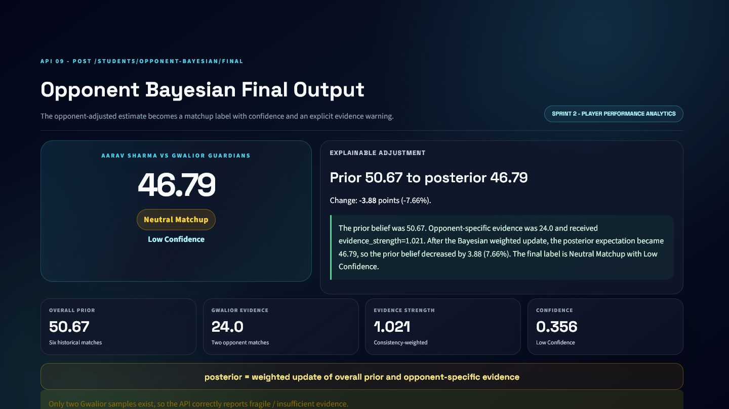
DASHBOARD INTEGRATION
Opponent Bayesian Final Output API: visual evidence
Presentation-ready output produced from the real API service response.
PRODUCT PLACEMENT
Pre-match player panel
Opponent-adjusted fantasy input
AI matchup explanation
HONEST LIMITATIONS
Sparse opponent history produces low confidence
Neutral label can mask a meaningful but uncertain shift
46.79
Neutral Matchup
Low Confidence
demo_only
ADJUSTED
LABEL
CONFIDENCE
MODE

Slide 54
INTEGRATION SUMMARY
Sprint 2: the complete story
From player history to explainable context
API MODULES
WHAT THIS SPRINT ADDS TO KHEL AI
6
Form Trend Derived Variables API
Aarav Sharma provides one continuous six-match story
7
Form Trend Final Output API
Regression exposes direction, fit and volatility
8
Opponent Bayesian Derived Variables API
Bayesian updates balance prior belief with opponent evidence
9
Opponent Bayesian Final Output API
Confidence warnings prevent overclaiming small samples
4 INDEPENDENTLY REUSABLE ENDPOINTS

Slide 55
SPRINT 3
Fantasy Decision Engine
02
Two APIs connect event probabilities, player context and a saved prediction model.
APIs

Slide 56
SPRINT 3
API 10
10
Expected Fantasy Points Derived Variables API
POST /STUDENT5/EXPECTED-FANTASY-DERIVED
FANTASY DECISION
PURPOSE
Calculate expected fantasy value from event probabilities and scoring rules.
WHERE KHEL AI USES IT
Fantasy outcomes combine uncertain batting, bowling, and fielding events; raw averages hide those components.
Fantasy contribution chart • Player comparison • Explainable recommendation input

Slide 57
PROCESSING LOGIC
Expected Fantasy Points Derived Variables API: how it works
A visible path from validated cricket input to explainable output.
1
2
3
4
5
Receive event probabilities
Load point values
Multiply each probability by value
Sum component totals
Classify expected value
MAIN FORMULAS AND RULES
ENGINEERING APPROACH
event_EV = probability x point_value
Pydantic validates the contract
total_EV = batting_EV + bowling_EV + fielding_EV
Service logic handles cricket rules
Response includes interpretation

Slide 58
INPUT AND OUTPUT SCHEMA
Expected Fantasy Points Derived Variables API: API contract
The frontend and model service agree on one explicit, validated contract.
REQUEST
RESPONSE
Field | Type | Rule | Meaning
player | khel_showcase_fantasy_vari | Optional | Player identity and role
batting_event_probabilities | khel_showcase_fantasy_vari | Required | Batting probabilities, each 0-1
bowling_event_probabilities | khel_showcase_fantasy_vari | Required | Bowling probabilities, each 0-1
fielding_event_probabilities | khel_showcase_fantasy_vari | Required | Fielding probabilities, each 0-1
event_point_values | khel_showcase_fantasy_vari | Optional | Fantasy scoring values
Field | Type | Rule | Meaning
metric | str | Required | metric
label | str | Required | label
explanation | str | Required | explanation
batting_event_probabilities | dict[str, float] | Required | Batting probabilities, each 0-1
bowling_event_probabilities | dict[str, float] | Required | Bowling probabilities, each 0-1
fielding_event_probabilities | dict[str, float] | Required | Fielding probabilities, each 0-1
event_point_values | dict[str, float] | Required | Fantasy scoring values
Field
Type
Rule
Meaning
Field
Type
Rule
Meaning
Nested records are summarized for presentation. The complete machine-readable contract remains available through FastAPI OpenAPI.

Slide 59
VALIDATION AND EXAMPLE
Expected Fantasy Points Derived Variables API: request to response
The example is generated from the same local service logic used by the dashboard.
SAMPLE REQUEST
SAMPLE RESPONSE
GUARDRAILS
{
"player": {
"player_id": "1",
"player_name": "Aarav Sharma",
"role": "batter"
},
"batting_event_probabilities": {
"run_0": 0.3835,
"run_1": 0.3058,
"run_2": 0.1359,
"run_3": 0.0049
},
"bowling_event_probabilities": {
"dot_ball": 0,
"wicket": 0,
"maiden_over": 0,
"economy_bonus": 0
},
"fielding_event_probabilities": {
"catch": 0.5,
"run_out": 0,
"stumping": 0.1667
}
}
{
"metric": "expected_fantasy_points_derived_variables",
"label": "Low Expected Fantasy Value",
"explanation": "Expected fantasy points are calculated as sum(probability * point_value) across batting, bowling, and fielding events. The total expected value is 7.42.",
"batting_event_probabilities": {
"run_0": 0.3835,
"run_1": 0.3058,
"run_2": 0.1359,
"run_3": 0.0049
},
"bowling_event_probabilities": {
"dot_ball": 0,
"wicket": 0,
"maiden_over": 0,
"economy_bonus": 0
},
"fielding_event_probabilities": {
"catch": 0.5,
"run_out": 0,
"stumping": 0.1667
}
}
All probabilities constrained to 0-1
Required event groups enforced
Point values have documented defaults
Non-negative player event inputs
Clear 4xx/5xx errors, never silent failure

Slide 60
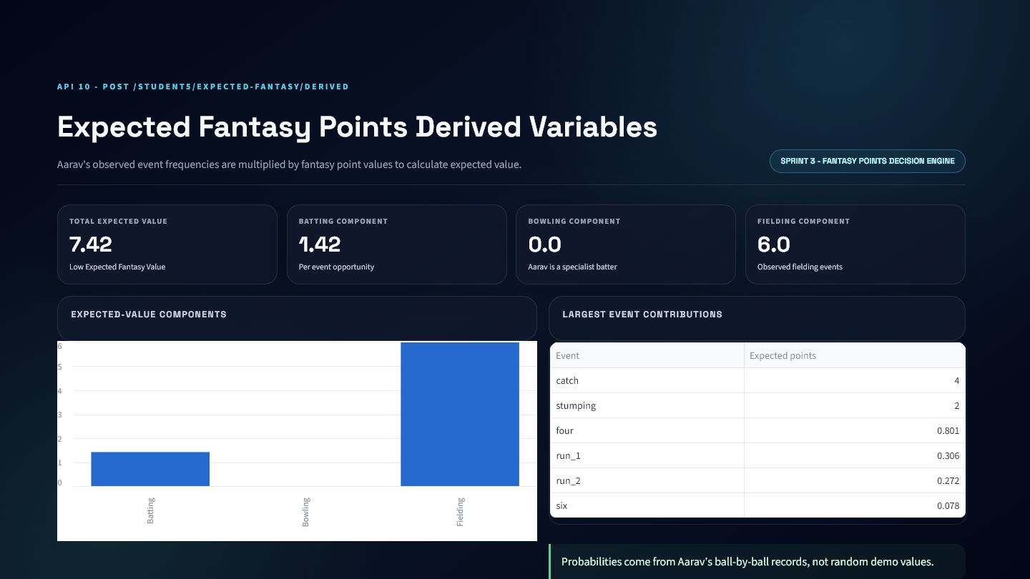
DASHBOARD INTEGRATION
Expected Fantasy Points Derived Variables API: visual evidence
Presentation-ready output produced from the real API service response.
PRODUCT PLACEMENT
Fantasy contribution chart
Player comparison
Explainable recommendation input
HONEST LIMITATIONS
Per-opportunity EV is not a complete match projection
Probabilities need larger role-specific samples
7.42
1.42
0
6
TOTAL EV
BATTING
BOWLING
FIELDING

Slide 61
SPRINT 3
API 11
11
Expected Fantasy Points Final Output API
POST /STUDENT5/EXPECTED-FANTASY-FINAL
FANTASY DECISION
PURPOSE
Produce the final fantasy projection, model provenance, risk, and selection label.
WHERE KHEL AI USES IT
Khel AI needs an actionable prediction while retaining feature-contract safety, fallback behavior, and honest model limits.
Fantasy selection panel • Batch player ranking • AI model-vs-statistical explanation

Slide 62
PROCESSING LOGIC
Expected Fantasy Points Final Output API: how it works
A visible path from validated cricket input to explainable output.
1
2
3
4
5
Build pre-match historical features
Load cached .pkl bundle
Enforce feature_columns.json
Validate prediction range/distribution
Return ML or statistical fallback
MAIN FORMULAS AND RULES
ENGINEERING APPROACH
final_prediction = valid ML output else statistical fallback
Pydantic validates the contract
selection: Must Pick / Strong Pick / Risk Pick / Avoid
Service logic handles cricket rules
Response includes interpretation

Slide 63
INPUT AND OUTPUT SCHEMA
Expected Fantasy Points Final Output API: API contract
The frontend and model service agree on one explicit, validated contract.
REQUEST
RESPONSE
Field | Type | Rule | Meaning
player | khel_showcase_fantasy_fina | Optional | Player identity and role
opponent_team_id | str | None | Optional | opponent team id
opponent_team_name | str | None | Optional | opponent team name
venue | str | None | Optional | venue
target_match_date | datetime.date | None | Optional | Anti-leakage cutoff date
adjusted_posterior | float | None | Optional | adjusted posterior
player_match_rows | list[khel_showcase_fantasy | Optional | Historical player-match rows
Field | Type | Rule | Meaning
metric | str | Required | metric
label | str | Required | label
expected_fantasy_points | float | Required | expected fantasy points
final_prediction | float | Required | final prediction
supervised_ml_prediction | float | None | Optional | supervised ml prediction
ml_prediction_valid | bool | Required | ml prediction valid
fallback_used | bool | Required | fallback used
Field
Type
Rule
Meaning
Field
Type
Rule
Meaning
Nested records are summarized for presentation. The complete machine-readable contract remains available through FastAPI OpenAPI.

Slide 64
VALIDATION AND EXAMPLE
Expected Fantasy Points Final Output API: request to response
The example is generated from the same local service logic used by the dashboard.
SAMPLE REQUEST
SAMPLE RESPONSE
GUARDRAILS
{
"player": {
"player_id": "1",
"player_name": "Aarav Sharma",
"role": "batter"
},
"opponent_team_id": "4",
"opponent_team_name": "Gwalior Guardians",
"venue": "Holkar Cricket Stadium",
"target_match_date": "2026-07-15",
"adjusted_posterior": 46.79
}
{
"metric": "expected_fantasy_points_final_output",
"label": "Strong Pick",
"expected_fantasy_points": 51.29,
"final_prediction": 38.9,
"supervised_ml_prediction": 38.9,
"ml_prediction_valid": true
}
Exact saved feature order
At least one prior match
No target-date leakage
Reject NaN, infinite, or 0-200 outliers
Batch size 1-100
Clear 4xx/5xx errors, never silent failure

Slide 65
DASHBOARD INTEGRATION
Expected Fantasy Points Final Output API: visual evidence
Presentation-ready output produced from the real API service response.
PRODUCT PLACEMENT
Fantasy selection panel
Batch player ranking
AI model-vs-statistical explanation
HONEST LIMITATIONS
Demo-only synthetic model
Negative test R2 indicates weak generalization
Free-tier Render can cold-start
38.9
51.29
Strong Pick
linear_regression
PREDICTION
STATISTICAL
SELECTION
MODEL

Slide 66
MODEL SAFETY AND DEPLOYMENT
API 11 model card
The saved model is useful as a demonstrator, but its measured limits remain visible.
MODEL IDENTITY
DATA AND SPLIT
REQUEST SAFETY
StandardScaler
+
Linear Regression
264 canonical rows
model.pkl loads once
VERSION 2.0.0
220 modelling rows
Exact feature order
DEMO_ONLY
Chronological 70/15/15
No request-time retraining
154 / 33 / 33 records
Batch size 1-100
26.577
33.530
-0.037
29.065
TEST MAE
TEST RMSE
TEST R²
BASELINE MAE
PUBLIC DEPLOYMENT
INTERPRETATION
student5-expected-fantasy-final-api.onrender.com
Negative test R² means the model is not production-ready.

Slide 67
INTEGRATION SUMMARY
Sprint 3: the complete story
From uncertain events to a selection recommendation
API MODULES
WHAT THIS SPRINT ADDS TO KHEL AI
10
Expected Fantasy Points Derived Variables API
Expected value keeps batting, bowling and fielding auditable
11
Expected Fantasy Points Final Output API
Saved-model prediction never retrains during requests
Feature-contract and anti-leakage checks protect validity
Risk, model source and fallback reason remain visible
2 INDEPENDENTLY REUSABLE ENDPOINTS

Slide 68
CONCLUSION
One explainable cricket pipeline
The eleven APIs answer three progressively more valuable questions.
01
02
03
What is happening?
How is the player trending?
What decision should Khel AI make?
Score, innings, chase resources, required rate and outlook.
Form direction, opponent evidence, posterior expectation and confidence.
Expected fantasy value, saved-model prediction, risk and selection label.
REAL LOGIC • VALIDATED SCHEMAS • HONEST METRICS • DASHBOARD-READY OUTPUT

